Slide 1
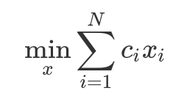
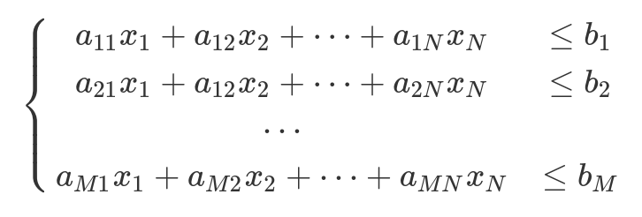
Formulation of Integer Linear Problem
The elements of the vector x are integers and the search is for them.
N – number of variables
M – number of constrains
The elements of the matrix a, the vector c and the vector b are real numbers and represent the instance of the application under consideration.

