Slide 1
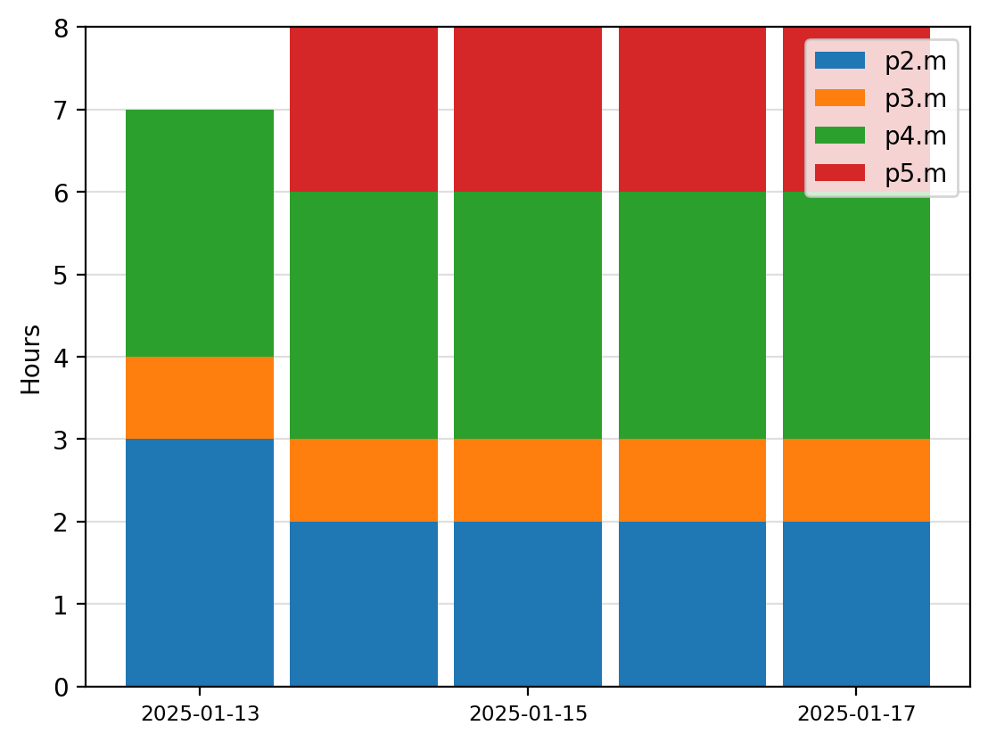
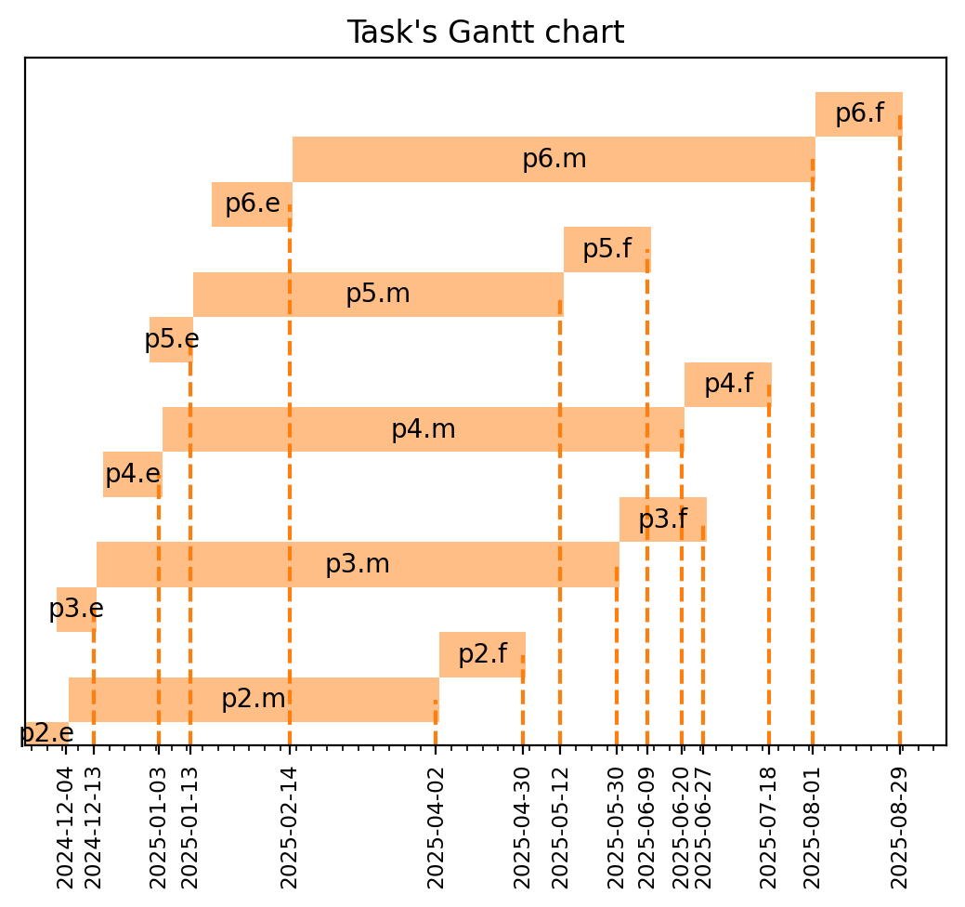
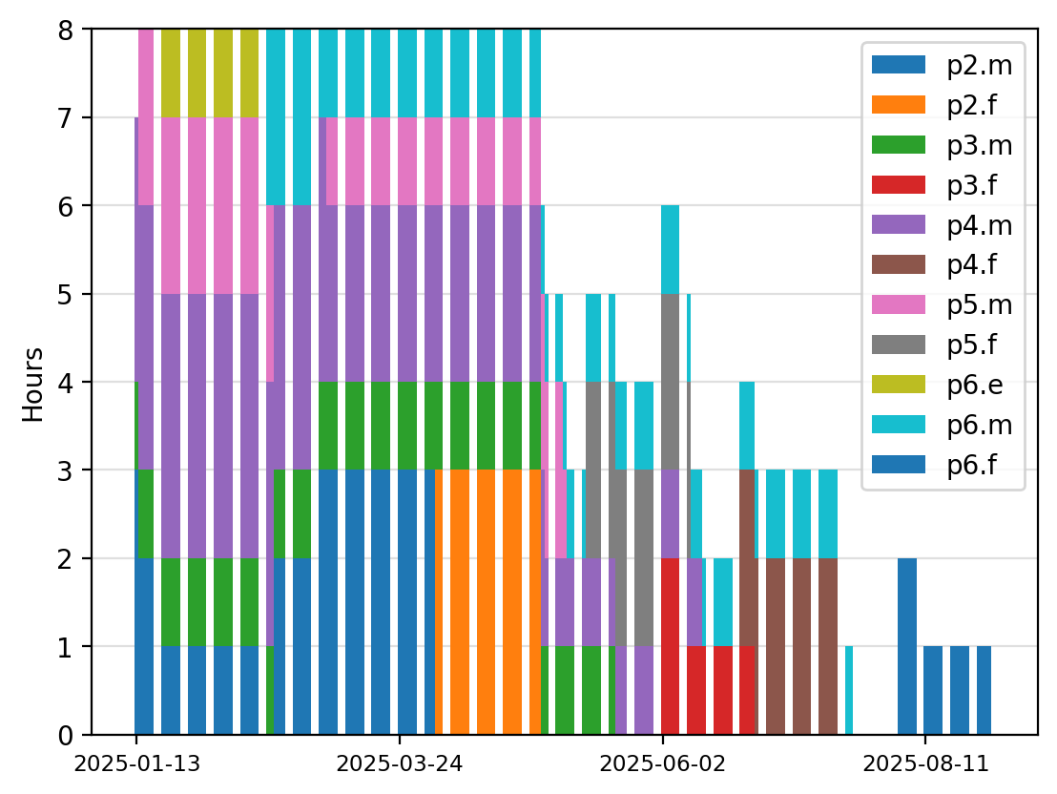
Business rules and requirements like experts availability or the permitted number of working hours per day
Mathematical model based on Mixed Integer Linear Programming

