Slide 1









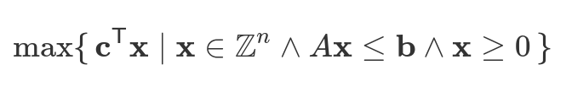
Business rules and customer requirements
People preferences and their availability
Constrains in integer linear optimization problem

