Slide 1

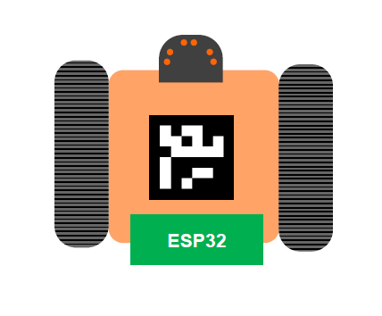
EMBEDDED SYSTEM PROJECT Prof. Dr. Rolf Schuster
Project Name: IoT based Autonomous Bot
Developed by: Rohan Ijare

Slide 2
AGENDA
Problem Statement
Role of Aws IOT
Class Diagram
State Diagram
Activity Diagram
System Implementation
System Design
Components Used
Outcome
Real Time Application

Slide 3
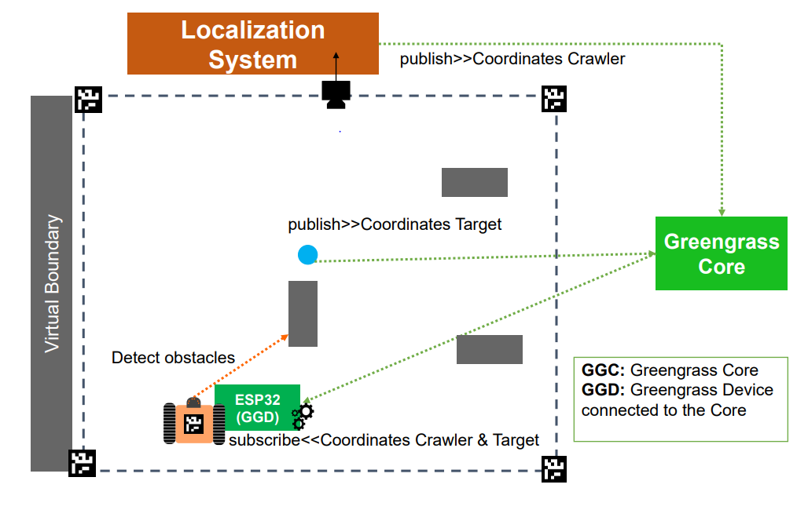
PROBLEM STATEMENT
Implement an autonomous crawler that finds targets randomly distributed in a scenario full of obstacles.
Acquire the data from AWS server through a localization system.
Process the data in an embedded system to fetch data and achieve the targets

Slide 4
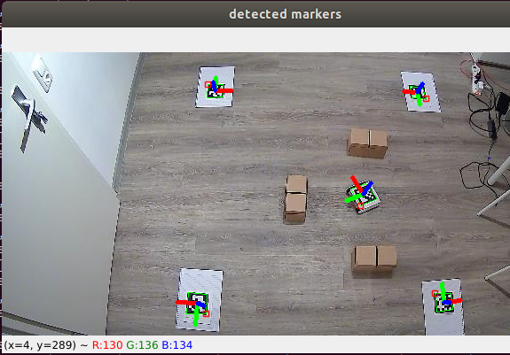
COMPONENTS USED
FHDO ESP32-Basedboard
Time-of Flight Distance Sensor (3Channels)
Chassis
Two DC motors
WEBCAM
Markers
AWS Services
Obstacle (Cardboard Box)

Slide 5
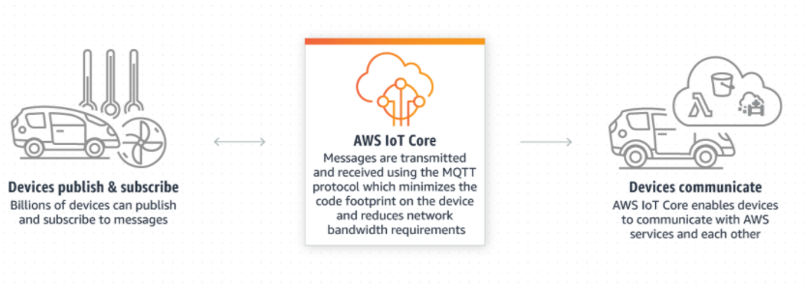
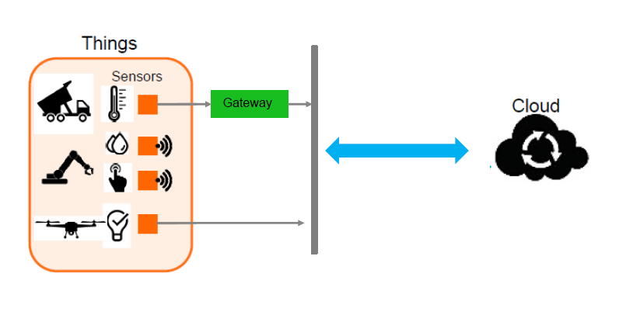
ROLE OF AWS IOT
AWS IoT Core allows you to connect any number of devices to the cloud and to other devices without requiring you to provision or manage servers. AWS IoT Core allows you to scale your device fleets easily and reliably.

Slide 6
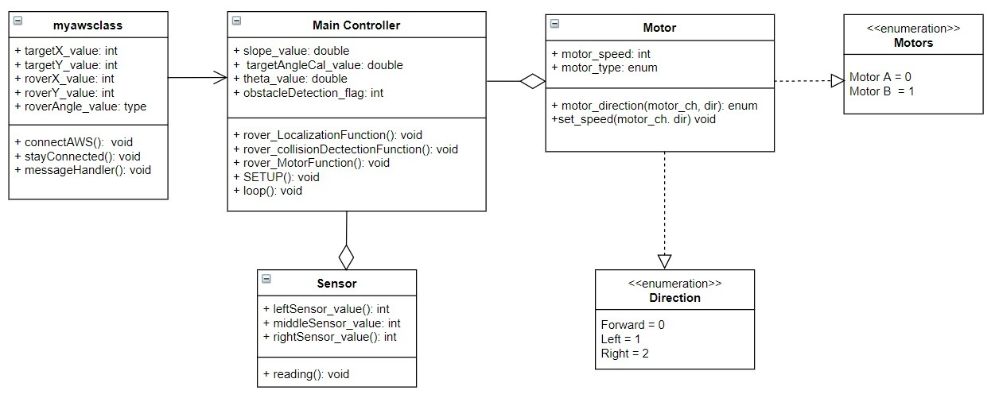
CLASS DIAGRAM

Slide 7
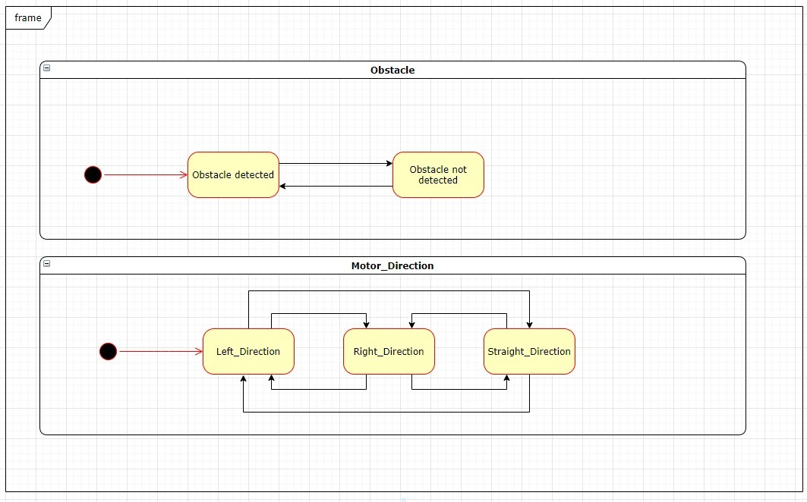
STATE DIAGRAM

Slide 8
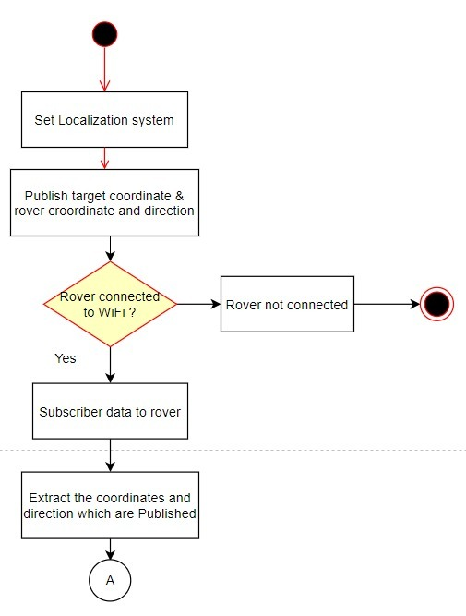
AWS ACTIVITY DIAGRAM

Slide 9
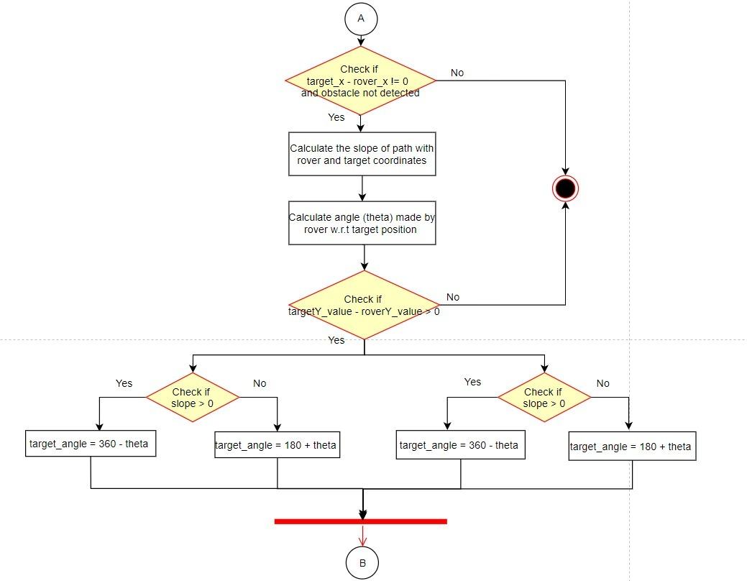
TARGET ACQUISITION ALGORITHM

Slide 10
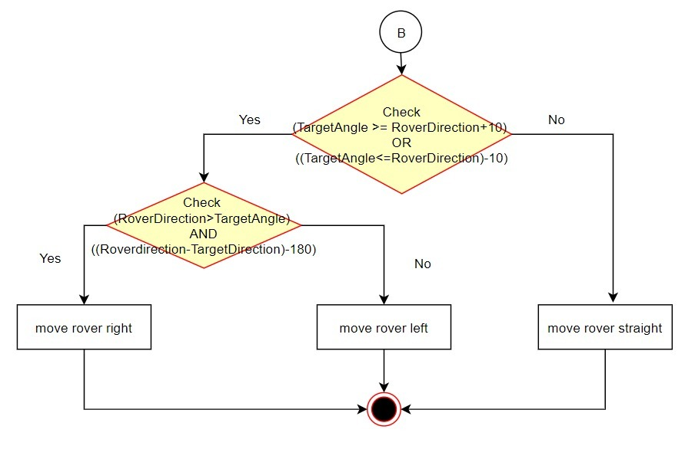

Slide 11
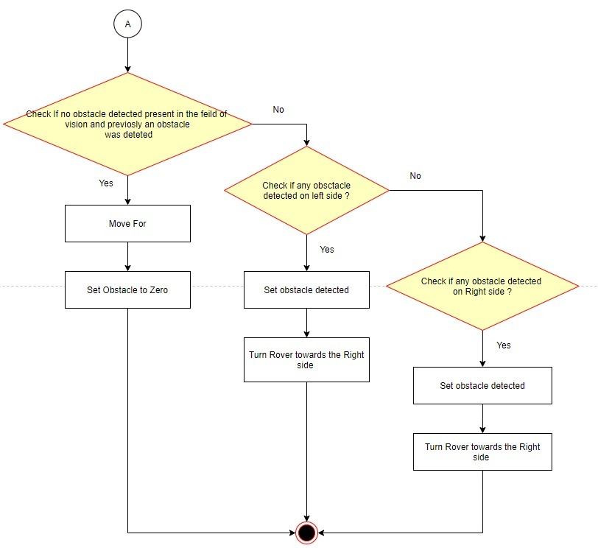
OBSTACLE AVOIDANCE ALGORITHM

Slide 12
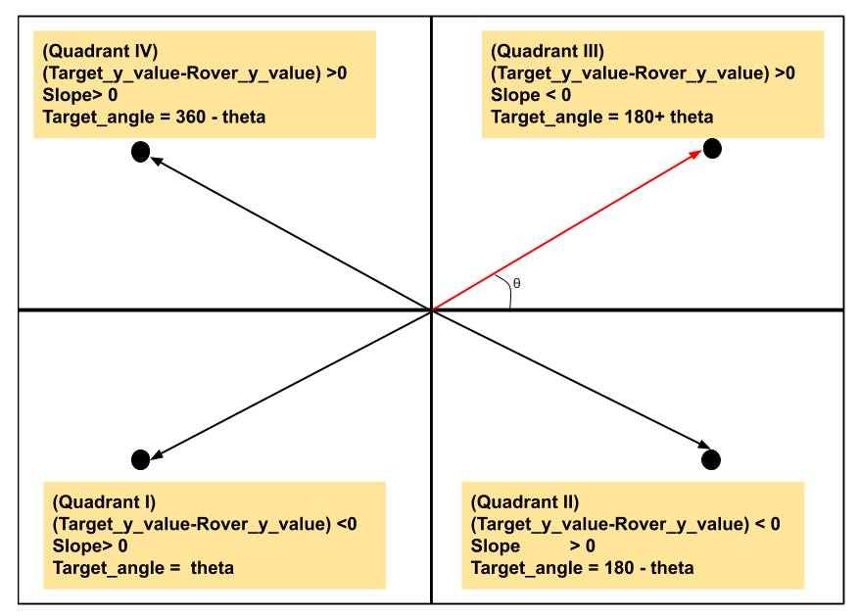
SYSTEM IMPLEMENTATION

Slide 13
SYSTEM DESIGN
Discovery Services
Discovery Services
Localization
(Camera Publisher)
AWS Cloud Service
Crawler
ESP-32
(Subscriber
Motor
Sensors

Slide 14
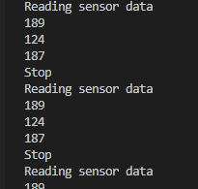
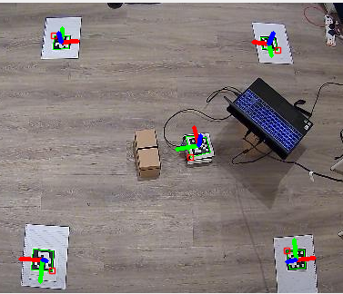
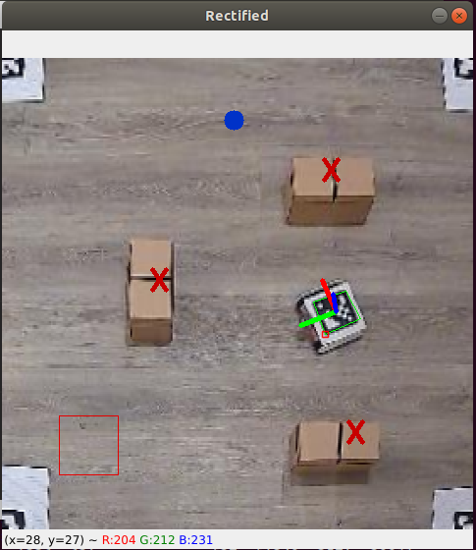
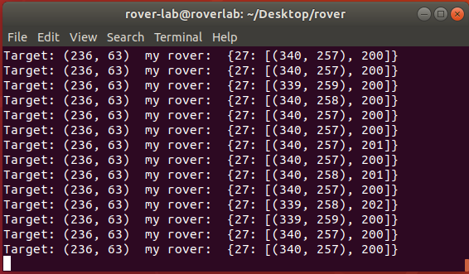
OUTCOME
Manual Sensor Calibration
Target Scenario
Coordinates from AWS Received

Slide 15
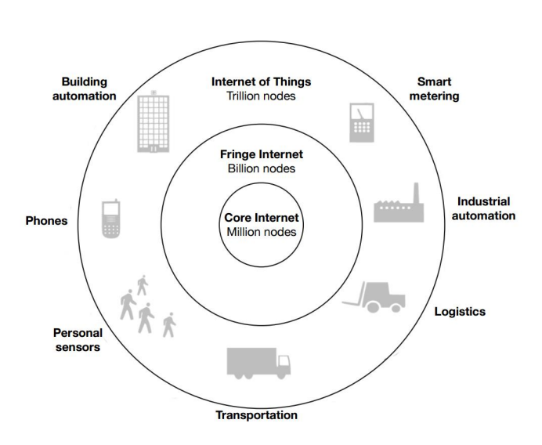
REAL TIME APPLICATION
Guided Vehicles
Military Applications
Logistics Supply Chain
Autonomous Driving Systems
Rescue Operations

Slide 16
Thank You

