Slide 1
Resource provider
Upgrading opportunity

Slide 2
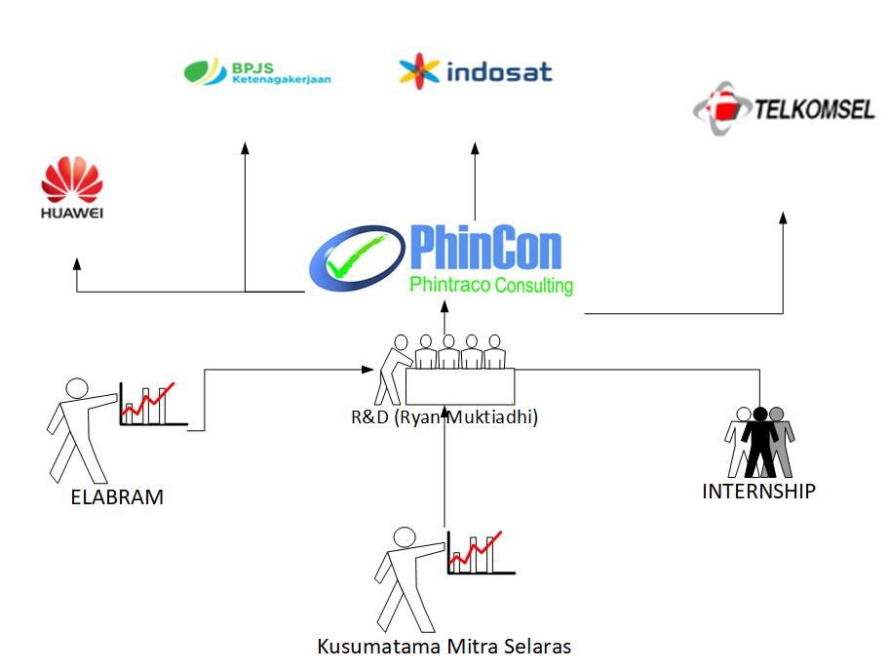

Slide 3
ESTIMASI SEMENTARA

Slide 4
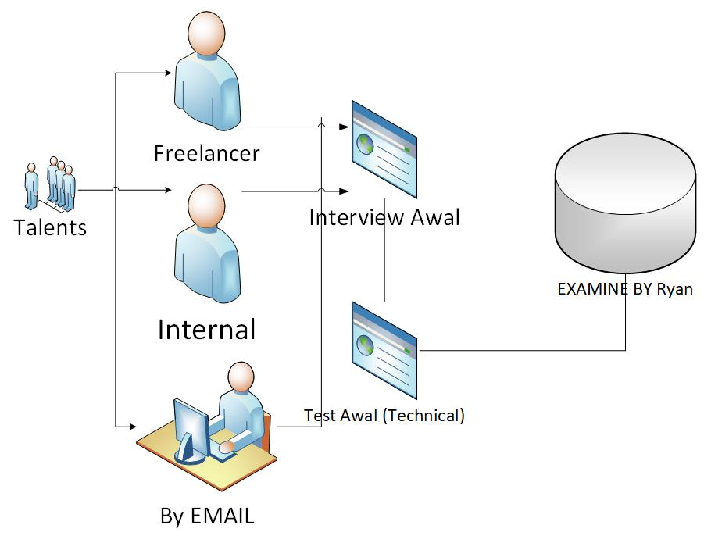
DESIGN SYSTEM SEMENTARA I :

Slide 5

DESIGN SYSTEM SEMENTARA II :
Acceptant Confirmation
Overing Resource
Application Works
KMS
Clearence

