Slide 1

FINMARK CORPORATION
Customer Intelligence Through Data Analytics and Machine Learning
Presented by: Ronachel Marie Digma

Slide 2
Understanding the FinMark Business Problem
BUSINESS PROBLEM
FinMark Corporation collects customer transactions, social media interactions, and demographic information. However, inconsistencies across these datasets and the volume of information make it difficult to transform raw data into actionable business insights.
These challenges limit FinMark's ability to:
  Understand customer purchasing behavior and preferences.
  Identify meaningful customer groups.
  Recognize patterns across different data sources.
  Make informed marketing and strategic decisions.
Business Need: FinMark needs an integrated, data-driven approach that transforms its existing customer data into meaningful insights to support better business decisions.

Slide 3


Identified Problem and Project Objectives
Turning fragmented customer data into meaningful insights
IDENTIFIED PROBLEM
Fragmented customer data, inconsistent records, and limited cross-dataset insights.
FinMark's datasets have different record structures and contain inconsistencies. Without reliable preprocessing and customer-level integration, identifying relationships across customer characteristics, transactions, and digital engagement is challenging.
PROJECT OBJECTIVES
Clean, analyze, integrate, visualize, and prepare the data for future ML development.
  Examine and clean the demographic, transaction, and social media datasets.
  Analyze customer characteristics and purchasing behavior using descriptive and inferential statistics.
  Explore relationships across datasets through customer-level aggregation and visualization.
  Establish an analytical foundation for future machine learning development and data-driven business decisions.

Slide 4



Three Datasets, One Analytical Foundation
3,000
Customer Demographics
Customer-level records
Age, Gender, IncomeLevel, CustomerID
3,015
Customer Transactions
Transaction-level records
Amount, ProductCategory, PaymentMethod, TransactionDate
3,020
Social Media Interactions
Interaction-level records
Platform, InteractionType, Sentiment, CustomerID
The datasets contain different observational units and were analyzed at their appropriate levels before customer-level integration.

Slide 5
Data Preparation and Preprocessing
Raw data
Cleaning
Validation
Processed data
CUSTOMER DEMOGRAPHICS
  Removed 23 exact duplicates from 3,023 records.
  Retained 3,000 customer records.
  Converted invalid ages to missing values and used median imputation.
  Standardized inconsistent category labels.
CUSTOMER TRANSACTIONS
  Removed 185 exact duplicate rows from 3,200 records.
  Retained 3,015 transaction records.
  Converted transaction amounts into numeric values.
  Treated negative amounts as anomalous and imputed missing amounts using the median.
  Retained zero-value transactions for further business validation.
SOCIAL MEDIA INTERACTIONS
  Retained 3,020 records after exact duplicate removal.
  Standardized and inspected categorical fields.
  Documented Unknown values and 20 duplicated InteractionIDs that remained.

Slide 6
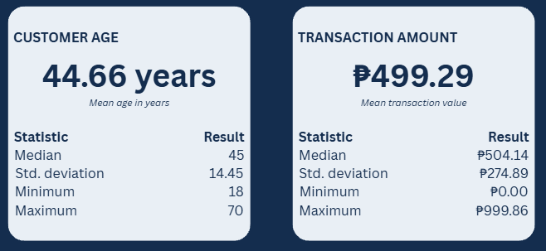
Descriptive and Inferential Statistics
ONE-WAY ANOVA
  Variable compared: transaction Amount across ProductCategory groups.
  Significance level: α = 0.05.
  Obtained p-value: 0.2314.
  Decision: Fail to reject the null hypothesis.
INTERPRETATION
The observed differences in average transaction amounts across product categories were not statistically significant at the 0.05 significance level.

Slide 7
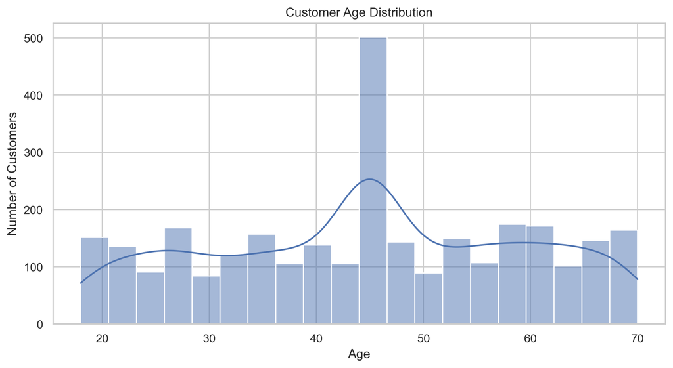
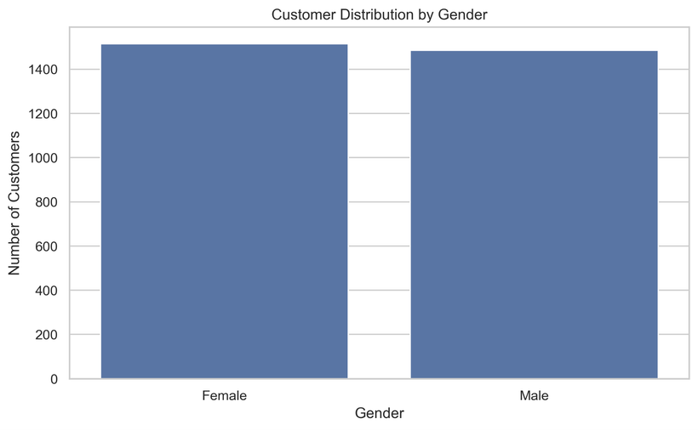
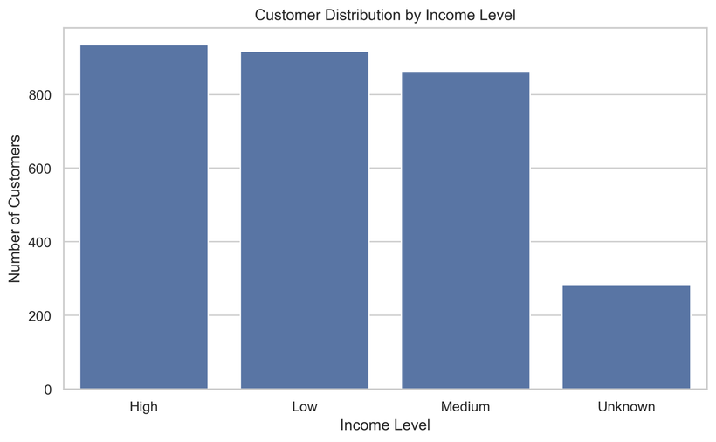
Understanding the FinMark Customer Profile
KEY FINDINGS
  Average customer age: 44.66 years.
  Female customers: 1,515 (50.50%).
  Male customers: 1,485 (49.50%).
  High-income: 935; Low-income: 918; Medium-income: 863.
  Unknown income records: 284 (9.47%).
BUSINESS INSIGHT
The customer population is relatively balanced by gender and across the three known income categories. However, Unknown income values represent unavailable information and should be handled appropriately during future feature engineering.

Slide 8
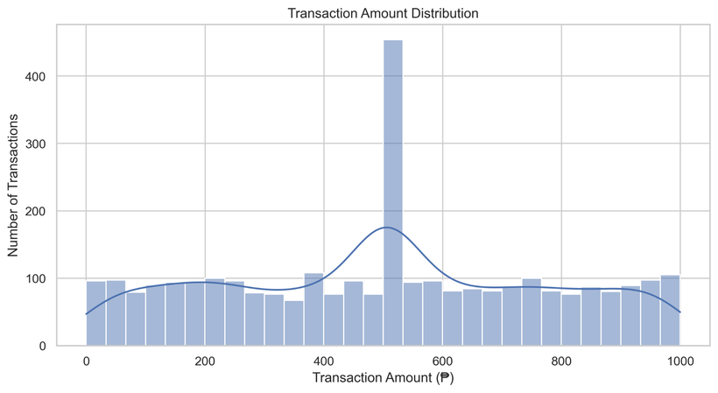
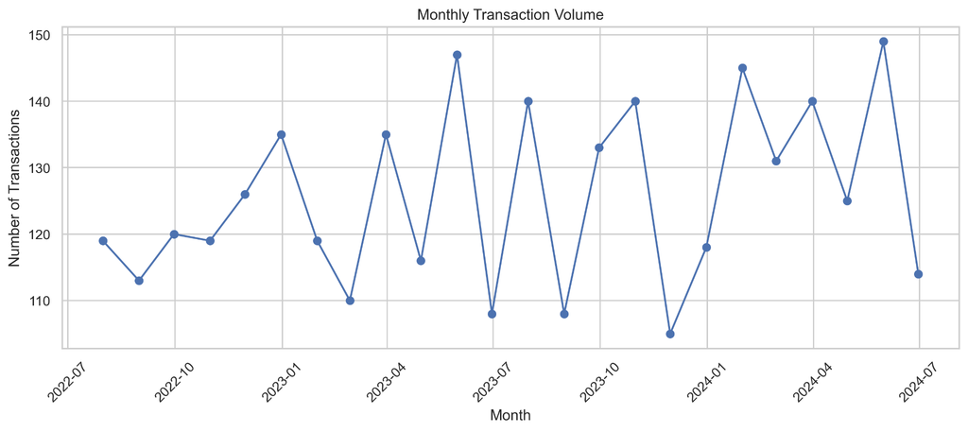
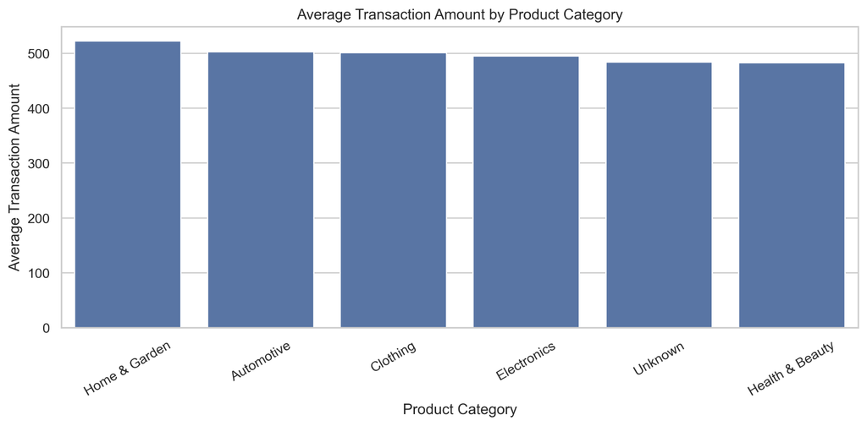
Analyzing Purchasing Behavior and Transaction Patterns
KEY FINDINGS
  Mean transaction amount: ₱499.29.
  Median transaction amount: ₱504.14.
  Clothing recorded the highest transaction frequency (571).
  Home & Garden had the highest average transaction amount (₱522.74).
  Monthly transaction volume ranged from 105 to 149.
BUSINESS INSIGHTS
  Transaction amounts exhibit substantial variability.
  Product-category frequencies are relatively comparable.
  Average transaction differences are descriptive, not statistically significant according to the ANOVA result.
  Transaction volume fluctuates over time rather than following a consistent upward or downward trend.

Slide 9

Cross-Dataset Analysis: Customer Spending and Engagement
Pearson correlations with TotalSpend
Age -0.003
Essentially no linear relationship
TransactionCount 0.878
Strong positive association
InteractionCount -0.006
Essentially no linear relationship
Strong positive association. This relationship is partly structural because both TransactionCount and TotalSpend are derived from the same transaction records. It should not be interpreted as evidence of causation.
KEY TAKEAWAY
Customer-level aggregation enabled cross-dataset analysis while preserving the distinction between customer, transaction, and social media interaction records.

Slide 10

Data Limitations and Quality Considerations
IDENTIFIED DATA LIMITATIONS
15 duplicated TransactionIDs remained across 30 non-identical transaction records.
20 duplicated InteractionIDs remained after exact duplicate removal.
Unknown categories exist across demographic, transaction, and social media data.
Zero-valued transaction amounts require business validation.
Very Positive and Very Negative sentiment classes have relatively few observations.
The three datasets have different observational grains.
WHY THESE LIMITATIONS MATTER
These data-quality issues must be considered before developing predictive models. Unresolved identifiers, missing or unknown categories, and unusual values may affect the reliability of customer-level features and subsequent analysis.

Slide 11
Proposed Solution: FinMark Customer Intelligence Framework
1. DATA SOURCES
Demographics · Transactions · Social Media
2. DATA CLEANING AND VALIDATION
Duplicates · Missing Values · Inconsistent Records
3. CUSTOMER-LEVEL INTEGRATION
CustomerID · Aggregation · Data Alignment
4. ANALYSIS AND FEATURE ENGINEERING
Statistical Analysis · Customer Metrics · Visualizations
5. CUSTOMER INSIGHTS
Business Recommendations · Future Predictive Analytics
PROPOSED SOLUTION
Establish an integrated customer intelligence framework that consolidates FinMark's demographic, transaction, and social media data into a structured analytical foundation.
The framework supports customer-level analysis, identification of behavioral patterns, and evidence-based business recommendations.
EXPECTED BUSINESS VALUE
  Better understanding of customer characteristics and purchasing behavior.
  More informed marketing and customer engagement decisions.
  Improved visibility into patterns across different data sources.
  A more reliable foundation for future predictive analytics.

Slide 12
Future Machine Learning Development
Identify the business question, prediction target, and prediction point.
4. Encode categorical variables and apply scaling or transformation where appropriate.
2. Verify CustomerID integrity and investigate duplicate identifiers and unusual values.
5. Ensure features contain no information unavailable at the intended prediction point.
3. Create relevant customer-level features from demographic, transaction, and social media data.
6. Select suitable algorithms and evaluate them using appropriate validation and metrics.
IMPLEMENTATION STATUS
This project establishes the analytical foundation for future machine learning development. Predictive model selection, training, and evaluation are proposed next steps rather than completed activities.

Slide 13

Conclusion
Through data preprocessing, statistical analysis, and visualization, this project established a more reliable understanding of FinMark Corporation's customer, transaction, and social media datasets.
The analysis revealed customer characteristics, purchasing patterns, transaction trends, and cross-dataset relationships while identifying important data-quality limitations.
The proposed FinMark Customer Intelligence Framework provides a structured foundation for better-informed business decisions and future machine learning development.
The next step is to strengthen data quality, define a specific modeling objective, and develop predictive solutions aligned with FinMark's business needs.

