Slide 1
Pokemon App
Project scope:
1-Show all pokemons with pagination
2-Show details of a pokemon
3-Pokemon search (optional)

Slide 2
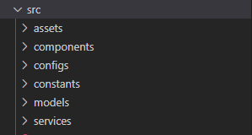
Creation of a basic structure
Project basic structure:
assets
components
configs
constants
models
services

Slide 3
Separate UI into components
Is better that each component to match on piece of the data model!
Pokemon app components:
PokemonsList
PokemonItem
PokemonDetails
Good to have also:
1.Pagination
2.Spinner
3.NotFound
4.NoDataToShow
5.Table

Slide 4
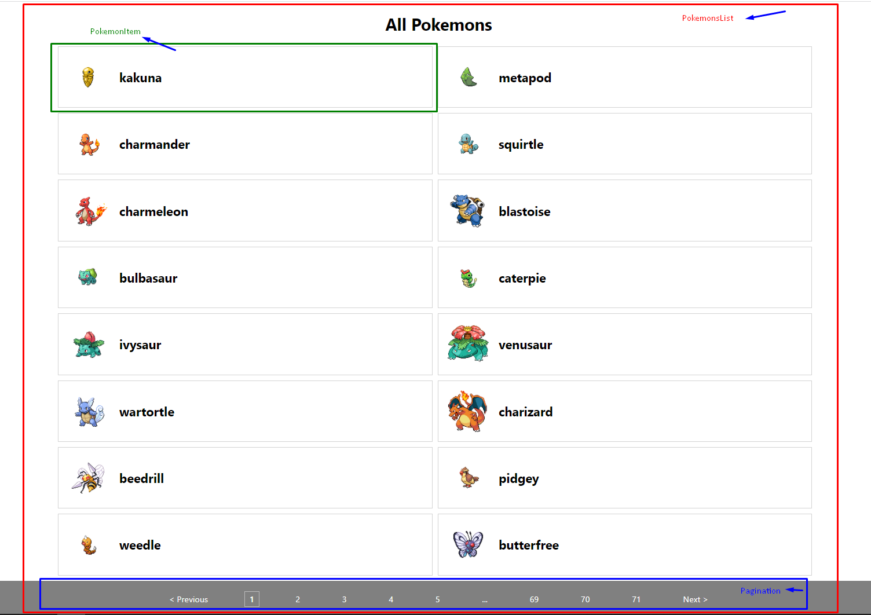

Slide 5
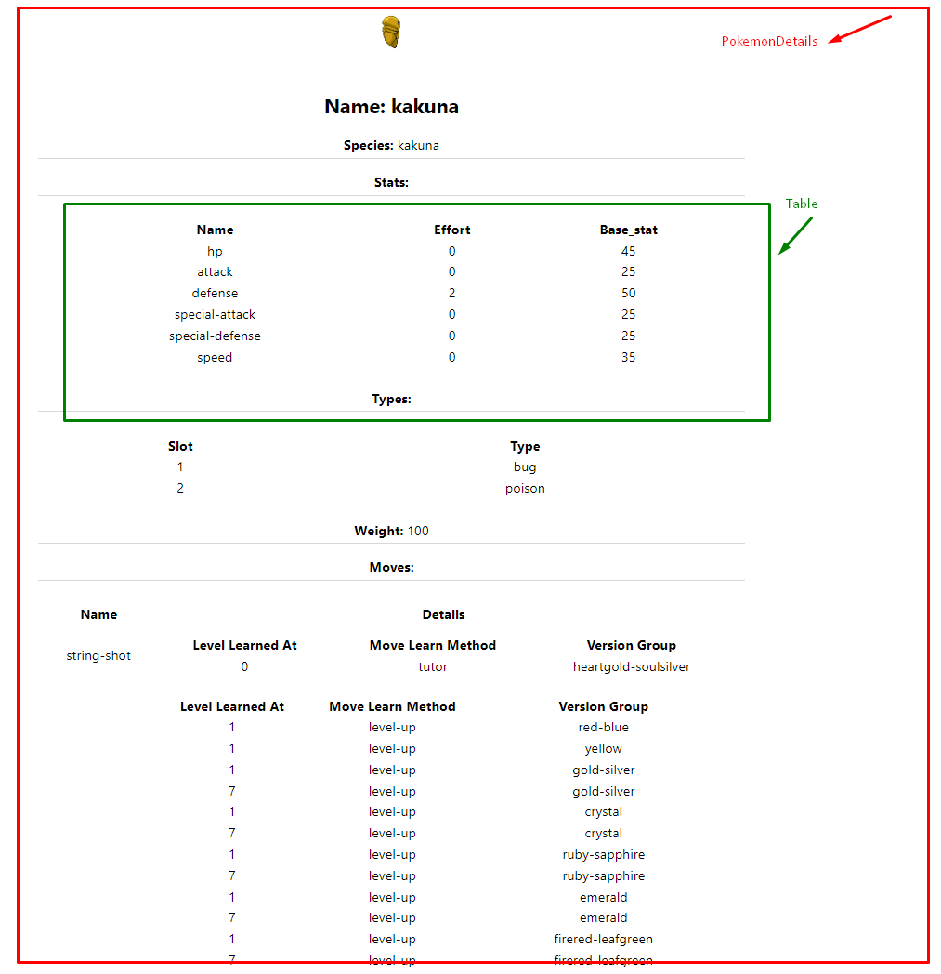

Slide 6
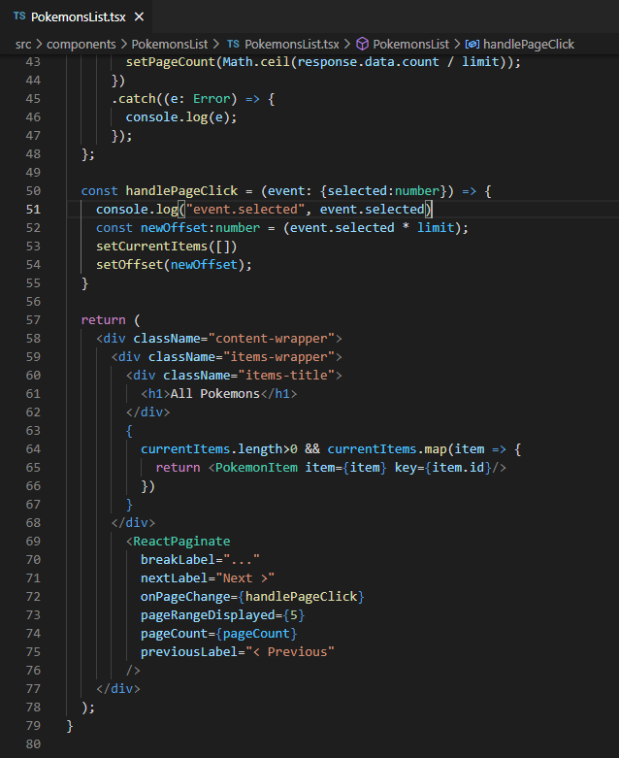
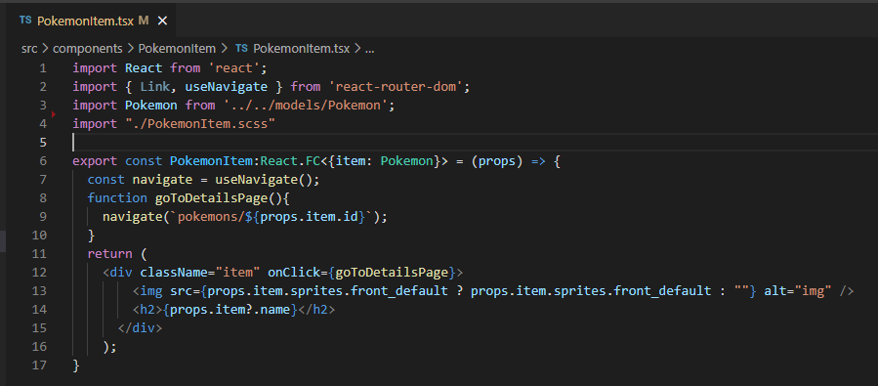
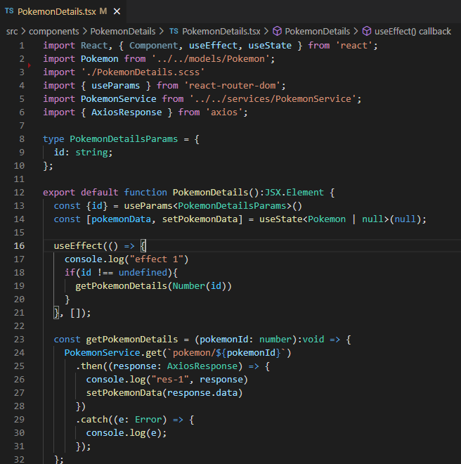

Slide 7
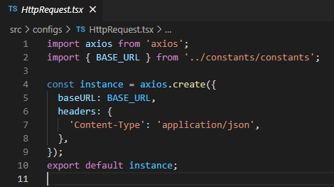
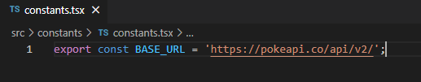
conigs and constants
In this app is used axios for API calls
configs folder have some configurations for axios
constant have the constants that are global

Slide 8
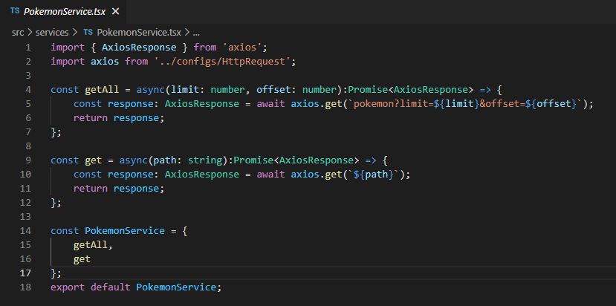
Services
Services folder have the methods for get all pokemons and get pokemon by id

Slide 9
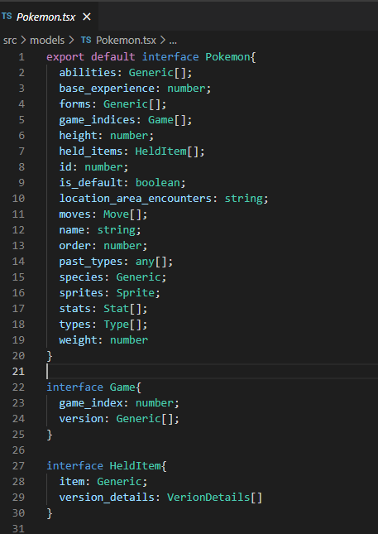
Models
In the models is the interface for Pokemon data and other models related to this.

Slide 10
Thank you!

