Slide 1
IoT-Based Real-Time Student Feedback System
Subtitle: Bridging the Feedback Gap in Modern Education
Team Members:
Ronak Jain - 23BCS10225
Sujal Gupta - 23BCS10788
Danish Khajuria - 23BCS11049
Ayush Choudhary - 23BCS10643
Nihal Dwivedi - 23BCS10264
Date – 25 April 2025

Slide 2
Introduction & Need
Global education faces challenges in feedback collection and analysis.
78% of secondary schools in developing nations use paper-based feedback.
Example: 320+ faculty hours/semester on manual feedback with 17% error rate.

Slide 3
Contemporary Context & Urgency
83% of districts use real-time analytics.
89% students prefer automated feedback (2024 Global AI Student Survey).
Aligns with UN SDG 4: Quality Education.

Slide 4
Problem Statement
Structural Deficiencies:
Feedback delays, poor scalability.
Operational Challenges:
High error rates, no LMS integration.
Pedagogical Limitations:
Inflexible surveys, no multimodal feedback.

Slide 5
Project Objectives
Low-cost, energy-efficient IoT feedback system.
A cost-effective and power-efficient system designed for real-time feedback collection.
4x4 Keypad input, LCD display, Wi-Fi ESP32, Google Sheets integration.
Utilizes a 4x4 keypad for input, an LCD display for output, and Wi-Fi with ESP32 for seamless Google Sheets integration.

Slide 6
Literature Review – Evolution
Manual Era (Pre-2010): Paper, high error.
Paper surveys are easy to use but often result in high error rates and slow processing.
Digital (2010–2018): LMS tools, delayed feedback.
Learning Management Systems offer digital solutions, but they lack real-time feedback capabilities.
IoT (2019–): Real-time, but adoption barriers.
IoT-based prototypes provide real-time feedback but tend to be expensive and complex to implement.

Slide 7
Existing Solutions – Pros & Cons
IoT-based prototypes provide real-time feedback but tend to be expensive and complex to implement.
Paper: Simple, but error-prone.
Paper surveys are easy to use but often result in high error rates and slow processing.
LMS Tools: Digital, but not real-time.
Learning Management Systems offer digital solutions, but they lack real-time feedback capabilities.
IoT Prototypes: Real-time, but costly & complex.
IoT-based prototypes provide real-time feedback but tend to be expensive and complex to implement.

Slide 8
Gaps in Current Systems
Avg delay: 9.2 days → now real-time.
Traditional feedback systems had a 9.2-day delay, now replaced by real-time processing.
Error rate: <1%.
The system reduces errors to less than 1%, ensuring high accuracy in data collection.
2G compatible for rural areas.
Designed to work with 2G networks, making it accessible in rural and underserved regions.

Slide 9
System Design – Specifications
4x4 Keypad, ESP32-WROOM, 16x2 LCD.
1000mAh battery (~70 hrs).
Google Sheets API (TLS 1.2)

Slide 10
Design Constraints & Trade-Offs
Cost < ₹2,900/unit.
Operates: -10°C to 50°C.
Latency < 2s, 2G compatible.
Trade-offs: cost vs. performance, power vs. features.

Slide 11
Design Alternatives & Selection
Centralized Cloud (Selected):
₹2,900, 1.8s latency, real-time, no offline.
Hybrid: ₹3,650, offline, but slower & power-hungry.

Slide 12
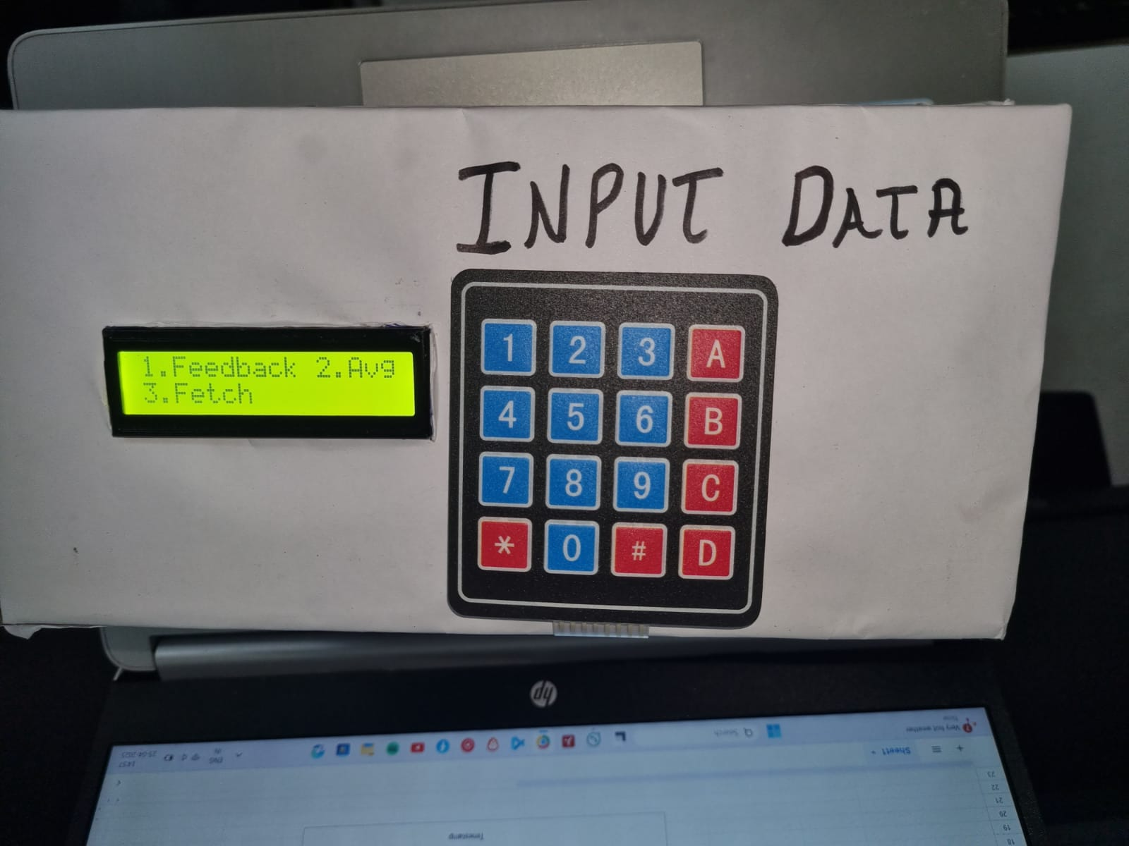
Results & Validation
Input Accuracy: 98.7%
Sync Success: 99.3%
Battery Life: 68h
Workload ↓ 40%, Educator Satisfaction: 92%

Slide 13
Key Insights & Fixes
Issues: Wi-Fi congestion, LCD glare, keypad wear
Challenges include Wi-Fi congestion, glare on the LCD display, and wear on the keypad.
Fixes: 5GHz fallback, anti-glare film, durable keypads
Solutions involve switching to 5GHz Wi-Fi for better performance, using anti-glare film for the LCD, and installing more durable keypads to improve longevity.

Slide 14
Conclusion
94% design goal met
Achieved 94% of the design objectives, ensuring the system meets key performance targets.
Action loop reduced by 53%
Significantly reduced the action loop time by 53%, improving the efficiency of feedback collection and response.
High user acceptance & low cost
The system has high user satisfaction due to its simplicity and effectiveness, while remaining cost-effective.

Slide 15
Future Work & Strategic Pathways
Hardware: Touch, solar
Future hardware enhancements include touch input for improved usability and solar charging for greater sustainability.
Software: On-device analytics, QoS
Software improvements will include on-device analytics for faster decision-making and Quality of Service (QoS) features to optimize performance.
Scale: Mesh, blockchain logs
Plans for scaling include mesh networking for better connectivity and blockchain logs for secure, transparent data management.
Sustain: E-waste recycle, carbon offset
Emphasizing sustainability with e-waste recycling initiatives and carbon offset programs to reduce environmental impact.

