Slide 1

Data Collection Form
Project Leader: Ronak Makwana (18BCP093)
Project Members: Samyak Vora (18BCP098)
Shubham Rawat (18BCP110)

Slide 2
Synopsis
Having trouble managing the data like personal details of your students/colleague/employees in orthodox paper forms?
We have a solution, which is the Data Collection Form (DCF).
This project lets you (the user) construct a Data Collection Form in a way you want using our GUI.

Slide 3
Synopsis
After choosing the right content for your form the program then generates a form which you have created using our GUI.
This generated form then can be shared to the target audience who can than fill in the required details.
These details are then collected and are stored in database and can be made easily available to you

Slide 4
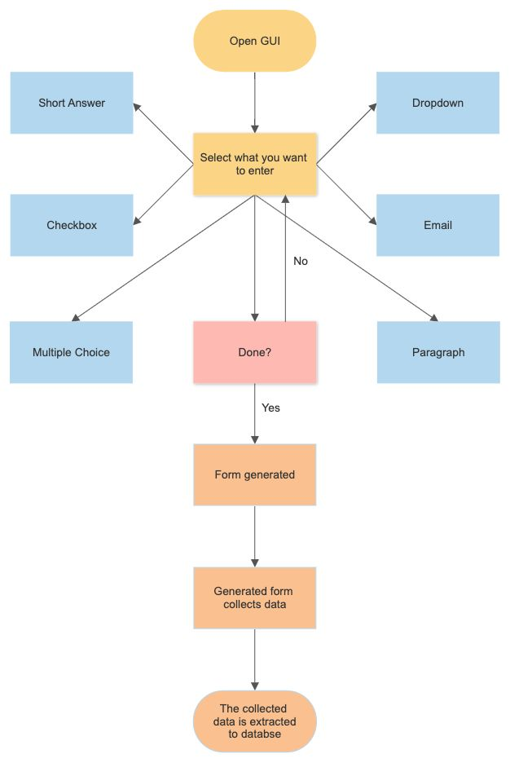
Flowchart

Slide 5
Functionalities
The GUI is user friendly and Dynamic.
A form of your choice can be made easily with an average internet knowledge.
The generated form is then easily made available to share with the targeted audience and can be easily accessed by them.
The data collected from the generated form can be easily accessed and stored.
We have used XAMPP server for handling backend request and used php scripts with SQL queries for backend.

Slide 6
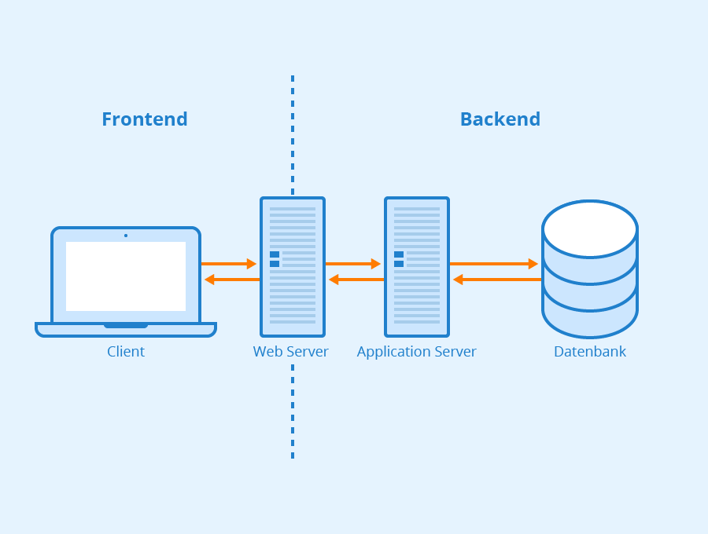
Frontend
First of all Frontend is the part of the project which users can see and interact with.
It contains GUI which makes any application or web application interactive to the users.
In our project we have used Swing GUI to make a fully Dynamic Data Collection Form where user can place questions and options according to his/her choice.

Slide 7
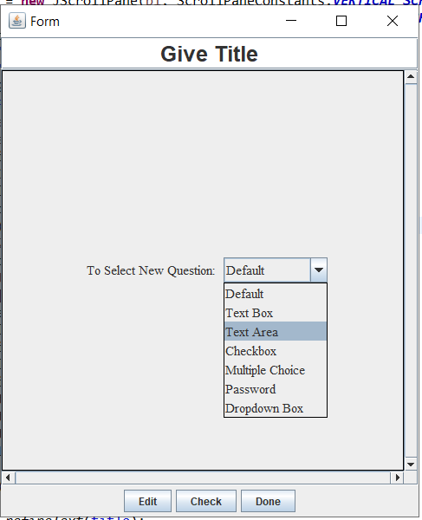
How can you Generate a form ?
This is the first page that will appear when you execute the program.
Here you can create a list of questions according to your choice.
Pressing 'Done' button will generate a static form that you can share.

Slide 8
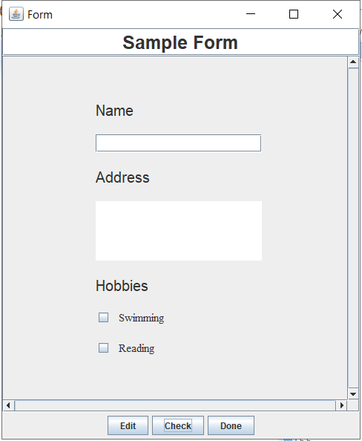
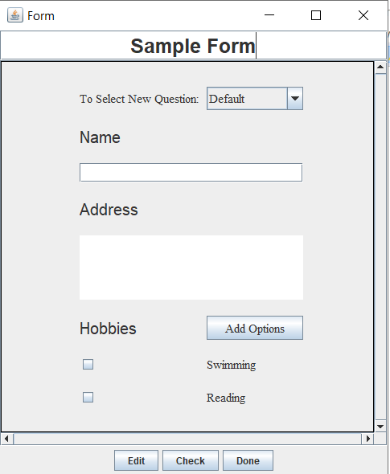
Here is a sample form:
After creating form you can check the outline of the form also.
Then click on Done button to create Form.

Slide 9
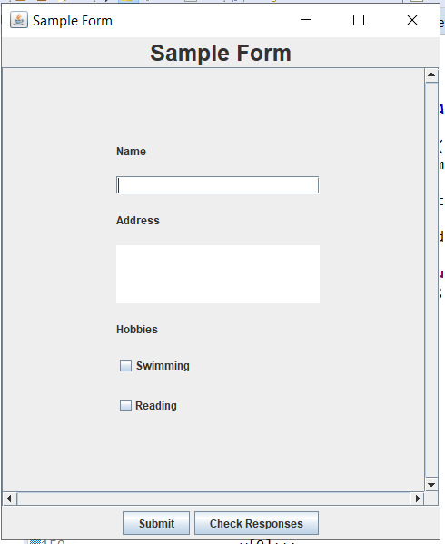
Clicking 'Done' will generate this...

Slide 10
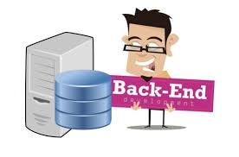
Backend

Slide 11
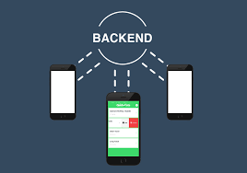
How did we manage Backend Tasks?
For the requirement of server we have used a XAMPP server.
XAMPP server is an open source cross platform web server solution pack.
For transaction with the XAMPP server and our project java files we have used php scripts.
Inside the php scripts for transaction with the database we have created a Short Language Query from the data received and that query when fired it does its appropriate task with the database provided by the XAMPP server.

Slide 12
Implementation Details:
Exception Handling:
List of GUI Components:
We have efficiently used Try-Catch block to handle the error that may occur in the Program.
JFrame
JPanel
JTextfield
JTextArea
JCheckBox
JRadioButton
JComboBox
JButton
ButtonGroup

Slide 13
Applications
It allows you to collect information easily and efficiently.
The UI is very easy to use.
You can create surveys in few minutes to ask your clients or collaborators information about your products or service.
You can conduct tests and take feedback of your annual teaching performance from students.

