Slide 1
Real-Time AI-Based
Suspicious Activity Detection System
Project Presentation
Presented by
Apoorv Jadav (CE-095) | 24CEUBS906
Ronak Maniya (CE-036) | 23CEUOG085
Guide: Prof. Hariom A. Pandya
Dharmsinh Desai University, Faculty of Technology
AI Surveillance Solution
B.Tech Computer Engineering - Semester 6 - SDP

Slide 2
Problem Statement
Why this project is necessary
1
Manual CCTV monitoring is difficult and error-prone for continuous surveillance.
2
Suspicious incidents are often detected late during post-event review.
3
Human operators face fatigue and cannot monitor multiple feeds reliably.
4
A real-time, automated, and scalable monitoring solution is required.
5
Goal: detect humans and classify activity as Normal or Suspicious instantly.
System Design Practice (SDP) - Group 3

Slide 3
Proposed Solution
Dual-model intelligence with full-stack deployment
AI Core
YOLOv8 detects persons and SlowFast-R101 classifies activity from temporal frame windows.
Web Platform
React frontend + Django REST backend provide live monitoring, analytics, upload analysis, and history.
Optimization
Frame skipping, classifier cooldown, and smoothing deliver stable labels with low latency.
Outcome
Real-time suspicious-activity alerts with event logs and downloadable annotated recordings.
System Design Practice (SDP) - Group 3

Slide 4
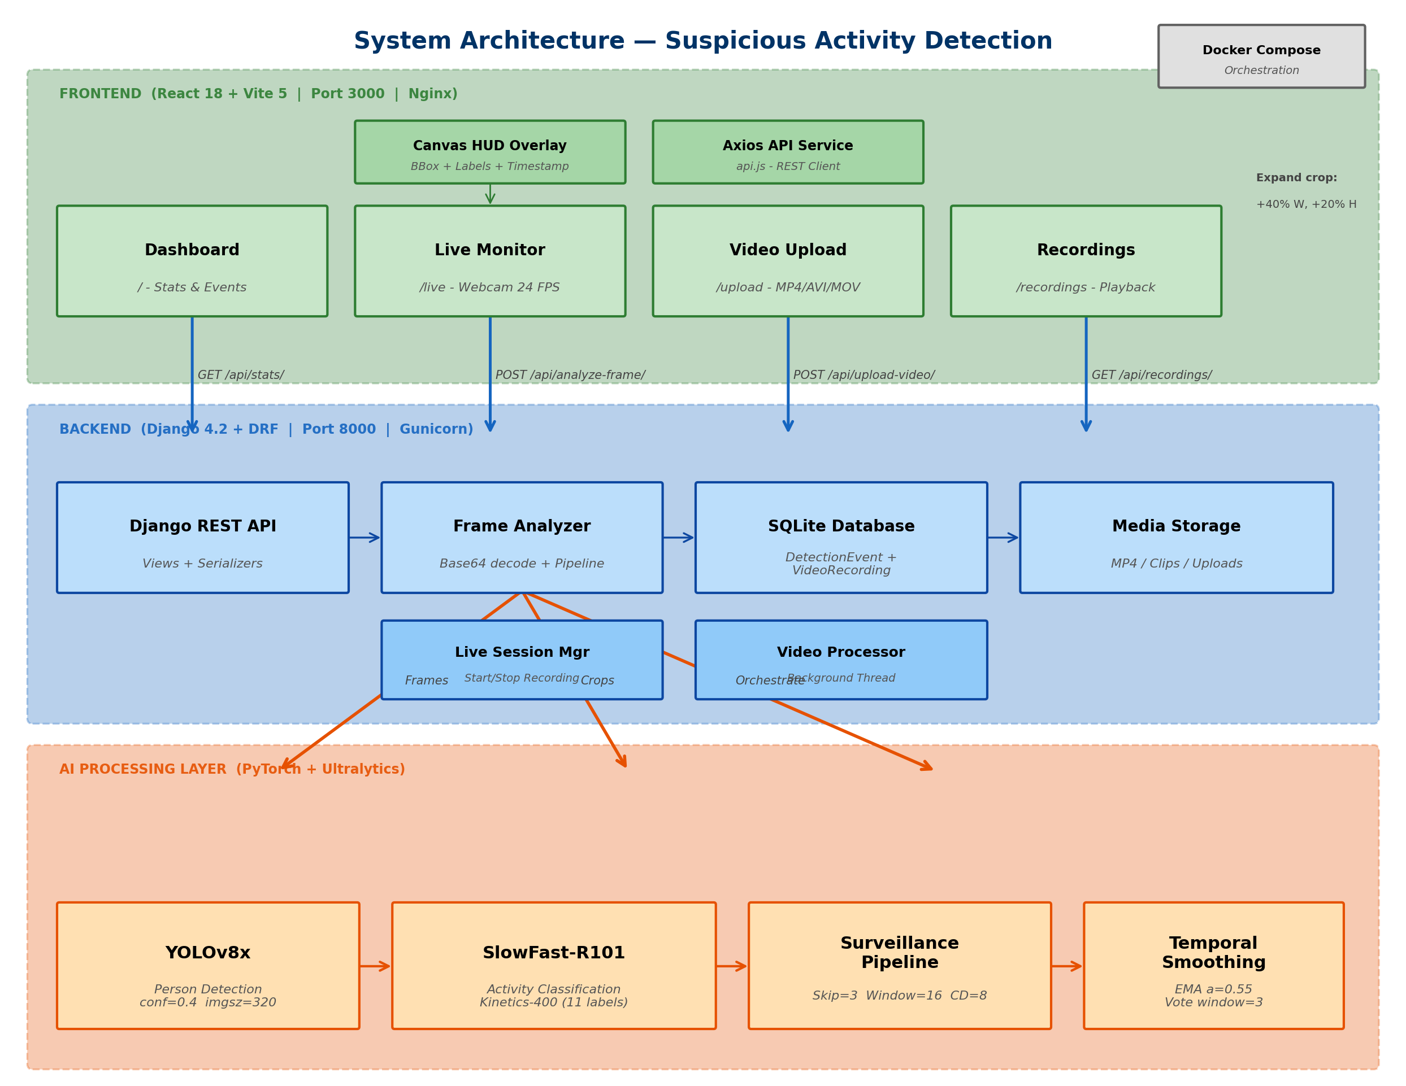
System Architecture
Input -> Processing -> Output
Frontend
Captures webcam frames and video uploads.
Backend
Routes requests to AI engine and storage.
AI + DB
Detection/classification and persistent event records.
System Design Practice (SDP) - Group 3

Slide 5
Technologies Used
Layer | Technology | Purpose
Frontend | React 18 + Vite | Real-time dashboard and monitoring UI
Backend | Django 4.2 + DRF | REST API and business logic
Detection | YOLOv8 (Ultralytics) | Human detection with bounding boxes
Classification | SlowFast-R101 (PyTorchVideo) | Normal vs Suspicious activity classification
Video Processing | OpenCV + FFmpeg | Frame extraction, annotation, encoding
Deployment | Docker + Nginx + Gunicorn | Containerized full-stack deployment
System Design Practice (SDP) - Group 3

Slide 6
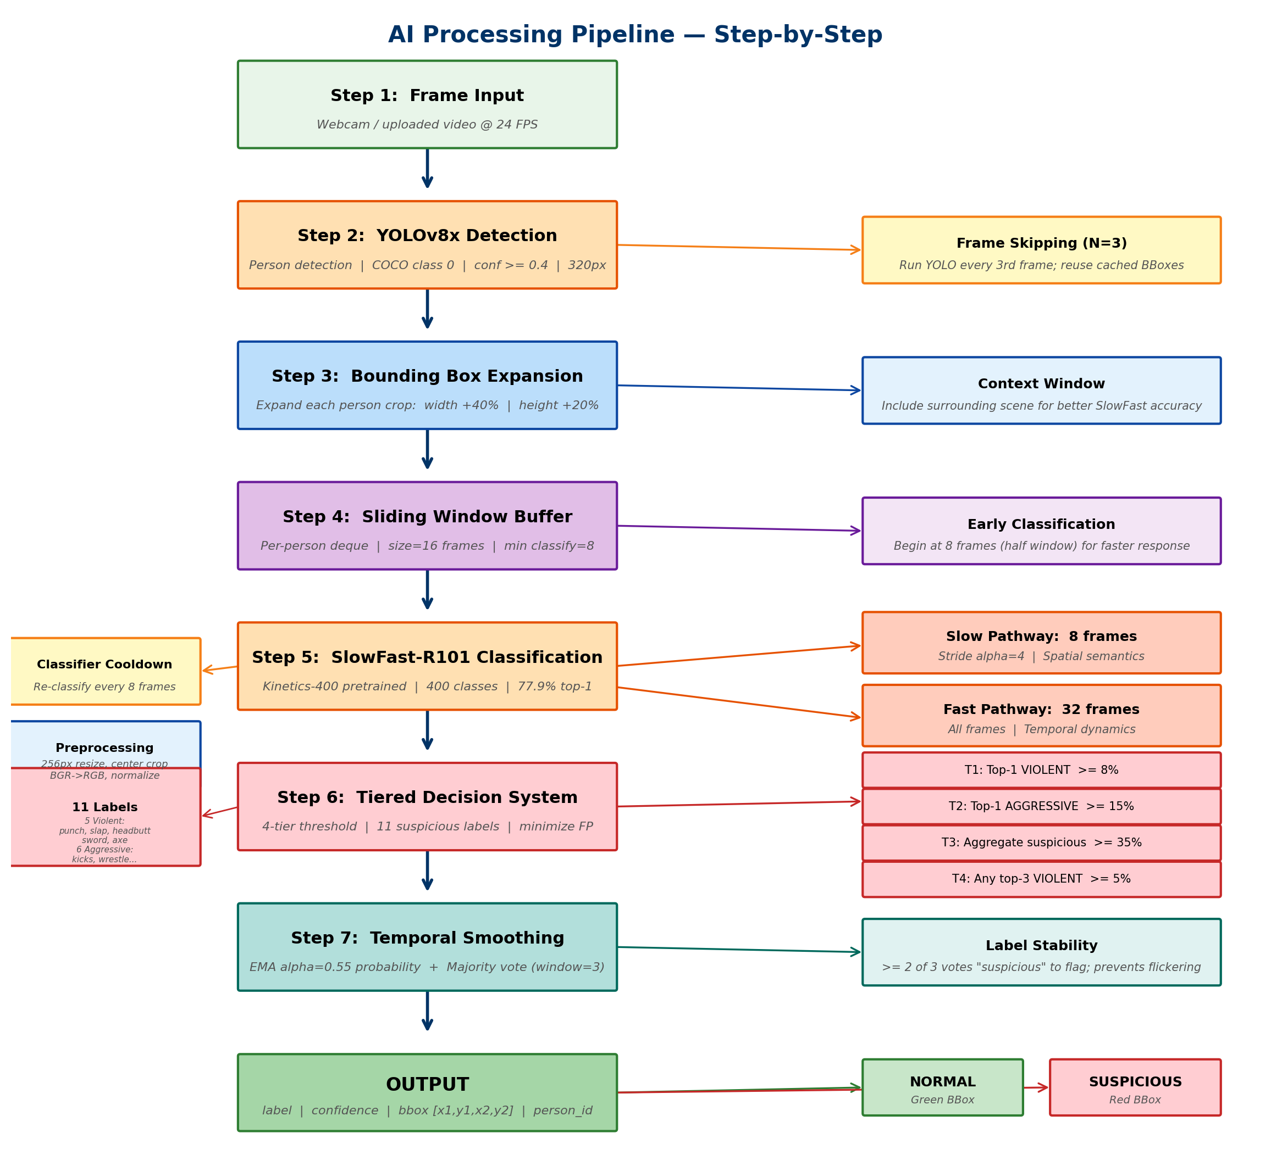
Working / Methodology
End-to-end detection flow
1
Capture frame from webcam or uploaded video.
2
Run YOLO detection with frame-skipping optimization.
3
Build person-wise temporal frame windows.
4
Run SlowFast classification after enough frames.
5
Apply temporal smoothing for stable labels.
6
Store events and processed recordings.
System Design Practice (SDP) - Group 3

Slide 7
Key Features
Feature 1
Live monitoring with AI overlays
Feature 2
Dual-model activity intelligence
Feature 3
Color alerts for suspicious events
Feature 4
Offline video upload analysis
Feature 5
Event history with confidence
Feature 6
Annotated MP4 storage/download
System Design Practice (SDP) - Group 3

Slide 8
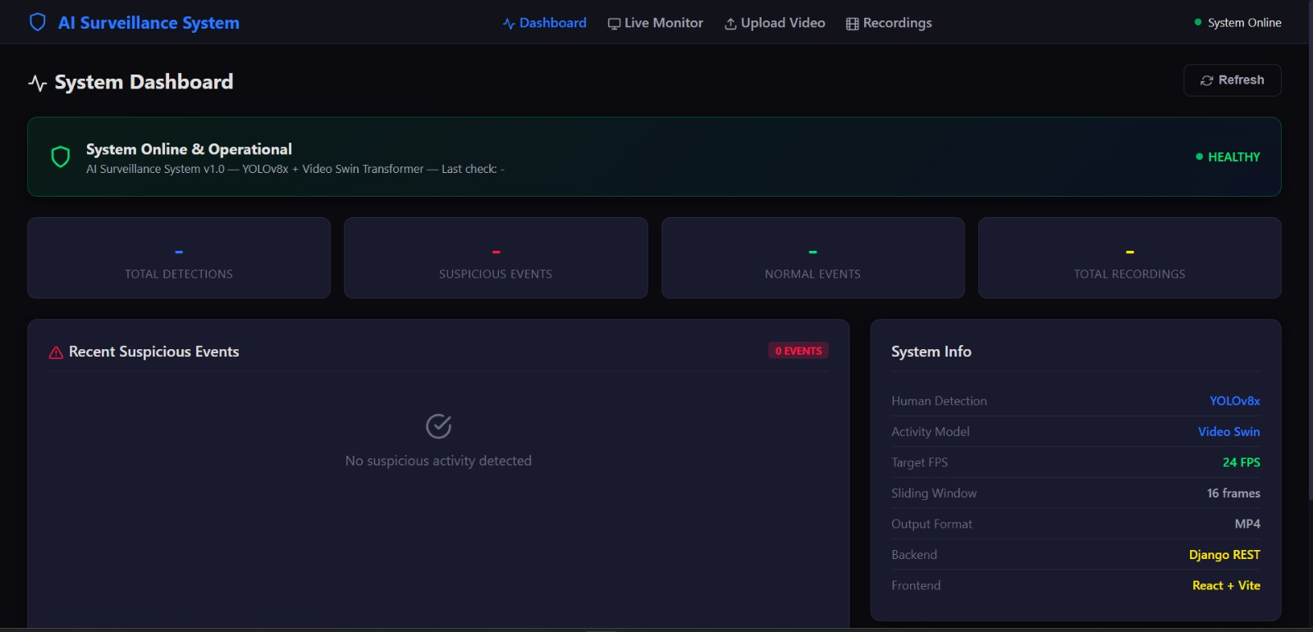
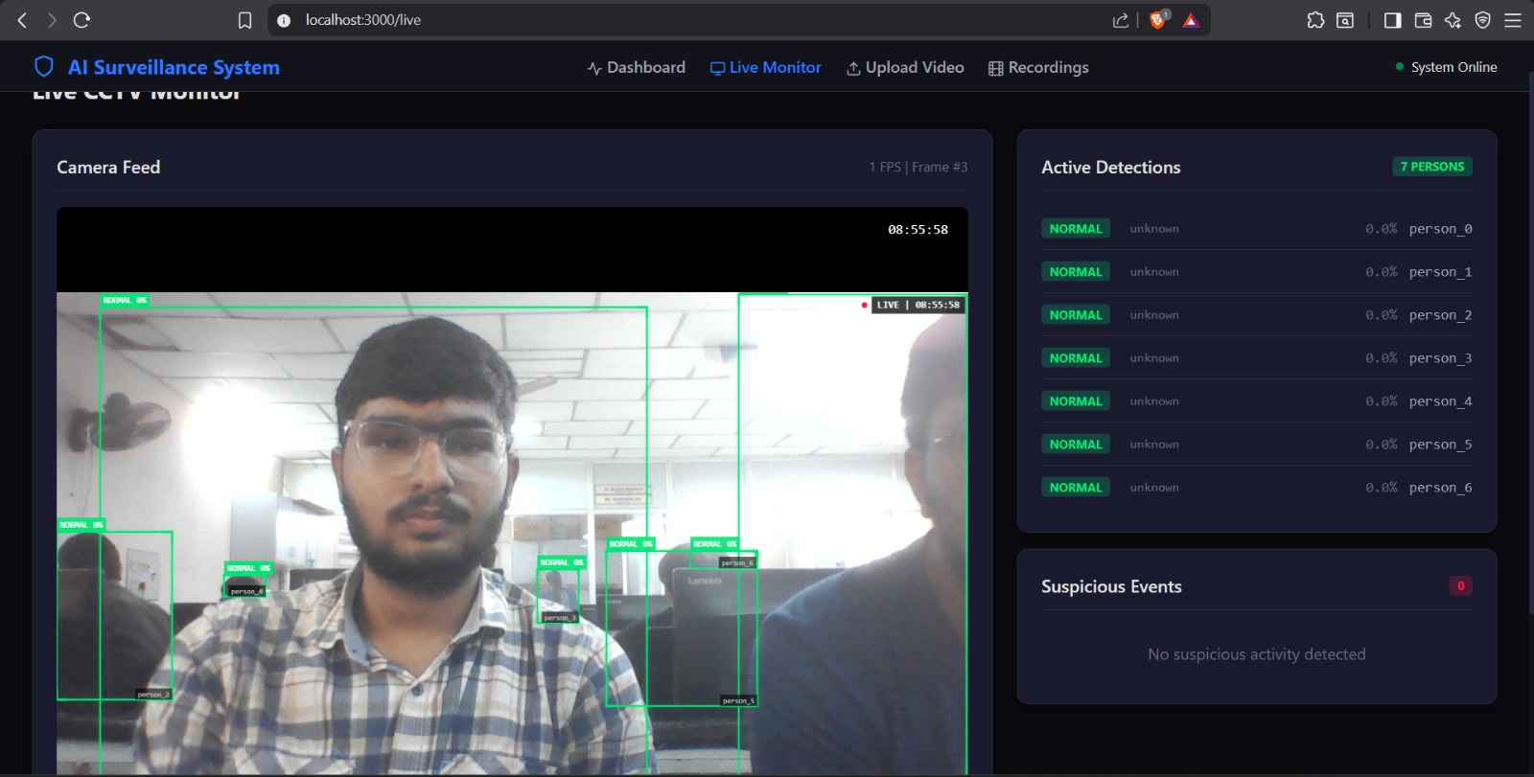
Screenshots / UI Demo (1/3)
2 screenshots per slide for clear PDF readability
Dashboard
Live Monitor
System Design Practice (SDP) - Group 3

Slide 9
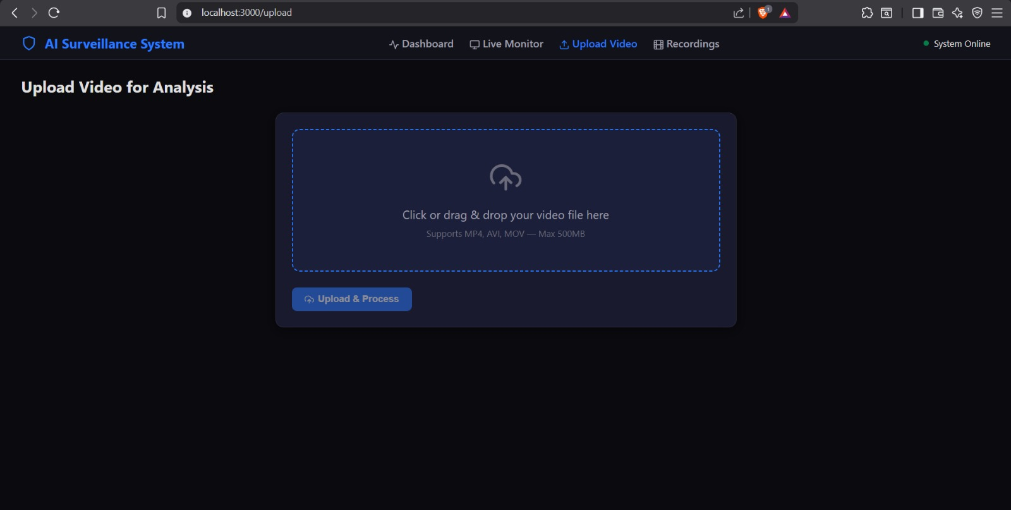
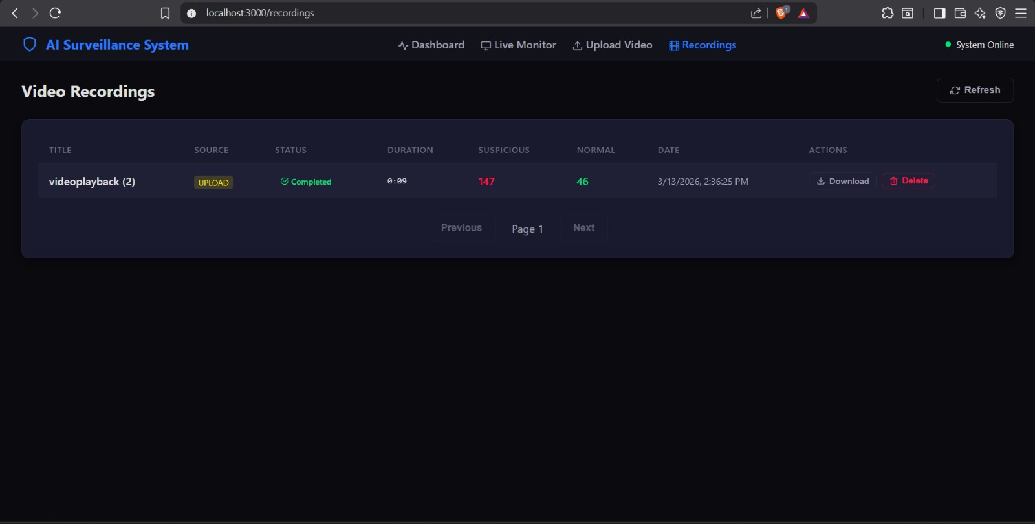
Screenshots / UI Demo (2/3)
2 screenshots per slide for clear PDF readability
Video Upload
Recordings
System Design Practice (SDP) - Group 3

Slide 10
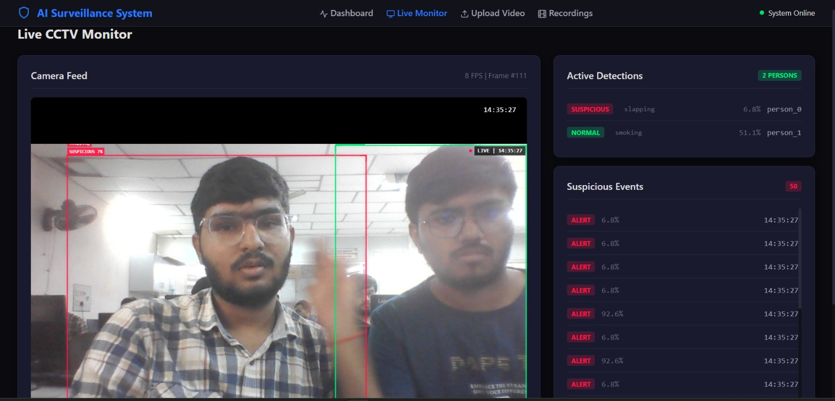
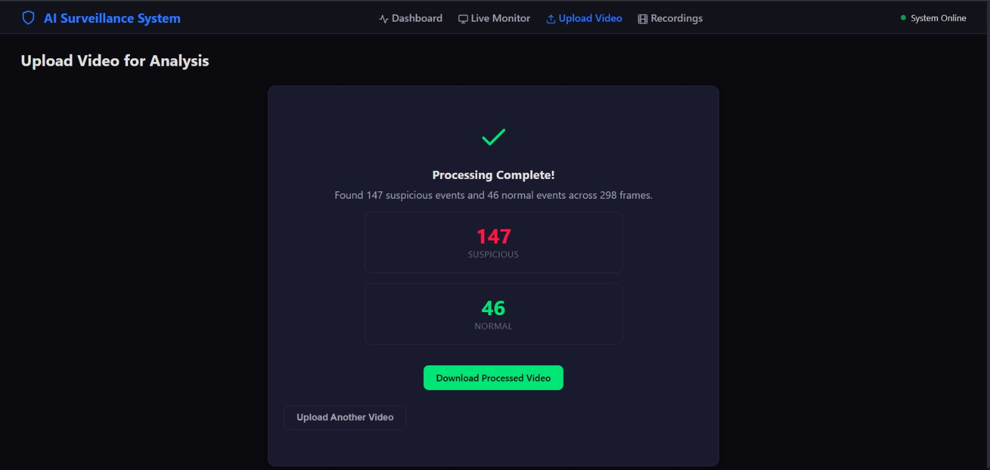
Screenshots / UI Demo (3/3)
2 screenshots per slide for clear PDF readability
Suspicious Detection
Upload Results
System Design Practice (SDP) - Group 3

Slide 11
Results / Output
Detection Output
Per person: bounding box, label, confidence, timestamp.
Processing
Target 24 FPS with optimization in live mode.
Latency
Detection delay target <= 1.5 s, API response < 500 ms.
Performance Summary
YOLO detection target >= 95% Binary activity classification target >= 90% Stable alerts after smoothing and cooldown logic.
Sample Response
detections:[bbox, confidence, activity_label] frame_number timestamp status for UI rendering
System Design Practice (SDP) - Group 3

Slide 12
Challenges Faced and Solutions
Challenge 1
Balancing high accuracy with real-time processing speed.
Solution
Used frame skipping, classifier cooldown and efficient pipeline orchestration.
Challenge 2
Temporal instability (flickering labels) in consecutive frames.
Solution
Applied smoothing (EMA + voting) and confidence thresholds for robust alerts.
System Design Practice (SDP) - Group 3

Slide 13
Future Scope
1
Multi-camera command center with centralized analytics
2
Advanced suspicious behavior classes and custom datasets
3
Real-time alert push via SMS / Email / Mobile app
4
Scalable cloud deployment and role-based access
5
Edge/offline inference using optimized models
6
Integration with CCTV/NVR enterprise systems
System Design Practice (SDP) - Group 3

Slide 14
Conclusion
Achievement
Built an end-to-end AI surveillance platform for suspicious activity detection.
Integration
Unified real-time detection, classification, event logging and annotated recordings.
Impact
A practical, scalable safety solution for campus, office, and public surveillance use cases.
System Design Practice (SDP) - Group 3

Slide 15
References
Ultralytics YOLOv8 official documentation
PyTorch and PyTorchVideo documentation
SlowFast Networks paper (Feichtenhofer et al.)
Django REST Framework documentation
React, Vite, OpenCV and FFmpeg documentation
Thank You - Questions and Discussion
System Design Practice (SDP) - Group 3

