Slide 1
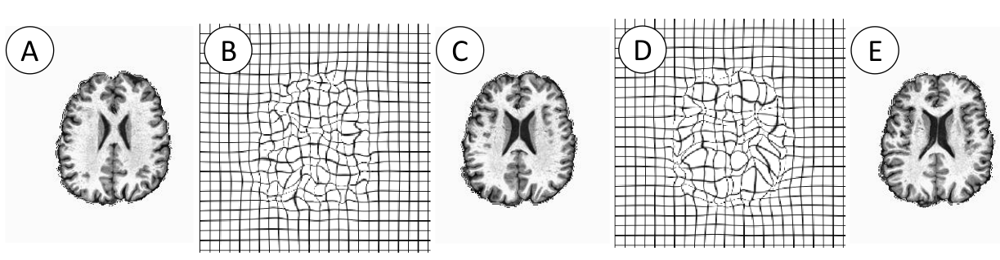
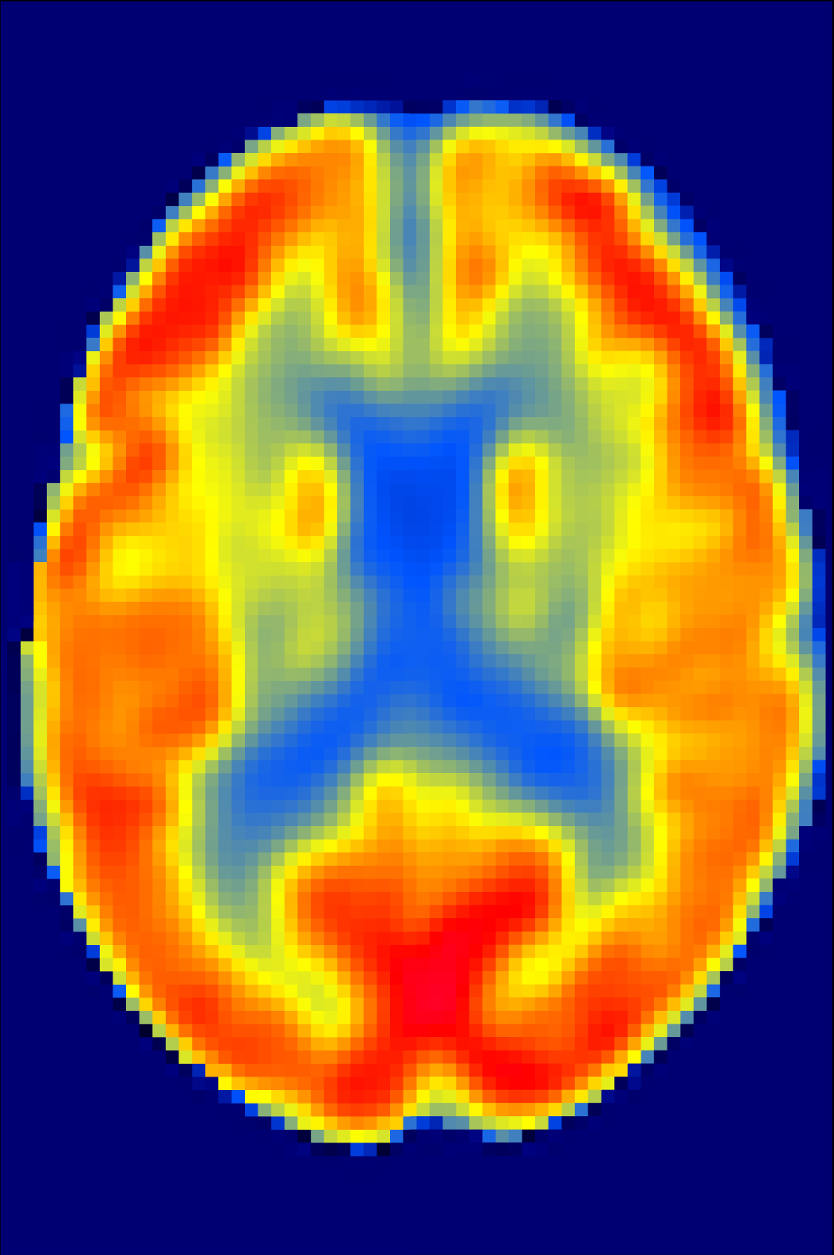















…
Imaging predictors
Conv $3×3×3$
$$112×112×67×8$$
InvResBlock $×1$
$$112×112×67×16$$
InvResBlock $×2$
$$56×56×34×16$$
InvResBlock $×3$
$$28×28×17×32$$
InvResBlock $×4$
$$14×14×9×64$$
InvResBlock $×3$
Clinical measures, CSF, blood, …
$$7×7×5×128$$
Avg Pool
Φ
$$1×1×1×128$$
Neural network for non-imaging predictors
Fully connected (FC)
Map to R$1$
Standardized Cognition score Z_{ij}

