Slide 1


Thread Theory
E-Commerce Website of Clothing
SDJ International College, Vesu
Affiliated To: Veer Narmad South Gujarat University
Presented By:
Bhingradia Fenil (6756) | Savsani Ronak (7191) | Avaiya Nand (6730)
Guided By: Mr. Smit Parekh
BCA Sem VI | A.Y. 2025-26

Slide 2
What is Thread Theory?
An innovative, cutting-edge e-commerce platform designed to redefine the online fashion retail experience by bridging the gap between physical retail and digital convenience.
Key Innovation
An advanced 3D Virtual Try-On system that leverages computer vision and 3D rendering. By utilizing real-time spatial body tracking via the user's camera, customers can virtually "wear" dynamic 3D clothing models (.glb format) , providing an immersive shopping journey that boosts buyer confidence and reduces return rates.
Technology Stack
Target Audience
Primary Goal
MERN Stack (MongoDB, Express.js, React, Node.js) with WebGL for 3D rendering
Fashion-conscious shoppers seeking confidence in online purchases
Reduce return rates by enabling accurate virtual product visualization

Slide 3

Project Objectives
1
2
Virtual Try-On Integration
User-Friendly Interface
Develop real-time 3D clothing visualization system using WebGL and Three.js libraries for interactive garment rendering
Create intuitive shopping experience with seamless navigation between product catalog and virtual fitting room
3
4
4
Data-Driven Command Center
Secure E-Commerce
Admins can manage complex inventory, 3D assets via GitHub links, and track real-time analytics.
Implement robust payment gateway integration and secure transaction processing with data protection protocols

Slide 4
Technology Stack
Frontend Architecture
Backend Infrastructure
React.js with Hooks for component-based UI development
Three.js for 3D model rendering and WebGL integration
WebGL for hardware-accelerated graphics processing
GLB/GLTF format support for 3D clothing models
Material-UI for responsive design system
Node.js & Express.js for server-side logic
MongoDB for document-based data storage
Socket.IO for real-time communication
JWT for secure authentication
Bcrypt for password encryption

Slide 5
Environment & Requirements
Minimum hardware and software specifications for optimal system performance.
Category | Hardware Requirement | Software Requirement
Processor | Intel i5 or higher | Node.js Runtime
Memory (RAM) | 8 GB Minimum | VS Code / Atom
Storage | 256 GB SSD | MongoDB Compass
Graphics | Integrated / Dedicated GPU | Modern Web Browser

Slide 6
Evolution from Existing Systems
Analyzing the limitations of traditional e-commerce vs. the Thread Theory solution.
Feature | Traditional E-commerce | Thread Theory (Proposed)
Visuals | Static 2D Images | Interactive 3D Models
Fitting | Imaginary / Size Charts | Real-time Virtual Try-On
Returns | High due to sizing issues | Significantly reduced
Experience | Transaction-based | Immersive & Interactive

Slide 7









Feasibility Study
Technical Feasibility
Economic Feasibility
Operational Feasibility
Utilizes the proven MERN stack for fast SPA performance. Client-side AI (MediaPipe) and WebGL (Three.js) enable seamless real-time 3D virtual try-ons without overloading the server.
Leveraging open-source technologies eliminates licensing fees. Hosting 3D assets externally reduces bandwidth costs, while the virtual fitting room maximizes ROI by drastically minimizing return rates.
The Admin Command Center securely streamlines daily workflows. Admins can easily manage 3D assets via simple URL links, while automated inventory and order tracking reduce manual overhead.

Slide 8
System Modules & Functionality
Customer Experience
Admin & Staff Operations
Virtual Try-On Engine: The core innovation. Uses webcam access and MediaPipe AI to map clothing onto users in real-time.
Product Discovery: Advanced, zero-reload filtering (by category, size, color, price) for seamless catalog browsing.
Cart & Checkout: Persistent shopping cart with secure payment gateway integration (Razorpay) and automated invoice generation.
Catalog Management: Full CRUD authority over products. Crucially, admins manage the GitHub raw URLs for the 3D .glb assets.
Order Fulfillment: Tools to track shipments, update logistics statuses, and manage dynamic inventory levels.
Business Dashboard: Real-time analytics tracking revenue, sales volume, and the reduction in return rates.

Slide 9
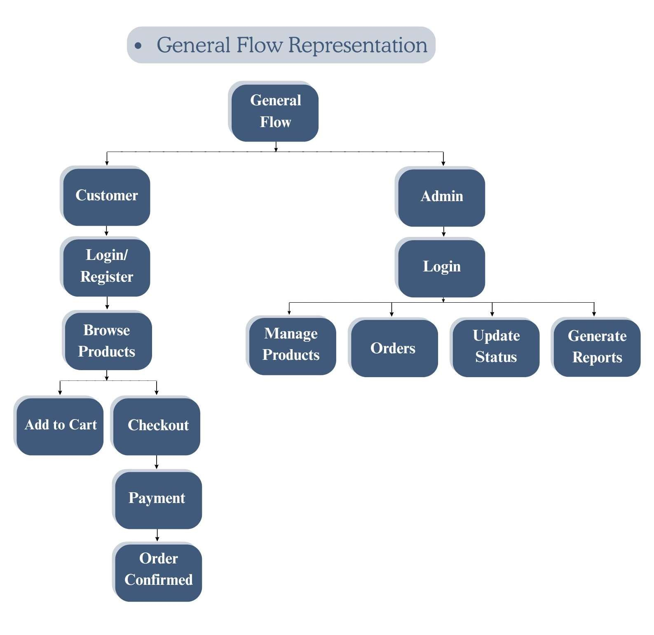
System Architecture & Flow
Thread Theory is built upon the high-performance MERN Stack architecture, integrated with advanced WebGL and AI tools:
Client Side (Front-End): React.js manages dynamic SPA views and state, styled flawlessly with Tailwind CSS. It integrates @react-three/fiber and MediaPipe AI for the real-time 3D Virtual Try-On engine.
Server Side (Back-End): Node.js provides a fast, asynchronous runtime while Express.js handles secure RESTful API routing, JWT authentication, and strict CORS policies.
Database Layer: MongoDB utilizes a flexible NoSQL schema to scale complex clothing variants (sizes, stock) and securely store GitHub raw URLs for 3D .glb assets.

Slide 10
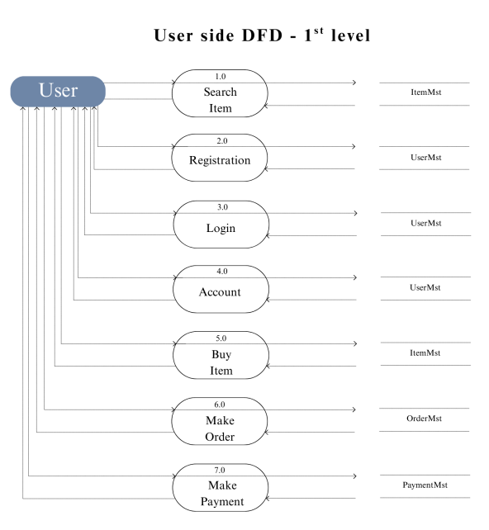
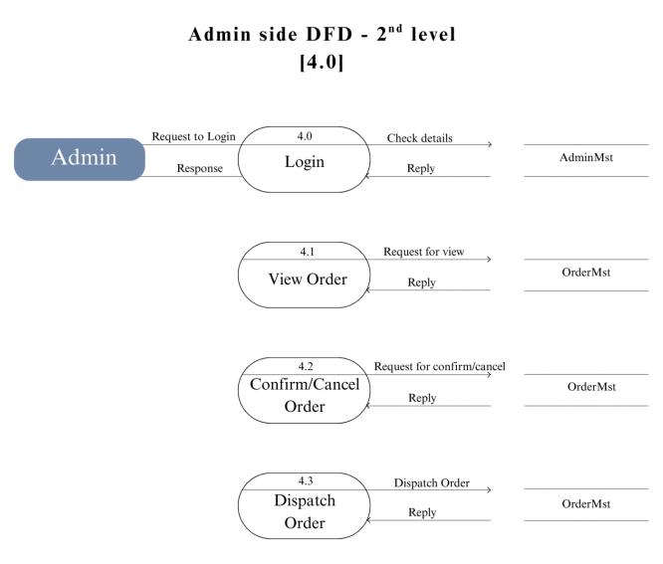
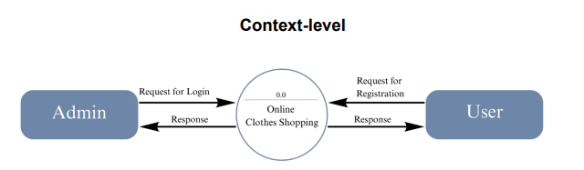
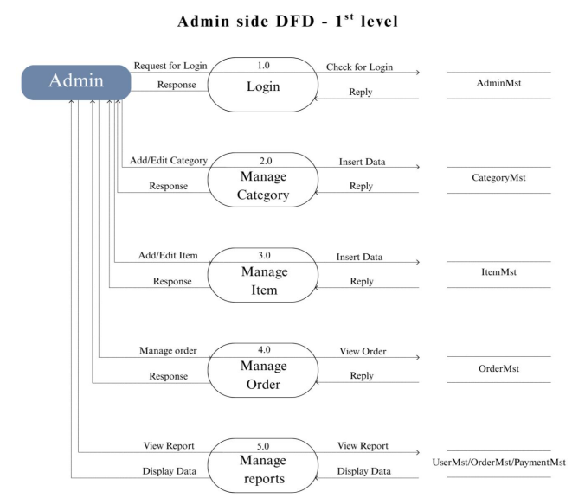


Dataflow Diagram

Slide 11
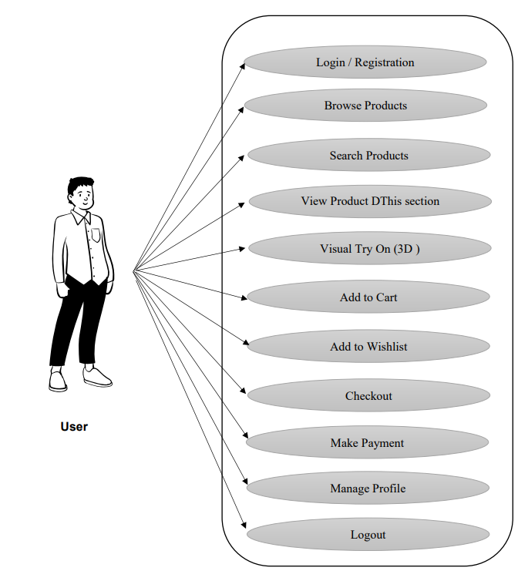
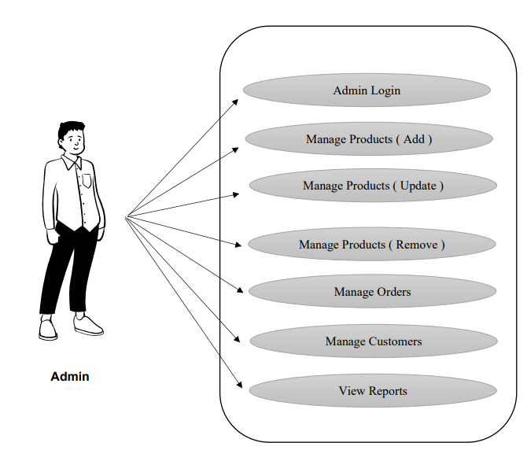
Use Case Diagram

Slide 12
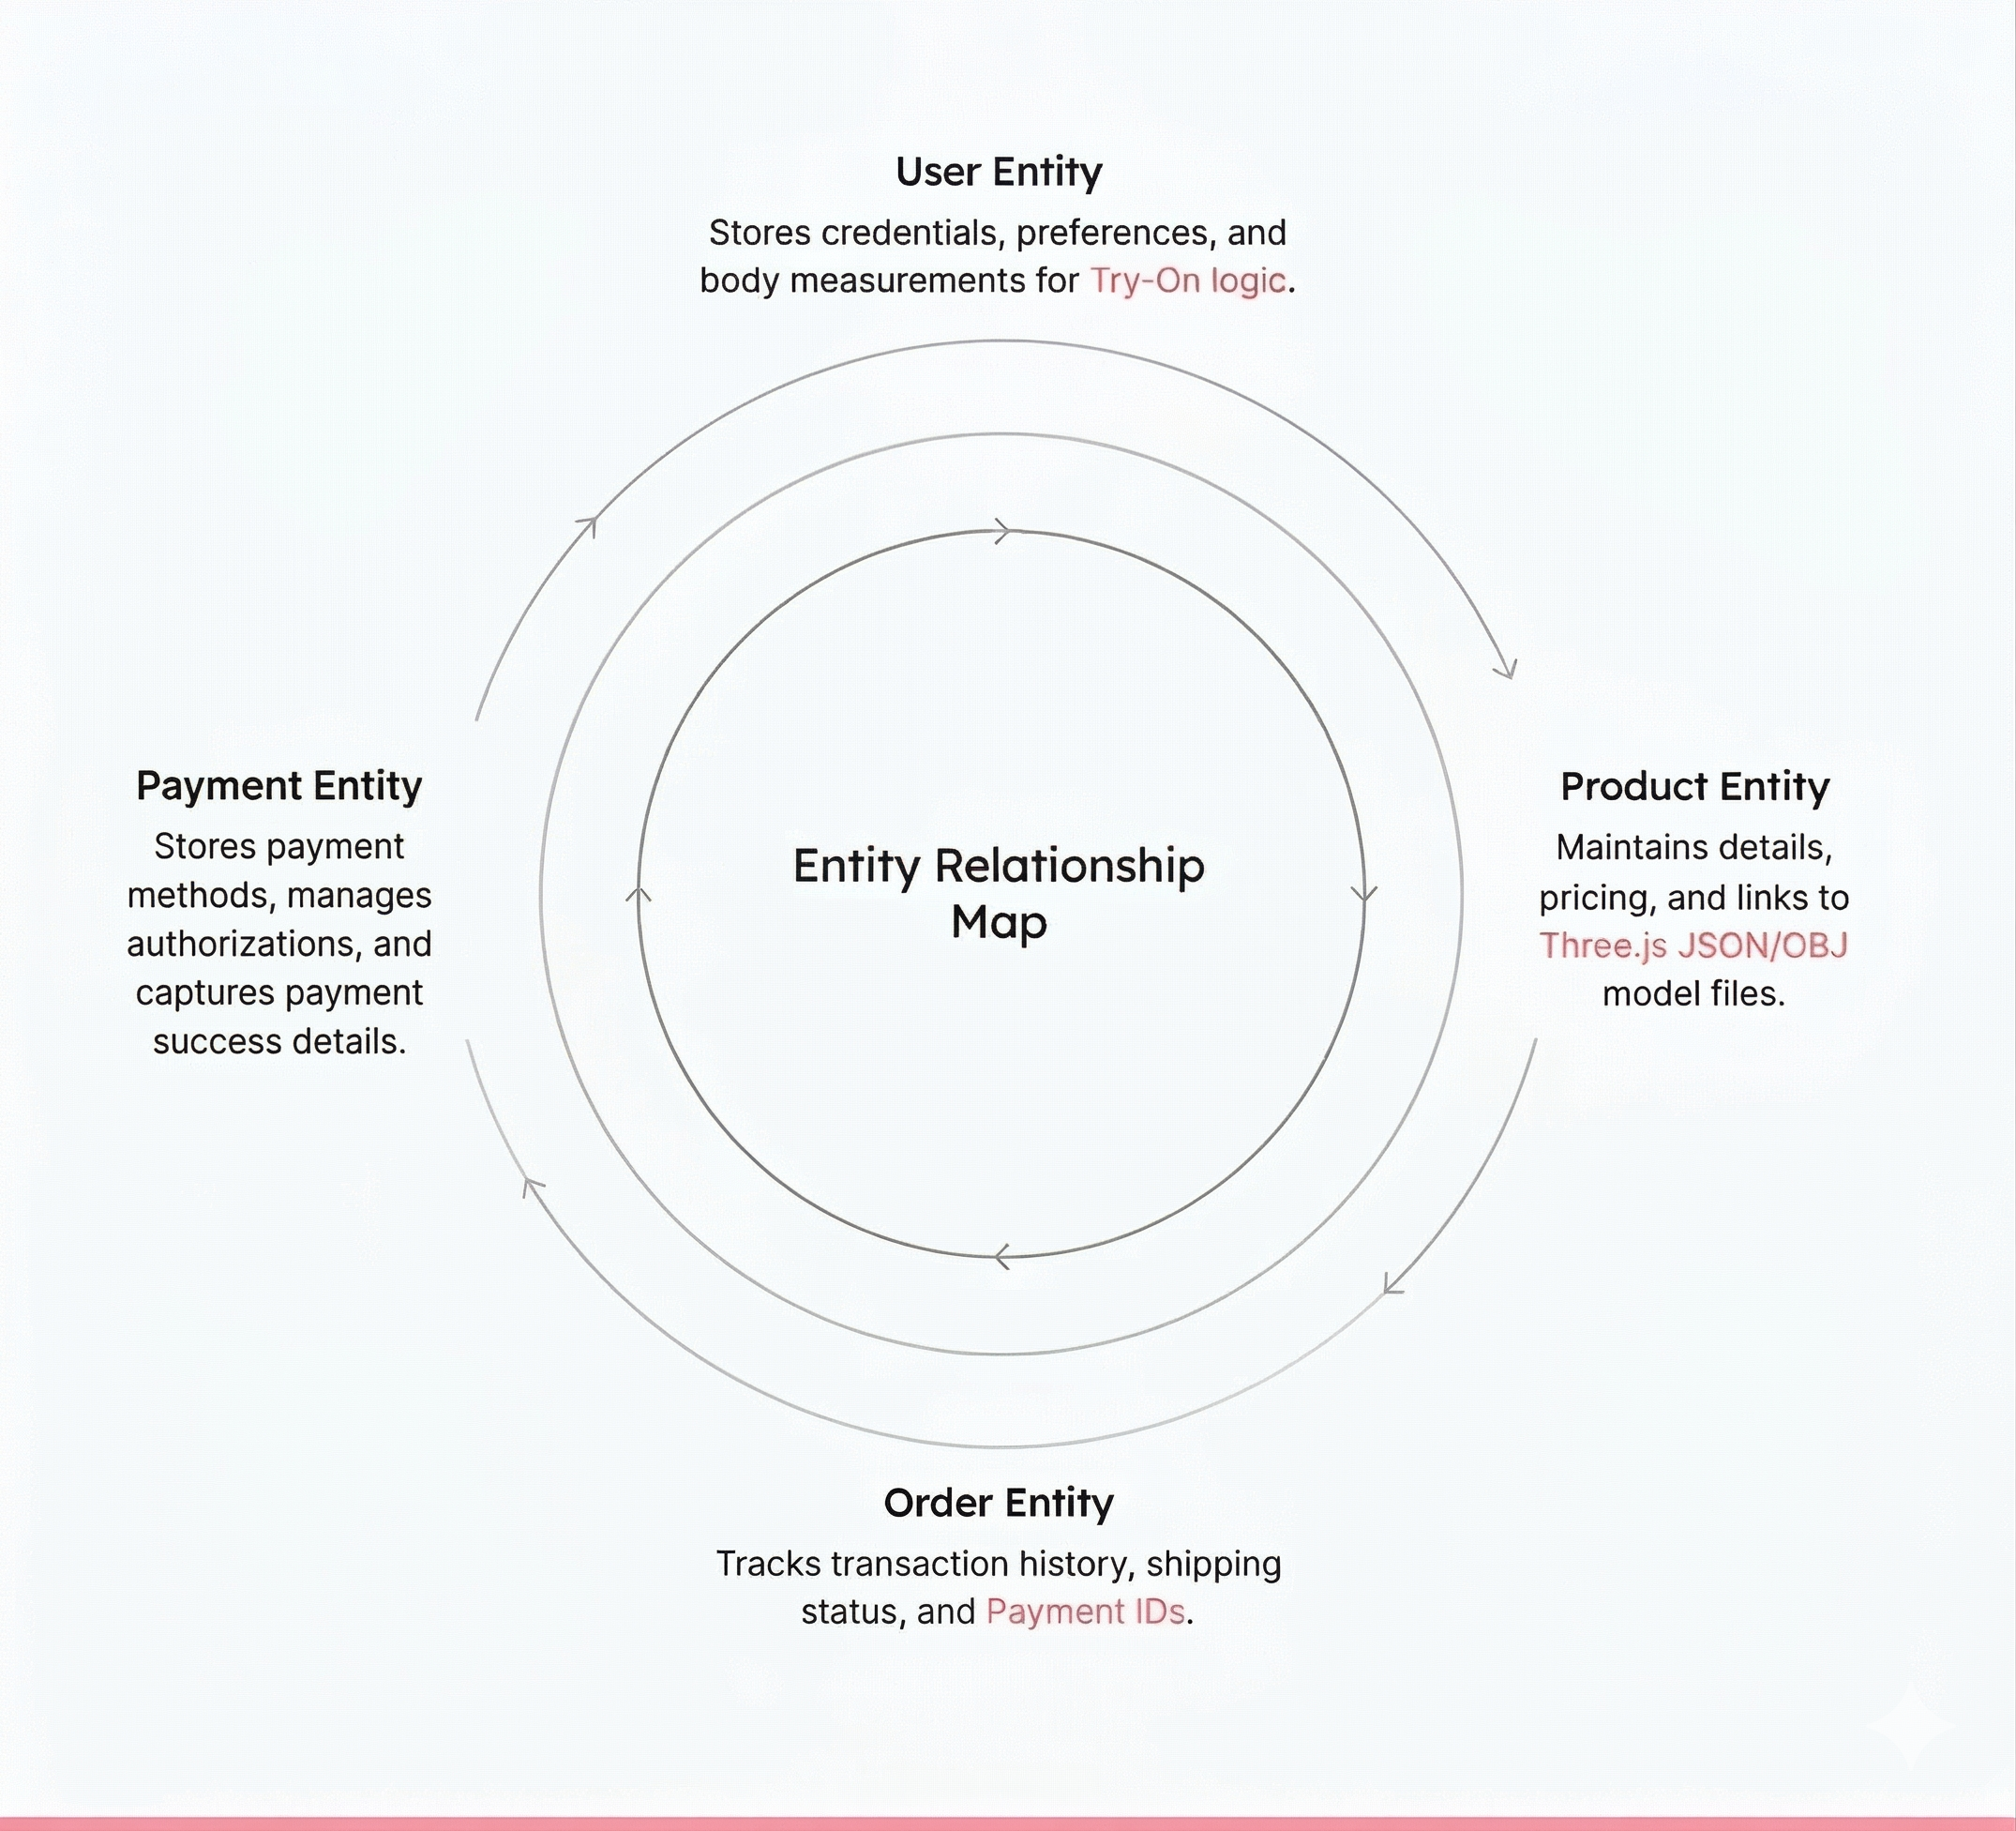
Data Architecture (ER Diagram)
Visualizing entities, relationships, and data flow within the MongoDB ecosystem.

Slide 13
Database Design (MongoDB Collections)
Collection | Key Fields (JSON Documents) | Purpose
User | _id, name, email, password (hashed), role, measurements | Manages authentication, access control, and stores preferences for Try-On logic.
Product | _id, name, price, stock, images, model3D_url | Stores the WATCHERA dynamic watch catalog and links to Three.js JSON/OBJ files.
Order | _id, user_ref, items, shippingAddress, totalPrice, status | Tracks customer purchases, delivery status, and order history.
Payment | _id, order_ref, transactionId, method, amount, status | Securely logs payment authorizations and captures success details.
Cart | _id, user_ref, products Array(id, quantity) | Maintains persistent, reload-free shopping carts for users.
Review | _id, product_ref, user_ref, rating, comment, createdAt | Stores customer feedback and star ratings for specific watch models to build trust and social proof.
Coupons | _id, code, discountType, discountValue, expiryDate, isActive | Manages promotional codes and automatically validates/applies discounts during the checkout process.

Slide 14
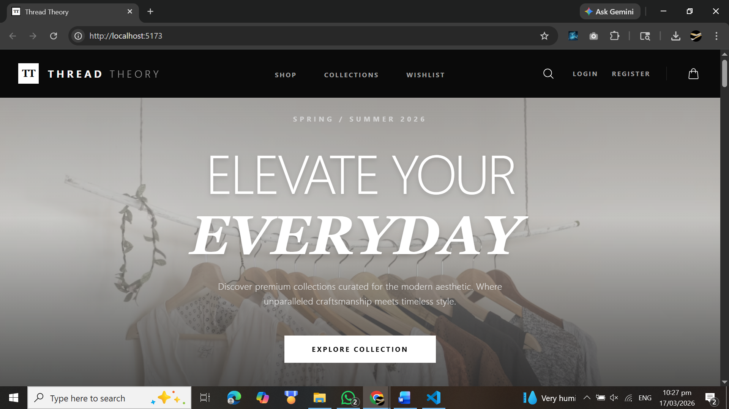
Implementation & UI Details
Component-Based: Developed a modular frontend using React.js, creating reusable UI components for dynamic product cards, navigation, and state management to ensure a fast, seamless single-page application (SPA) experience..
Premium Aesthetic: Utilized Tailwind CSS to establish a sophisticated "dark mode" luxury theme, accented with elegant gold tones, crisp typography, and smooth transitions fitting the WATCHERA brand.
Responsive Layout: Integrated Three.js to render interactive 3D luxury watch models directly in the browser, while ensuring the entire digital storefront adapts flawlessly across desktop, tablet, and mobile devices.
Secure API Routing: Configured Node.js and Express.js endpoints to securely handle data requests, product filtering, and seamless frontend-to-backend communication.

Slide 15
Comprehensive Software Testing
Ensuring stability, reliability, and security through rigorous QA phases.
System Testing
End-to-end testing of the complete flow to ensure the product browsing to final checkout process functions correctly across all devices.
Integration Testing
Checking how different modules interact, specifically the Frontend to Inventory Database link and secure payment API connections.
Unit Testing
Testing individual components like the Shopping Cart logic, Size/Color Selectors, and UI buttons for isolated errors.

Slide 16




Future Scope & Enhancements
Expanding Thread Theory's horizon with intelligent sizing, immersive tech, and scalable features.
Implementation of AI-driven size recommendations using machine learning to analyze user measurements and reduce clothing return rates.
Development of a Virtual Try-On feature leveraging AR (Augmented Reality) so customers can see how garments fit using their device's camera.
Deep integration with Social Commerce, allowing users to share custom "Thread Theory" outfit lookbooks directly to platforms like Instagram or Pinterest.
Expansion into a Multi-vendor Marketplace ecosystem, allowing independent fashion designers and boutique brands to sell on the platform.

Slide 17
Conclusion
"In conclusion, Thread Theory successfully demonstrates the integration of modern web technologies to create a premium clothing e-commerce experience. By utilizing a robust React.js frontend and secure backend architecture, the project delivers a seamless, responsive, and user-centric shopping platform. It not only meets current digital retail standards but also establishes a highly scalable foundation ready to embrace future innovations like AI and AR in fashion tech."

Slide 18
Questions?
Thank you for your attention.
fenil.bhingradia@sdjic.edu | ronak.savsani@sdjic.edu | nand.avaiya@sdjic.edu

