Slide 1

LOAN PREDICTION ANALYSIS
GROUP 9

Slide 2

AGENDA
OBJECTIVE
DATASET
METHODOLOGY
TRAINING AND TESTING
RESULTS AND DISCUSSION

Slide 3
OBJECTIVE
TO BUILD A MODEL WHICH WILL PREDICT WHETHER CUSTOMER SHOULD DEFAULT ON A LOAN
TO REDUCE THE RISK OF THE LENDING CLUB OVER LOAN

Slide 4

DATASET
20% TESTING SET
80% TRAINING SET
887,380
OBSERVATION &
74 VARIABLES
NUMERICAL VARIABLES
loan_amount
installment
Int_rate
annual_income
dti
emp_length
CATEGORICAL VARIABLES
emp_title
purpose
loan_status
ver_status
term

Slide 5

METHODOLOGY
DATA CLEANING
Checking for NA values
Removing the columns if NA values are more than 60%
Remove unnecessary columns
No need to replace the NA values as our data has many records even after all the missing values are cleared

Slide 6
METHODOLOGY
DATA TRANSFORMATION
These manipulations are needed to make some variables able to use in our Logistic Model
Binarization of variable Term.
Categorization of variable grade.
Getting rid of unnecessary characters within attribute.
Changing the format of the data.
89,866 obs. of 27 variables

Slide 7
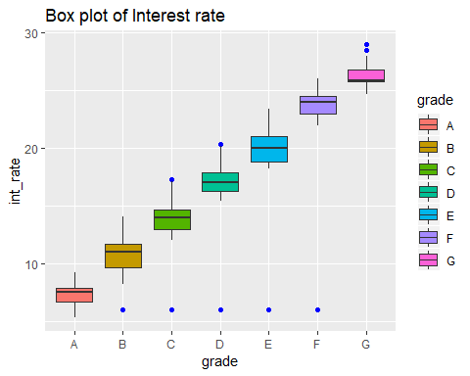
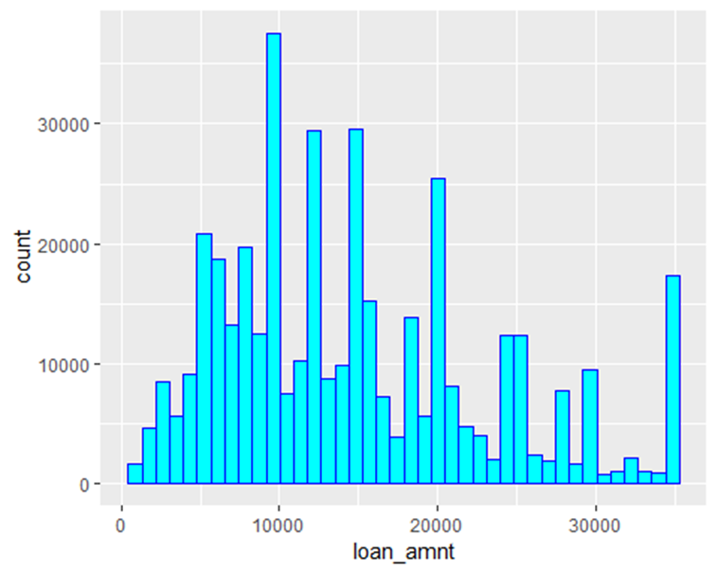
METHODOLOGY
DATA VISUALIZATION

Slide 8
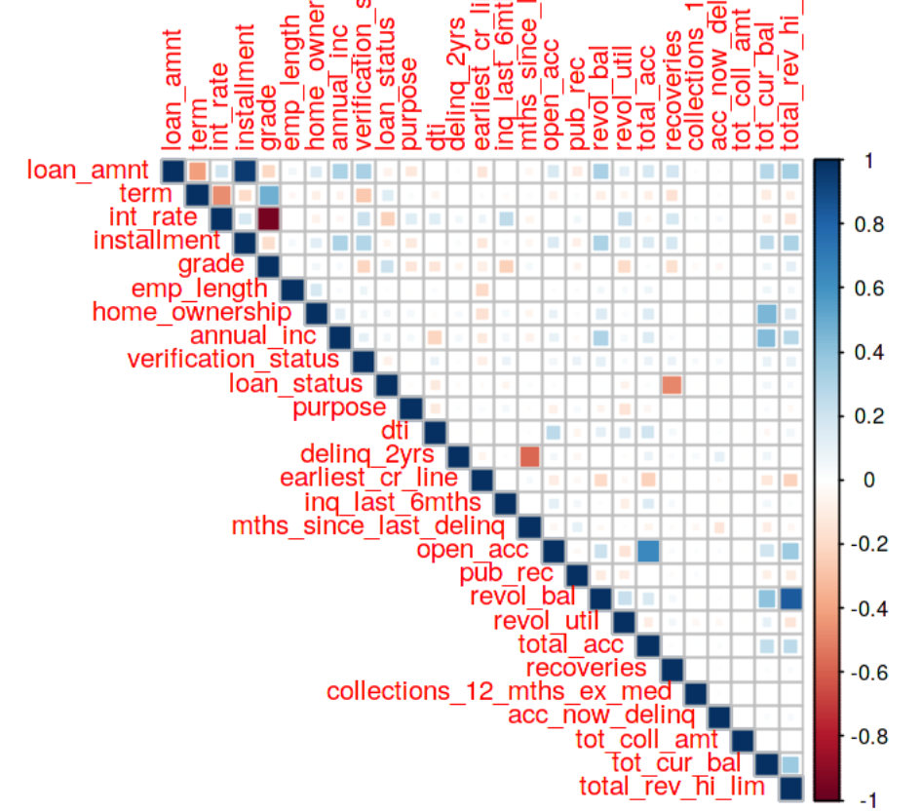
METHODOLOGY
LOGISTIC REGRESSION MODEL
Understanding multi-collinearity problem
One of the assumptions required to build model of logistic regression is not possessing strong correlated variables.
To check, if we have ones I decided to build correlation matrix and remove one of pair strongly correlated variables.

Slide 9
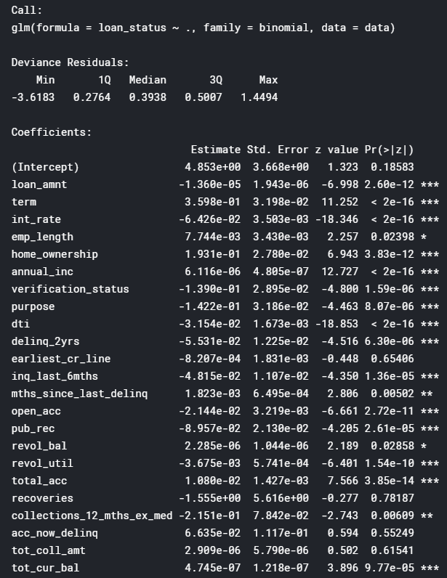
METHODOLOGY
LOGISTIC REGRESSION MODEL
FIRST MODEL
First model after all transformations and most of used variables are relevant.
Nevertheless, there are still many ways to improve it.

Slide 10
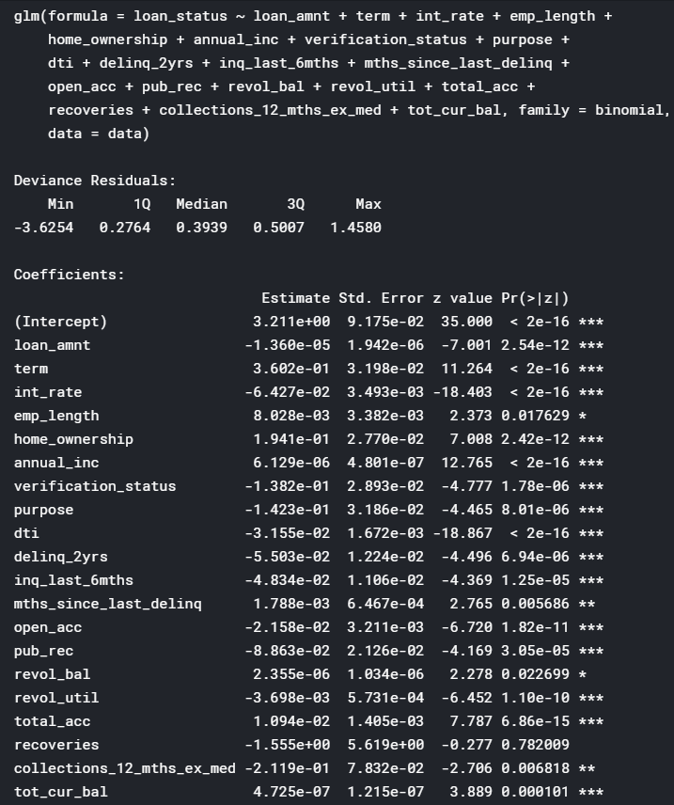
METHODOLOGY
LOGISTIC REGRESSION MODEL
ADJUSTED BY AIC CRITERIA
One of the metrics that determines quality of econometric model is AIC criteria.
We use stepAIC algorithm to gain model with the lowest possible AIC score which gives us best possible model
The variables which have p value greater than 0.05 have been removed as they have no significance.
After applying the AIC, We gain a model where AIC score is lower and we have just one irrelevant variable.

Slide 11
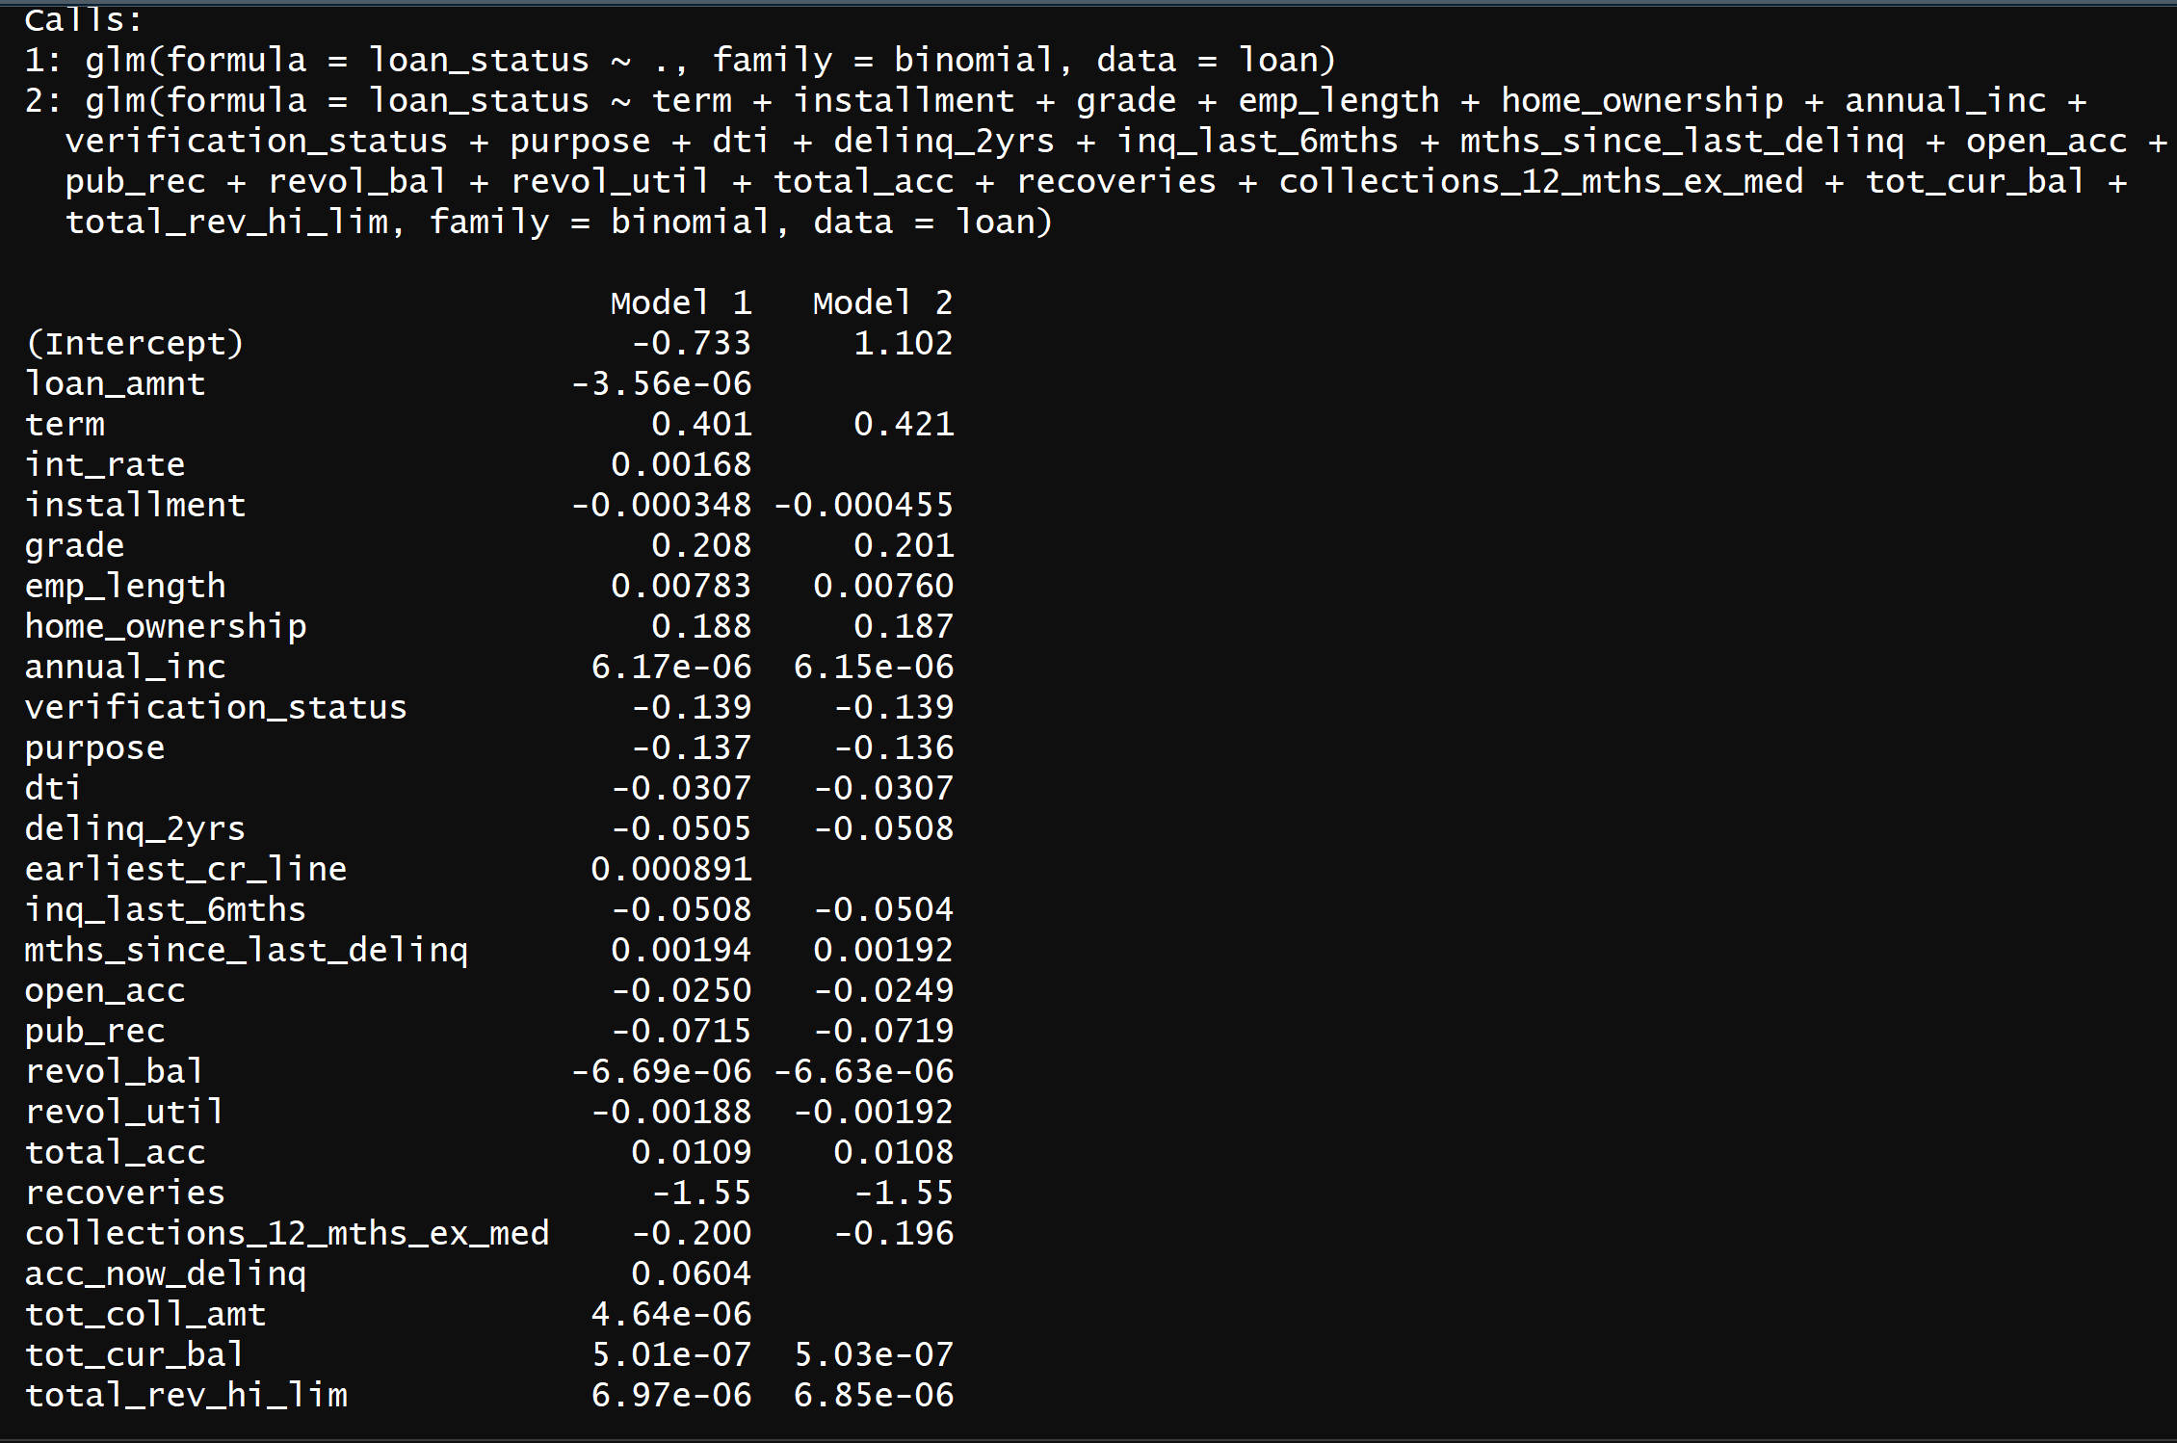
METHODOLOGY
COMPARING BOTH THE MODELS
Comparing the coefficients of both the models

Slide 12
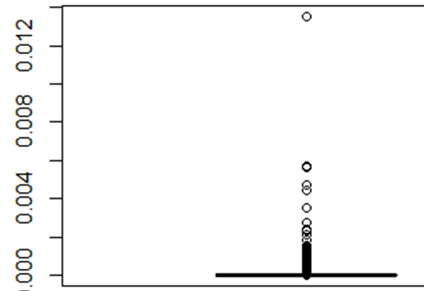
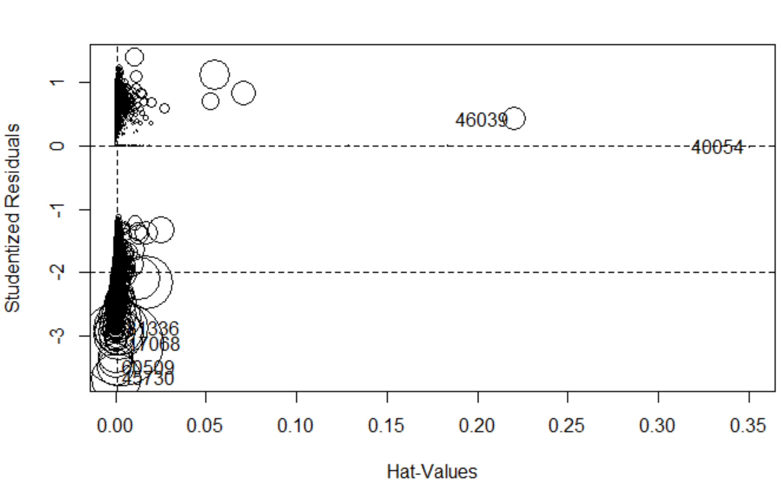
METHODOLOGY
OPTIMIZING THE MODEL 2
Excluding the records whose hat-value is greater than 0.003 (cook’s distance) and creating new model.

Slide 13
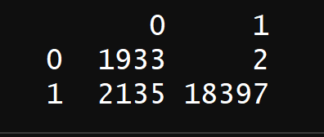
TRAINING AND TESTING
20% TESTING SET
80% TRAINING SET
To make a prediction, at first we need to split our database on train and test datasets. To check if model built on one set of data will predict correctly data that were not used to built one. We split data with proportion 20% test, 80% train.
Now we build model with the same variables as we’ve got in model 3, but using train data.
Confusion matrix of actual vs prediction.

Slide 14
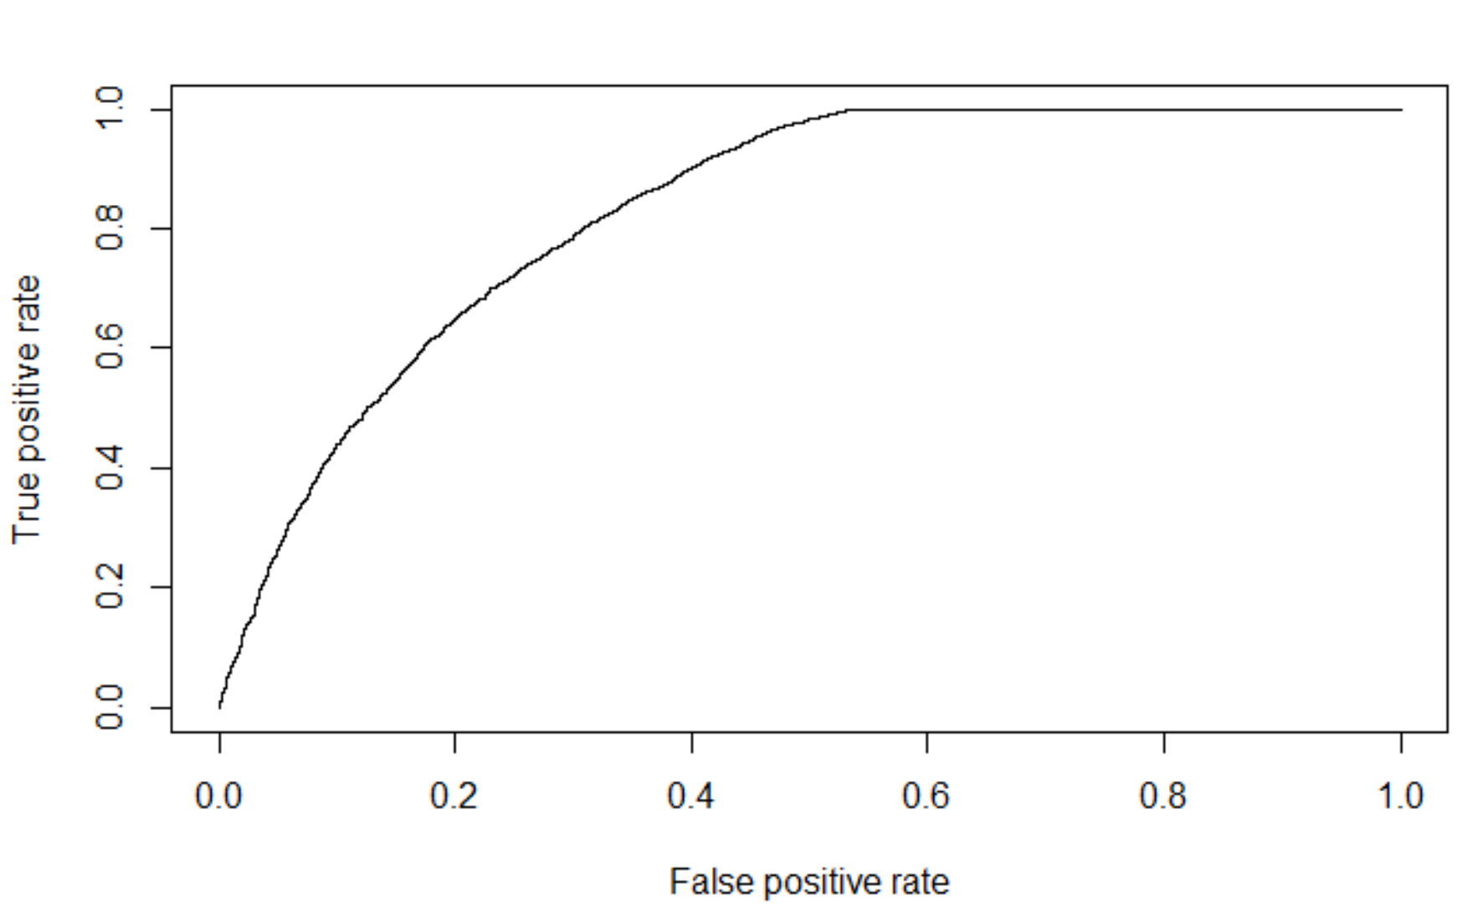
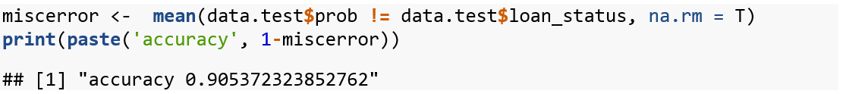
ACCURACY OF THE FINAL MODEL
Accuracy of the model is 90.5 %
ROC Curve
Area under the curve = 0.83

Slide 15
THANK YOU!

