Slide 1
Lecture 9: Query Expansion

Slide 2
This lecture
Improving results
  For high recall. E.g., searching for aircraft doesn’t match with plane; nor thermodynamic with heat
Options for improving results…
  Focus on relevance feedback
  The complete landscape
    Global methods
      Query expansion
        Thesauri
        Automatic thesaurus generation
    Local methods
      Relevance feedback
      Pseudo relevance feedback
Notes:
The examples in the first bullet refer to the Cranfield data set which we have used as a programming exercise.

Slide 3
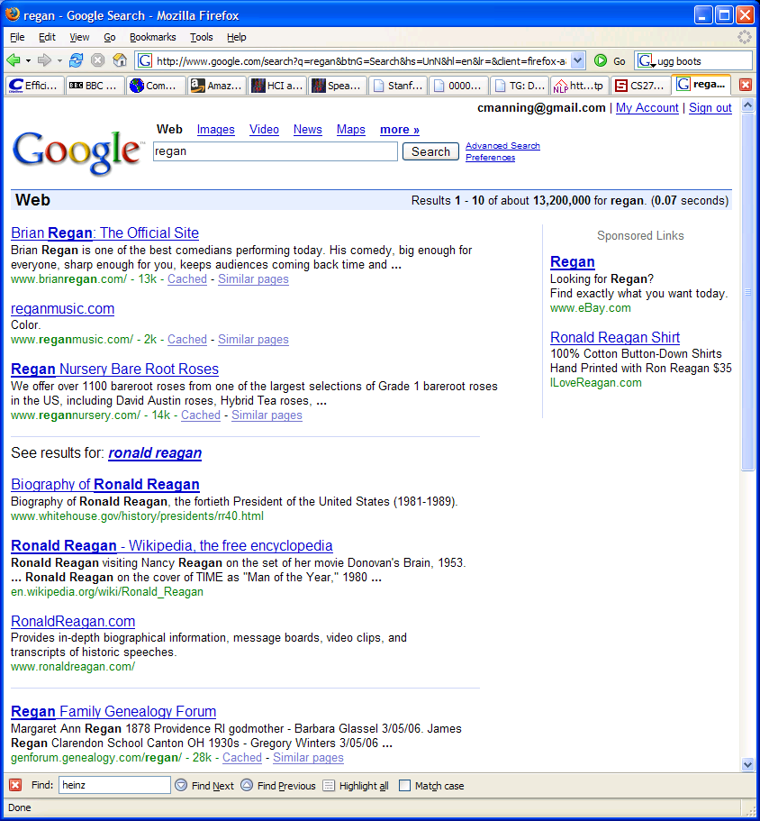
Query expansion

Slide 4
Relevance Feedback
Relevance feedback: user feedback on relevance of docs in initial set of results
  User issues a (short, simple) query
  The user marks returned documents as relevant or non-relevant.
  The system computes a better representation of the information need based on feedback.
  Relevance feedback can go through one or more iterations.
Idea: it may be difficult to formulate a good query when you don’t know the collection well, so iterate

Slide 5
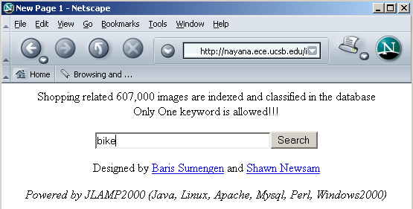
Relevance Feedback: Example
Image search engine http://nayana.ece.ucsb.edu/imsearch/imsearch.html

Slide 6
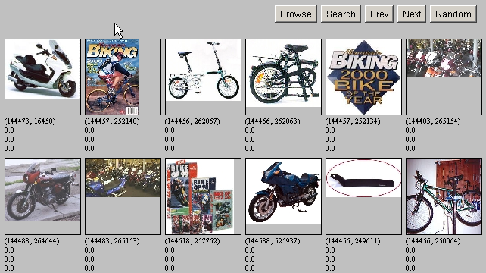
Results for Initial Query

Slide 7
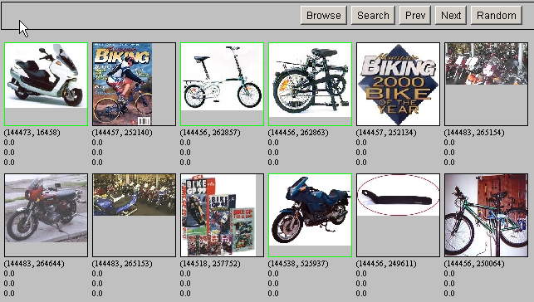
Relevance Feedback

Slide 8
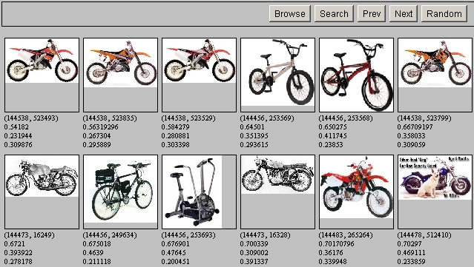
Results after Relevance Feedback

Slide 9
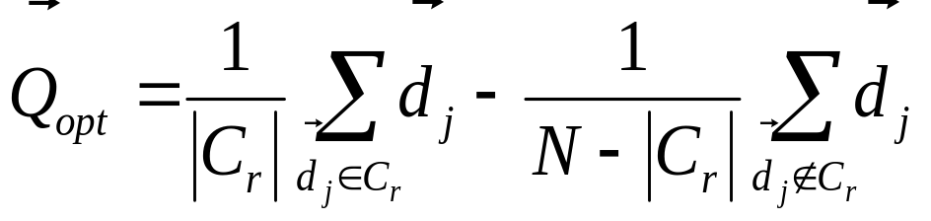
Rocchio Algorithm
The Rocchio algorithm incorporates relevance feedback information into the vector space model.
Want to maximize sim (Q, C_{r}) - sim (Q, C_{nr})
The optimal query vector for separating relevant and non-relevant documents (with cosine sim.):
Q_{opt} = optimal query; C_{r} = set of rel. doc vectors; N = collection size
Unrealistic: we don’t know relevant documents.
Notes:
Q = query, Cr = relevant documents Cnr = not relevant documents

Slide 10
The Theoretically Best Query
x
x
x
x
o
x
x
x
x
x
x
x
x
o
x
o
x
o
x
x
Δ
o
o
x
x
x non-relevant documents
o relevant documents
Optimal query

Slide 11
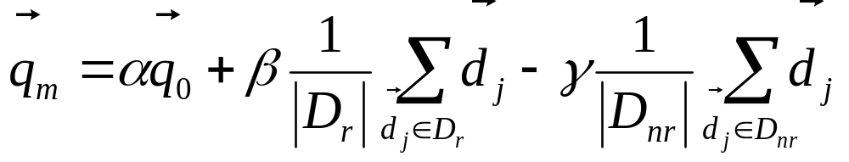
Rocchio 1971 Algorithm (SMART)
Used in practice:
q_{m} = modified query vector; q₀ = original query vector; α,β,γ: weights (hand-chosen or set empirically); D_{r} = set of known relevant doc vectors; D_{nr} = set of known irrelevant doc vectors
New query moves toward relevant documents and away from irrelevant documents
Tradeoff α vs. β/γ : If we have a lot of judged documents, we want a higher β/γ.
Term weight can go negative
  Negative term weights are ignored (set to 0)
Notes:
SMART: Cornell (Salton) IR system of 1970s to 1990s.

Slide 12
Relevance feedback on initial query
Initial query
x
x
x
o
x
x
x
x
Δ
x
x
x
o
x
o
x
Δ
x
o
x
o
o
x
x
x
x
x known non-relevant documents
o known relevant documents
Revised query

Slide 13
Relevance Feedback in vector spaces
We can modify the query based on relevance feedback and apply standard vector space model.
Use only the docs that were marked.
Relevance feedback can improve recall and precision
Relevance feedback is most useful for increasing recall in situations where recall is important
  Users can be expected to review results and to take time to iterate
Notes:
Just as we modified the query in the vector space model, we can also modify it here. I’m not aware of work that uses language model based Ir this way.

Slide 14
Positive vs Negative Feedback
Positive feedback is more valuable than negative feedback (so, set γ < β; e.g. γ = 0.25, β = 0.75).
Many systems only allow positive feedback (γ=0).
Why?
Notes:
It’s harder for user to give negative feedback (absence of evidence is not evidence of absence). It’s also harder to use since relevant documents can often form tight cluster, but non-relevant documents rarely do.

Slide 15
Probabilistic relevance feedback
Rather than reweighting in a vector space…
If user has told us some relevant and irrelevant documents, then we can proceed to build a classifier, such as a Naive Bayes model:
  P(t_{k}|R) = |D_{rk}| / |D_{r}|
  P(t_{k}|NR) = (N_{k} - |D_{rk}|) / (N - |D_{r}|)
    t_{k} = term in document; D_{rk} = known relevant doc containing t_{k}; N_{k} = total number of docs containing t_{k}
  This is effectively another way of changing the query term weights
  But note: the above proposal preserves no memory of the original weights

Slide 16
Relevance Feedback: Assumptions
A1: User has sufficient knowledge for initial query.
A2: Relevance prototypes are “well-behaved”.
  Term distribution in relevant documents will be similar
  Term distribution in non-relevant documents will be different from those in relevant documents
    Either: All relevant documents are tightly clustered around a single prototype.
    Or: There are different prototypes, but they have significant vocabulary overlap.
    Similarities between relevant and irrelevant documents are small

Slide 17
Violation of A1
User does not have sufficient initial knowledge.
Examples:
  Misspellings (Brittany Speers).
  Cross-language information retrieval
  Mismatch of searcher’s vocabulary vs. collection vocabulary
    Cosmonaut/astronaut

Slide 18
Violation of A2
There are several relevance prototypes.
Examples:
  Burma/Myanmar
  Contradictory government policies
Often: instances of a general concept
Good editorial content can address problem
  Report on contradictory government policies

Slide 19
Relevance Feedback: Problems
Why do most search engines not use relevance feedback?
Notes:
A long vector space query is like a disjunction: you have to consider documents with any of the words, and sum partial cosine similarities over the various terms.

Slide 20
Relevance Feedback: Problems
Long queries are inefficient for typical IR engine.
  Long response times for user.
  High cost for retrieval system.
  Partial solution:
    Only reweight certain prominent terms
      Perhaps top 20 by term frequency
Users are often reluctant to provide explicit feedback
It’s often harder to understand why a particular document was retrieved after apply relevance feedback
Why?
Notes:
A long vector space query is like a disjunction: you have to consider documents with any of the words, and sum partial cosine similarities over the various terms.

Slide 21
Evaluation of relevance feedback strategies
Use q₀ and compute precision and recall graph
Use q_{m} and compute precision recall graph
  Assess on all documents in the collection
      Spectacular improvements, but … it’s cheating!
      Partly due to known relevant documents ranked higher
      Must evaluate with respect to documents not seen by user
  Use documents in residual collection (set of documents minus those assessed relevant)
      Measures usually then lower than for original query
      But a more realistic evaluation
      Relative performance can be validly compared
Empirically, one round of relevance feedback is often very useful. Two rounds is sometimes marginally useful.
Notes:
It’s lower because the results aren’t on the documents that came in top on the original query, which are the ones most likely to be relevant.

Slide 22
Relevance Feedback on the Web
Some search engines offer a similar/related pages feature (this is a trivial form of relevance feedback)
  Google (link-based)
  Altavista
  Stanford WebBase
But some don’t because it’s hard to explain to average user:
  Alltheweb
  msn
  Yahoo
Excite initially had true relevance feedback, but abandoned it due to lack of use.
α/β/γ ??

Slide 23
Excite Relevance Feedback
Spink et al. 2000
Only about 4% of query sessions from a user used relevance feedback option
  Expressed as “More like this” link next to each result
But about 70% of users only looked at first page of results and didn’t pursue things further
  So 4% is about 1/8 of people extending search
Relevance feedback improved results about 2/3 of the time

Slide 24
Other Uses of Relevance Feedback
Following a changing information need
Maintaining an information filter (e.g., for a news feed)

Slide 25
Relevance Feedback
Summary
Relevance feedback has been shown to be very effective at improving relevance of results.
  Requires enough judged documents, otherwise it’s unstable (≥ 5 recommended)
  Requires queries for which the set of relevant documents is medium to large
Full relevance feedback is painful for the user.
Full relevance feedback is not very efficient in most IR systems.
Other types of interactive retrieval may improve relevance by as much with less work.

Slide 26
The complete landscape
Global methods
  Query expansion/reformulation
    Thesauri (or WordNet)
    Automatic thesaurus generation
  Global indirect relevance feedback
Local methods
  Relevance feedback
  Pseudo relevance feedback
Notes:
Global methods are independent of query and results returned from it.
Local methods adjust query relative to documents that are initially retrieved

Slide 27
Query Reformulation: Vocabulary Tools
Feedback
  Information about stop lists, stemming, etc.
  Numbers of hits on each term or phrase
Suggestions
  Thesaurus
  Controlled vocabulary
  Browse lists of terms in the inverted index

Slide 28
Query Expansion
In relevance feedback, users give additional input (relevant/non-relevant) on documents, which is used to reweight terms in the documents
In query expansion, users give additional input (good/bad search term) on words or phrases.

Slide 29

Query Expansion: Example
Also: see www.altavista.com, www.teoma.com

Slide 30
Types of Query Expansion
Global Analysis: (static; of all documents in collection)
  Controlled vocabulary
    Maintained by editors (e.g., medline)
  Manual thesaurus
    E.g. MedLine: physician, syn: doc, doctor, MD, medico
  Automatically derived thesaurus
    (co-occurrence statistics)
  Refinements based on query log mining
    Common on the web
Local Analysis: (dynamic)
  Analysis of documents in result set

Slide 31
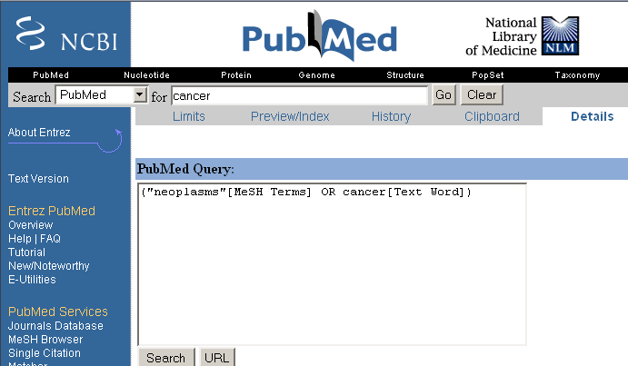
Controlled Vocabulary

Slide 32
Thesaurus-based Query Expansion
This doesn’t require user input
For each term, t, in a query, expand the query with synonyms and related words of t from the thesaurus
  feline → feline cat
May weight added terms less than original query terms.
Generally increases recall.
Widely used in many science/engineering fields
May significantly decrease precision, particularly with ambiguous terms.
  “interest rate” → “interest rate fascinate evaluate”
There is a high cost of manually producing a thesaurus
  And for updating it for scientific changes

Slide 33
Automatic Thesaurus Generation
Attempt to generate a thesaurus automatically by analyzing the collection of documents
Two main approaches
  Co-occurrence based (co-occurring words are more likely to be similar)
  Shallow analysis of grammatical relations
    Entities that are grown, cooked, eaten, and digested are more likely to be food items.
Co-occurrence based is more robust, grammatical relations are more accurate.

Slide 34
Co-occurrence Thesaurus
Simplest way to compute one is based on term-term similarities in C = AA^{T} where A is term-document matrix.
w_{i,j} = (normalized) weighted count (t_{i} , d_{j})
d_{j}
n
t_{i}
m

Slide 35
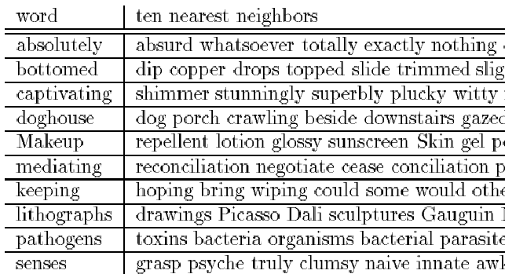
Automatic Thesaurus Generation
Example

Slide 36
Automatic Thesaurus Generation
Discussion
Quality of associations is usually a problem.
Term ambiguity may introduce irrelevant statistically correlated terms.
  “Apple computer” → “Apple red fruit computer”
Problems:
  False positives: Words deemed similar that are not
  False negatives: Words deemed dissimilar that are similar
Since terms are highly correlated anyway, expansion may not retrieve many additional documents.

Slide 37
Query Expansion: Summary
Query expansion is often effective in increasing recall.
  Not always with general thesauri
  Fairly successful for subject-specific collections
In most cases, precision is decreased, often significantly.
Overall, not as useful as relevance feedback; may be as good as pseudo-relevance feedback

Slide 38
Pseudo Relevance Feedback
Mostly works (perhaps better than global analysis!)
  Found to improve performance in TREC ad-hoc task
  Danger of query drift
pseudo relevance feedback is the relevance feedback without user intervention
Automatic local analysis
Pseudo relevance feedback attempts to automate the manual part of relevance feedback.

Slide 39
Retrieve an initial set of relevant documents.
Assume that top m ranked documents are relevant.
Do relevance feedback

Slide 40
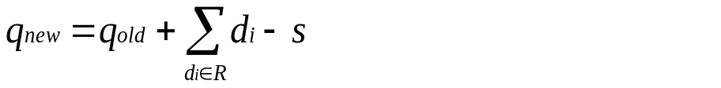
There are two well-known models for applying relevance feedback:
(i) Ide’s method [69]: This method adds all the terms of relevant documents of the set provided for relevance feedback and removes the terms of first irrelevant document in the set. Modified query vector is constructed as:
where q_{old} is the original query vector, qnew is the new query, di is the vector of relevant document R and s is the vector of the first irrelevant document in the feedback set.

Slide 41
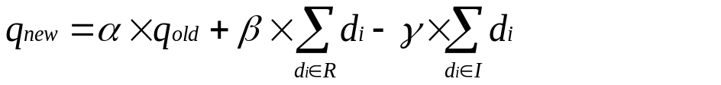
(ii) Rocchio’s method [127]: Rocchio’s method consists of moving the initial query vector toward the centroid of the relevant documents and away from the centroid of the non-relevant documents. It attempts to estimate “the optimal” user query through relevance feedback. This can be described by the following equation:
Where, d_{i} is relevant or irrelevant document obtained by manual or automatic feedback during initial retrieval, I is the set of irrelevant documents and α, β and γ are coefficients. These coefficients are set by trial and error method.
α =1, β=.75 and γ = .15

Slide 42
In pseudo-relevance feedback, the modified query vector is calculated by dropping the negative terms appearing in the Ide’s and Rocchio’s equation.
Notes:
In real relevance feedback, the user is asked to give relevance information and this information is used to revise the query. The requirement for explicit relevance judgments interferes with users’ information seeking behavior [75]. Users are often not willing to provide feedback information. Hence, this is often replaced with automatic relevance feedback termed as “pseudo relevance feedback” or “retrieval feedback” [134], where the few top ranked retrieved documents are assumed relevant without user intervention and then used to reformulate the query.

Slide 43
query drift
Query expansion following retrieval feedback may degrade the performance if the top ranked documents retrieved during initial run are not relevant.
Expanding query by adding terms from irrelevant documents, or adding terms from relevant documents that are not closely related to the query terms, will move the query representation away from what may be “optimal” query representation.
This results in alteration of focus of the query i.e. ‘query drift’.

Slide 44
Pseudo relevance feedback:
Cornell SMART at TREC 4
Results show number of relevant documents out of top 100 for 50 queries (so out of 5000)
Results contrast two length normalization schemes (L vs. l), and pseudo relevance feedback (PsRF) (done as adding 20 terms)
  lnc.ltc 3210
  lnc.ltc-PsRF 3634
  Lnu.ltu 3709
  Lnu.ltu-PsRF 4350

Slide 45
Indirect relevance feedback
On the web, DirectHit introduced a form of indirect relevance feedback.
DirectHit ranked documents higher that users look at more often.
  Clicked on links are assumed likely to be relevant
    Assuming the displayed summaries are good, etc.
Globally: Not user or query specific.
This is the general area of clickstream mining
Notes:
Link analysis is kind of similar too.

