Slide 1
Index Compression
Mansi A. Radke

Slide 2
Why do we need to compress the inverted index?
First advantage is obvious, we need less disk space. Compression ratios of 1:4 are easy to achieve, potentially cutting the cost of storing the index by 75%.
Second advantage is increased used of caching. Search systems use some part of the index (dictionary and posting lists) more than others. So, the posting lists of such terms if they are in the cache, the entire computation on the posting list can happen in the main memory. Instead of accessing the posting list via a disk seek operation, it can be accessed in cache and decompressed in main memory. Increased speed owing to caching is main motivation for compression.
Third advantage is faster transfer of data from disk to main memory. Transferring compressed data from disk to main memory and decompressing it takes less time as compared to transferring uncompressed data from disk to main memory as decompression algorithms run fast on modern hardware.

Slide 3
Statistical properties of terms in IR
Here we consider posting lists consisting of docIDs and we are not considering positional posting lists.
Observe the following table on the next slide:
Delta indicates the decrease in percentage from previous row.
T indicates total decrease in percentage from the first row.
Rule of 30: The rule of 30 states that the most common 30 words account for the 30% of the tokens in the written text!

Slide 4
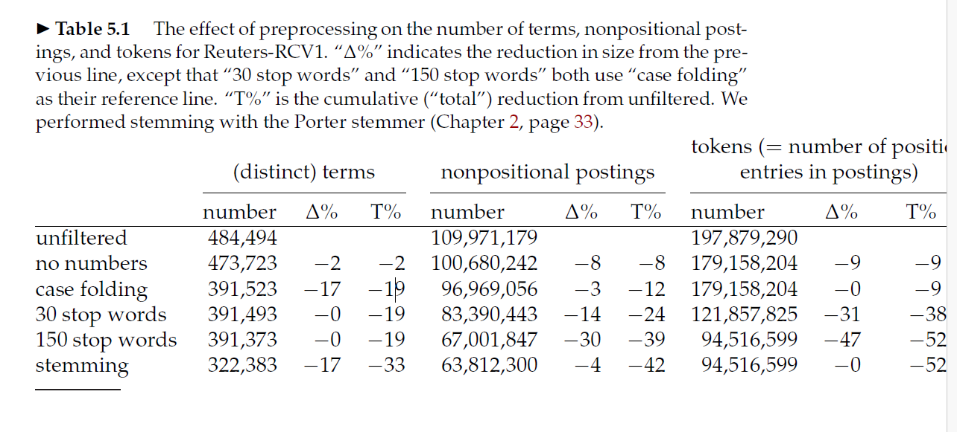

Slide 5
Observations from the table:

Slide 6
Lossless and lossy compression
The compression techniques we describe in the remainder of this chapter are lossless, that is, all information is preserved.
Better compression ratios can be achieved with lossy compression, which discards some information.
Case folding, stemming, and stop word elimination are forms of lossy compression.

Slide 7

Heap’s law: Estimating the number of terms
Estimates the vocabulary size as a function of the collection size
M indicates the number of distinct terms in the collection
T is number of tokens in the collection
30 <= k <= 100
b approximately 0.5
Note: Oxford English Dictionary (OED) has more than 600,000 words. The vocabulary of most large collections is larger than this as it includes names of people, places and organization, products, scientific keyword or entities etc.

Slide 8
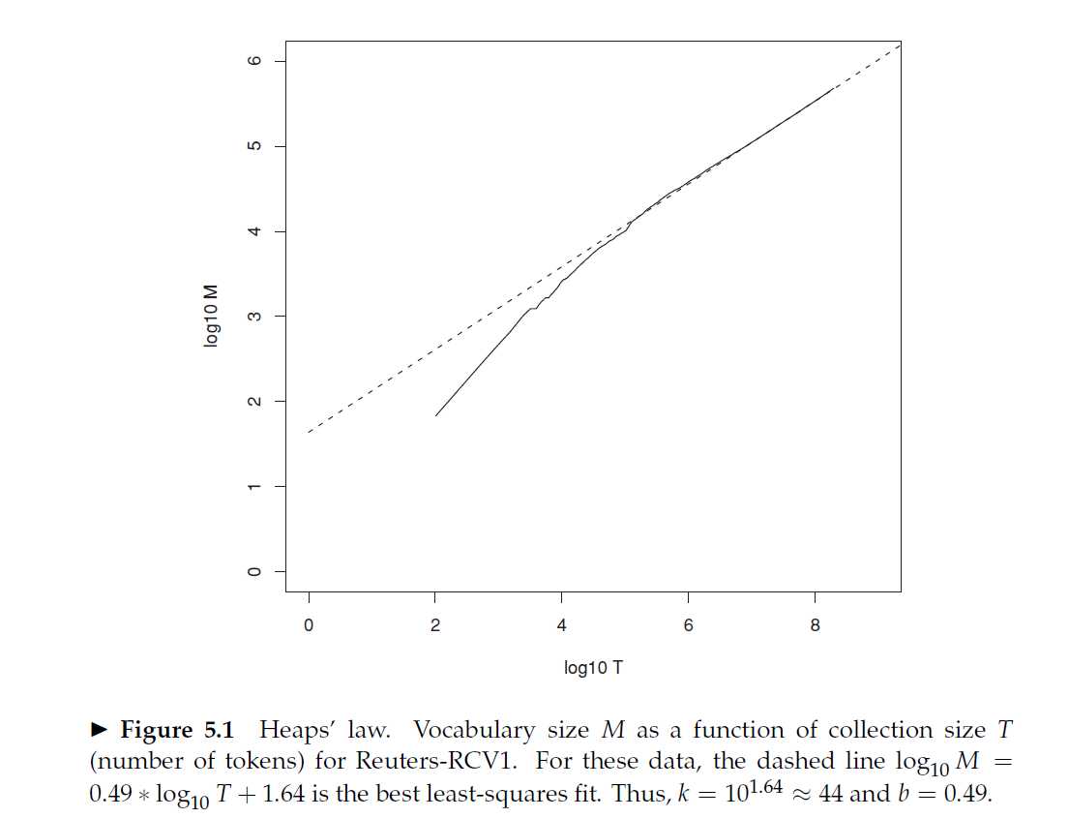
Heaps Law

Slide 9
Heaps’ law suggests that: (i) the dictionary size continues to increase with more documents in the collection, rather than a maximum vocabulary size being reached, and (ii) the size of the dictionary is quite large for large collections.
The motivation for Heaps’ law is that the simplest possible relationship between collection size and vocabulary size is linear in log–log space and the assumption of linearity is usually born out in practice as shown in Figure 5.1 for Reuters-RCV1.
In this case, the fit is excellent for T > 10⁵ = 100,000, for the parameter values
b = 0.49 and k = 44.
For example, for the first 1,000,020 tokens Heaps’ law predicts 38,323 terms:
44×1,000,0200.49 ≈ 38,323.
The actual number is 38,365 terms, very close to the prediction.
The parameter k is quite variable because vocabulary growth depends a lot on the nature of the collection and how it is processed. Case-folding and stemming reduce the growth rate of the vocabulary, whereas including numbers and spelling errors increase it.

Slide 10

Zipf’s Law: Modeling the distribution of terms Intuition: Frequency decreases very rapidly with rank
Zipf’s law states that, if t₁ is the most common term in the collection, t₂ is the next most common, and so on, then the collection frequency cfi of the i^{th} most common term is proportional to 1/i
Most frequent term occurs cf₁ times,
Second most frequent term has half as many occurrences
Third most frequent term has one third as many occurrences
And so on.

Slide 11


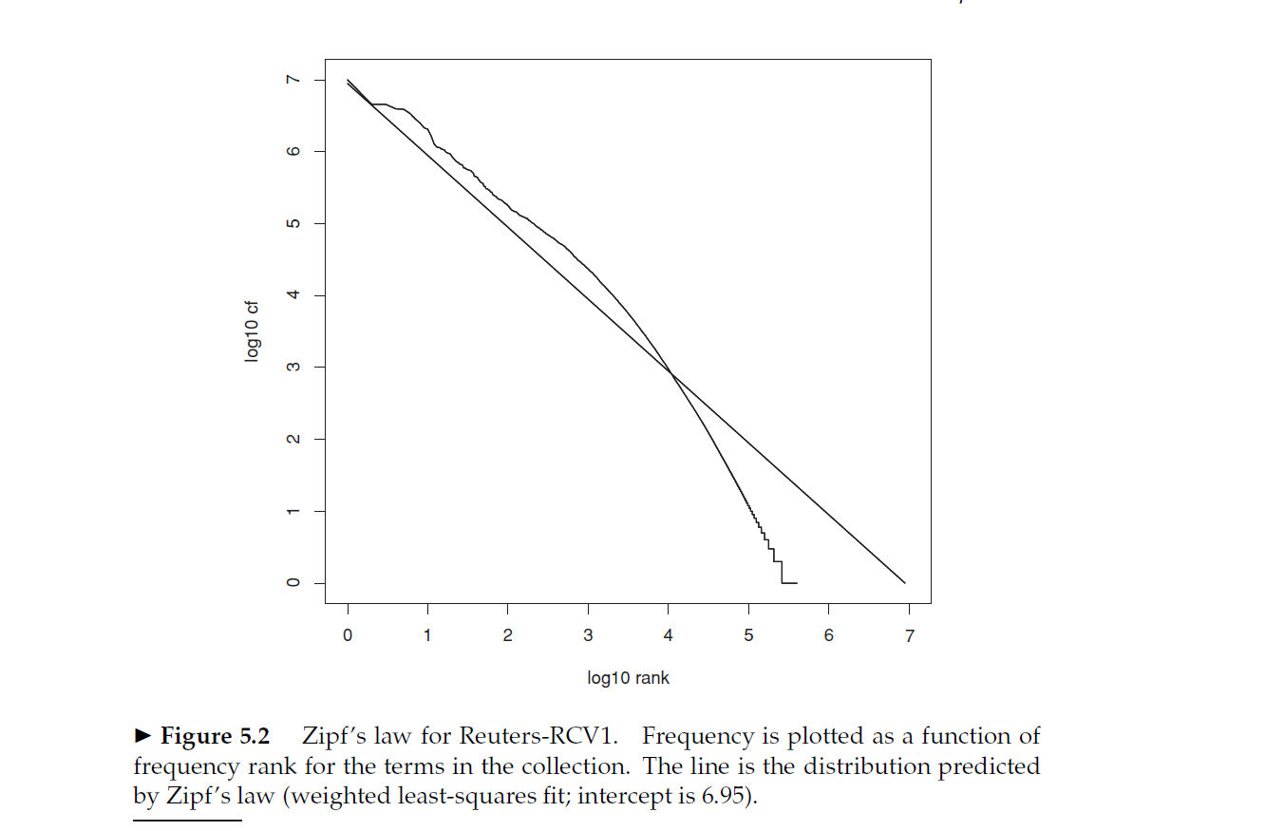
It is therefore a power law with exponent k = −1.

Slide 12
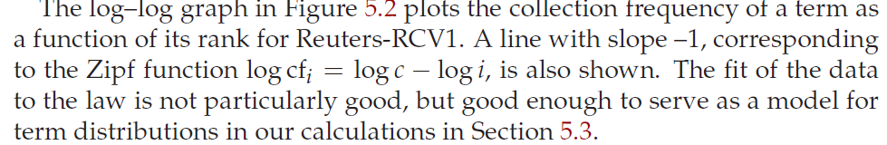

Slide 13
Compression of an inverted index
Dictionary compression
Postings compression

Slide 14
Dictionary Compression
Dictionary is very small compared to the postings list.
So why compress it if it is a small part of the inverted index?
Firstly to keep/fit the dictionary in main memory at least major part of it. This is to reduce latency and increase query throughput
Secondly we need to design search systems for limited hardware such as mobile phones and onboard computers
Thirdly, having to share resources with other applications like for e.g. your search system on your PC should get along with memory hogging word processing suite that you are using at the same time.

Slide 15
Two methods for dictionary compression: 1. Dictionary as a string 2. Blocked storage
Method 1 for dictionary:
Sort the vocabulary lexicographically
Store it in an array of fixed width entries
20 bytes for each term
4 bytes for document frequency
4 bytes for pointer to its posting list
A four byte pointer resolves a 4 GB address space
For large collections like the web, we need more bytes per pointer
We look up terms in the array by binary search
For RCV1, we need M * (20+4+4) = 400,000*28 = 11.2 MB

Slide 16
Method 2 for dictionary: as a string:
Average length of a term in English is 8
So, using fixed width entries of size 20 is clearly wasteful
We are wasting 12 bytes per term
Also terms like
Hydrochloroflurocarbons – no way to store these
Store the dictionary as a long string of characters
The pointer to the next term is also used to demarcate the end of current term
Saves 60% as compared to the previous scheme
12 bytes on an average for each term is saved.
Term pointers resolve 400000*8 = 3.2 * 10⁶ positions
So, they need to log 3.2 * 10⁶ == 22 bits approximately i.e. 3 bytes long
400000*(4+4+3+8) = 7.6 MB
4 bytes for frequency
4 bytes for postings pointer
3 bytes for the term pointer
8 bytes for the term

Slide 17
Method 3: Blocked storage
Group the terms into blocks of k size
Keep the term pointer only to the first term of each block
Store the length of the term as an additional byte at the beginning of the term
We eliminate k-1 term pointers
But need k additional bytes for storing the length of each term
For k = 4, we save (k-1)* 3= 9 bytes of term pointers
But need k = 4 bytes for term lengths
So total requirement is reduced by 5 bytes per 4 term block
So total saving for RCV1 = 400,000 * ¼ * 5 = 0.5 MB
So total requirement = 7.6 – 0.5 = 7.1 MB
By increasing the block size k, we get better compression, however there is a tradeoff between compression and the speed of lookup

Slide 18
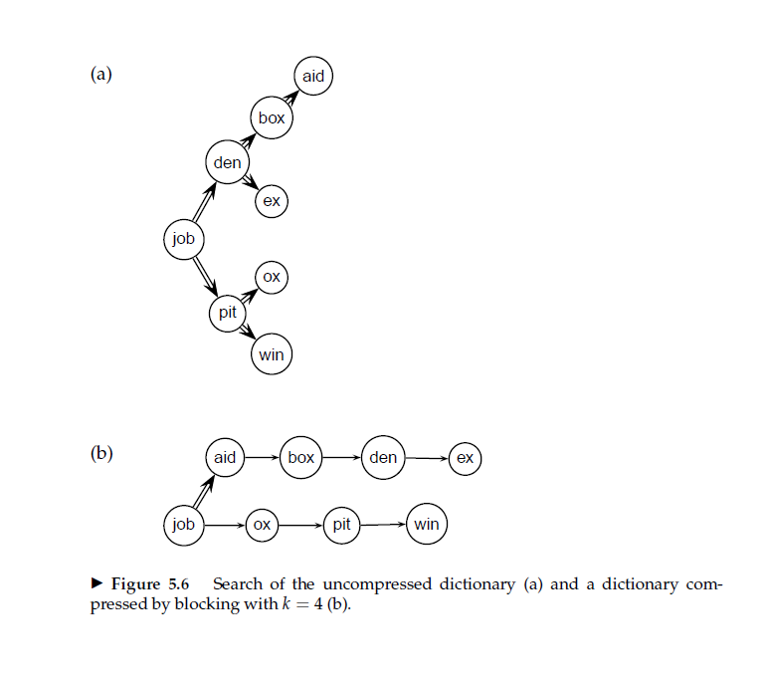
Searching in compressed and uncompressed dictionary in blocked storage (Uncompressed dictionary search is binary search. In compressed dictionary first binary search then linear search in the block
Searching the uncompressed dictionary
in (a) takes on average (0 +1 + 2+ 3+ 2 +1 +2 + 2)/8 ≈ 1.6 steps,
assuming each term is equally likely to come up in a query. For example,
finding the two terms, aid and box, takes three and two steps, respectively.
With blocks of size k = 4 in (b),we need (0+1+2+3+4+1+2+3)/8 = 2
steps on average, ≈ 25% more. For example, finding den takes one binary
search step and two steps through the block. By increasing k, we can get
the size of the compressed dictionary arbitrarily close to the minimum of
400,000 × (4 + 4 + 1 + 8) = 6.8 MB, but term lookup becomes prohibitively
slow for large values of k.

Slide 19
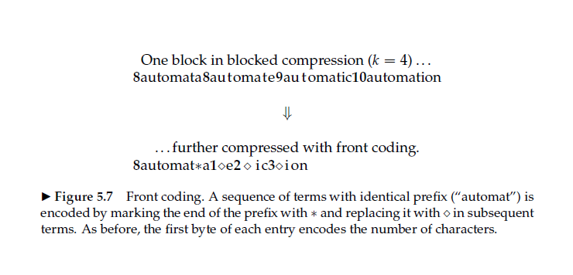
Front coding
As the terms of the dictionary are sorted lexicographically or in alphabetic order, there is lot of redundancy in the dictionary as consecutive entries have common prefixes. E.g. automata, automate, automatic, automation have a common prefix that is “automat”.

Slide 20
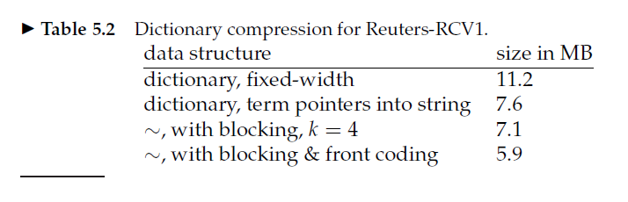
Summary of dictionary compression

