Slide 1
Index Compression (Postings compression)
Mansi A. Radke

Slide 2
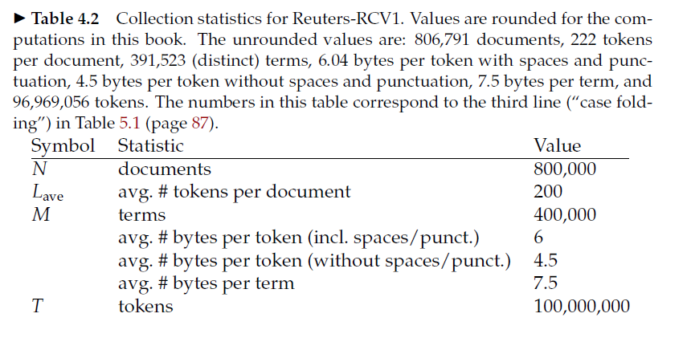
Postings file compression Reuters RCV1 Corpus statistics:

Slide 3
In summary Reuters-RCV1
800,000 documents
200 tokens per document
6 characters per token
100,000,000 postings
Posting is defined as docID (excluding frequency and positions)
800,000 documents, so Document identifiers are log₂ 800,000 = 20 bits
Size of the collection is 800,000 * 200*6 = 960 MB
Size of the uncompressed postings file is 100,000,000 * 20 /8 = 250 MB

Slide 4
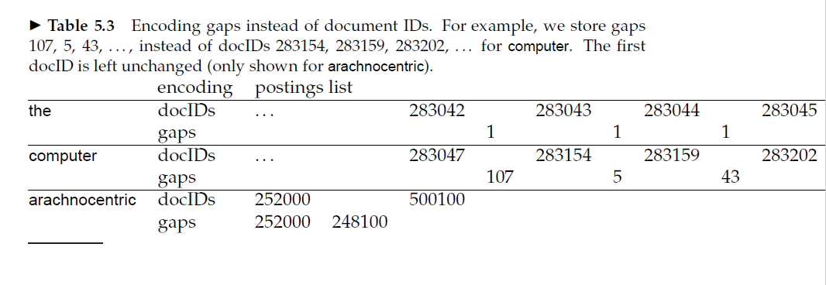
Observation about postings file
Encoding gaps instead of docIDs – gaps are smaller than docIDs. For stop words gaps are mostly equal to 1.

Slide 5
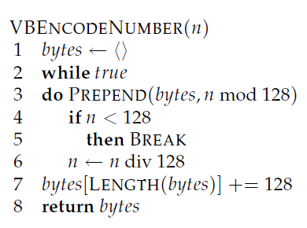
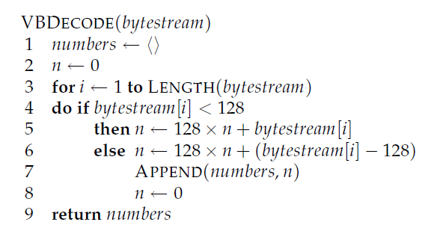
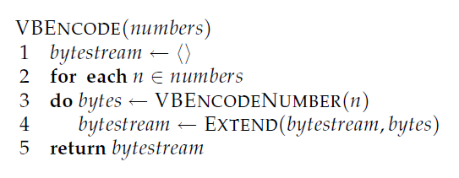
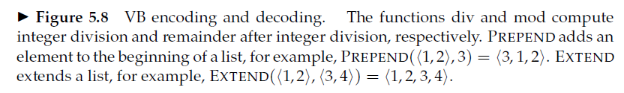
Solve:
824
5
214577
511
1025

Slide 6
Solve for the following:
824
5
214577
511
1025

Slide 7
Unary code – n 1s followed by a 0
5 111110
10 11111111110
3 1110

Slide 8
Gamma codes
γ codes implement variable-length encoding by splitting the representation of a gap G into a pair of length and offset. Offset is G in binary, but with the leading 1 removed.
For example, for 13 (binary 1101) offset is 101. Length encodes the length of offset in unary code.
For 13, the length of offset is 3 bits, which is 1110 in unary. The γ code of 13 is therefore 1110101, the concatenation of length 1110 and offset 101.

Slide 9
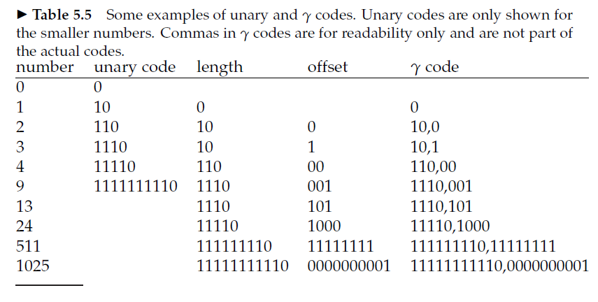

Slide 10
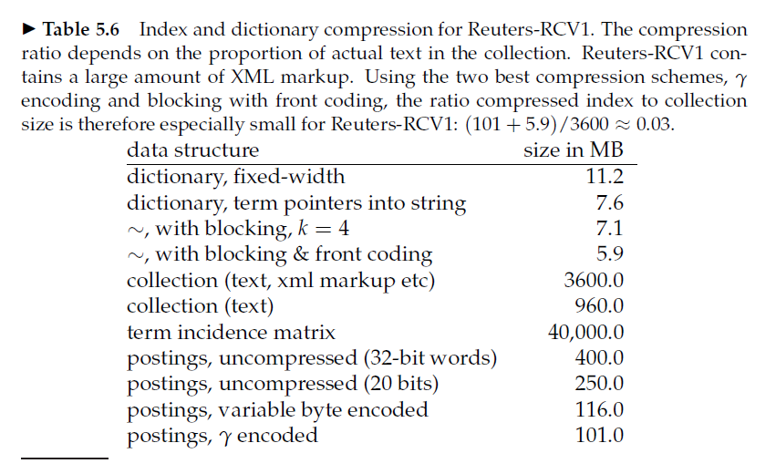

Slide 11
Some facts about Gamma code
Gamma codes are always of odd length
They are optimal (with a factor of 2)

Slide 12
Delta codes
Similar to gamma, length is also in gamma form
For example, the δ code of 7 is 10,0,11 (again, we add commas for readability).
10,0 is the γ code for length (2 in this case) and the
encoding of offset (11) is unchanged.

Slide 13
In summary advantages of index compression
One benefit of compression is immediately clear. We need less disk space. As we will see, compression ratios of 1:4 are easy to achieve, potentially cutting the cost of storing the index by 75%
Increased use of caching
Faster transfer of data from disk to memory. Efficient decompression algorithms run so fast on modern hardware that the total time of transferring a compressed chunk of data from disk and then decompressing it is usually less than transferring the same chunk of data in uncompressed form

Slide 14
Homework
Revise Huffman Coding
How is it used in IR?
Who is fond of probability statistics?
Assignment 3 (Deadline 20th September)
Explore this project, replicate it and run it on a different text corpus.
https://github.com/Panjete/iidsearch

