Slide 1
Vector Space Model
Mansi A. Radke

Slide 2
Ranking is essential. Why?
Boolean model output could be too large to enable user to sift through (In this a document is either relevant or not relevant. There is no ranking as such.)
This implies that every document returned by the query must have a score associated with it.
Score is assigned to a (query, document) pair
Notes:
So far we saw the Boolean model and all documents returned are at the same rank. A document is either relevant or not relevant. However, sometimes the output might be quite large not making it possible for the user to sift through. Therefore rank-ordering the documents is essential.

Slide 3
We will study three main things in this chapter
Indexing and retrieving documents by metadata using parametric and zone indexes
We understand the weighting of the importance of a term in a document, based on the statistics of occurrence of the term.
Viewing the document as a vector of such weights i.e. the concept of vector space scoring.
Finally we see the variants of the term weighing for vector space scoring.

Slide 4
Retrieving documents through meta data
Documents in machine recognizable form have some meta data associated with them (e.g. language in which the document is written, author of the document, its title or some date associated with it etc)
Search engine could support querying ranges on such ordered data by using a structure such as B tree to store the dictionary of that particular field

Slide 5
Zones
Similar to fields except that the contents of a zone can be free text
A field takes a relatively small set of values
A zone can be thought of as unbounded amount of text
For e.g. document title and abstracts are treated as zones and a separate inverted index could be built for each zone of the document

Slide 6
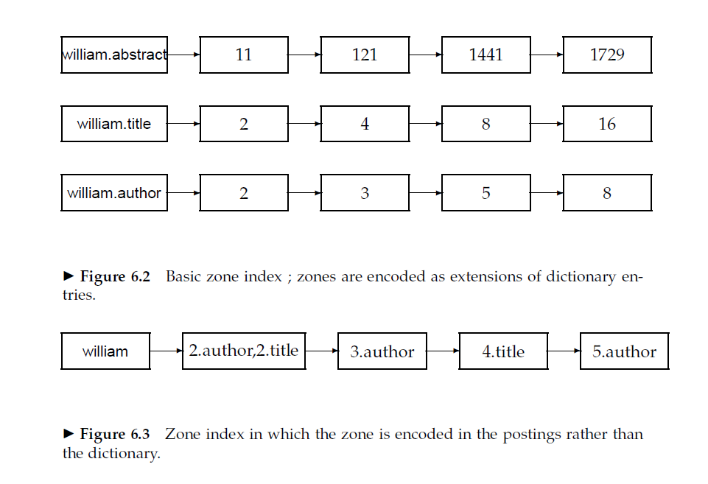
Find documents with merchant in the title, William in the author list and rain in the body!
Option 1
Option 2

Slide 7
First one explodes the size of the dictionary
When that’s a concern, we use the second option

Slide 8
Weighted Zone scoring
Each zone contributes a Boolean score
Linear combination of zone scores is calculated
A query document pair (q,d) gets a score in the interval [0,1]
Weighted zone scoring is sometimes referred to as ranked Boolean retrieval

Slide 9
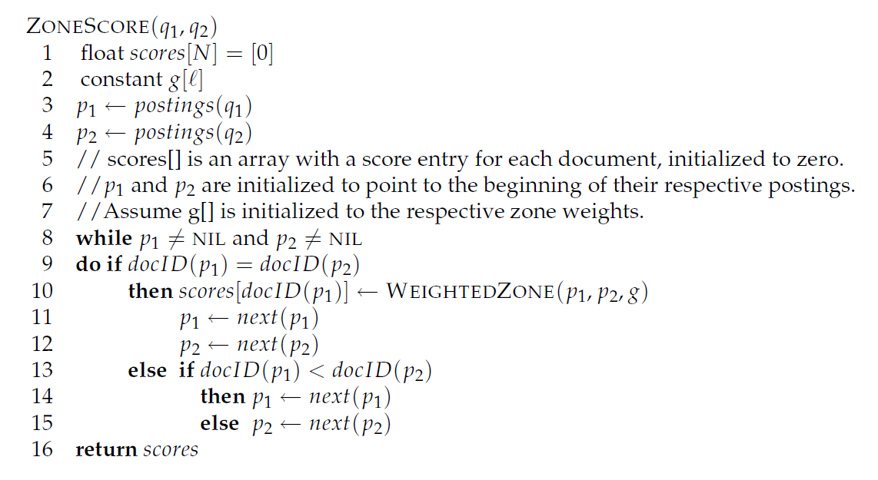
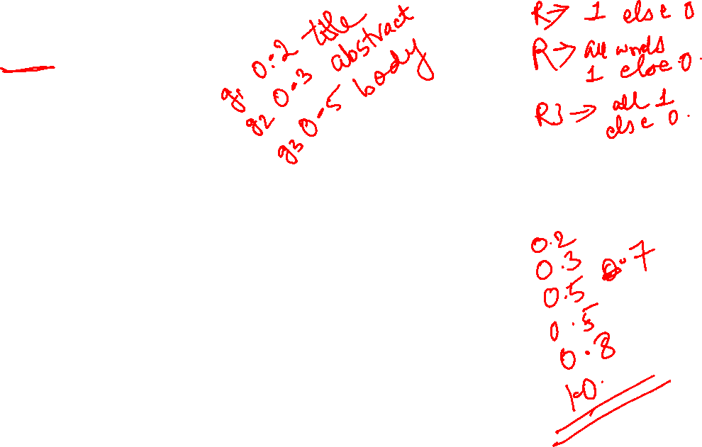
Example of weighted zone scoring

Slide 10
Weights g_{i}? How to decide those
Either mentioned by an expert
Or learned from training samples – Machine learned relevance

Slide 11

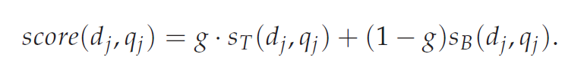
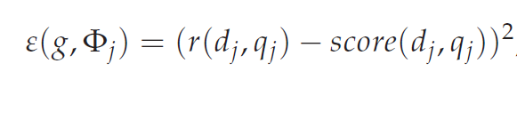
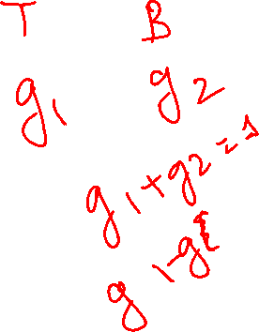
Only two zones in the documents- title and body
Error function

Slide 12
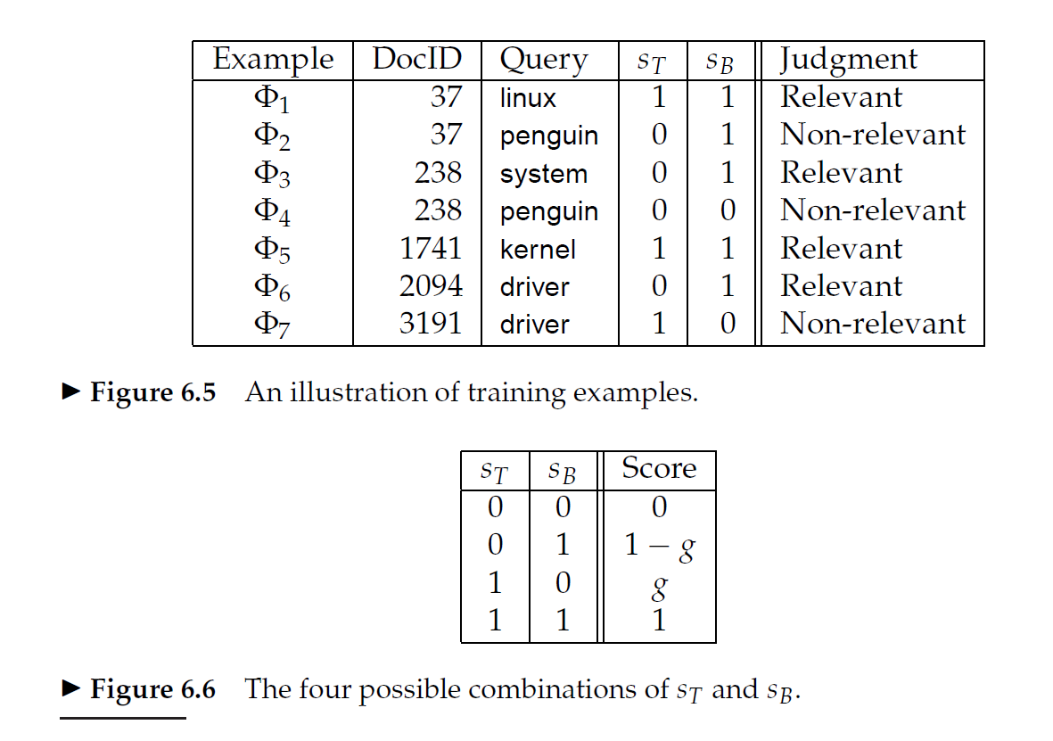
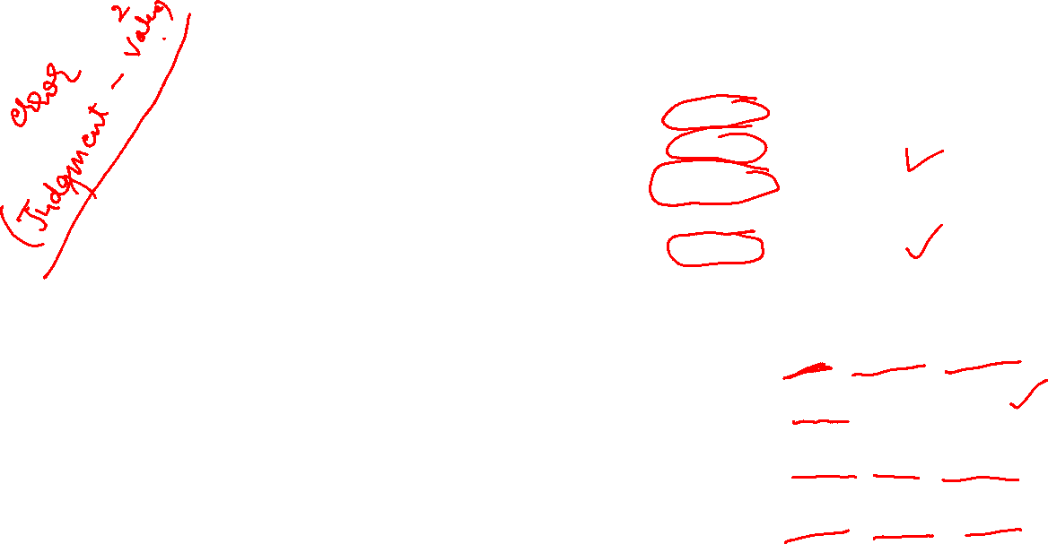
n₀₀ = 1 n_{00r} = 0 n_{00n} = 1
n₀₁ = 3 n_{01r} = 2 n_{01n} = 1
n₁₀ = 1 n_{10r} = 0 n_{10n} = 1
n₁₁ = 2 n_{11r} = 2 n_{11n} = 0

Slide 13

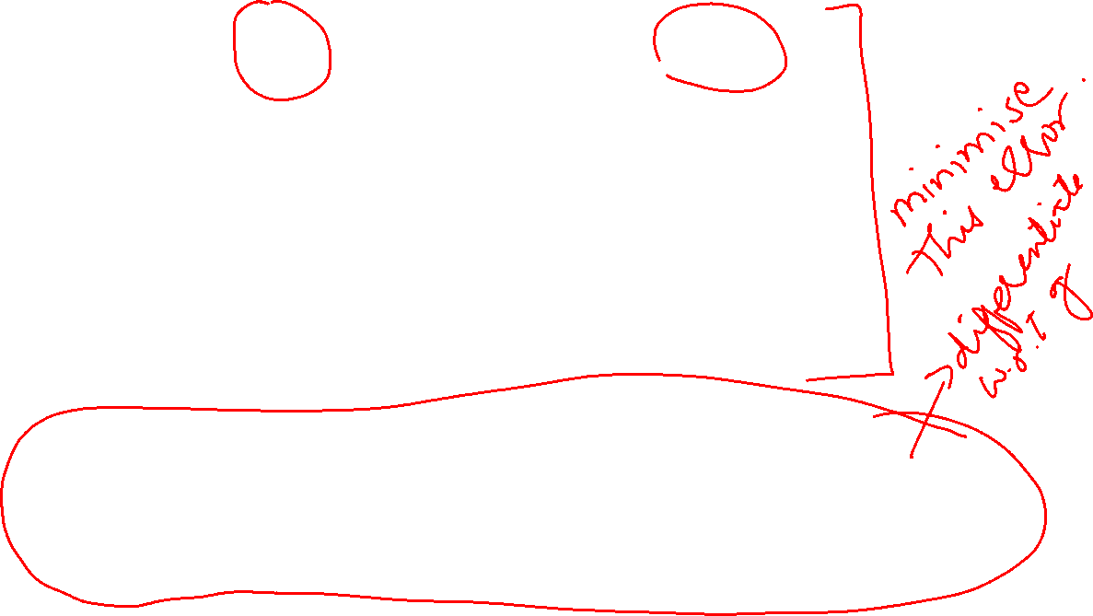







Slide 14





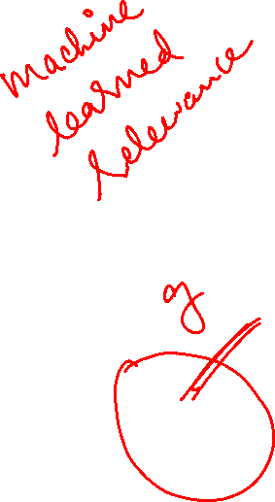








Slide 15
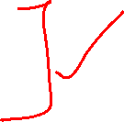
When using weighted zone scoring, is it essential that all the zones use the same Boolean match function?
NO
Title could be – 50 % of query terms appear – value 1 else 0
Body could be – all of the query terms appear – value 1 else 0

Slide 16
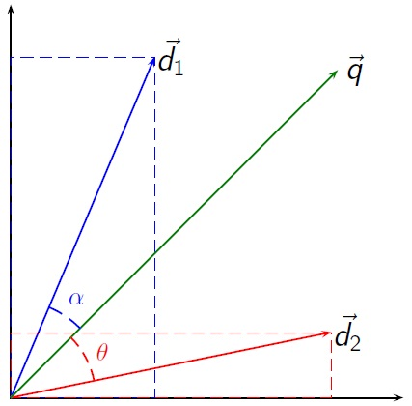

Vector Space Model – Basic concept
Basic Concept:
Every term is a dimension
Query as a vector
Document as a vector
Cosine similarity Measure
Angle between query and document
cos is an monotonically decreasing function
Greater the angle, smaller the cos value and lesser the similarity

Slide 17

Solve the following question….
Consider a very small collection C that consists of the following 3 documents:
D1: red green rainbow
D2: red green blue
D3: yellow rainbow
For all the documents, calculate the tf scores for all the documents in C. Ignore idf now for simplicity. Assume that the words in the vectors are ordered alphabetically. The normalization by maximum frequency is not needed because the maximum frequency is 1 here.
Given the following query, “blue green rainbow”, calculate the tf vector for the query and cosine similarity score of each document in C with respect to the query. (Do not forget to compute the lengths of the vectors). What is the final order in which the documents are presented as a result to the query?

Slide 18




























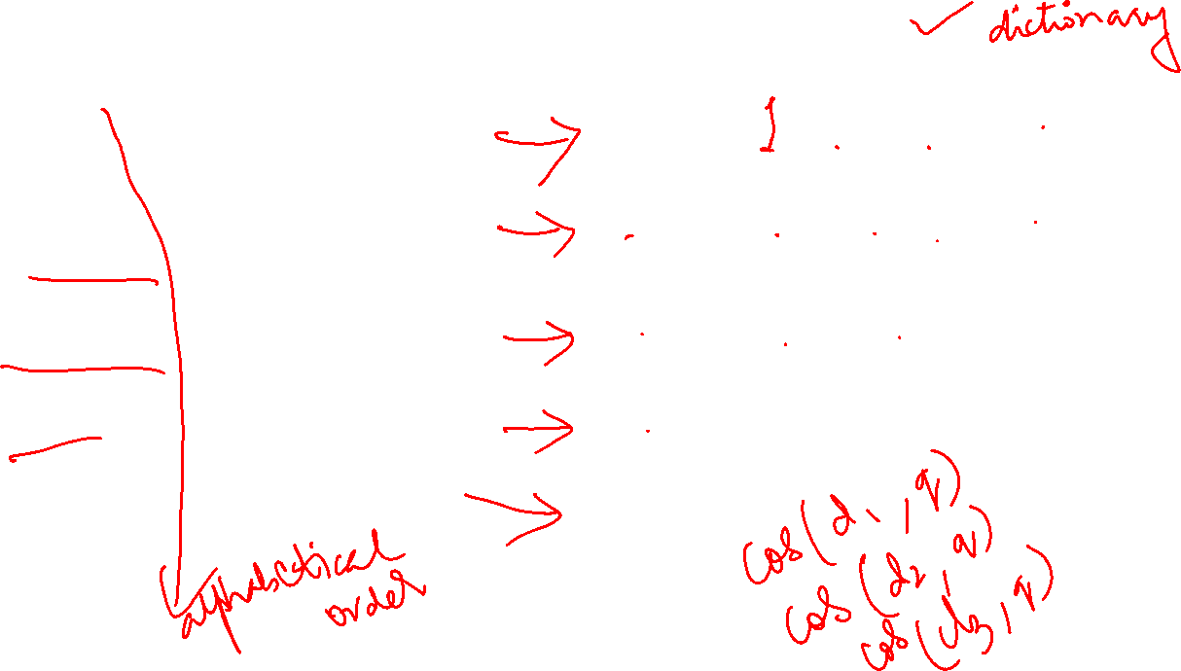




Slide 19













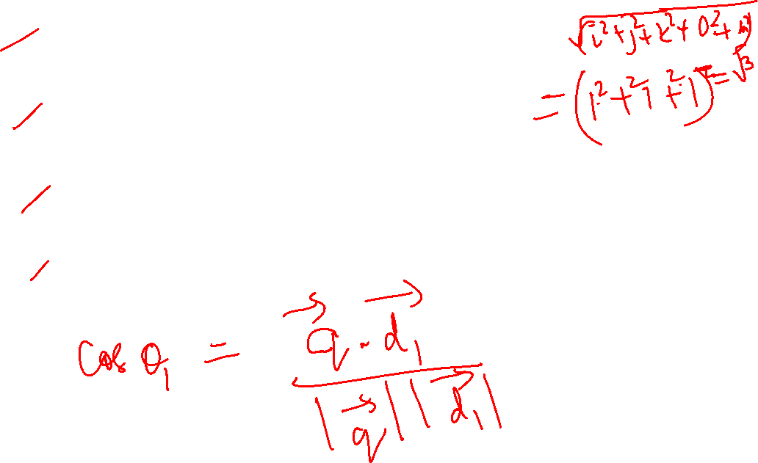



Slide 20






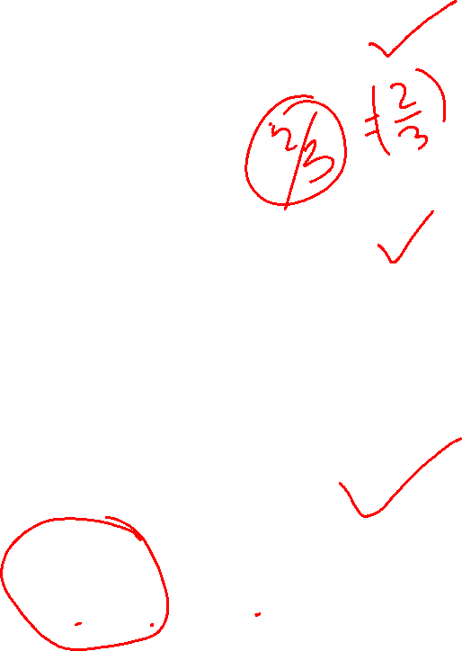
















Slide 21
Answer:
d1 or d2 in any order (Same rank)
d3

Slide 22

Solve the following question……
Consider a very small collection C that consists of the following 4 documents.
D1: cute puppy
D2: big puppy
D3: cute white kitten
D4: white kitten
For all the documents, calculate the tf scores for all the documents in C. Ignore idf now for simplicity. Assume that the words in the vectors are ordered alphabetically. The normalization by maximum frequency is not needed because the maximum frequency is 1 here.
Given the following query, “big white puppy”, calculate the tf vector for the query and cosine similarity score of each document in C with respect to the query. (Do not forget to compute the lengths of the vectors). What is the final order in which the documents are presented as a result to the query?

Slide 23
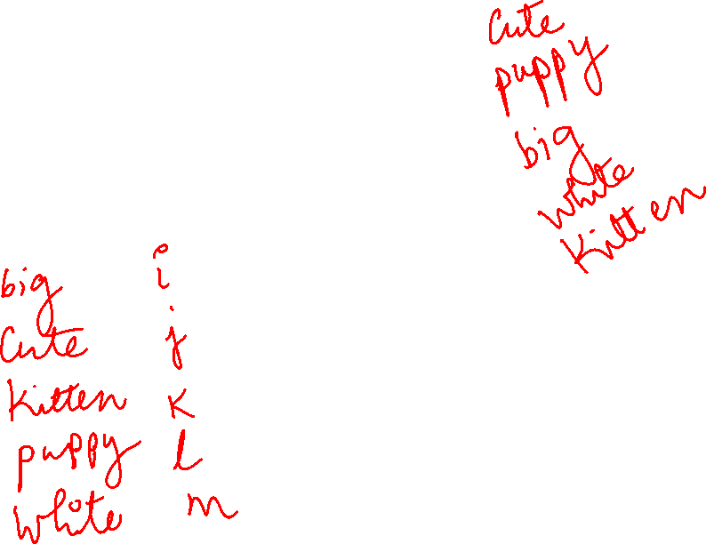
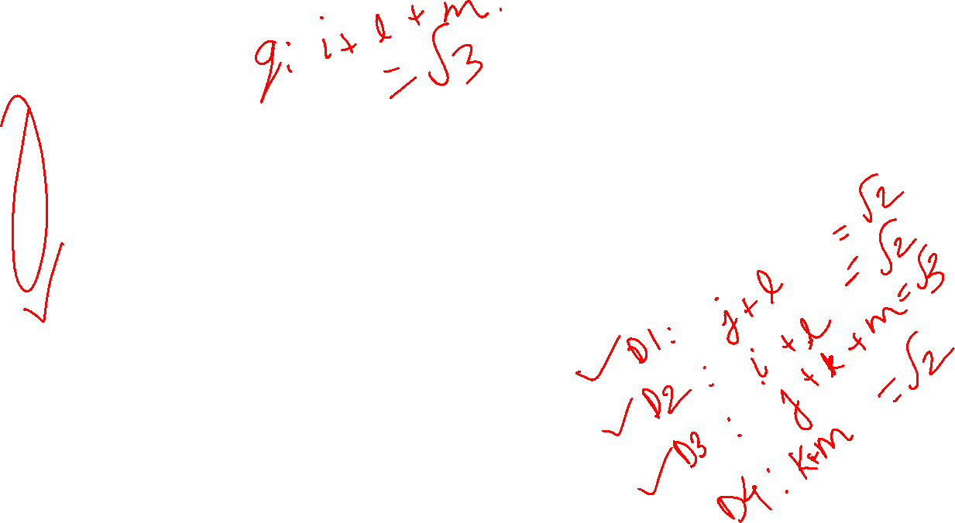
Answer:
d2
d1 and d4 in any order (same rank)
d3

Slide 24
Vector Space Model (Continued)
From textbook: “Introduction to Information Retrieval”
Authors: Christopher Manning, Prabhakar Raghavan and Hinrich Schutze

Slide 30
Bag of words model
John is quicker than Mary
Mary is quicker than John
Both are same with respect to Bag of words
The number of times a term appears matters but not the ordering or positions

Slide 31
Overlap Score Measure
$\sum_{t\text{∈} \text{q}}{tf∗idft,d}$

Slide 32
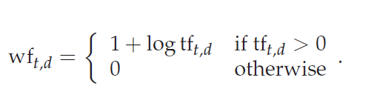

Term appears 20 times? Should it carry 20 times weightage as opposed to when it occurs only once?
For assigning a weight for each term in each document, a number of alternatives to tf and tf-idf have been considered.

Slide 33

Normalized term frequency (a is between 0 and 1 usually 0.4)
Tf_{max}(d) is the frequency of the term which occurs maximum number of times.

Slide 34
supposed we were to take a document d and create a new document d′ by simply appending a copy of d to itself. While d′ should be no more relevant to any query than d is, the use of previous equation would assign it twice as high a score as d.
Replacing tf-idf_{t,d} by ntf-idf_{t,d} eliminates the anomaly in the above case
Maximum tf normalization does suffer from the following issues:
1. The method is unstable in the following sense: a change in the stop word list can dramatically alter term weightings (and therefore ranking). Thus, it is hard to tune.
2. A document may contain an outlier term with an unusually large number of occurrences of that term, not representative of the content of that document.
3. More generally, a document in which the most frequent term appears roughly as often as many other terms should be treated differently from one with a more skewed distribution.

Slide 35
Thank you !
Any Questions??

