Slide 1
Evaluation in IR
Mansi A. Radke

Slide 2
3 key things !
To measure ad hoc information retrieval effectiveness in the standard way, we need a test collection consisting of three things:
1. A document collection
2. A test suite of information needs, expressible as queries
3. A set of relevance judgments, standardly a binary assessment of either relevant or nonrelevant for each query-document pair.

Slide 3
Gold standard / Ground truth
With respect to a user information need, a document in the test collection is given a binary classification as either relevant or nonrelevant. This decision is referred to as the gold standard or ground truth judgment of relevance. This is done by a domain expert manually.
This process is called as Annotation
Who does it? Domain expert – for NLP?
Gold labour indicates the people who do this annotation

Slide 4
How many queries?
As a rule of thumb, 50 information needs has usually been found to be a sufficient minimum.
(Whatever be the size of the corpus )

Slide 5
Relevance is assessed relative to an information need, not a query
A document is relevant if it addresses the stated information need, not because it just happens to contain all the words in the query. This distinction is often misunderstood in practice, because the information need is not overt

Slide 6
Development test collection
Many systems contain various weights (often known as parameters/hyperparameters/system parameters) that can be adjusted to tune system performance.
It is wrong to report results on a test collection which were obtained by tuning these parameters to maximize performance on that collection. That is because such tuning overstates the expected performance of the system, because the weights will be set to maximize performance on one particular set of queries rather than for a random sample of queries. (Kind of overfitting)
In such cases, the correct procedure is to have one or more development test collections, and to tune the parameters on the development test collection.
The tester then runs the system with those weights on the test collection and reports the results on the test collection collection as an unbiased estimate of performance.

Slide 7
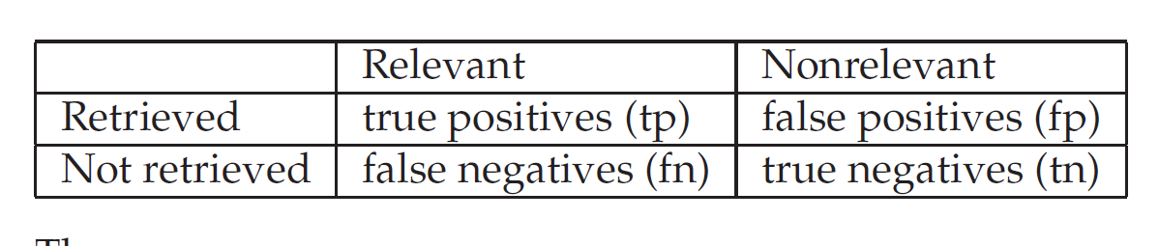
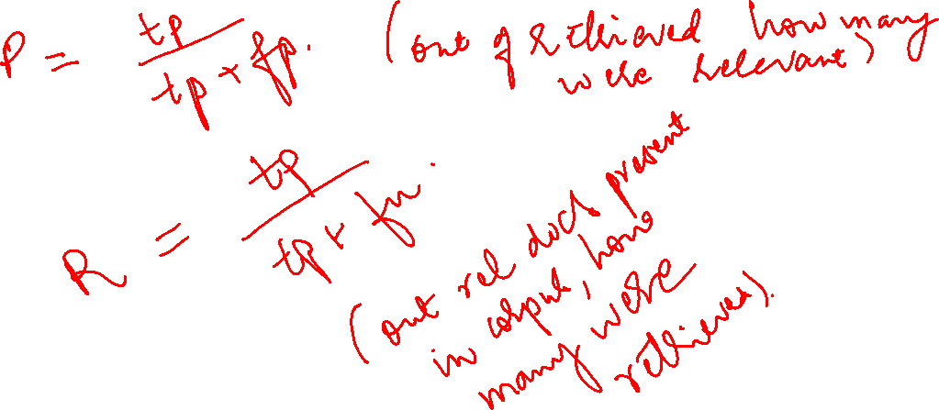

Slide 8
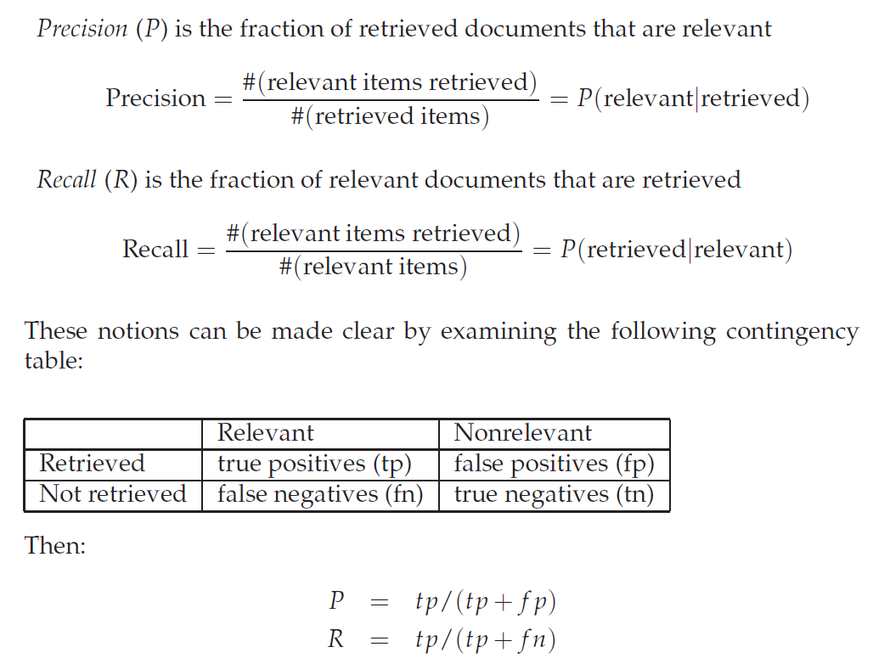
Evaluation in unranked retrieval

Slide 9
Suppose a computer program for recognizing dogs in photographs identifies 8 dogs in a picture containing 12 dogs and some cats. Of the 8 identified as dogs, 5 actually are dogs, while the rest are cats.
The program's precision is 5/8
while its recall is 5/12.

Slide 10
When a search engine returns 30 pages only 20 of which were relevant while failing to return 40 additional relevant pages.
Its precision is 20/30 = 2/3
while its recall is 20/60 = 1/3.

Slide 11
Interpretation of precision and recall!
Precision is "how useful the search results are", and recall is "how complete the results are".

Slide 12
Accuracy
An obvious alternative that may occur to the reader is to judge an information retrieval system by its accuracy, that is, the fraction of its classifications that are correct.
Accuracy = (tp + tn)/(tp + f p + f n + tn).
Correctly classified documents/total number of documents

Slide 13
Why accuracy is not a good measure?
In almost all circumstances, the data is extremely skewed: normally over 99.9% of the documents are in the nonrelevant category.
Query : VNIT, Nagpur on the web
A system tuned to maximize accuracy can appear to perform well by simply deeming all documents nonrelevant to all queries.
Even if the system is quite good, trying to label some documents as relevant will almost always lead to a high rate of false positives. However, labeling all documents as nonrelevant is completely unsatisfying to an information retrieval system user.

Slide 14
Why precision and recall both?
Typical web surfers would like every result on the first page to be relevant (high precision) but have not the slightest interest in knowing let alone looking at every document that is relevant.
In contrast, various professional searchers such as paralegals and intelligence analysts are very concerned with trying to get as high recall as possible, and will tolerate fairly low precision results in order to get it.
Individuals searching their hard disks are also often interested in high recall searches.

Slide 15
Arithmetic, geometric and harmonic mean
Arithmetic mean of 2 and 18 is 10
What is the Geometric Mean of 2 and 18?
First we multiply them: 2 × 18 = 36. Then (as there are two numbers) take the square root: √36 = 6
Harmonic mean of 2 and 18 is
½ + 1/18
= 10/18
As there are 2 numbers we divide by 2
10/(18*2)
Then take reciprocal = reciprocal of 10/36 = 36/10 = 3.6

Slide 16
Precision and recall trade off
If you increase precision, recall tends to drop
If you increase recall, precision tends to drop

Slide 17
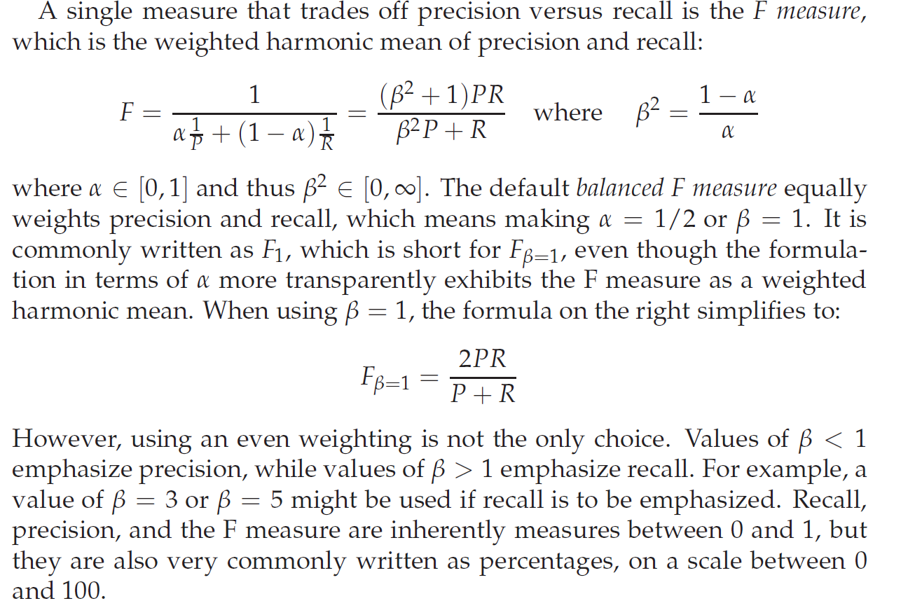
F1 measure

Slide 18
Values of Beta
<1 precision emphasized
>1 recall emphasized
=1 equal priority

Slide 19
Why harmonic mean?
we can always get 100% recall by just returning all documents, and therefore we can always get a 50% arithmetic mean by the same process. This strongly suggests that the arithmetic mean is an unsuitable measure to use.
In contrast, if we assume that 1 document in 10,000 is relevant to the query, the harmonic mean score of this strategy is 0.02%.
The harmonic mean is always less than or equal to the arithmetic mean and the geometric mean.
When the values of two numbers differ greatly, the harmonic mean is closer to their minimum than to their arithmetic mean

Slide 20
Evaluation of ranked retrieval
Mansi A. Radke

Slide 21
Precision, recall and F1 are set-based measures.
They are computed using unordered set of documents.
Now, for ranked retrieval, we need to extend these measures or come up with new measures

Slide 22
Evaluation of ranked retrieval
In a ranked retrieval context, appropriate sets of retrieved documents are naturally given by the top k retrieved documents. For each such set, precision and recall values can be plotted to give a precision-recall curve, such as the one shown in next slide
Precision-recall curves have a distinctive saw-tooth shape: if the (k + 1)th document retrieved is nonrelevant then recall is the same as for the top k documents, but precision has dropped. If it is relevant, then both precision and recall increase, and the curve jags up and to the right.

Slide 23
Precision recall curve

Slide 24

It is often useful to remove these jiggles and the standard way to do this is with an interpolated precision: the interpolated precision pinterp at a certain recall level r is defined as the highest precision found for any recall level r′ ≥ r
The justification is that almost anyone would be prepared to look at a few more documents if it would increase the percentage of the viewed set that were relevant (i.e. if the precision with the larger set if higher)

Slide 25
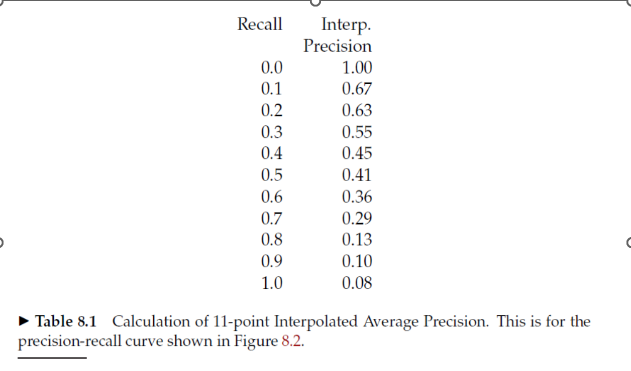
Interpolated precision

Slide 26
11 point interpolated average precision
The entire precision-recall curve is very informative, but there is often a desire to boil this information down to a few numbers, or perhaps a single number. So, came up the - eleven point interpolated average precision.
For each information need, the interpolated precision is measured at the 11 recall levels of 0.0, 0.1, 0.2, . . . , 1.0. For the precision-recall curve. For each recall level, we then calculate the arithmetic mean of the interpolated precision at that recall level for each information need in the test collection

Slide 27
For each recall level, we then calculate the arithmetic mean of the interpolated precision at the recall level for each information need in the test collection.
A composite precision recall curve can then be graphed as shown on the next slide.

Slide 28
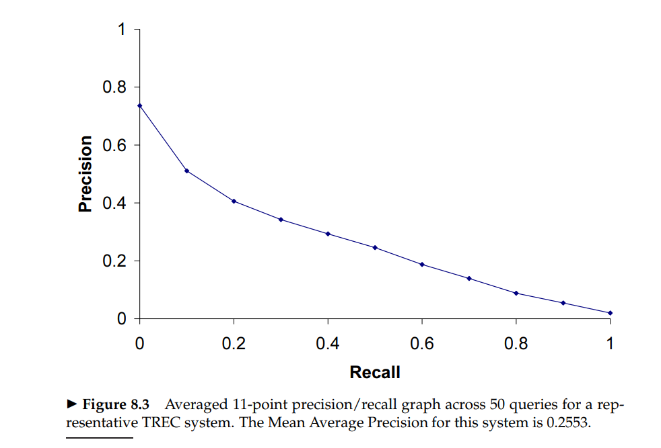

Slide 29
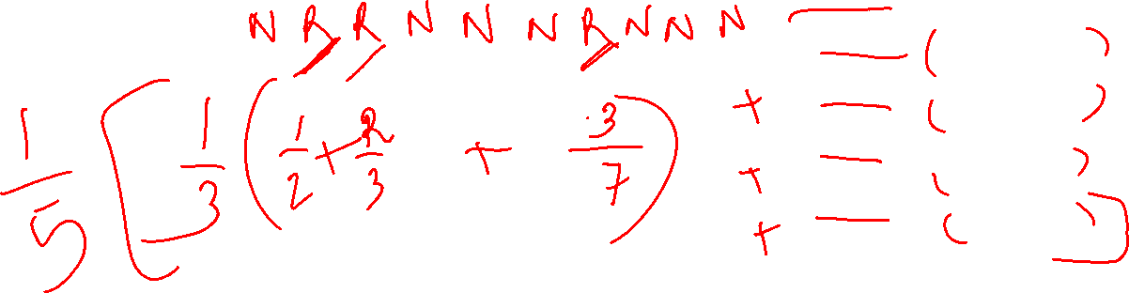
Mean Average precision (MAP)
In recent years other measures came up like MAP which provides a single-figure measure of quality across recall levels.
Among all the evaluation measures, MAP has been shown to have good discrimination and stability.

Slide 30
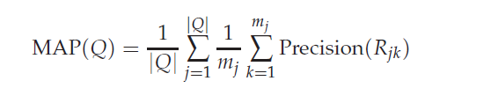
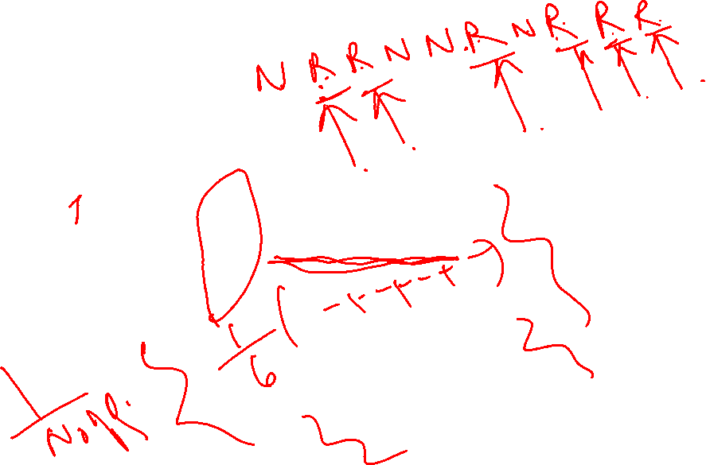
Mean average precision
Average precision: average of the precision value obtained for the set of top k documents existing after each relevant document is retrieved

Slide 31
Note:
Using MAP, fixed recall levels are not chosen, and there is no interpolation
For a single information need, average precision approximates the area under the precision recall curve
MAP is roughly the average area under the precision recall curve for a set of queries
MAP has the effect of weighting each information need equally in the final reported number, even if many documents are relevant to some queries and very few are relevant to other queries.

Slide 32
Calculated MAP scores normally vary widely across information needs when measured within a single system, for instance, between 0.1 and 0.7.
Indeed, there is normally more agreement in MAP for an individual information need across systems than for MAP scores for different information needs for the same system.
This means that a set of test information needs must be large and diverse enough to be representative of system effectiveness across different queries

Slide 33
PRECISION AT k
The measure like MAP and eleven point interpolated average precision factor in the precision at all recall levels.
However, what matters to users is what results are there on the first page or the top 3 pages or the top few results
So, came up …….Precision at the kth document …… though not a very stable measure…….and doesn’t average well because the number of documents relevant to a query has a very high influence on the precision at k………. So the measure R-precision came up

Slide 34
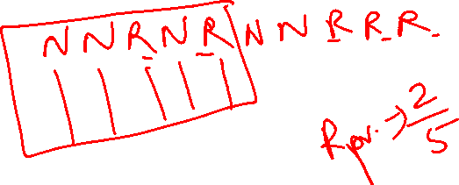
R-PRECISION
Count the number of relevant documents say k
Calculate the precision at that point i.e. kth document.
Report it as the R-precision
The perfect system could score 1 on this metric for each query, however a perfect system could score just 0.4 in terms of precision at 20 if there were only 8 documents relevant to an information need in a collection. So, averaging this measure across queries makes more sense

Slide 35

BREAK-EVEN POINT
If we calculate the R-precision at |Rel| number of docuemnts, and we find r relevant, then we observe that the precision and recall at that point is r/|Rel| !!!!
Thus it is break even point in the precision recall curve (When P = R )
Why should we be interested in R-precision ? …… Its because…….It has been empirically shown and observed that though R-precision is a single point on the curve, it is highly correlated with MAP.

Slide 36
Non Binary notion of relevance
Suppose we have 3 classes
Highly relevant
Somewhat relevant
Not relevant
There are 3 classes say 0,1,2…… so this is non binary relevance judgements.
So metrics for these ???

Slide 37
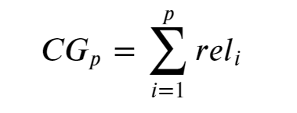
Cumulative gain
If every recommendation has a graded relevance score associated with it, CG is the sum of graded relevance values of all results in a search result list

Slide 38
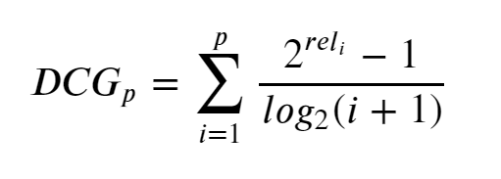
Discounted cumulative gain
The problem with CG is that it does not take into consideration the rank of the result set when determining the usefulness of a result set. In other words, if we was to reorder the graded relevance scores returned in result set we will not get a better insight into the usefulness of the result set since the CG will be unchanged.
To overcome this we introduce DCG. DCG penalizes highly relevant documents that appear lower in the search by reducing the graded relevance value logarithimically proportional to the position of the result.

Slide 39
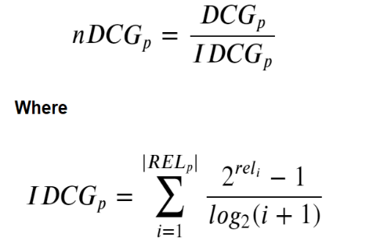
Normalised Discounted cumulative gain
An issue arises with DCG when we want to compare the search engines performance from one query to the next because search results list can vary in length depending on the query that has been provided. Hence, by normalizing the cumulative gain at each position for a chosen value of p across queries we arrive at NDCG. We perform this by sorting all the relevant documents in the corpus by their relative relevance producing the max possible DCG through position p (a.k.a Ideal Discounted Cumulative Gain)

Slide 40
Characteristics of NDCG
The ratios will always be in the range of [0, 1] with 1 being a perfect score — meaning that the DCG is the same as the IDCG. Therefore, the NDCG values can be averaged for all queries to obtain a measure of the average performance of a recommender systems ranking algorithm.
1.The NDCG does not penalize for bad documents in the results 2.Does not penalize missing documents in the result.
3.May not be suitable to measure performance of queries that may often have several equally good results
The main difficulty that we face when using NDCG is that often times we don’t know the ideal ordering of results when only partial relevance feedback is available. However, the NDCG has proven to be an effect metric to evaluate ranking quality for various problems.

Slide 41
Difficulty in IR
Information Retrieval is an Empirical Discipline
•Lack of “Correct answer”
•Requiring thorough and careful evaluation

Slide 42
Relevance
“Something (A) is relevant to a task (T) if it increases the likelihood of accomplishing the goal (G), which is implied by T.”[Hjørland & Sejer Christensen, 2002]
Is subjective - and not entirely so!
• A document is judged relevant within the context of the query (or more precisely, the information need)
• Who judges?
• What is useful?

Slide 43
Kappa Measure
Pooling: For large modern collections, it is usual for relevance to be assessed only for a set of documents returned by a number of IR systems.

Slide 44
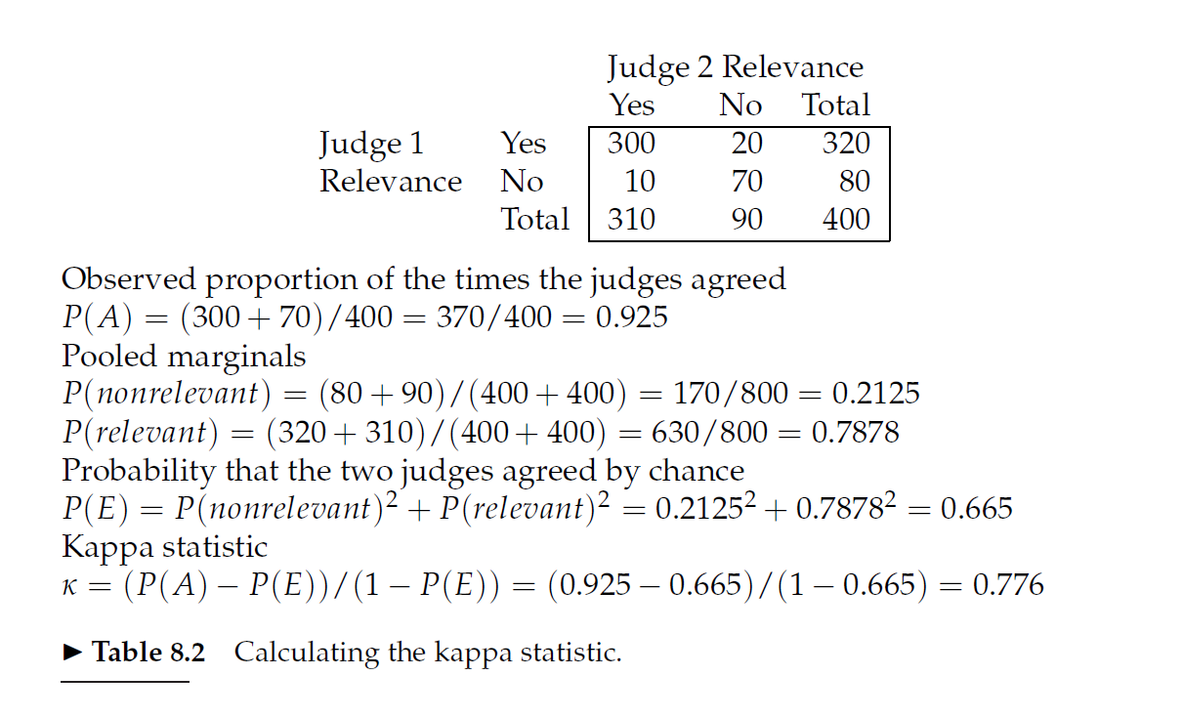

Slide 45
0.8 – 1.0 ----- good
0.67 – 0.8 ------ fair
Below 0.67 ----- not satisfactory or acceptable for experimentation

Slide 46
Marginal relevance
Novelty
Diversity
Even if a document is highly relevant, its information can be completely redundant with other documents which have already been examined. The most extreme case of this is documents that are duplicates – a phenomenon that is actually very common on the World Wide Web – but it can also easily occur when several documents provide a similar precis of an event. In such circumstances, marginal relevance is clearly a better measure of utility to the user. Maximizing marginal relevance requires returning documents that exhibit diversity and novelty. One way to approach measuring this is by using distinct facts or entities as evaluation units. This perhaps more directly measures true utility to the user but doing this makes it harder to create a test collection.

Slide 47
System issues
There are many practical benchmarks on which to rate an information retrieval system beyond its retrieval quality. These include:
How fast does it index, that is, how many documents per hour does it
index for a certain distribution over document lengths? (cf. Chapter 4)
How fast does it search, that is, what is its latency as a function of index
size?
How expressive is its query language? How fast is it on complex queries?
How large is its document collection, in terms of the number of documents or the collection having information distributed across a broad range of topics? All these criteria apart from query language expressiveness are straightforwardly measurable: we can quantify the speed or size. Various kinds of feature checklists can make query language expressiveness semi-precise.

Slide 48
A/B testing
Click through analysis
Click stream mining

Slide 49
Numericals
Mansi A. Radke

Slide 50
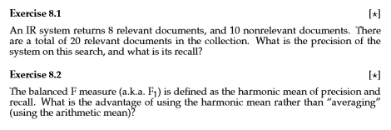












Problems

Slide 51


Slide 52
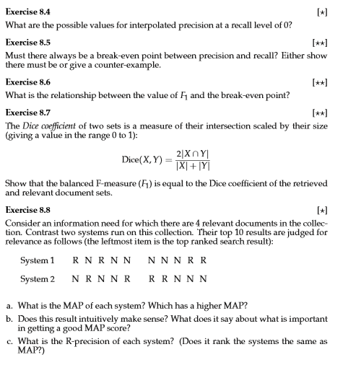



























Slide 53
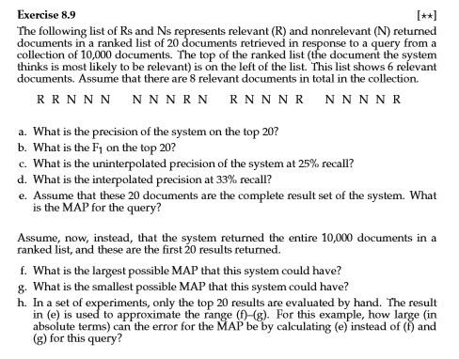

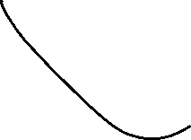















Slide 54
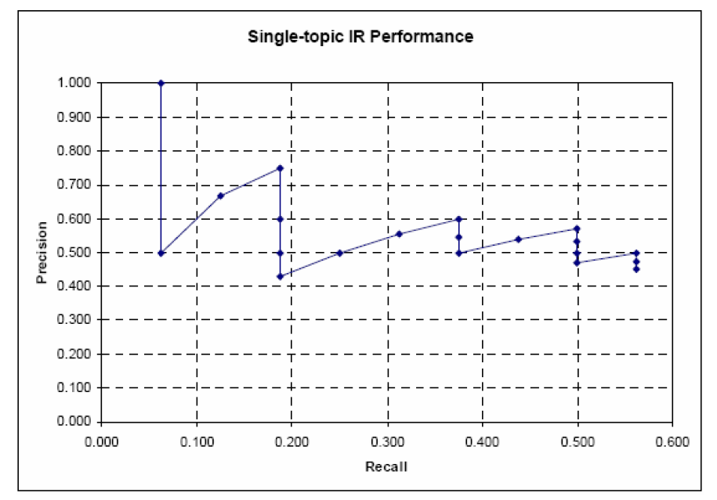
The following is the uninterpolated Precision-Recall Graph of an IR system, for one topic. You know that 20 hits were retrieved, and that there are 16 relevant documents for this topic (not all of which are retrieved).

