Slide 1
Computing scores in a complete search system
Mansi A. Radke

Slide 2
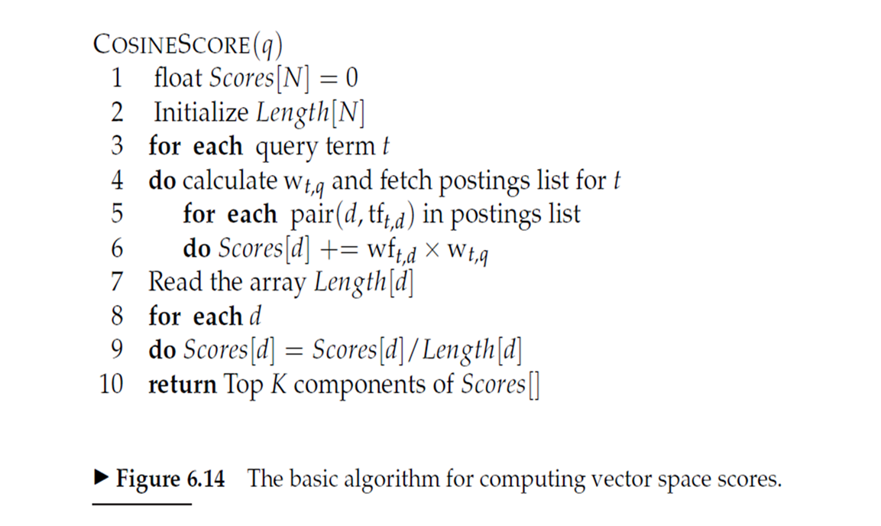
Basic algorithm for computing cosine scores
The brown crow
The is less important than crow and brown
So, we give weights to the terms in the query
W_{t,q} is the wight of term t in the query q.

Slide 3
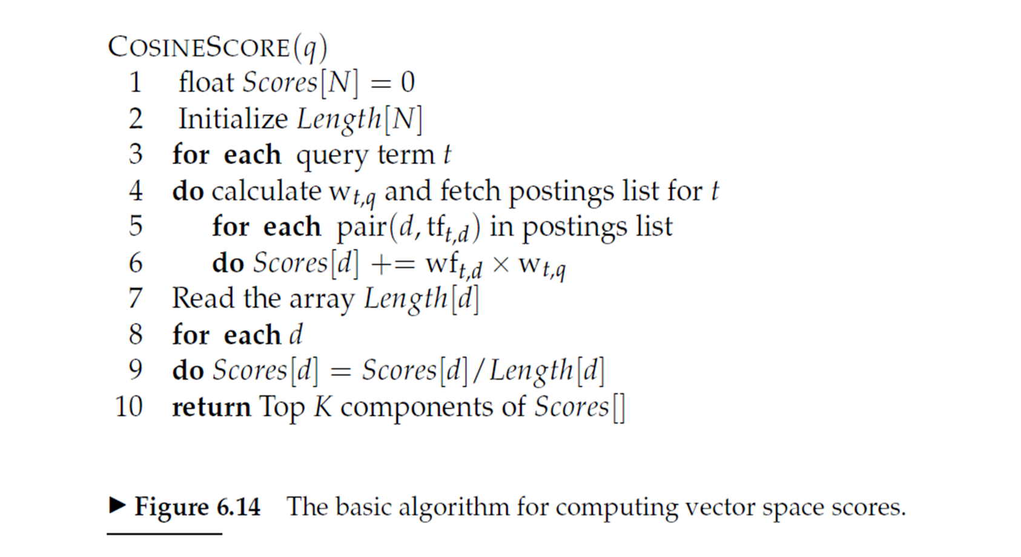
If we consider a query with only two words
The unit vector will have only 2 non zero components
If we do not have any differing weights for the query terms, the non zero components are equal – in case of query with 2 terms 0.707

Slide 4




Efficient scoring and ranking in a complete search system
For the purpose of ranking the documents matching a given query, we are really interested in the relative (rather than absolute) scores of the documents in the collection.
To this end, it suffices to compute the cosine similarity from each document unit vector v(d) to V (q) (in which all non-zero components of the query vector are set to 1), rather than to the unit vector v(q) for any two documents d1 and d2.

Slide 5
Line 6 becomes just addition and multiplication step avoided
idf value for each term of the dictionary is maintained in the dictionary
tf for each document is maintained in posting list

Slide 6
The algorithm computes scores for every document which is in the posting of any of the query terms.
And that is likely to be a number much less than N where N is the total number of documents.

Slide 7
Efficient scoring and ranking in a complete search system
For any document d, the cosine similarity V (q) · v(d) is the weighted sum, over all terms in the query q, of the weights of those terms in d.

Slide 8
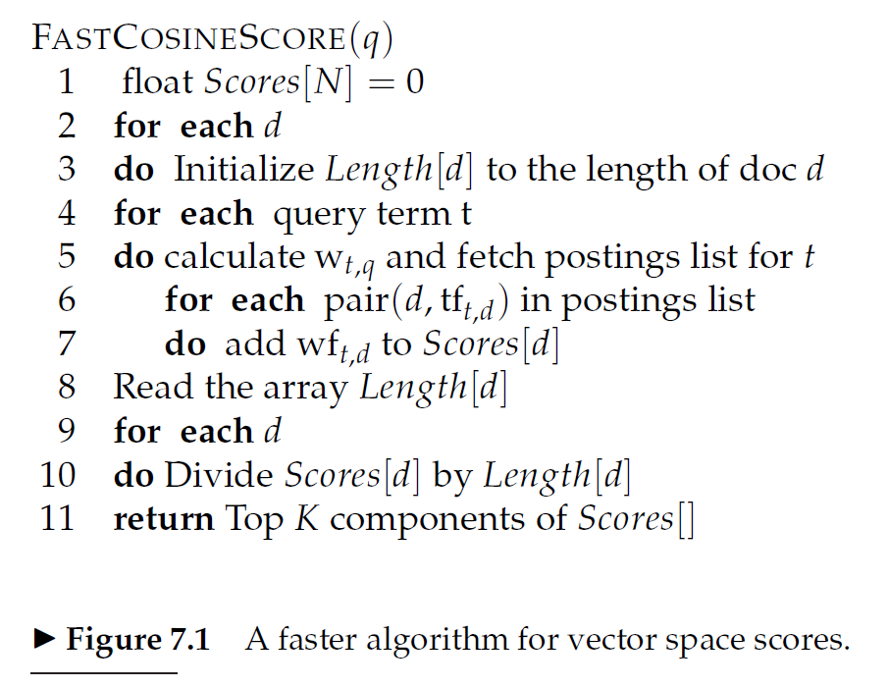

Slide 9
Use of Max Heap!
Given these scores, the final step before presenting results to a user is to pick out the K highest-scoring documents. While one could sort the complete set of scores, a better approach is to use a heap to retrieve only the top K documents in order
Where J is the number of documents with non-zero cosine scores, constructing such a heap can be performed in O(J), following which each of the K highest scoring documents can be “read off” the heap in O(log J). So total is O(k log J)

Slide 10
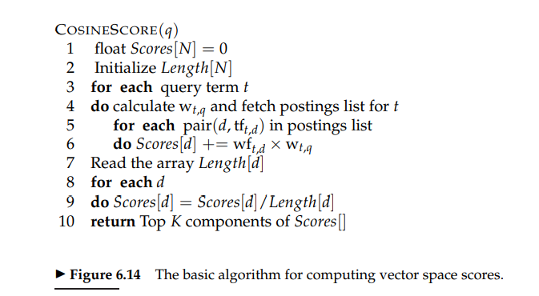

Slide 11
Inexact top-k document retrieval
In most applications, it suffices to retrieve k documents whose scores are very close to those of the k – best
By this we can potentially avoid computing the scores for most of N documents in the collection
We use some heuristics and find a set A of documents that are potential candidates for top k (k < |A| << N)
Note that A does not necessarily contain the k top scoring documents for the query, but is likely to have many documents with scores near to those of top k
Return the top k scoring documents in A

Slide 12
Index Elimination
For a multiterm query, we only consider documents containing at least one of the query terms
Additional Heuristics
We consider only those documents containing terms whose idf exceeds a preset threshold
Thus in the postings traversal, we only traverse the postings for terms with high idf. This has a fairly significant benefit as the postings list for low idf terms are generally long. With these removed, the set of documents for which we compute the cosine scores is greatly reduced
In short low idf terms are treated like stop words
The cut-off threshold can be adopted in query dependent manner
We contain the documents that contain many (as a special case, all) the query terms
Danger of this is : We may end up in fewer than k candidate documents in the output

Slide 13
Champion Lists
Champion lists = fancy lists = top docs
The idea is to precompute, for each term t in the dictionary, the set of r documents with highest weights for t The value of r is chosen in advance
For tf-idf weighting, these would be the r documents with the highest tf values for term t. We call this set of r documents the champion list for term t.
Now, given a query q we create a set A as follows: we take the union of the champion lists for each of the terms comprising q.
We now restrict cosine computation to only the documents in A.
A critical parameter in this scheme is the value r, which is highly application dependent. Intuitively, r should be large compared with K, especially if we use any form of the index elimination

Slide 14
Issue In champion lists
One issue here is that the value r is set at the time of index construction, whereas K is application dependent and may not be available until the query is received; as a result we may (as in the case of index elimination) find ourselves with a set A that has fewer than K documents. There is no reason to have the same value of r for all terms in the dictionary; it could for instance be set to be higher for rarer terms.
Note : r need not be same for all terms in dictionary. R could be greater for rarer terms

Slide 15
Static Quality scores and ordering
In many search engines, we have available a measure of quality g(d) for each document d that is query independent and thus static
Static quality measure has a value between 0 and 1
Example: In context of news stories on the web, g(d) may be derived from the number of favourable reviews of the story by web surfers
Net score = combination of (g(d) and query dependent score)
For e.g. net score(q,d) = g(d) + cosine score of d with respect to q
Both components can have equal contributions assuming each is between 0 and 1 .
Other relative weightings are also possible, the effectiveness of our heuristics depends on the specific relative weighting

Slide 16
Ideas for static quality scores and ranking
Idea 1:
Consider ordering the documents in the posting list for each term by decreasing order of g(d)
Idea 2:
Extension of champion lists
Global champion list: for a well chosen r, we maintain for each term ‘t’, a global champion list of r documents with highest values of g(d) + tf-idf(t,d)
At query time, we only compute the net scores for documents in the union of global champion lists

Slide 17
Ideas for static quality scores and ranking
Idea 3:
We maintain for each term t, two posting lists consisting of disjoint sets of documents, each sorted by g(d) values
First list -> high-> m docs with highest tf values for t
Second list -> low-> remaining docs containing t
While processing a query, scan only the high lists. If we get k docs in the process terminate. If not, go to the low lists

Slide 18
Impact ordering
In all the postings lists described thus far, we order the documents consistently by some common ordering: typically by document ID or by static quality scores.
Such a common ordering supports the concurrent traversal of all of the query terms’ postings lists, computing the score for each document as we encounter it. Computing scores in this manner is sometimes referred to as document-at-a-time scoring.
We will now introduce a technique for inexact top-K retrieval in which the postings are not all ordered by a common ordering, thereby precluding such a concurrent traversal. We will therefore require scores to be “accumulated” one term at a time so that we have term-at-a-time scoring.
The idea is to order the documents d in the postings list of term t by decreasing order of tft,d. Thus, the ordering of documents will vary from one postings list to another, and we cannot compute scores by a concurrent traversal of the postings lists of all query terms.

Slide 19
Impact ordering
Given postings lists ordered by decreasing order of tft,d, two ideas have been found to significantly lower the number of documents for which we accumulate scores:
(1) when traversing the postings list for a query term t, we stop after considering a prefix of the postings list – either after a fixed number of documents r have been seen, or after the value of tft,d has dropped below a threshold;
(2) when accumulating scores, we consider the query terms in decreasing order of idf, so that the query terms likely to contribute the most to the final scores are considered first.
This latter idea too can be adaptive at the time of processing a query: as we get to query terms with lower idf, we can determine whether to proceed based on the changes in document scores from processing the previous query term. If these changes are minimal, we may omit accumulation from the remaining query terms, or alternatively process shorter prefixes of their postings lists.

Slide 20
Impact ordering
We may also implement a version of static ordering in which each postings list is ordered by an additive combination of static and query-dependent scores. We would again lose the consistency of ordering across postings, thereby having to process query terms one at time accumulating scores for all documents as we go along. Depending on the particular scoring function, the postings list for a document may be ordered by other quantities than term frequency; under this more general setting, this idea known as impact ordering.

Slide 21
Cluster Pruning

Slide 22
Cluster pruning

Slide 23
Query processing in cluster pruning
1. Given a query q, find the leader L that is closest to q. This entails computing cosine similarities from q to each of the √N leaders.
2. The candidate set A consists of L together with its followers. We compute the cosine scores for all documents in this candidate set.
Note: The use of randomly chosen leaders for clustering is fast and likely to reflect the distribution of the document vectors in the vector space: a region of the vector space that is dense in documents is likely to produce multiple leaders and thus a finer partition into sub-regions.

Slide 24
Variations of cluster pruning
Variations of cluster pruning introduce additional parameters b1 and b2, both of which are positive integers. In the pre-processing step we attach
each follower to its b1 closest leaders, rather than a single closest leader.
At query time we consider the b2 leaders closest to the query q.
Clearly, the basic scheme above corresponds to the case b1 = b2 = 1. Further, increasing b1 or b2 increases the likelihood of finding K documents that are more likely to be in the set of true top-scoring K documents, at the expense of more computation.

Slide 25
Points to ponder!
When discussing champion lists, we simply used the r documents with the largest tf values to create the champion list for t. But when considering global champion lists, we used idf as well, identifying documents with the largest values of g(d) +tf-idft,d. Why do we differentiate between these two cases?

Slide 26
When query = a single term t, union of champion lists for each term is the same as that of t. Ranking by netscore=g(d)+ tf(d) idf(t,d) is equivalent to Ranking by netscore=g(d)+ tf(d) So use of global champion list within m=K suffices for finding K highest scoring documents.

Slide 27
Points to Ponder!
If we were to only have one-term queries, explain why the use of global champion lists with r = K suffices for identifying the K highest scoring documents. What is a simple modification to this idea if we were to only have s-term queries for any fixed integer s > 1?
For a one-term query, the ordering of documents is independent of of the term in the query. It only depends on the weight of the term in the documents. The truncated weight-ordered postings list contains the K documents with the highest weights. Thus, it is identical to the ranked list for the one-term query.

Slide 28
Explain how the common global ordering by g(d) values in all high and low lists helps make the score computation efficient.
In the general case, the postings list of query terms are traversed to find the documents which contains all or most of query terms and then scores are calculated for these documents to find the top K. Thus more importance is given to v(q) .v(d) in the short listing stage and g(d)is accounted for later. If common global ordering by g(d) is implemented, not just it increases the efficiency of results but also less documents would have to undergo score calculation process thereby reducing some work through at the cost of initial ordering.

Slide 29
Points to ponder!
The nearest-neighbor problem in the plane is the following: given a set of N data points on the plane, we preprocess them into some data structure such that, given a query point Q, we seek the point in N that is closest to Q in Euclidean distance. Clearly cluster pruning can be used as an approach to the nearest-neighbor problem in the plane, if we wished to avoid computing the distance from Q to every one of the query points. Devise a simple example on the plane so that with two leaders, the answer returned by cluster pruning is incorrect (it is not the data point closest to Q).

Slide 30
Solution

Slide 31
Points to Ponder!
Explain how the postings intersection algorithm first introduced in Section 1.3 can be adapted to find the smallest integer ω that contains all query terms.
Move concurrently through the positional postings of all query terms, until a document D is found that contains all the query terms.
1. Move the cursor on each postings to the first positional occurrence of the term.
2. Measure the window size to be the distance between the leftmost and rightmost cursors.
3. Repeat the following until some cursor exits document D:
4. Pick the left-most cursor among all postings and move right to the next occurrence; measure the window size as above.
5. Output the minimum of all of these measurements.

Slide 32
Adapt this procedure in previous question to work when not all query terms are present in a document
a. Check whether all k query terms are present in a document. If yes, apply algorithm of k nearest neighbor cluster pruning.
b. If k>=2,Make all possible combinations of (k-1) query terms and check for a document D which contains all terms of any of the combinations.
If yes, change the query[] to exclude all query terms not in that combination and recur.
If not, repeat step b until a document D is found. If k=1, return all documents containing the remaining query term.

Slide 33
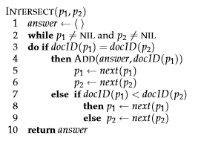
Thank you!
Any Questions?

