Slide 1
Probabilistic Retrieval
Mansi A. Radke

Slide 2

Probability Review
P(A,B) = P(A ∩ B) = P(A| B)*P(B) = P(B|A)*P(A)
P($\overline{A}, B)=P($B| $\overline{A}$)* P($\overline{A}$)
P(B) = P (A,B) + P($\overline{A}$,B)

Slide 3
Probability Ranking Principle (PRP)
If an IR system’s response to each query is a ranking of the documents in the collection in order of decreasing probability of relevance, then the overall effectiveness of the system to the user will be maximised

Slide 4
How to model?
D -> documents
Sample space: collection of documents indexed by search engine
Q –> query
Sample space: any query consisting of one or more terms
R -> user’s judgement of relevance ( R is a binary random variable)
Sample space: 0 or 1

Slide 5

What is the probability that a user will judge a particular document relevant to a given query?
Suppose we want to model this question, we need
P(R = 1 | D = d, Q = q) -------------Equation 1
We can write this as:
P(r | D, Q) = 1 – P ($\overline{r}$|D, Q)

Slide 6
Log Odds / Logit
Given a probability p, the logit (p) is defined as:
Logit(p) = log(p/(1-p))
Where the base of the logarithm may be chosen arbitrarily

Slide 7
Properties of log Odds or Logit
As p varies from 0 to 1, logit(p) varies from -∞ to ∞
If the odds are even i.e. p = 0.5, then logit(p) = 0
Given two probabilities p and q, logit(p) > logit (q) only if p>q
Thus log odds or logit and probability are rank equivalent

Slide 8
Modelling relevance - Assumptions
The binary independence assumption is that documents are binary vectors. That is only the presence or absence of terms in the documents are recorded
The terms are independently distributed in the set of relevant documents and they are also independently distributed in the set of irrelevant or non-relevant documents. The representation is an ordered set of Boolean vectors
A document is represented by a vector d = (x1, x2, …….., xm) where xt = 1 if term t is present in the document and xt = 0 if it is not.
Queries represented in similar way.

Slide 9
Notion of independence
Independence signifies that the terms in the document are considered independently from each other and no association between the terms is modelled.

Slide 10

Go back to Equation 1
P(R = 1 | D = d, Q = q) -------------Equation 1
We can write this as:
P(r | D, Q)
Also we have
P(r | D, Q) = 1 – P ($\overline{r}$|D, Q)

Slide 11

Applying Baye’s theorem
Bayes theorem is: P(A|B) = P(B|A) * P(A) / P(B)
P(r| D, Q) = P(D, Q|r)* P(r)/ P(D,Q)
And
P($\overline{r}$| D, Q) = P(D, Q| $\overline{r}$) * P($\overline{r}$)/ P(D,Q)

Slide 12

Taking log odds of equation 1
$log⁡(P(r|D, Q)/(1−P(r|D, Q)$)
= log($P(r|D, Q)/(P(\overline{r }$| D, Q)) ----------Equation 2

Slide 13

Applying Baye’s theorem equation 2 becomes
log ((P(D,Q|r)*P(r) / P(D, Q) )/ (P(D,Q|$\overline{r}$ )*P($\overline{r}$ )/P(D, Q))
= log ((P(D,Q|r)*P(r))/ ((P(D,Q|$\overline{r}$ )*P($\overline{r}$ ))) ------- Equation 3

Slide 14
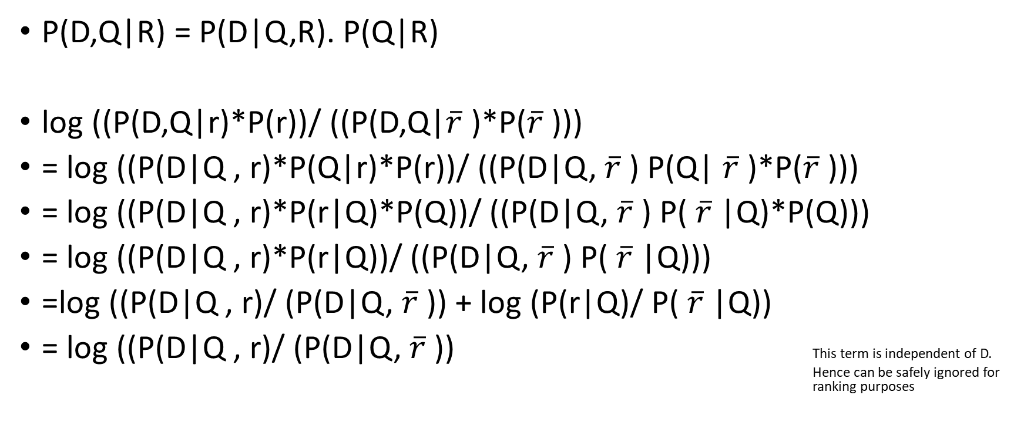
We may expand the joint probabilities in equation 3 into conditional probabilities by using the equality
P(D,Q|R) = P(D|Q,R). P(Q|R)
log ((P(D,Q|r)*P(r))/ ((P(D,Q|$\overline{r}$ )*P($\overline{r}$ )))
= log ((P(D|Q , r)*P(Q|r)*P(r))/ ((P(D|Q, $\overline{r}$ ) P(Q| $\overline{r}$ )*P($\overline{r}$ )))
= log ((P(D|Q , r)*P(r|Q)*P(Q))/ ((P(D|Q, $\overline{r}$ ) P( $\overline{r}$ |Q)*P(Q)))
= log ((P(D|Q , r)*P(r|Q))/ ((P(D|Q, $\overline{r}$ ) P( $\overline{r}$ |Q)))
=log ((P(D|Q , r)/ (P(D|Q, $\overline{r}$ )) + log (P(r|Q)/ P( $\overline{r}$ |Q))
= log ((P(D|Q , r)/ (P(D|Q, $\overline{r}$ )) This term is independent of D. Hence can be safely ignored for ranking purposes

Slide 15

So we get to the ranking formula
log ((P(D|Q , r)/ (P(D|Q, $\overline{r}$ )) --------------Equation 4

Slide 16
The Binary Independence Model – 1st assumption
Given relevance terms are statistically independent
Given a positive relevance judgement, the presence or absence of one term does not depend on the presence or absence of any other terms
Given a negative relevance judgement, the presence or absence of one term does not depend on the presence or absence of any other terms
With this assumption, we rewrite the probabilities of equation 4 as

Slide 17
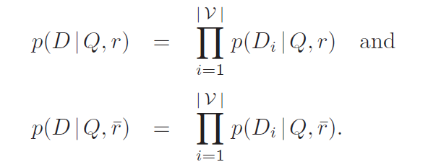

Slide 18
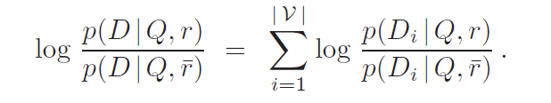
So equation 4 becomes :
-----Equation 5

Slide 19
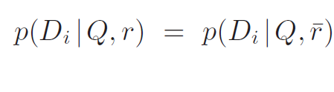
BIM-We make the second strong assumption
The presence of a term in a document depends on relevance only when the term is present in the query
As a result of this 2nd assumption, if qi = 0, then

Slide 20
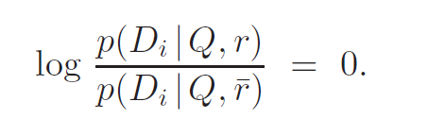

Slide 21
The effect of this assumption is to change the summation in Equation 5 from a summation over all terms in the vocabulary to a summation over all terms in the query. Because conditioning on the query is now redundant, we can drop it and our ranking formula then becomes
------ Equation 6

Slide 22
We now subtract from Equation 6 its own value when no query terms appear in the document
We can subtract this constant as it has no impact on ranking
When all query terms are absent, this term is a constant

Slide 23
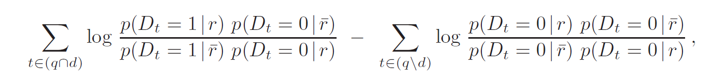
Rearranging the terms
This term is 0

Slide 24
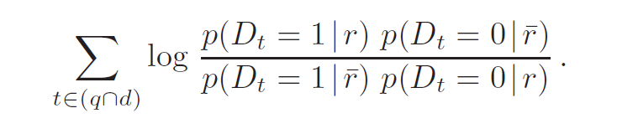
So our formula becomes !
So, this refinement of the equation 4 under the assumptions 1 and 2 and considering only the presence an absence of terms is called as the Binary Independence model

Slide 25

Robertson Spark Jones weighting formula
This is BIM equation
Rewritten as

Slide 26

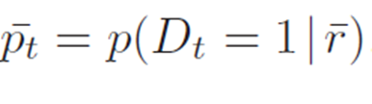

wt is associated with each term
Equation A

Slide 27

For a given query, let
Nr = expected number of relevant documents in the collection
Nt,r = expected number of relevant documents in the collection containing term t
N is number of documents in the collection
Nt is number of documents in the collection containing term t
We may now estimate

Slide 28
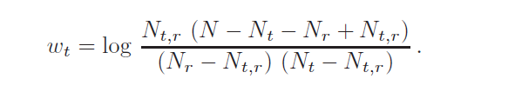
Substituting in equation A

Slide 29

Applying smoothing
nr is count of relevant documents
nt,r is the count of relevant documents containing term t

Slide 30
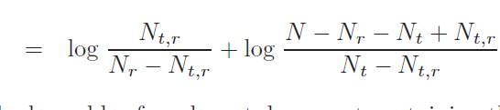
We again start with equation A

Slide 31

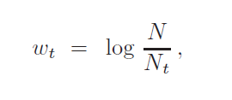
The term on the left is the log-odds of a relevant document containing the term t. If we assume
that both Nr and Nt,r are small relative to both N and Nt, which may not be unreasonable for
relatively common terms over a large collection, we can approximate the term on the right by
setting Nr = Nt,r = 0, giving
if pt = 0.5 and Nt is small relative to N, then the standard IDF formula approximates this formula.

Slide 32
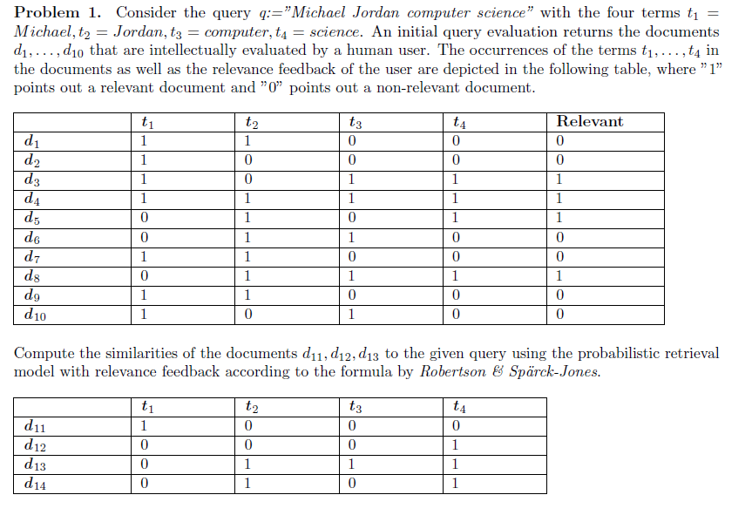

Slide 35
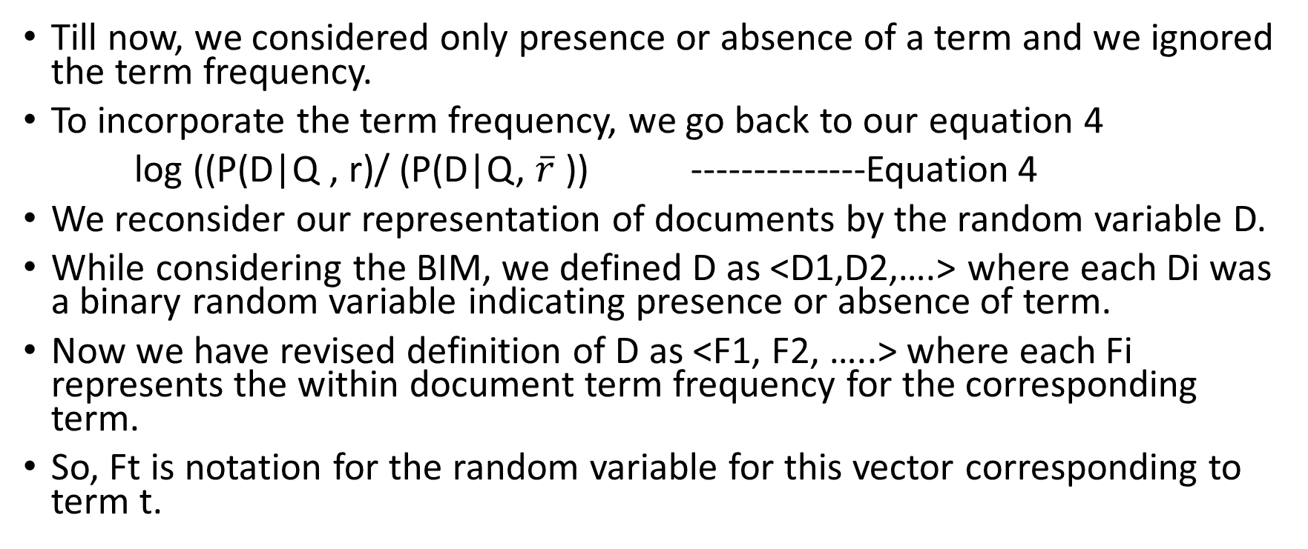
Term Frequency
Till now, we considered only presence or absence of a term and we ignored the term frequency.
To incorporate the term frequency, we go back to our equation 4
log ((P(D|Q , r)/ (P(D|Q, $\overline{r}$ )) --------------Equation 4
We reconsider our representation of documents by the random variable D.
While considering the BIM, we defined D as <D1,D2,….> where each Di was a binary random variable indicating presence or absence of term.
Now we have revised definition of D as <F1, F2, …..> where each Fi represents the within document term frequency for the corresponding term.
So, Ft is notation for the random variable for this vector corresponding to term t.

Slide 36
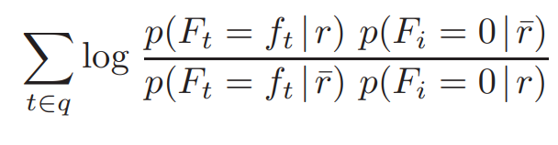


Doing a similar derivation, as BIM we get
………………..(Equation 7)
ft represents the number of times the term t occurs in the document.
For this equation to be usable, we must estimate the values for
and

Slide 37
Eliteness
When writing a document about a particular topic, an author will generally choose terms related to that topic.
As a result, when a term is associated with a particular topic, we might expect the term to appear more frequently in a document about that topic than in document not about that topic.
It will still occur occasionally in documents not related to the topic.
A document is said to be elite in term t when it is somehow about the topic associated with the term.
We could flip the relationship around and infer probability of eliteness from term frequency – greater the term frequency, the more likely that the term is elite in the document.

Slide 38
In summary----- Documents about a topic are more likely to be elite in terms related to that topic and therefore these terms are more likely to occur in these documents
So, we define a binary random variable Et corresponding to each Ft and representing the eliteness of term t
Et = 1 indicates document is elite in term t (e as shorthand)
Et = 0 indicates document in not elite in term t. ( as shorthand)

Slide 39
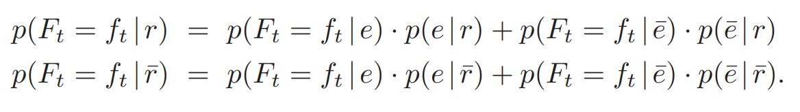
The relationship between relevance and term frequency may be then formalised as follows:
Substituting in equation 7 we get, …………………(Equation 8)

Slide 40
Bookstein’s Two-Poisson Model
We can make our vague definitions of eliteness more concrete by having specific distribution of terms in documents as mixture of two Poisson distributions, with one Poisson distribution corresponding to documents that are elite in the term and the other corresponding to the documents that are not elite in the term.
Lets see what is Poisson distribution on next slide and then come back to this……

Slide 41
Poisson distribution
Invented by a French mathematician Simeon Poisson in 1838
It is a distribution often used to model the number of events or arrivals of some defined type that occur within a given time period.
E.g. A Poisson distribution can be used to model
the number of car accidents per year at a particular intersection
the number of times a web server is accessed each minute etc.
the number of alpha particles emitted by a gram of uranium in one second
Events occurring in one time period are assumed to be stochastically independent of events occurring in a separate time period

Slide 42

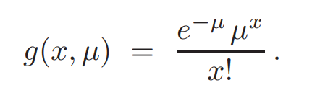
In our case…..
Occurrence of a term is the “event”
Document as whole takes on the role of a “time period”
Given a random variable X over the non negative integers and a real valued parameter representing the mean number events in a given period, the Poisson distribution is defined as

Slide 43
In order to use this distribution to model term distribution, we need to assume that all documents are of the same length.
Because a collection may contain books and email messages both that differ in length by a factor of 1000 or more, this assumption is not at all realistic.
Let us assume it for now and revisit it later.

Slide 44

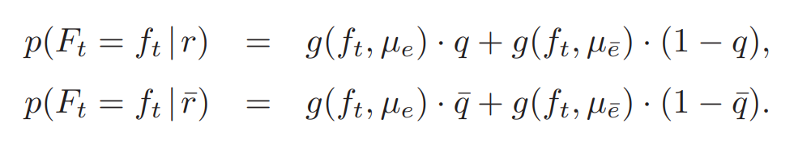
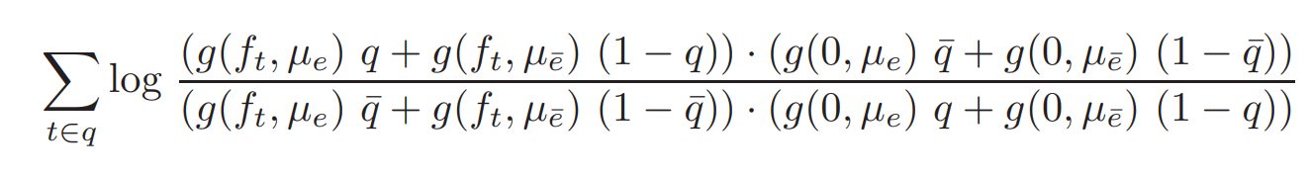
If we let q = p(e|r) and
Substituting these values in equation 8, we get,
Substituting these in equation 7, we get our equation 8

Slide 45

…..equation 8
Although the term weight may appear complex at first glance, its structure is actually fairly simple
Each factor appearing in the numerator and the denominator is a mixture of the same two poisson distributions representing eliteness and noneliteness
For a given term, there are 4 parameters to be determined:

Slide 46
In particular, eliteness is a hidden variable that we cannot directly observe, which greatly complicates the estimation process. Nonetheless, we can make several valuable observations from this term weight.
Two observations:
First, when a term is absent (ft = 0) the term weight assigns a value of 0, as we might expect.
Second, as ft increases, the assigned weight also increases. Again, this behavior is consistent with our expectations.

Slide 47
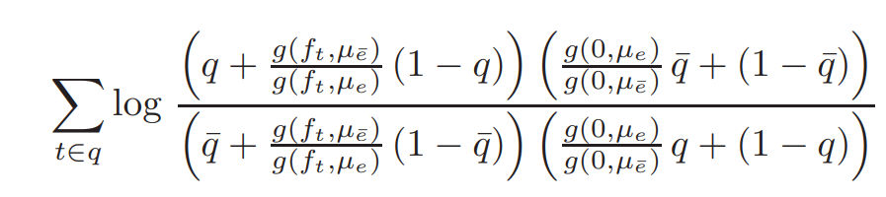
Finally, we consider the behavior of the weight as the number of terms goes to infinity (ft → ∞).
With some rearrangement, equation 8 becomes
…………………………………………………………………………………………………equation 9

Slide 48
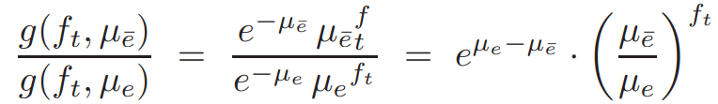

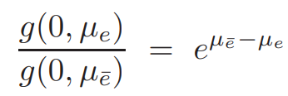
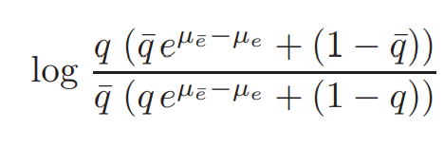
This goes to 0 as ft goes to infinity because
Also
So, equation 9 becomes
………….equation 10

Slide 49
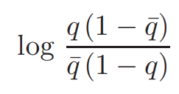
Thus, as the number of terms increases, the weight saturates, reaching an asymptotic maximum given by equation 10.
In other words, there is a limit to how much the repetition of a term can contribute to a document’s score.
Moreover, if we assume that eμe¯−μe is small, contributing little to the weight, we may approximate it with 0. The weight then becomes

Slide 50
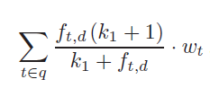
Approximating the Two-Poisson model
Robertson and Walker have suggested a simple approximation to the Two Poisson term weight which we can write as:
……………………equation 11
Where f_{t,d} represents the frequency of term t in document d, wt represents any variant of the Robertson Spark Jones weight and k₁>0
The term weight is 0 when ft,d = 0 and grows with increasing ft,d.
When ft,d is 1 the weight is equal to w_{t}
As f_{t,d} tends to infinity, the weight goes to (k+1) w_{t}
This the weight saturates to a constant factor of the RSJ weight consistent with equation 9

Slide 51
Typically 1 <=k1<2, with the same value used for all terms in all queries.
We use k1 = 1.2 as our default value for examples and experiments because this value is often accepted as the default value in the research literature.

Slide 52
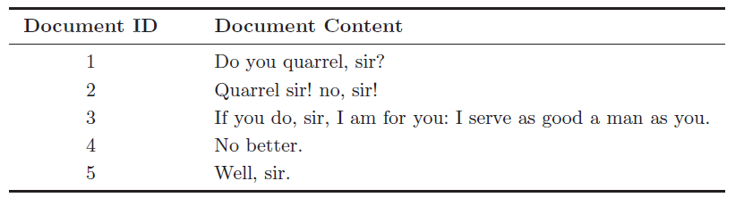
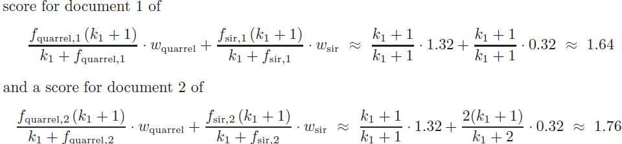
Consider the following example:
If we apply equation 11 to the above example, with respect to the query <“quarrel”, “sir”> ,
Additional occurrence of “sir” in document 2 leads to a higher score.
Saturation property places a limit on the impact that a term can have on the document’s score, regardless of number of times it appears.

Slide 53


Query term frequency
The repetition of a term in a query could be a much stronger indication of the terms significance than repetition in a document.
As a result the typical values of k₃ are often much larger than the corresponding value so k₁.
Setting k₃ as it tends to infinity, the resulting ranking formula becomes:
…………………equation 12

Slide 54


Document length: BM25
In two poisson model, the implicit assumption is that documents are of the same length.
One simple technique to account for varying document length is to normalise the actual term frequency f_{t,d} , scaling it according to document length.
Where ld is the length of document d
Lavg is the average document length across the entire collection. So equation 12 becomes

Slide 55

Although this adjustment is consistent with the two Poisson model, the formula may still not be consistent with the reality.
Consider two documents, one twice as long as the other with the longer one containing twice as many occurrences of each query term as the shorter, it will , both documents will get the same score.
Robertson et al. suggest a blending of equation 11 and 12 with a parameter b controlling the level of normalization for document length where 0<b<1. When b = 0, it is equation 11 and when b is 1 it is equation 12.
B = 0.75 and is same for all queries ……Okapi BM25 (BM = Best Match)

Slide 56
Thank you !!

