Slide 1
Information Retrieval Winter-2024 CSL 436 3-0-2-4
Mansi A. Radke, Assistant Professor, CSE, VNIT

Slide 2
Indexing and Inverted Indices
Inverted Indices for inverted files – Data structure
Consider the following
Doc 1: I am Mansi
Doc 2: I live in Nagpur
Doc 3: I am a teacher
Dictionary for this corpus will consist of the following words:
I, am, Mansi, live, in, Nagpur, am, a, teacher
Inverted Index for this corpus will look like
I
am
Mansi
live
in
Nagpur
a
teacher
doc1
doc2
doc3
doc1
doc3
doc1
doc2
doc2
doc2
doc3
doc3

Slide 3
Draw the inverted index for the following document collection.
Doc 1: new home sales top forecasts
Doc 2: home sales rise in July
Doc 3: increase in home sales in July
Doc 4: July new home sales rise

Slide 5
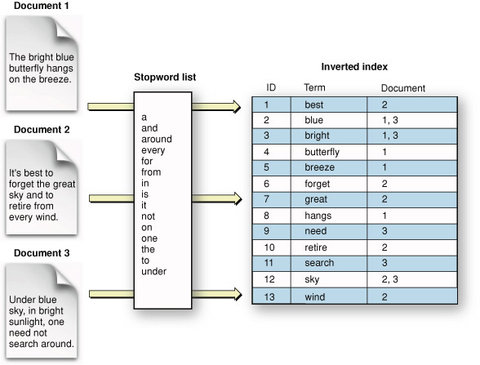
The inverted Index – another example

Slide 6
Term Document Incidence Matrix
Consider the following corpus consisting of 3 documents
Doc 1: I am Mansi
Doc 2: I live in Nagpur
Doc 3: I am a teacher
Dictionary/Vocabulary/Lexicon for this corpus will consist of the following words:
I, am, Mansi, live, in, Nagpur, a, teacher
The term document Incidence matrix for this corpus will look like:
 | Doc1 | Doc2 | Doc3
I | 1 | 1 | 1
am | 1 | 0 | 1
Mansi | 1 | 0 | 0
live | 0 | 1 | 0
in | 0 | 1 | 0
Nagpur | 0 | 1 | 0
a | 0 | 0 | 1
teacher | 0 | 0 | 1

Slide 7
Draw the term document incidence matrix for the following document collection
Doc 1: Breakthrough drug for schizophrenia
Doc 2: New schizophrenia drug
Doc 3: New approach for treatment of schizophrenia
Doc 4: New hopes for schizophrenia patients

Slide 9
For the same document collection what will be the returned results for the following:
schizophrenia AND drug
Vector for ‘schizophrenia’ 1 1 1 1
Vector for ‘drug’ 1 1 0 0
for AND NOT (drug OR approach)
Vector for ‘for’ 1 0 1 1
Vector for ‘drug’ 1 1 0 0
Vector for approach 0 0 1 0

Slide 11
Stop Words in English and the concept of Stop List
["i", "me", "my", "myself", "we", "our", "ours", "ourselves", "you", "your", "yours", "yourself", "yourselves", "he", "him", "his", "himself", "she", "her", "hers", "herself", "it", "its", "itself", "they", "them", "their", "theirs", "themselves", "what", "which", "who", "whom", "this", "that", "these", "those", "am", "is", "are", "was", "were", "be", "been", "being", "have", "has", "had", "having", "do", "does", "did", "doing", "a", "an", "the", "and", "but", "if", "or", "because", "as", "until", "while", "of", "at", "by", "for", "with", "about", "against", "between", "into", "through", "during", "before", "after", "above", "below", "to", "from", "up", "down", "in", "out", "on", "off", "over", "under", "again", "further", "then", "once", "here", "there", "when", "where", "why", "how", "all", "any", "both", "each", "few", "more", "most", "other", "some", "such", "no", "nor", "not", "only", "own", "same", "so", "than", "too", "very", "s", "t", "can", "will", "just", "don", "should", "now"]
In computer search engines, a stop word is a commonly used word (such as "the") that a search engine has been programmed to ignore, both when indexing entries for searching and when retrieving them as the result of a search query.
The list of words that are not to be added is called a stop list.

Slide 12
Tf-idf model
Term frequency (tf)
Document frequency (Dft)
Inverse document frequency (idf)
Total number of terms in the corpus (N)
Inverse Document frequency (idf) for a term is given is given by log (N/Dft)
Tf-idf model weighs each term by its tf-idf value
Tf-idf value of a term is its term frequency multiplied by inverse document frequency
Tf-idf (of a term t) = tf * log (N/Dft)
How stop words get handled in this model ?
e.g. The brown crow

Slide 14
Stemming, lemmatization and case folding
Stemming
Chopping off affixes is called stemming
Examples of stemmers: Porter Stemmer, Snowball Stemmer, Lancaster Stemmer
Recommened: Snowball
Examples
Marketing
Market
Successful
success
Case folding
converts everything to lower case and helps match the case differences
Lemmatization:
Lemma – original form of the word
Lemmatization is the process of converting a word to its base form. The difference between stemming and lemmatization is, lemmatization considers the context and converts the word to its meaningful base form, whereas stemming just removes the last few characters, often leading to incorrect meanings and spelling errors.
Examples of lemmatizers: NLTK, TextBlob, spaCy, Pattern and Stanford CoreNLP
Recommended: Spacy
Examples
Saw
See
Is
Be
Was
be

Slide 15
Information Retrieval Models
Boolean Model
Vector Space Model
Probabilistic Model

