Slide 1
Knuth Morris Pratt Algorithm
Mansi A. Radke

Slide 2
What does it do?
It finds the occurrences of a given input string s1 in the text/string s2 and at what offsets. i.e. it checks if s1 is a substring of s2 and at what offset.
Brute force algorithm (goes back and forth) and takes time complexity of the order of (m*n)

Slide 3
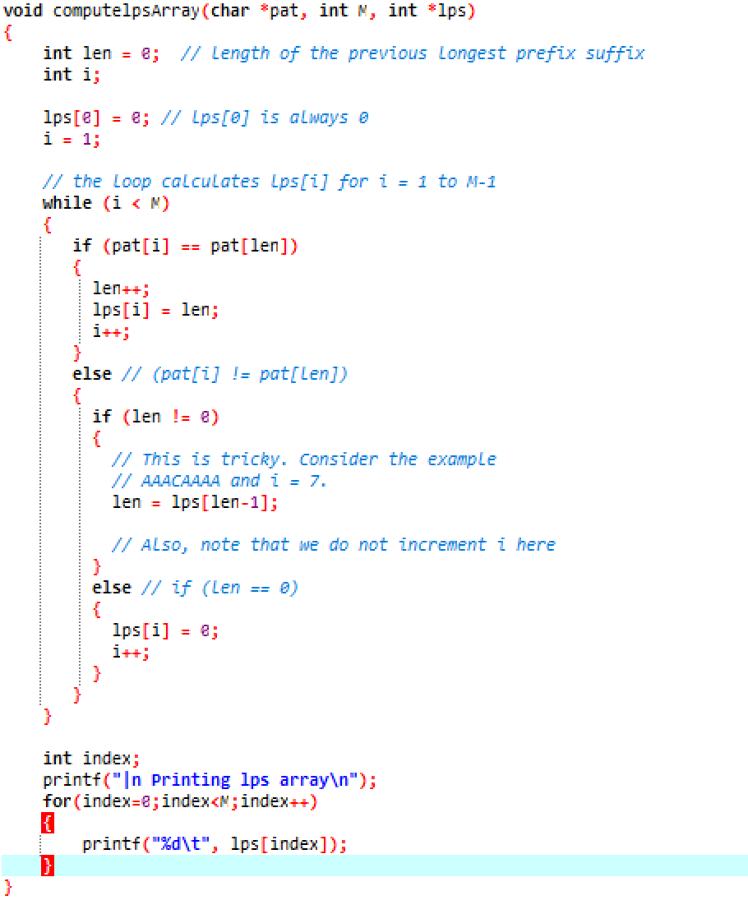






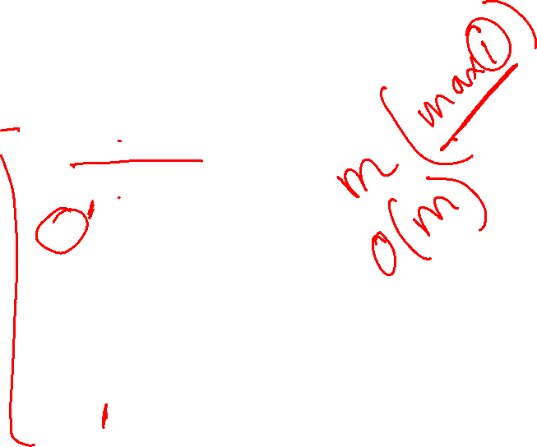

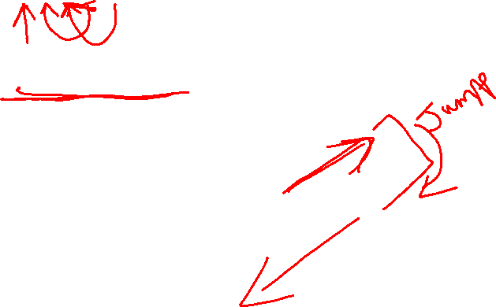
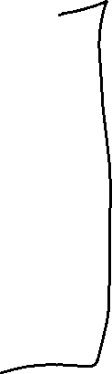


a b a b a c a
0 0 1 2 3 0 1
a b a c a b
0 0 1 0 1 2

Slide 4
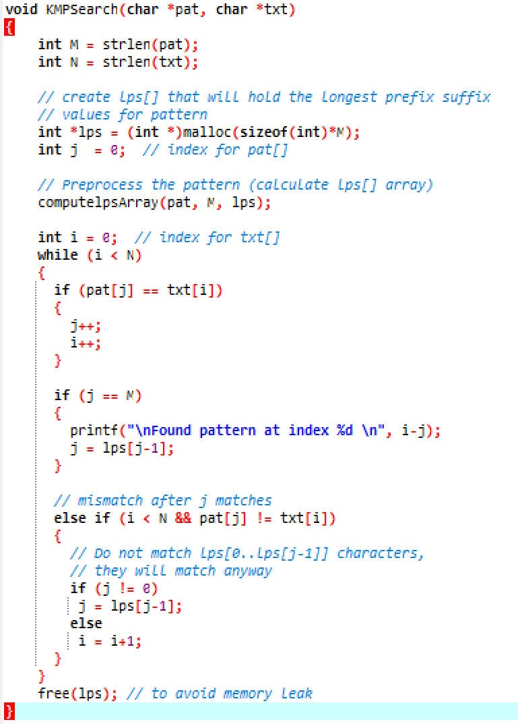







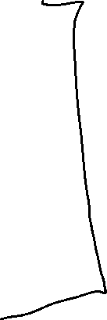




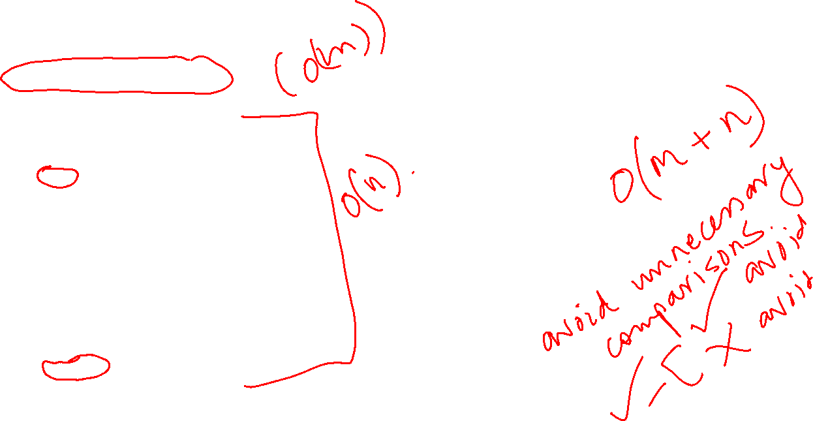

ababaca
Lps array is
a b a b a c a
0 0 1 2 3 0 1
Text is
bacbababaabcbab

Slide 5


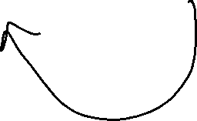




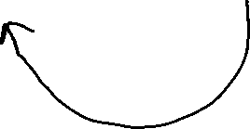
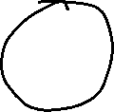







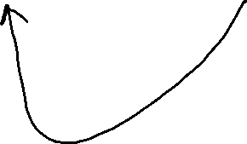




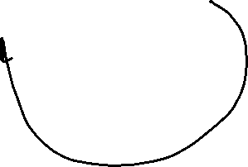

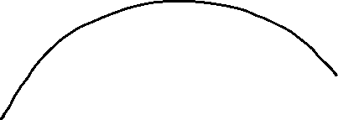
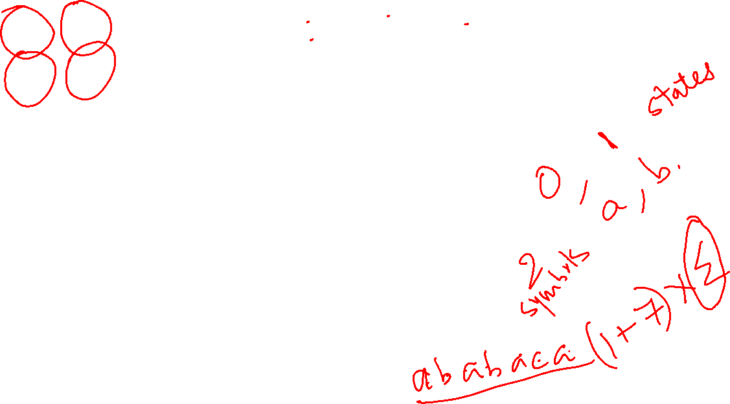



















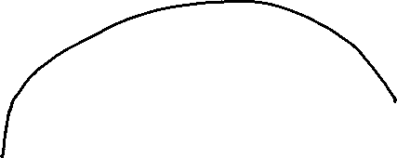


Slide 6

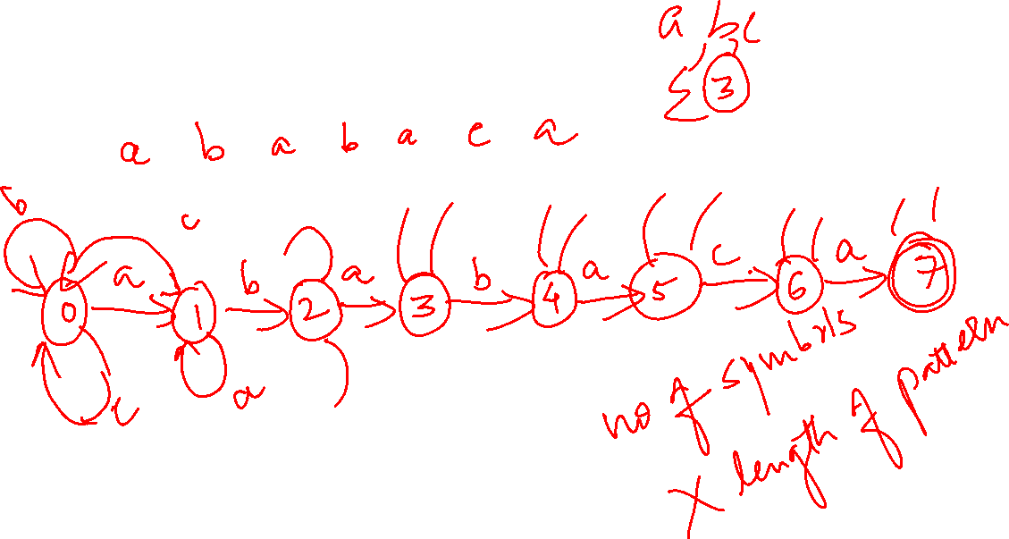




Slide 7





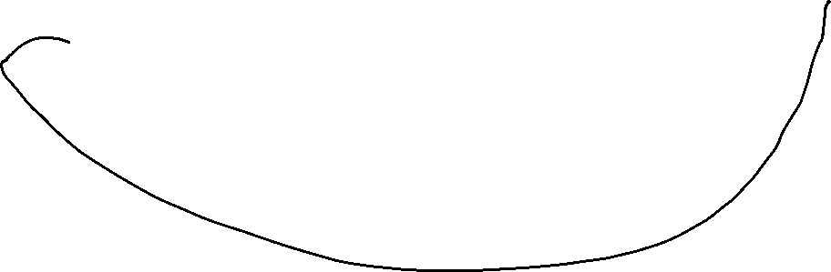













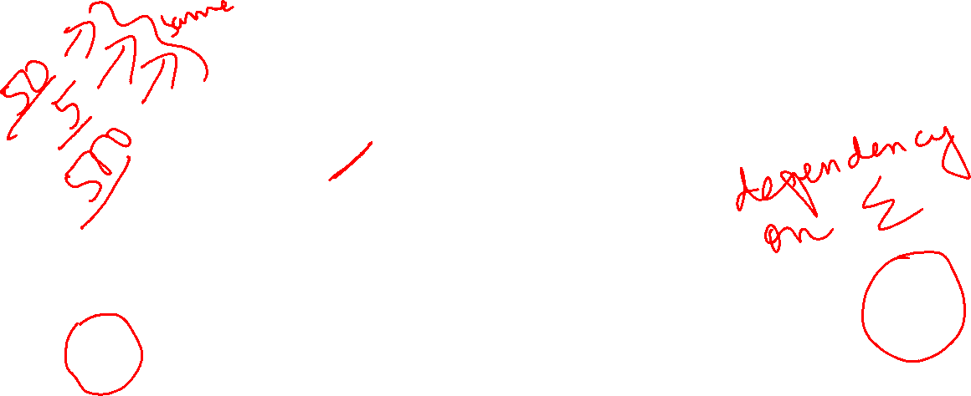

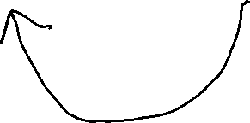

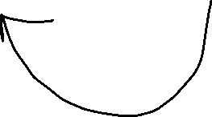





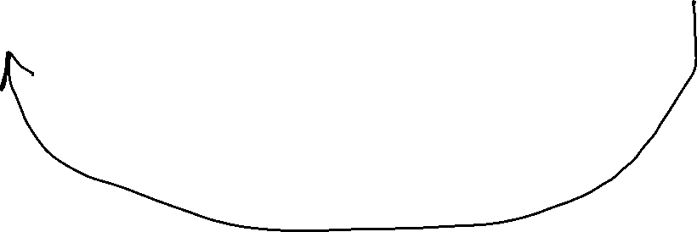
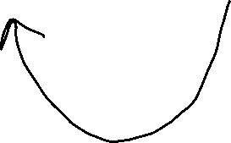









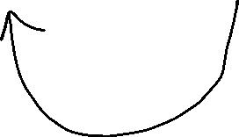



Slide 8

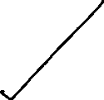
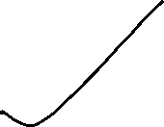




Note:
If number of symbols is 5 O(m + n)
If number of symbols is 50 O(m + n)
If number of symbols is 500 O(m + n)
Depends only on text and pattern string length.

Slide 9






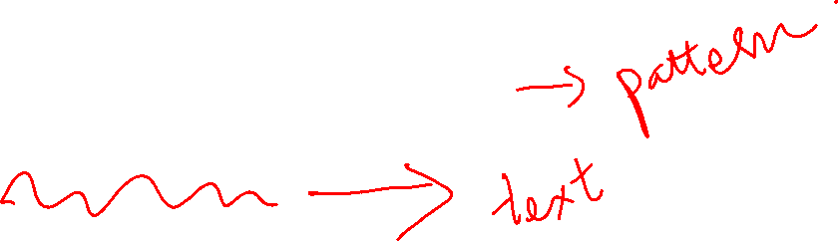




Complexity of the function
Compute prefix is O(M) or O(length of the string)
KMP O(m+n)

Slide 10

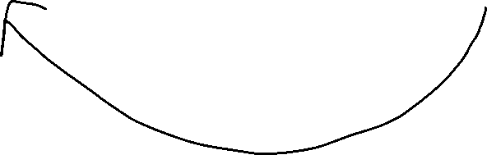











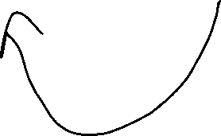

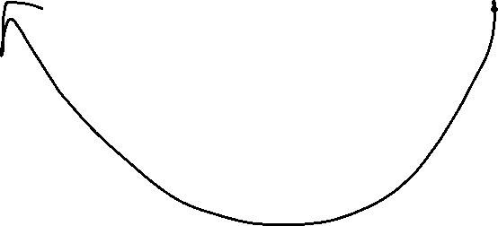
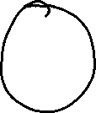











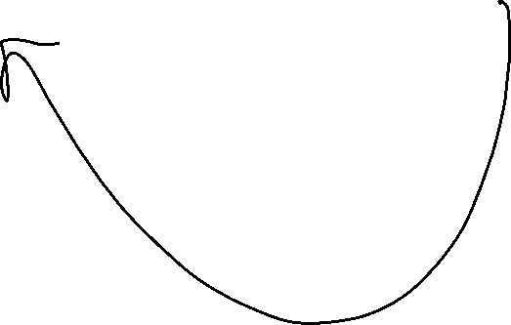









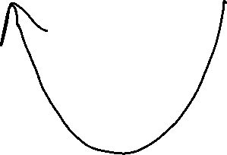






















Slide 11
Knuth Morris Pratt Algorithm for string matching
Linear algorithm
Complexity O(m+n)
Never backtracks on the input text string T
Makes use of prefix function
The compute prefix function calculates the overlap of pattern string with itself.
The KMP matcher calculates the overlap between the text string and the pattern string.

Slide 12
Find the Longest prefix suffix array LPS or Pi as you call it and see if the pattern string is present in the original text and how many times and what offsets
1)
Text T is : abacaabaccabacabaa
Pattern P is : abacab Pi values: 001012
2)
Text T is: bacbabababacaab
Pattern P is: ababaca
Pi values: 0012301

Slide 13
Amortized analysis of KMP

Slide 14
KMP Analysis Amortized

Slide 15
What is the worst case for computelpsArray?
Abcde
0 0 0 0 0
So, i is strictly less than m
New value of len is strictly less than its current value
len can never be greater than i
And len never becomes negative!
So len can be decremented only as much as i has been incremented!
If I can increment m times, len can decrement m times
In the worst case m increments and m decrements means O(2m) which is O(m) i.e. loop runs 2m times
Exactly parallel argument for KMPSearch
i is strictly less than.
New value of j is strictly less than its current value
j is always less than i
j never becomes negative
So j can be decremented as much as i is incremented!
In the worst case n increments and n decrements means O(2n) i.e loop runs 2n times
So KMP algorithm = O(2m+2n) = O(m+n) i.e. linear in size of text string and pattern string

Slide 16
Thank you !
Any Questions?

