Slide 1
The Boolean Model

Slide 2
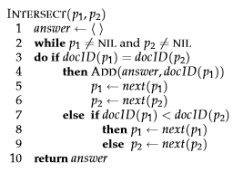
Posting list intersection algorithm(AND query)

Slide 3
Order of processing
For a conjunctive query, is processing postings lists in order of size guaranteed to be optimal?
Term 1 – 1,2,3
Term2 – 2,3,4,5
Term3 – 10,11,20,30,50

Slide 4
Write the pseudo code for posting list merge for two posting lists for an OR query…………
function merge_posting_lists_OR(PL1, PL2):
pointer1 = 0 // Pointer for PL1
pointer2 = 0 // Pointer for PL2
ML = [] // Initialize empty list for merged result
while pointer1 < length(PL1) AND pointer2 < length(PL2):
if PL1[pointer1] == PL2[pointer2]:
// If both pointers point to the same document ID, add it once
ML.append(PL1[pointer1])
pointer1 += 1
pointer2 += 1
elif PL1[pointer1] < PL2[pointer2]:
// If the document ID in PL1 is smaller, add it and move pointer1
ML.append(PL1[pointer1])
pointer1 += 1
else:
// If the document ID in PL2 is smaller, add it and move pointer2
ML.append(PL2[pointer2])
pointer2 += 1
// Add any remaining document IDs from PL1
while pointer1 < length(PL1):
ML.append(PL1[pointer1])
pointer1 += 1
// Add any remaining document IDs from PL2
while pointer2 < length(PL2):
ML.append(PL2[pointer2])
pointer2 += 1
return ML

Slide 5
For the queries below, can we still run through the intersection in O(x+y) time where x and y are the lengths of the posting lists for Brutus and Caesar? If not what can we achieve?
a. Brutus AND NOT Caesar
B. Brutus OR NOT Caesar

Slide 6
Recommend the query processing order for:
(tangerine OR trees) AND (marmalade OR skies) AND (Kaliedoscope OR eyes)
Given the following posting list sizes:
Term | Postings Size
eyes | 213312
Kaliedoscope | 87009
marmalade | 107913
skies | 217658
tangerine | 46653
trees | 316812

Slide 7
Question
For the queries below, can we still run through the intersection in time O(x + y), where x and y are the lengths of the postings lists for Brutus and Caesar? If not, whatcan we achieve?
a. Brutus AND NOT Caesar
b. Brutus OR NOT Caesar

Slide 8
Answer
a. Time is O(x+y). Instead of collecting documents that occur in both postings lists, collect those that occur in the first one and not in the second.
b. Time is O(N) (where N is the total number of documents in the collection) assuming we need to return a complete list of all documents satisfying the query. This is because the length of the results list is only bounded by N, not by the length of the postings lists.

Slide 9
Question
Extend the postings merge algorithm to arbitrary Boolean query formulas. What is its time complexity? For instance, consider:
c. (Brutus OR Caesar) AND NOT (Anthony OR Cleopatra)
Can we always merge in linear time? Linear in what? Can we do better than this?

Slide 10
Answer
We can always intersect in O(qN) where q is the number
of query terms and N the number of documents, so the intersection time is
linear in the number of documents and query terms. Since the tightest bound
for the size of the results list is N, the number of documents, you cannot do
better than O(N).

Slide 11
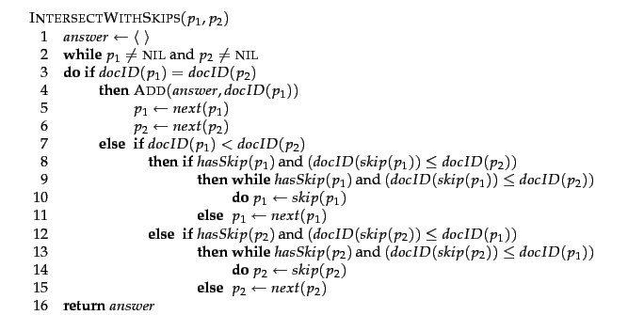
Posting list intersection with skip pointers

Slide 12
Posting list intersection with skip pointers example

Slide 13
heuristic for placing skips
PL of length p
No of skip pointers ?

Slide 15
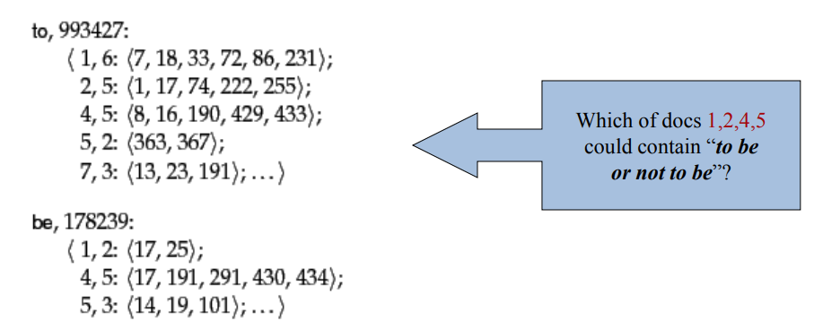
Positional Index

Slide 16
