Slide 1
Use of positional index
It is majorly used to handle phrase queries
Consider the following positing lists
Term1: 1:<7,50>
Term2: 1: <17,45>
K = 10

Slide 2
Proximity Intersection Algorithm/ Positional Intersect Algorithm
An algorithm for proximity intersection of postings lists p1 and p2. The algorithm finds places where the two terms appear within k words of each other and returns a list of triples giving docID and the term position in p1 and p2.
Key idea of the algorithm is it moves the pointers only to the right. Its not brute force.

Slide 3
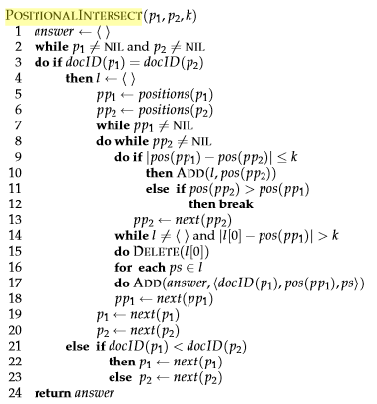

Slide 4
Consider the following two posting lists P1 and P2 and K is 10. Find out Term1 /k Term2
Term1: Doc1: 2: <7, 50>
Term2: Doc1: 2: <17, 45>

Slide 5
Consider the following positional index and it is given that k = 5. Find out Term 1 /k Term 2
Term1: Doc1: 4: <1, 10, 20, 46>
Doc2: 6: <1, 7, 8, 15, 40, 50>
Doc3: 2: <17, 88>
Doc5: 4: < 9, 15, 22, 37>
Term2: Doc2: 5: <3, 10, 20, 45, 100>
Doc4: 3: <1, 7, 19, 55>
Doc5: 2: <6, 13>

Slide 6
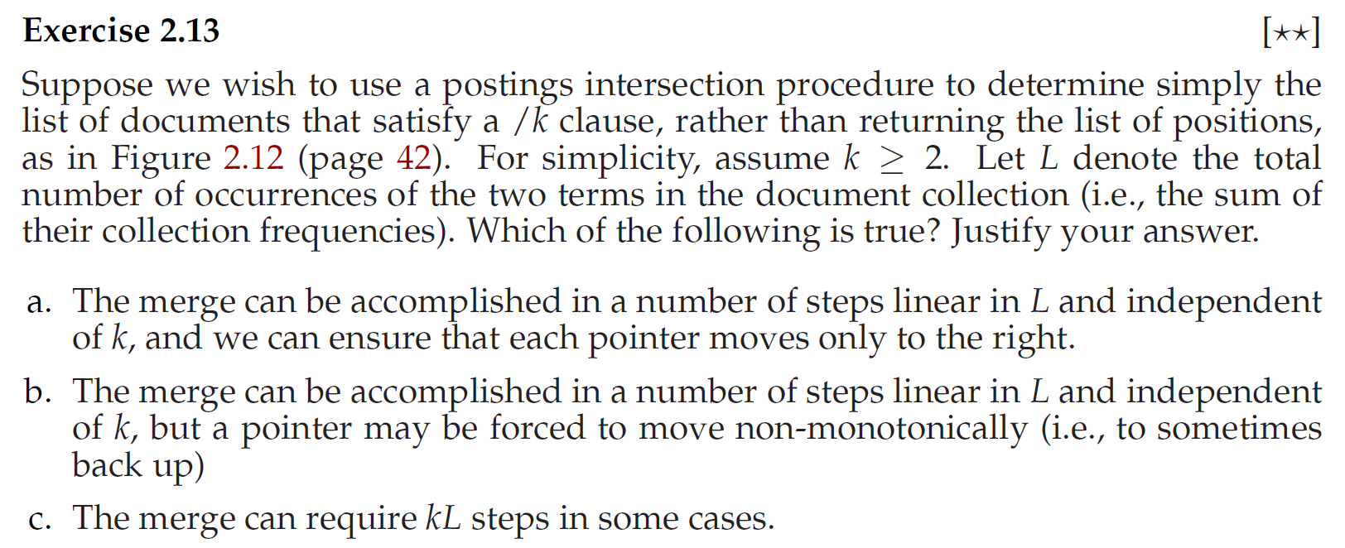

Slide 7
Applications of Positional Intersect Algorithm
Search Engines : Documents where the query terms appear close to each other are likely to be more relevant. Document Clustering: Documents that have a high number of common terms appearing at similar positions can be considered similar and can be clustered together into one category.
Text Analytics: It can be used to find sentences or paragraphs where specific terms co-occur, which can be useful in sentiment analysis or topic modelling
Natural Language Processing (NLP): In NLP, the Positional Intersect algorithm can be used to find patterns in text. For example, it can be used to find instances of a specific grammatical structure in a data collection.
Plagiarism Detection: By locating parts of text where many terms appear in the same order or very close to each other, it's possible to identify potential cases of plagiarism.

Slide 8
Biword Indices plus positional indices- Combination scheme
Biword indexes and positional indexes can be profitably combined.
Many biwords are extremely frequent: Michael Jackson, Britney Spears etc
For these biwords, increased speed compared to positional postings intersection is substantial.
Combination scheme: Include frequent biwords as vocabulary terms in the index. Do all other phrases by positional intersection.

Slide 9
Disadvantages of Boolean Retrieval Model
The Boolean model gives counterintuitive results for certain types of queries
A and B and C and D and E
Low precision
Low recall
Size of the output may be too large or too small
No provision for ranking. All the documents have the same rank
Difficult to control the number of documents retrieved
During the indexing process for the Boolean model, it is necessary to decide whether a particular document is either relevant or nonrelevant with respect to a given index term
The Boolean model has no provision for assigning importance factors or weights to query terms
Difficult to perform relevance feedback

