Slide 1
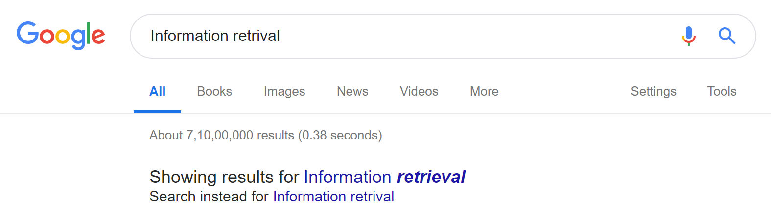
Dictionaries and Tolerant retrieval

Slide 2
How does that happen
String matching Algorithms……
Edit Distance is one of those

Slide 3
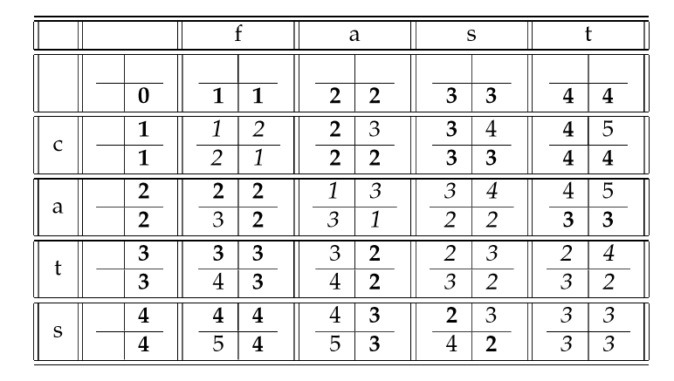
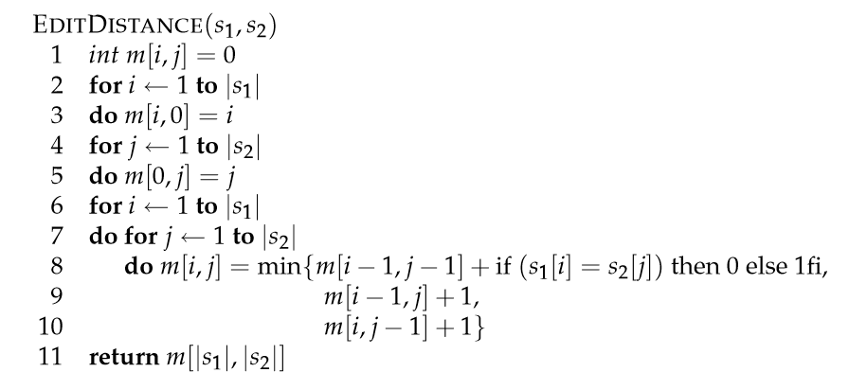
Edit distance between ‘cats’ and ‘fast’

Slide 4


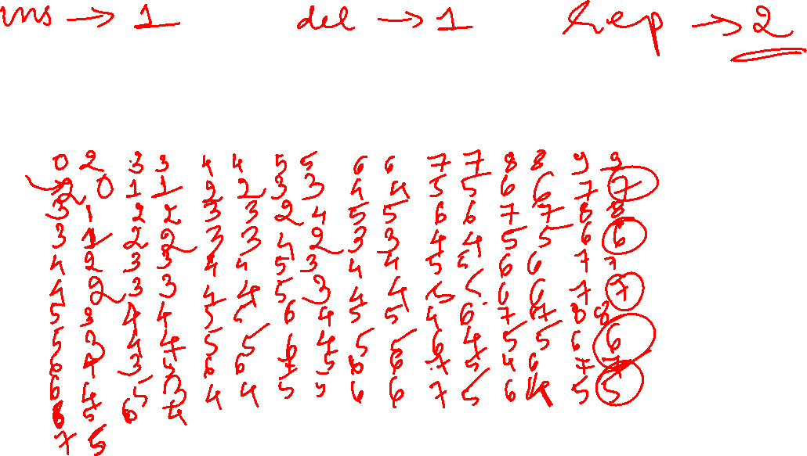


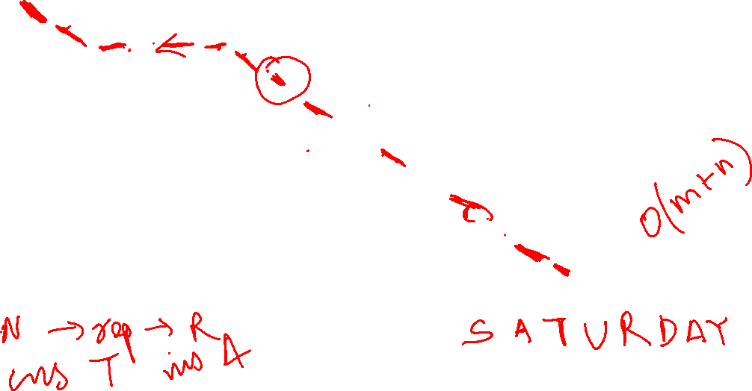
0 | S 1 | A 2 | T 3 | U 4 | R 5 | D 6 | A 7 | Y 8
S 1
U 2
N 3
D 4
A 5
Y 6

Slide 5

















0 | S 1 | A 2 | T 3 | U 4 | R 5 | D 6 | A 7 | Y 8
S 1
U 2
N 3
D 4
A 5
Y 6

Slide 6











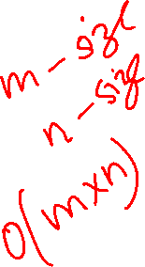
Tracing back the answer

Slide 7
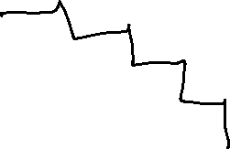



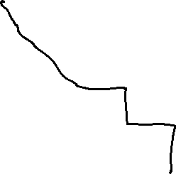


Minimum edit distance algorithm
Lavenshtein distance – when insert, delete, replace all costs 1 unit
Max(s1,s2) when no common character
Time complexity ?
O(mXn)
Trace back the answer

Slide 8




Note:
Insertion
Deletion
Replacement

Slide 9


0 | I 1 | N 2 | T 3 | E 4 | N 5 | T 6 | I 7 | O 8 | N
E 2
X 4
E 6
C 8
U 10
T 12
I 14
O 16
N 18

Slide 10


