Slide 1
Dictionaries
Mansi A. Radke

Slide 2
We address the following aspects in this chapter
Firstly we need to search for a term in the query in the vocabulary
We need to develop data structures that help the search for terms in the vocabulary in an inverted index
Secondly we study the idea of wildcard query
* - wildcard
E.g. automat* automation, automatic, automated etc.
This is used when:
a user is unsure about the spelling or
wants to search for variants of a query term
Thirdly addressing spelling errors
Isolated spelling correction
Edit distance
K-gram overlap
Context sensitive spelling correction
Fourthly searching phonetically close query terms

Slide 3
We address four aspects in this chapter
Firstly we need to search for a term in the query in the vocabulary
We need to develop data structures that help the search for terms in the vocabulary in an inverted index
Secondly we study the idea of wildcard query
* - wildcard
E.g. automat* automation, automatic, automated etc.
This is used when:
a user is unsure about the spelling or
wants to search for variants of a query term
Thirdly addressing spelling errors
Isolated spelling correction
Edit distance
K-gram overlap
Context sensitive spelling correction
Fourthly searching phonetically close query terms

Slide 4
What is the data structure used to represent the dictionary of an inverted index?
When a user poses a query, first task is to check whether each query term exists in the dictionary or vocabulary of the inverted index.
The vocabulary lookup operation is to be supported by the data structure.
There are two ways in which dictionary can be implemented:
Hashing
Search trees

Slide 5
Search trees or Hashing?
Terms in the dictionary are called as keys (as per data structures nomenclature).
Whether we use a search tree or whether we use hashing, is governed by the following facts:
How many keys are we likely to have?
Is the number likely to be static or will change often?
The change could be in the form of adding new keys or also deletion of existing keys from the dictionary?
What are the relative frequencies with which these keys could be accessed?

Slide 6
Hashing – advantages and drawbacks
Advantages
Hashing has been used for dictionary look up in some search engines
Each key is hashed to an integer over a large enough integer space to avoid collisions
Still collisions could be there and for handling them some auxiliary data structures need to be maintained which need some effort
Drawbacks
We cannot seek for all instances of a word with a prefix say automat like automatic, automatically, automaton etc.
In a setting such as the World Wide Web where the size of the vocabulary keeps growing, a hash function designed for current needs may not suffice in few years time

Slide 7
Search trees overcome the drawbacks of Hashing
We can enumerate all the query terms with the prefix automat
We can search in log n time provided the tree is balanced
The principle issue here is rebalancing needs to be done if new terms/keys are added or some terms/keys are deleted from the tree
Note: Search trees demand that the characters used in the document collection have a prescribed ordering like A…B…..Z

Slide 8
To avoid rebalancing B tree can be used
B tree is the structure used for dictionaries in search engines

Slide 9
We address four aspects in this chapter
Firstly we need to search for a term in the query in the vocabulary
We need to develop data structures that help the search for terms in the vocabulary in an inverted index
Secondly we study the idea of wildcard query
* - wildcard
E.g. automat* automation, automatic, automated etc.
This is used when:
a user is unsure about the spelling or
wants to search for variants of a query term
Thirdly addressing spelling errors
Isolated spelling correction
Edit distance
K-gram overlap
Context sensitive spelling correction
Fourthly searching phonetically close query terms

Slide 10
Wildcard Queries
They are used in the following situations:
User is unsure of the spelling (Sydney versus Sidney)
User is unaware of multiple variants of the spelling of a term (Color versus colour)
User wants to check if the search engine is performing stemming (judicial versus judiciary leading to the wildcard query judicia*)

Slide 11
Search trees as dictionary are convenient for handling trailing wildcard queries where * is at the end of the word for e.g. mon*
What about when the wildcard character is not trailing one i.e. the * symbol is not constrained to be at the end of the search string
For now consider leading wildcard query *mon
We can do the following to handle it:

Slide 12
Consider a reverse B tree on the dictionary where – one in which root to leaf path of the B-tree corresponds to a term in the dictionary written backwards.
Lemon will be written as root->n->o->m->e->L
A traversal of the reverse B tree then enumerates all terms in the vocabulary with a given prefix

Slide 13
Using a regular B-tree with a reverse B-tree, we can handle even more general case , wildcard queries in which there is a single * symbol such as e.g. se*mon
With the regular B tree we enumerate the set W of dictionary terms beginning with the prefix se and a non-empty suffix
Reverse B tree to enumerate set R of all terms ending with the suffix mon
Then we take intersection of W and R and thus handle wildcard queries that contain a single * symbol

Slide 14
What about general wildcard queries?
Permuterm index
Hello$
ello$H
llo$He
lo$Hel
o$Hell
$Hello
The key is to roate the wildcard query and bring it to the end and then use our algorithm.
Permuterm vocabulary
Disadvantage – dictionary becomes bigger

Slide 15
Fi*mo*er
All terms in the dictionary that are in the permuterm index of erFi*
Exhaustively search all of those to check which terms have mo.

Slide 16
K-Gram indexes for wildcard queries
Almost 10 fold space increase by permuterm index in the dictionary
Castle
$castle$
3 grams are:
$ca
cas
ast
stl
tle
le$

Slide 17
All kgrams that occur in the corpus form the dictionary and posting of a kgram has all words which contain that kgram ‘
Consider query: re*ve
Run a Boolean query $re and ve$

Slide 18
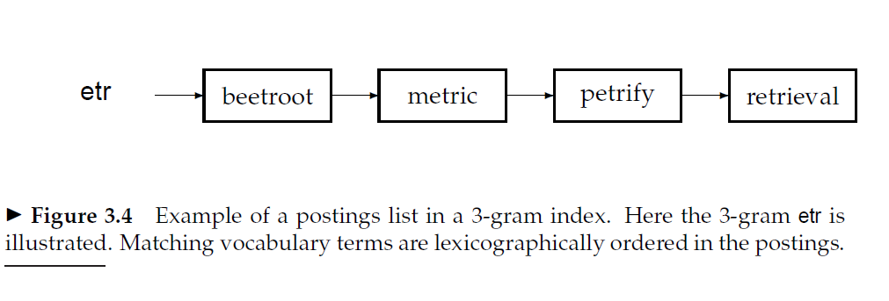
Wild card query processing puts load on the search engine, so this functionality is hidden in advanced search option which is not used every time the user searches for something

Slide 19
We address four aspects in this chapter
Firstly we need to search for a term in the query in the vocabulary
We need to develop data structures that help the search for terms in the vocabulary in an inverted index
Secondly we study the idea of wildcard query
* - wildcard
E.g. automat* automation, automatic, automated etc.
This is used when:
a user is unsure about the spelling or
wants to search for variants of a query term
Thirdly addressing spelling errors
Isolated spelling correction
Edit distance
K-gram overlap
Context sensitive spelling correction
Fourthly searching phonetically close query terms

Slide 20
Edit distance algorithm and Restricted Edit distance algorithm for isolated spelling correction
Done already

Slide 21
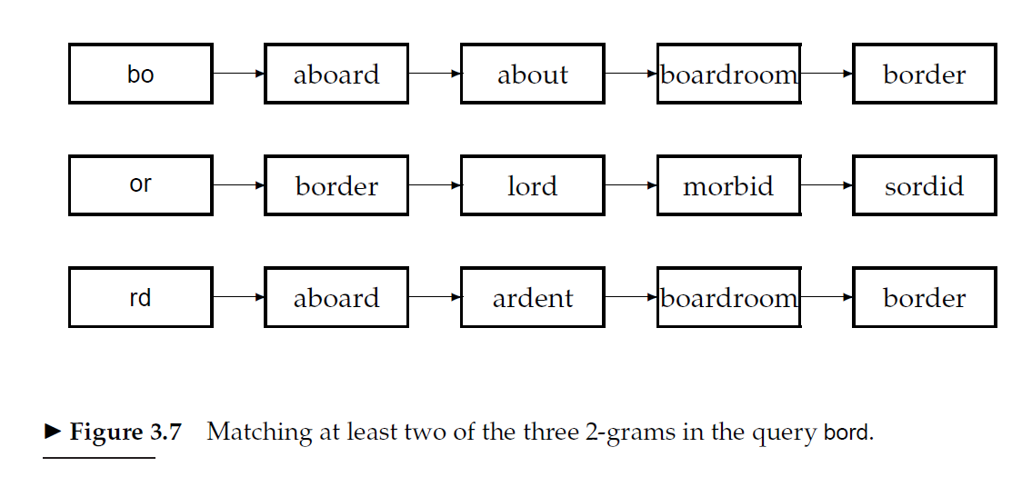
K-gram indexes for spelling correction
To further limit the set of vocabulary terms for which we compute edit distances to the query term, we now show how to invoke the k-gram index to assist with retrieving vocabulary terms with low edit distance to the query q.
we will use the k-gram index to retrieve vocabulary terms that have many k-grams in common with the query. We will argue that for reasonable definitions of “many k-grams in common,” the retrieval process is essentially that of a single scan through the postings for the k-grams in the query string q
Suppose we wanted to retrieve
vocabulary terms that contained at least two of these three bigrams. A single
scan of the postings would let us enumerate all such terms; in the example of Figure 3.7 we would enumerate aboard, boardroom and border.

Slide 22
This straightforward application of the linear scan intersection of postings immediately reveals the shortcoming of simply requiring matched vocabulary terms to contain a fixed number of k-grams from the query q: terms like boardroom, an implausible “correction” of bord, get enumerated.
we require more nuanced measures of the overlap in k-grams between a vocabulary term and q.
The linear scan intersection can be adapted when the measure of overlap is the Jaccard coefficient for measuring the overlap between two sets A and B, defined to be |A ∩ B|/|A ∪ B|. The two sets we consider are the set of k-grams in the query q, and the set of k-grams in a vocabulary term. As the scan proceeds, we proceed from one vocabulary term t to the next, computing on the fly the Jaccard coefficient between q and t. If the coefficient exceeds a preset threshold, we add t to the output; if not, we move on to the next term in the postings. To compute the Jaccard coefficient, we need the set of k-grams in q and t.
Since we are scanning the postings for all k-grams in q, we immediately have these k-grams on hand. What about the k-grams of t? In principle, we could enumerate these on the fly from t; in practice this is not only slow but potentially infeasible since, in all likelihood, the postings entries themselves do not contain the complete string t but rather some encoding of t.

Slide 23
The crucial observation is that to compute the Jaccard coefficient, we only need the length of the string t.
To see this, recall the example of Figure 3.7 and consider the point when the postings scan for query q = bord reaches term t = boardroom. We know that two bigrams match. If the postings stored the (pre-computed) number of bigrams in boardroom (namely, 8), we have all the information we require to compute the Jaccard coefficient to be 2/(8+3−2); the numerator is obtained from the number of postings hits (2, from bo and rd) while the denominator is the sum of the number of bigrams in bord and boardroom, less the number of postings hits.
We could replace the Jaccard coefficient by other measures that allow efficient on the fly computation during postings scans.
How do we use these for spelling correction?
One method that has some empirical support is to first use the k-gram index to enumerate a set of candidate vocabulary terms that are potential corrections of q. We then compute the edit distance from q to each term in this set, selecting terms from the set with small edit distance to q.

Slide 24
Pseudo code for calculating Jaccard coefficient
Jaccard (query, t)
A = set of k-grams of t
B = set of k-grams of query
count=0
for i = 1 to length(B)
list = postingslist of B[i]
if (list contains t)
count++
Jaccard co-efficient = count/(length(A)+length(B)-count)

Slide 25
Consider the four-term query ‘catched in the rye’ and suppose that each of the query terms has five alternative terms suggested by isolated-term correction. How many possible corrected phrases must we consider if we do not trim the space of corrected phrases, but instead try all six variants for each of the terms?
6*6*6*6

Slide 26
Jaccard coefficient considering bigrams
J(X,Y) = |X∩Y| / |X∪Y|
J(bord, border) = 3/5
bo, or, rd, bo, or, rd, de, er
J(bord, lord) = 2/4
Bo, or, rd, lo, or, rd
J(bord, morbid) = 1/7
J(bord, sordid) = 2/6

Slide 27
Context sensitive spelling correction
Flew form Heathrow
Individually each word is correct
But phrase is incorrect
Enumerate the corrections of each of the query term though each of the terms are correctly spelled with known algorithms and try substitutions of each correction in the phrase.
This is expensive, too many combinations
So, some heuristics used to trim the search space
Most frequent combinations in the collection
Most frequent combinations in the query logs
Biwords considered which are more common
For example, ‘flew from’ would be considered but not ‘fled fore’ and ‘flea form’ since ‘flew from’ is a more common biword.

Slide 28
We address four aspects in this chapter
Firstly we need to search for a term in the query in the vocabulary
We need to develop data structures that help the search for terms in the vocabulary in an inverted index
Secondly we study the idea of wildcard query
* - wildcard
E.g. automat* automation, automatic, automated etc.
This is used when:
a user is unsure about the spelling or
wants to search for variants of a query term
Thirdly addressing spelling errors
Isolated spelling correction
Edit distance
K-gram overlap
Context sensitive spelling correction
Fourthly searching phonetically close query terms

Slide 29
Phonetic correction
Misspellings that arise because user types a query which sounds like the target term.
Main idea is to generate, for each term, a “phonetic hash” so that similar sounding terms hash to the same value.
Algorithms for phonetic hashing are known as soundex algorithms.

Slide 30
Phonetic correction – soundex algorithm
1. Turn every term to be indexed into a 4-character reduced form. Build an inverted index from these reduced forms to the original terms; call this the soundex index.
2. Do the same with query terms.
3. When the query calls for a soundex match, search this soundex index. The variations in different soundex algorithms have to do with the conversion of terms to 4-character forms. A commonly used conversion results in a 4-character code, with the first character being a letter of the alphabet and the other three being digits between 0 and 9.

Slide 31
Conversion of terms to four character form
1. Retain the first letter of the term.
2. Change all occurrences of the following letters to ’0’ (zero): ’A’, E’, ’I’, ’O’,’U’, ’H’, ’W’, ’Y’.
3. Change letters to digits as follows:
B, F, P, V to 1.
C, G, J, K, Q, S, X, Z to 2.
D,T to 3.
L to 4.
M, N to 5.
R to 6.
4. Repeatedly remove one out of each pair of consecutive identical digits.
5. Remove all zeros from the resulting string. Pad the resulting string with trailing zeros and return the first four positions, which will consist of a letter followed by three digits.

Slide 32
Soundex of Hermann according to previous steps
Hermann
Retain H
E -> 0 H0
R ->6 H06
M ->5 H065
A -> 0 H0650
N -> 5 H06505
N -> 5 H065055
Remove consecutive digits H06505
Remove all 0s H655
Pad 0s. H65500000……
Final code: H655

Slide 33
The algorithm rests on a few observations:
Vowels are viewed as interchangeable in transcribing names
Consonents with similar sounds are kept in equivalence classes
e.g. D and T

Slide 34
Find two differently spelled proper nouns whose soundex codes are same
Answer: MARY and MIRA and MEERA and MYRA M060 and M060 and M0060 and M060
M600 and M600 and M600 and M600

Slide 35
Find two phonetically similar proper nouns whose soundex codes are different
Chebyshev and Tchebycheff
C00102001 and T2001020011
C121 and T212

Slide 36
Thank you !!!

