Slide 1
Index construction
Mansi A. Radke

Slide 2
Note
Assumption: Collection is static i.e. it never changes …. There are no additions or deletions to the collection
Desirable to keep entire index in RAM for performance reasons, however in many applications it is not feasible
Hard drive is much cheaper than the RAM. In 2010 1GB RAM costed 200 times of the cost of 1GB hard drive space. This difference might be even more today
An in memory index is 10 to 20 times faster than an on-disk index.
Hence throughout the chapter we focus on hybrid organizations of the index in which some parts of the index are kept in main memory and majority of the data are on the hard disk. We do so assuming that main memory is a scarce resource

Slide 3
Index components
Dictionary
Posting lists
Note that for every query term in an incoming search query, the search engine first needs to locate the term’s posting list before it can start actually processing the query
It is the dictionary which provides a mapping between the terms and the location of their posting lists in the index

Slide 4
Life cycle of an inverted index
Index construction
The text collection is processed sequentially, one token at a time, and a postings list is built for each term in the collection in an incremental fashion
Also called phase 1
The time required for this is called indexing time
Query processing
The information stored in the index built in the phase 1 is used to process search queries
Also called as phase 2
The time required for this is called as query time

Slide 5
Dictionary
Dictionary is the central data structure that is used to manage the set of terms in a text collection
Provides mapping between index term and the location of its posting list
At query time locating the posting list if one of the first operations performed when processing an incoming keyword query
At indexing time, the dictionary’s lookup capability allows the search engine to quickly obtain the memory address of the inverted list for each incoming term and append a new posting at the end of that list

Slide 6
Set of operations supported by the dictionary
Insert a new entry for term T
Find and return the entry for term T (if present)
Find and return the entries of all terms that start with a given prefix P
For e.g. prefix queries like “inform*” – all words that begin with prefix inform

Slide 7
Size of the dictionary
For a typical natural language text collection, the size of the dictionary is very small compared to the total size of the index
Examples: GOV 2 copus 0.6 percent, Shakespeare corpus – 7%
(This is because of the Zipf’s law – assume for now as we will study it later)
Hence we assume that the dictionary is small enough to fit into the main memory
Notes:
%

Slide 8
Two most common ways to realise an in-memory dictionary are:
A sort-based dictionary, in which all the terms that appear in the text collection are arranged in a sorted array or in a search tree, in lexicographical (i.e. alphabetical) order. Lookup operations are realised through tree traversals typically using a BST when the list is sorted
A hash based dictionary, in which each index term as a corresponding entry in a hash table. Collisions in the table (i.e. two terms are assigned the same hash value) are resolved using chaining

Slide 9
Basic steps in constructing a non positional index are:
Make a pass through the collection collecting all term id - document id pairs
Sort the term id – document id pairs with term id as the dominant key and the document id as the secondary key
Organise the document ids for each term into a posting list
Compute the statistics like term and document frequency
For small collections, all this can happen in the memory. Our focus is on methods for large collections that require the use of secondary storage
Note: termIDs are represented as numbers instead of strings where each termID is a unique serial number

Slide 11
Blocked Sort Based Indexing – An external sorting algorithm
Segments the collection into parts of equal size
Sorts the termID-docID pairs of each part in the memory
Stores intermediate sorted results on the disk
Merges the intermediate results into the final index

Slide 13
ParseNextBlock accumulates termID documentID pairs in memory until a block of fixed size is full.
We choose a block size such that it fits comfortably in the main memory to permit fast in memory sort
The block is then inverted and written to disk. Inversion involves 2 steps:
Sort termID – docID pairs
Collect all termID – docID pairs into a posting list

Slide 15
Merging – suppose 10 blocks
Open all the block files simultaneously
Maintain small read buffers for the 10 blocks which we are reading
A small write buffer for the final merged index which we are writing
In each iteration, the smallest term id is selected which has not been processed yet using a priority queue or similar data structure
All posting lists for this term id are read and merged
Merged list is written back to the disk
Each buffer is filled from its file when necessary

Slide 16
Time complexity of BSBI
O(T Log T) where T is the number of term id – doc id pairs
The step with highest time complexity is sorting which takes O (T Log T) time
But, ParseNextBlock and MergeBlocks usually dominates time taken due to disk access time

Slide 17
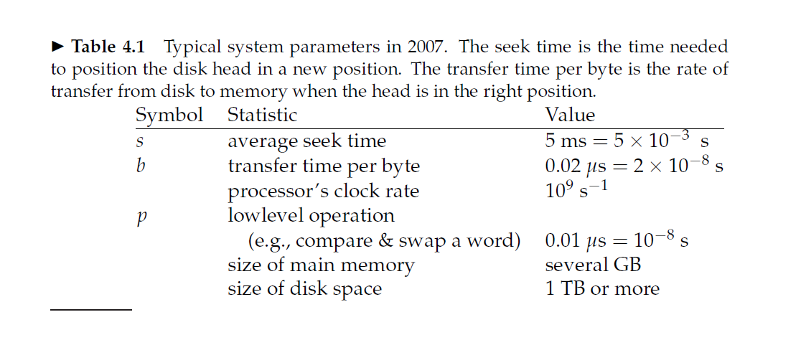

Slide 18
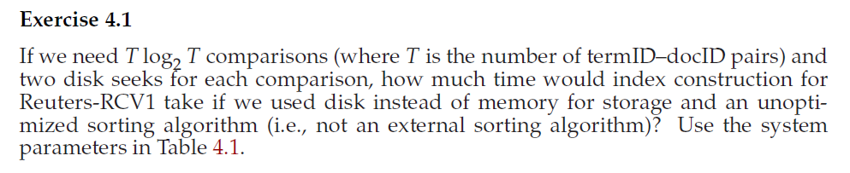
Solve the following question…

Slide 19
Solution
An unoptimized sorting algorithm would be to have all the postings stored on the disk and transfer them back and forth from disk to memory to make comparisons
A trivial index construction would consist of these 2 steps:
Parsing the documents and creating the postings O(n)
Sorting the postings 2*n log n * diskseektime
For RCV1
N = 100,000,000 = 10^8
Step 2 dominates the total time by a large factor
Answer = 2 * 10^8 * log 10^8 * 5 * 10^-3 seconds

Slide 20
Answer the following question…
How would you create the dictionary in blocked sort based indexing on the fly to avoid an extra pass through the data?
Solution: Simply accumulate the vocabulary in memory using a hash

Slide 21
BSBI advantages and disadvantages
Advantage:
Excellent scaling properties
Disadvantage:
Needs a data structure for mapping terms to term ids. For very large collections this data structure does not fit into memory

Slide 22
SPIMI (Single pass in memory indexing)
SPIMI uses terms instead of term ids
It writes a block of dictionary to the disk and starts a new dictionary for the next block
It can index collections of any size as long as disk space is available

Slide 24
Time complexity of SPIMI
O(T)

Slide 25
BSBI versus SPIMI
SPIMI does not collect term id –doc id pairs
SPIMI does not need to sort the term id document id pairs
SPIMI adds postings directly to its posting list
SPIMI uses a dynamic posting list (i.e. its size is adjusted as it grows)
SPIMI keeps track of the term a postings list belongs to and no term ids are stored due to which the blocks that individual calls of SPIMI-INVERT can process are larger and so the index construction process as a whole is more efficient

Slide 26
Distributed Indexing
Collections are huge
Indexing cannot be done on single machine (e.g world wide web)
Hence distributed indexing algorithms used
Distributed index is partitioned across several machines
According to term
or
According to document
In the next slides we discuss both these partitioning techniques

Slide 28
Term partitioning and document partitioning
In a document-partitioned index, each node holds an index
for a subset of the documents in the collection. For instance, the index maintained by node 2
in Figure 14.1(a) contains the following docid lists:
L1 = 4, 6, L2 = 5, L4 = 4, L5 = 6, L7 = 4, 6.
In a term-partitioned index, each node is responsible for a subset of the terms in the collection.
The index stored in node 1 in Figure 14.1(b) contains the following lists:
L1 = 1, 3, 4, 6, 9, L2 = 2, 5, L3 = 2, 3, 8.
In this chapter we will discuss about distributed indexing for term partitioned index

Slide 29
MapReduce
MapReduce is an architecture for distributed computing
Master node
Worker nodes
Master node directs the process of assigning and reassigning tasks to individual worker nodes
The map and reduce phases of MapReduce split up the computing job into chunks that standard machines can process in a short time
The chunks should be not too small and not too large

Slide 30
Role of master node
Assigns and reassigns tasks to worker nodes
As machine finishes one split, it is assigned next one
If machine dies or has hardware problems, the split it is working on is assigned to another machine

Slide 31
Key value pairs indexing are <term id, doc id >
MAP Phase:
mapping splits of input data to key value pairs
The map phase writes its output to local intermediate files called as segment files
Reduce Phase:
All values of a given key get stored together
the keys are partitioned into j term partitions
Note: The term partitions are defined by the person who operates the indexing system

Slide 32
Parsers and inverters
Parsers and inverters are not separate sets of machines.
The master identifies idle machines and assigns tasks to them.
The same machine can be a parser in the map phase and an inverter in the reduce phase.
And there are often other jobs that run in parallel with index construction, so in between being a parser and an inverter a machine might do some crawling or another unrelated task.

Slide 34
Thank you !
Any Questions?

