Slide 1
Inverted Index as an ADT
Mansi A. Radke
Note that this topic is taken from the reference book:
Information Retrieval: Implementing and evaluating search engines by Stephen Buttcher, Charles Clarke, Golden Cormak

Slide 2

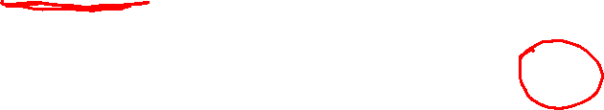
first(hurlyburly)
= 316669
first(witching)
= 265197
last(thunder)
= 1247139
last(witching)
= 265197
next(witch, 745429)
= 745451
prev(hurlyburly, 345678)
= 316669
next(hurlyburly, 345678)
= 745434
next(witch, 1245276) = ∞
prev(witch, 1598) = -∞
L_{c}= 1271504

Slide 3
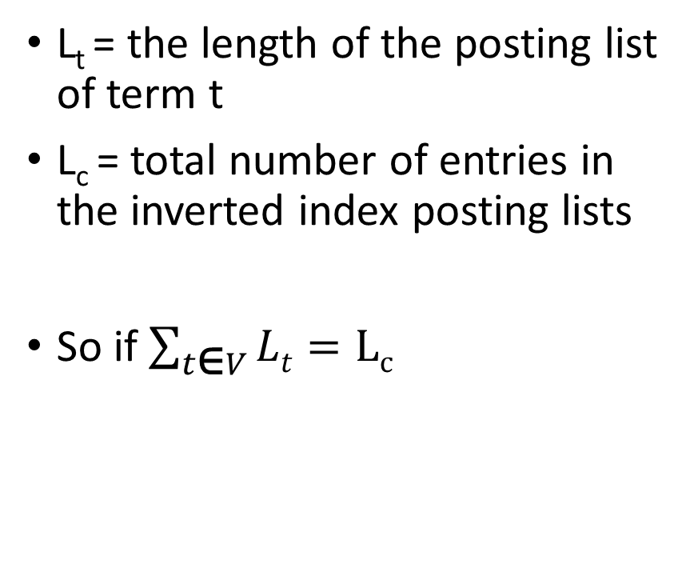
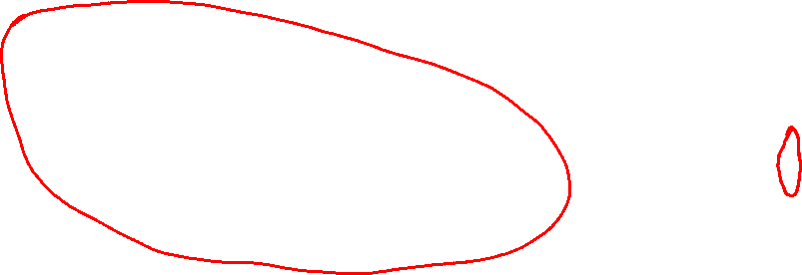
Traversing the Posting list ADT in general
L_{t} = the length of the posting list of term t
L_{c} = total number of entries in the inverted index posting lists
So if $\sum_{t\text{∈}V}{Lt}=Lc$

Slide 6
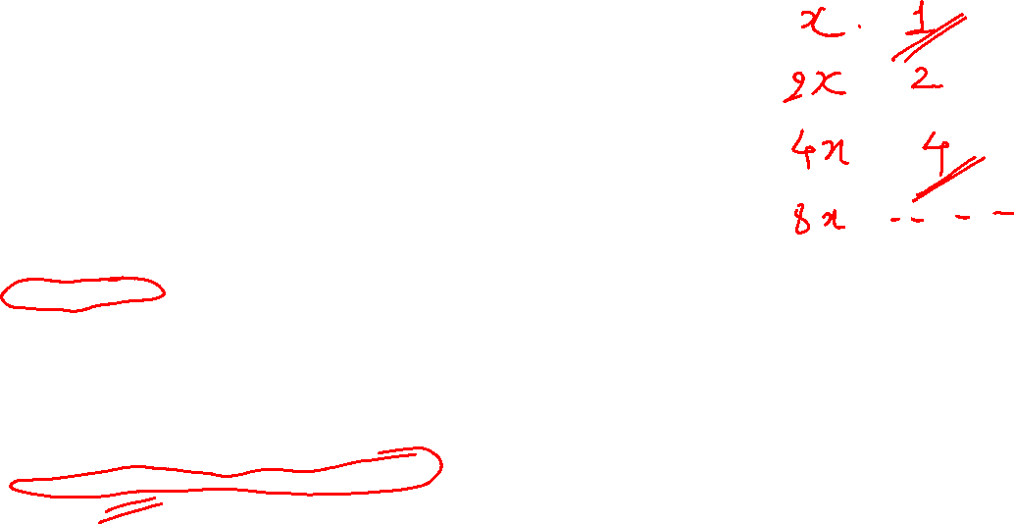

Slide 7
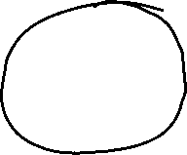
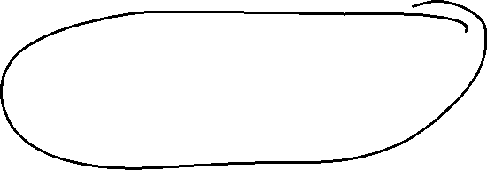


Slide 8



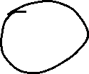















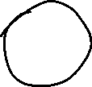




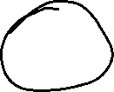


Slide 9
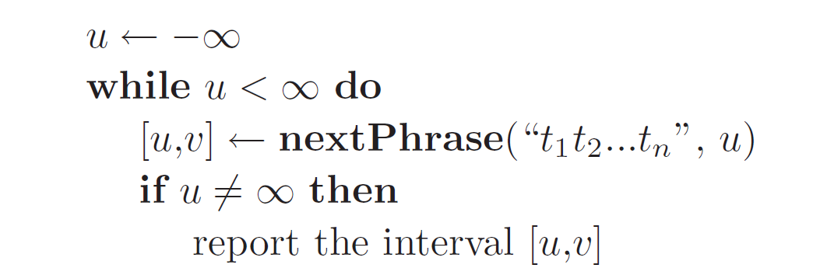
If all the occurrences of the term are required then we need another loop which calls the nextPhrase function

Slide 10
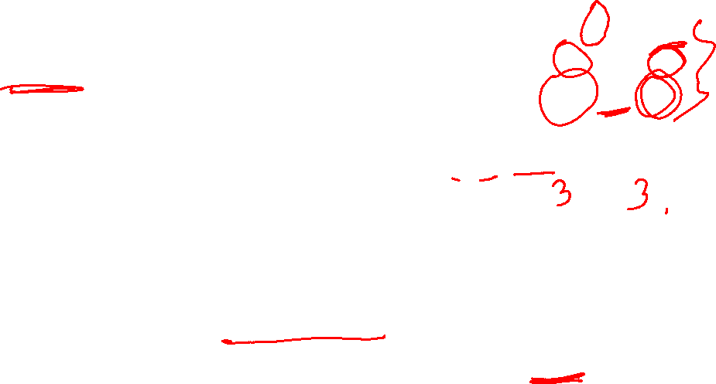
Another version of nextphrase function which makes calls to next but no calls to previous!
Example:
a-> 1->4->5->8->9->15
b->2 ->6->10->12->16
c->3->7->13->15->17
nextPhrase(a,b,c,5)
u = 8, v= 8
V= 10, v=12,v-u = 4 != n-1
nextPhrase(abc, 12-3)
= nextPhrase(abc,9)
U = 15, v= 15
V=16, v = 17, v-u = n-1 = 2
Return(15,17)

Slide 11
Question to ponder!
When combined with galloping search to find all occurrences of a phrase, would you expect improved efficiency compared to the original version? Explain.

Slide 12
Thank you !
Any Questions?

