Slide 1
Information Retrieval Winter-2024 CSL 436 3-0-2-4
Mansi A. Radke, Assistant Professor, CSE, VNIT

Slide 2
Introduction of Mansi A. Radke
B.E. (CSE), Cummins college of Engineering for Women, Pune, India - 2004
M.S. (CS), University of Maryland, Baltimore County (UMBC), USA – 2008
Ph.D. (CSE), Visvesvaraya National Institute of Technology, Nagpur, India – 2018
17+ years of experience together in industry and academics
5+ years of Industry Experience:
Cummins India limited, Pune, India (2004-2006)
SAP Washington, DC, USA (2007-2008)
Take Supply Chain, Austin, Texas, USA (2009)
Persistent systems, Nagpur, India (2009-2011)
12+ years of Teaching experience:
UMBC, Maryland, USA – Teaching Assistant (2006-2008)
Huston-Tillotson University, Austin, Texas, USA (2009)
Ramdeobaba College of Engineering, Nagpur, India (2011-2012)
Visvesvaraya National Institute of Technology, Nagpur, India (2012- till date)

Slide 3
Research Interests
Research Interests over the years
Information retrieval
Geographical Information Retrieval
Natural Language Processing
Applications of Machine learning to NLP And IR problems

Slide 4
Books for Information Retrieval
Text Book:
Christopher, D. Manning, Raghavan Prabhakar, and Schutz Hinrich. “An Introduction to information retrieval." An Introduction To Information Retrieval. Cambridge University Press, 2008.
Reference Book:
Büttcher, Stefan, Charles LA Clarke, and Gordon V. Cormack. Information retrieval: Implementing and evaluating search engines. Mit Press, 2010.
Additional resources may be pointed out in the class as and when needed.

Slide 5
Course Outline
Introduction to basics of Information retrieval
Boolean Retrieval
Posting Lists Algorithms
Inverted Indices as an ADT
Phrase Search Algorithms
Tolerant Retrieval
Edit distance algorithm
Restricted Edit distance
Damerau Edit distance
String matching algorithms
Knuth Morris Pratt Algorithm
Vector space model
Various variants of vector space model
Evaluation in Information retrieval

Slide 6
Course Outline – After Midterm
Index construction
Index compression
Relevance feedback
Probabilistic IR
Language models for IR
Latent Semantic Indexing
Web Search
Page rank algorithm
HITS algorithm
Advanced topics
Research Directions
Additional topics may be covered as per time availability

Slide 7
Grading Criteria
25 marks midterm exam
40 - 50 marks end semester exam
25 - 35 marks programming and written assignments

Slide 8
Basics of Information Retrieval

Slide 9
What is Information Retrieval?
Information Retrieval is the activity of -
obtaining information resources
relevant to an information need
from a collection of information resources.
The system doing this task is termed as a search engine!
Examples: Google, Bing, Yahoo
Note: The collection on which these search engines work is the world wide web.

Slide 10


Components of an IR System
Information
Need
Result
Query
Search Engine
deletions
Additions
Index

Slide 11
Steps In Information Retrieval
Crawling
Pre-processing
Tagging (optional)
Indexing
Relevance Ranking
Display of results to user

Slide 12
What is a corpus?
Data store / collection of documents on which search is performed
E.g. Reuters corpus, world wide web, news articles corpus etc.

Slide 13
Difference between structured and unstructured data
Structured
Data searchable by basic algorithms (The data has a structure associated with it)
Relational Database
Spread sheets etc.
Unstructured
Not searchable by basic search algorithms (The data does not have a specific structure associated with it)
Natural language text
Information Retrieval
Handles both structured and unstructured data

Slide 14
What is the difference between Information Retrieval and Data Mining?
IR retrieves the data in the same format as it is present in the data store
Example: A pdf will be returned as a pdf and doc file as it is
In data mining the data is analysed to find hidden patterns in the data
Example: A supermarket sales data could indicate that whoever buys eggs buys bread too. So they can keep bread and eggs in the same aisle.
It finds this out buy data mining and pattern matching algorithms

Slide 15
What is the difference between an information need and a query?
Information need is the need of the user or requirement of the user
Query is the representation of the information need such that computer will understand it
An IR systems performance is evaluated with reference to an information need and not with respect to the formulated query!

Slide 16
The notion of ‘Relevance’
Relevance denotes how well a retrieved document or set of documents meets the information need of the user

Slide 17
How is an IR system Evaluated?
Precision
What fraction of the returned results are relevant to the information need?
Recall
What fraction of the relevant documents in the collection were returned by the system?
F1 measure
Weighted harmonic mean of precision and recall.
Precision or recall alone is not sufficient to analyse the performance of an IR system.

Slide 18
Examples
Suppose a computer program for recognizing dogs in photographs identifies 8 dogs in a picture containing 12 dogs and some cats. Of the 8 identified as dogs, 5 actually are dogs, while the rest are cats.
The program's precision is 5/8
while its recall is 5/12.
When a search engine returns 30 pages only 20 of which were relevant while failing to return 40 additional relevant pages.
Its precision is 20/30 = 2/3
while its recall is 20/60 = 1/3.
Precision is "how useful the search results are", and recall is "how complete the results are".

Slide 19
Indexing and Inverted Indices
Inverted Indices for inverted files – Data structure
Consider the following
Doc 1: I am Mansi
Doc 2: I live in Nagpur
Doc 3: I am a teacher
Dictionary for this corpus will consist of the following words:
I, am, Mansi, live, in, Nagpur, am, a, teacher
Inverted Index for this corpus will look like
I
am
Mansi
live
in
Nagpur
a
teacher
doc1
doc2
doc3
doc1
doc3
doc1
doc2
doc2
doc2
doc3
doc3

Slide 20
Inverted Index of a corpus
Term Vocabulary / Lexicon/ Dictionary
+ =
Posting list for each term
Inverted Index for the corpus
(Note: Indexing is a one time activity)

Slide 21
Draw the inverted index for the following document collection.
Doc 1: new home sales top forecasts
Doc 2: home sales rise in July
Doc 3: increase in home sales in July
Doc 4: July new home sales rise

Slide 22
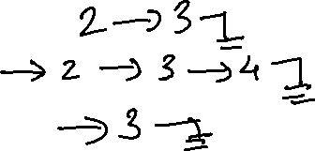
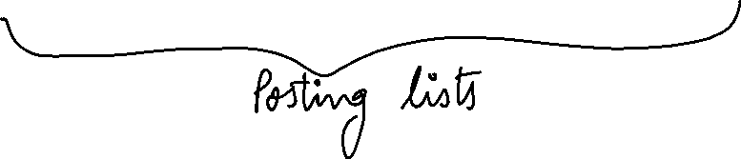

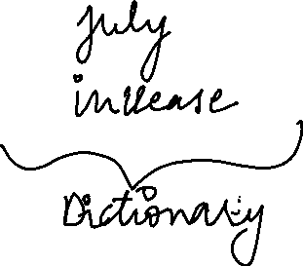







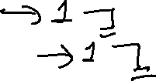



Slide 23
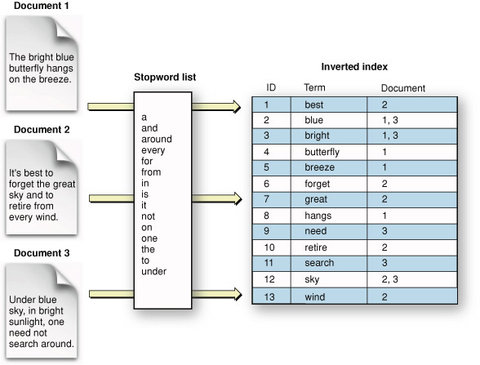
The inverted Index – another example

Slide 24
Term Document Incidence Matrix
Consider the following corpus consisting of 3 documents
Doc 1: I am Mansi
Doc 2: I live in Nagpur
Doc 3: I am a teacher
Dictionary/Vocabulary/Lexicon for this corpus will consist of the following words:
I, am, Mansi, live, in, Nagpur, a, teacher
The term document Incidence matrix for this corpus will look like:
 | Doc1 | Doc2 | Doc3
I | 1 | 1 | 1
am | 1 | 0 | 1
Mansi | 1 | 0 | 0
live | 0 | 1 | 0
in | 0 | 1 | 0
Nagpur | 0 | 1 | 0
a | 0 | 0 | 1
teacher | 0 | 0 | 1

Slide 25
Draw the term document incidence matrix for the following document collection
Doc 1: Breakthrough drug for schizophrenia
Doc 2: New schizophrenia drug
Doc 3: New approach for treatment of schizophrenia
Doc 4: New hopes for schizophrenia patients

Slide 26

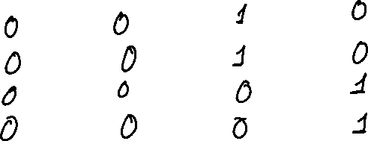
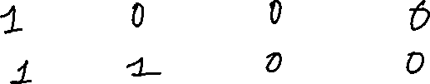
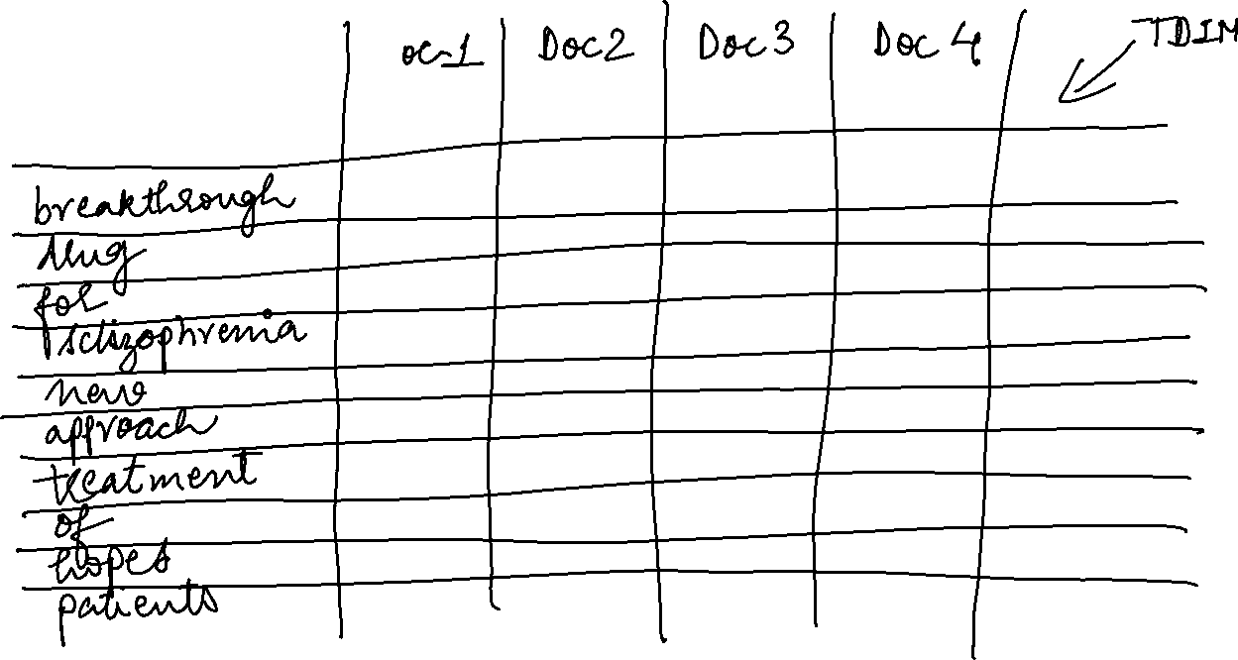

Slide 27
For the same document collection what will be the returned results for the following:
schizophrenia AND drug
Vector for ‘schizophrenia’ 1 1 1 1
Vector for ‘drug’ 1 1 0 0
for AND NOT (drug OR approach)
Vector for ‘for’ 1 0 1 1
Vector for ‘drug’ 1 1 0 0
Vector for approach 0 0 1 0

Slide 28
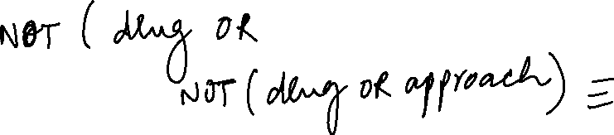




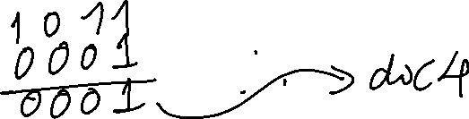
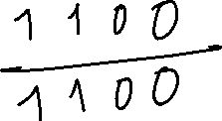




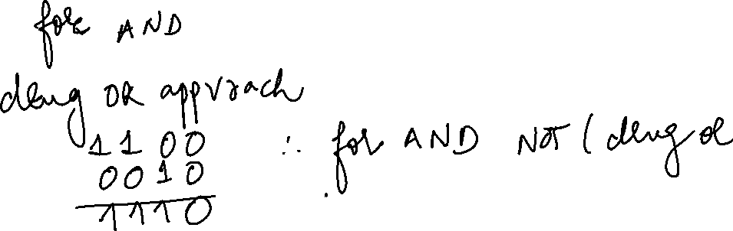

Slide 29
Term Frequency of a term in a document
Consider the following document:
The geography of a blog can be indicated in terms of its source geography and target geography. The source geography of the blog includes the physical location of the server on which the blog is located or the physical location of the author or owner of the blog. The target geography includes the contents of the blog or the subject about which the posts in the blog express opinion about. Generally people consider the target geography of a blog.
The term frequency of the word “geography” in this document is:
6
The term frequency of the word “blog” in this document is:
7

Slide 30
Document frequency of a term in a corpus
Consider a document containing 100 words wherein the word cat appears 3 times. The term frequency for cat is then 3. Now, assume that we have 10 million documents and the word cat appears in one thousand of these. Then the document frequency of the term cat in the corpus in 1000
Definition: Number of documents in the corpus which contain the particular term.

Slide 31
Stop Words in English and the concept of Stop List
["i", "me", "my", "myself", "we", "our", "ours", "ourselves", "you", "your", "yours", "yourself", "yourselves", "he", "him", "his", "himself", "she", "her", "hers", "herself", "it", "its", "itself", "they", "them", "their", "theirs", "themselves", "what", "which", "who", "whom", "this", "that", "these", "those", "am", "is", "are", "was", "were", "be", "been", "being", "have", "has", "had", "having", "do", "does", "did", "doing", "a", "an", "the", "and", "but", "if", "or", "because", "as", "until", "while", "of", "at", "by", "for", "with", "about", "against", "between", "into", "through", "during", "before", "after", "above", "below", "to", "from", "up", "down", "in", "out", "on", "off", "over", "under", "again", "further", "then", "once", "here", "there", "when", "where", "why", "how", "all", "any", "both", "each", "few", "more", "most", "other", "some", "such", "no", "nor", "not", "only", "own", "same", "so", "than", "too", "very", "s", "t", "can", "will", "just", "don", "should", "now"]
In computer search engines, a stop word is a commonly used word (such as "the") that a search engine has been programmed to ignore, both when indexing entries for searching and when retrieving them as the result of a search query.
The list of words that are not to be added is called a stop list.

Slide 32
Tf-idf model
Term frequency (tf)
Document frequency (Dft)
Inverse document frequency (idf)
Total number of terms in the corpus (N)
Inverse Document frequency (idf) for a term is given is given by log (N/Dft)
Tf-idf model weighs each term by its tf-idf value
Tf-idf value of a term is its term frequency multiplied by inverse document frequency
Tf-idf (of a term t) = tf * log (N/Dft)
How stop words get handled in this model ?
e.g. The brown crow

Slide 33




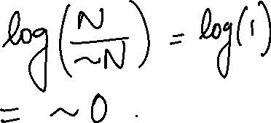



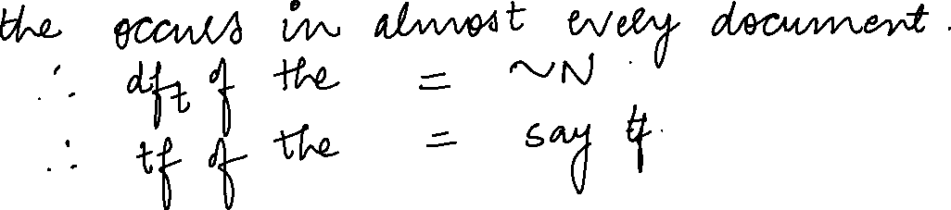


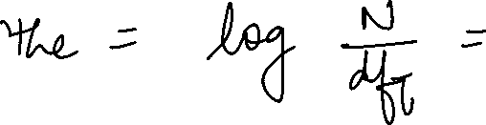

Slide 34
Some points to ponder!
Why is idf of a term always finite?
What is the idf of the term that occurs in every document? Compare this with the use of stop words list.
Can the tf-idf weight of a term in a document exceed 1?
While calculating the tf-idf scores, how does the base of the logarithm affect the scoring of the documents or ranking of the documents for a given query?

Slide 35
Stemming, lemmatization and case folding
Stemming
Chopping off affixes is called stemming
Examples of stemmers: Porter Stemmer, Snowball Stemmer, Lancaster Stemmer
Recommened: Snowball
Examples
Marketing
Market
Successful
success
Case folding
converts everything to lower case and helps match the case differences
Lemmatization:
Lemma – original form of the word
Lemmatization is the process of converting a word to its base form. The difference between stemming and lemmatization is, lemmatization considers the context and converts the word to its meaningful base form, whereas stemming just removes the last few characters, often leading to incorrect meanings and spelling errors.
Examples of lemmatizers: NLTK, TextBlob, spaCy, Pattern and Stanford CoreNLP
Recommended: Spacy
Examples
Saw
See
Is
Be
Was
be

Slide 36
Information Retrieval Models
Boolean Model
Vector Space Model
Probabilistic Model

Slide 37
Key areas in IR

Slide 38
Key Areas in Information Retrieval
Multimedia IR
Cross Language IR
Music IR
Personalised IR
Adversarial IR
Federated IR
Automatic Text summarization
Opinion extraction and Sentiment Analysis
Multimodal Information Retrieval

Slide 39
Multimedia IR
Aims at extracting semantic information from multimedia data sources
Images
Audio
Video

Slide 40
Cross Language IR
Language of query and language of resultant documents is different
Multiple names
cross-lingual information retrieval
Query in one language, results in another
translingual information retrieval
Query in one language, results in more than one language
multilingual information retrieval
Results from various languages translated into the user's language

Slide 41
Music Information Retrieval
Music information retrieval (MIR) is the interdisciplinary science of retrieving information from music
Multimodal Music Information Retrieval – very upcoming area!
Related fields with the perspective of engineering and computer science:
signal processing
Informatics
machine learning
optical music recognition
computational intelligence
or some combination of these!

Slide 42
Personalised IR
The diversity of users and their information needs makes personalized information retrieval (PIR) a necessity in Web-based information retrieval (IR) systems
However, since evaluating the performance of PIR systems depends on the users’ opinions and interests, evaluating such systems is a challenging task
User’s profile accessed, so breaches the privacy issue and is not scalable

Slide 43
Adversarial IR
Adversarial information retrieval (adversarial IR) is a topic in information retrieval related to strategies for working with a data source where some portion of it has been manipulated maliciously. Tasks can include gathering, indexing, filtering, retrieving and ranking information from such a data source. Adversarial IR includes the study of methods to detect, isolate, and defeat such manipulation.
On the Web, the predominant form of such manipulation is:
search engine spamming (also known as spamdexing), which involves employing various techniques to disrupt the activity of web search engines, usually for financial gain
Examples of spamdexing are link-bombing, spam blogs (splogs), malicious tagging, Reverse engineering of ranking algorithms, advertisement blocking, click fraud etc.

Slide 44
Federated Information Retrieval
Federated search retrieves information from a variety of sources via a search application built on top of search engine(s). A user makes a single query request which is distributed to the search engines, databases or other query engines participating in the federation. The federated search then aggregates the results that are received from the search engines for presentation to the user.
Federated search, unlike centralised search, requires centralized coordination of the searchable resources.

Slide 45
Automatic Summarization
Text summarization
Automatic text summarization is the data science problem of creating a short, accurate, and fluent summary from a longer document.
Image summarization
Video summarization

Slide 46
Sentiment Analysis and Opinion mining
Sentiment analysis and opinion mining is the field of study that analyzes people's opinions, sentiments, evaluations, attitudes, and emotions from written language.
It is one of the most active research areas in natural language processing and is also widely studied in data mining, Web mining, and text mining

Slide 47
Multi-modal Information Retrieval
Multiple modes like – text, images, videos etc
Multimodal information retrieval is a research problem of great interest in all domains, due to the huge collections of multimedia data available in different contexts like text, image, audio and video.

Slide 48
IR, ML and NLP go hand in hand!

