Slide 1
The Boolean Model

Slide 2
Boolean retrieval Model
AND , OR, NOT
No ordering of the results
All documents have the same rank with respect to the query
Only way to change output is to reformulate the query

Slide 3


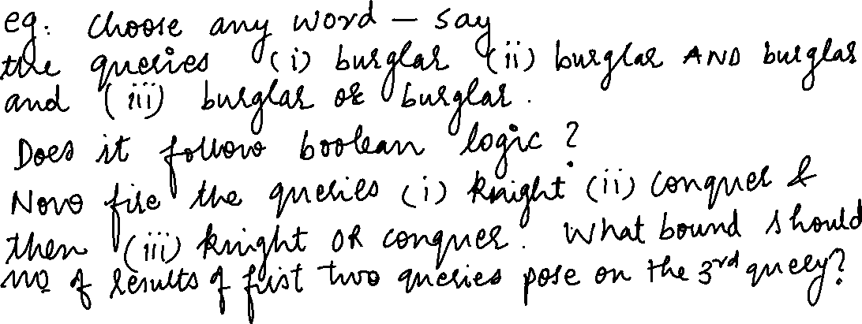




Slide 4
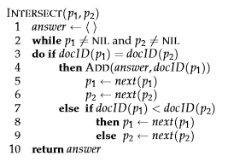
Posting list intersection algorithm(AND query)

Slide 5
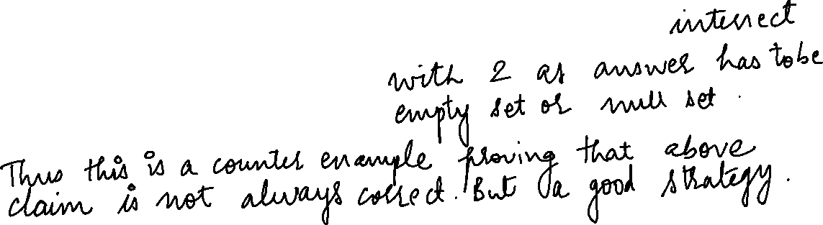


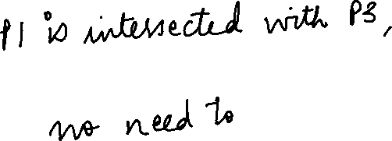

Order of processing
For a conjunctive query, is processing postings lists in order of size guaranteed to be optimal?
Term 1 – 1,2,3
Term2 – 2,3,4,5
Term3 – 10,11,20,30,50

Slide 6
Write the pseudo code for posting list merge for two posting lists for an OR query…………

Slide 7
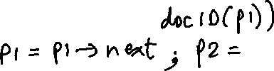









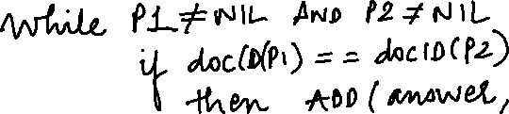











Posting list union/merge algorithm for (OR query)

Slide 8
For the queries below, can we still run through the intersection in O(x+y) time where x and y are the lengths of the posting lists for Brutus and Caesar? If not what can we achieve?
a. Brutus AND NOT Caesar
B. Brutus OR NOT Caesar

Slide 9
Recommend the query processing order for:
(tangerine OR trees) AND (marmalade OR skies) AND (Kaliedoscope OR eyes)
Given the following posting list sizes:
Term | Postings Size
eyes | 213312
Kaliedoscope | 87009
marmalade | 107913
skies | 217658
tangerine | 46653
trees | 316812

Slide 10
Question
For the queries below, can we still run through the intersection in time O(x + y), where x and y are the lengths of the postings lists for Brutus and Caesar? If not, whatcan we achieve?
a. Brutus AND NOT Caesar
b. Brutus OR NOT Caesar

Slide 11
Answer
a. Time is O(x+y). Instead of collecting documents that occur in both postings lists, collect those that occur in the first one and not in the second.
b. Time is O(N) (where N is the total number of documents in the collection) assuming we need to return a complete list of all documents satisfying the query. This is because the length of the results list is only bounded by N, not by the length of the postings lists.

Slide 12
Question
Extend the postings merge algorithm to arbitrary Boolean query formulas. What is its time complexity? For instance, consider:
c. (Brutus OR Caesar) AND NOT (Anthony OR Cleopatra)
Can we always merge in linear time? Linear in what? Can we do better than this?

Slide 13
Answer
We can always intersect in O(qN) where q is the number
of query terms and N the number of documents, so the intersection time is
linear in the number of documents and query terms. Since the tightest bound
for the size of the results list is N, the number of documents, you cannot do
better than O(N).

Slide 14
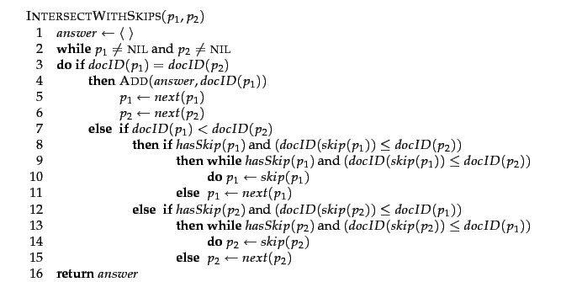
Posting list intersection with skip pointers

Slide 15
Posting list intersection with skip pointers example

Slide 16

heuristic for placing skips
PL of length p
No of skip pointers ?

Slide 18
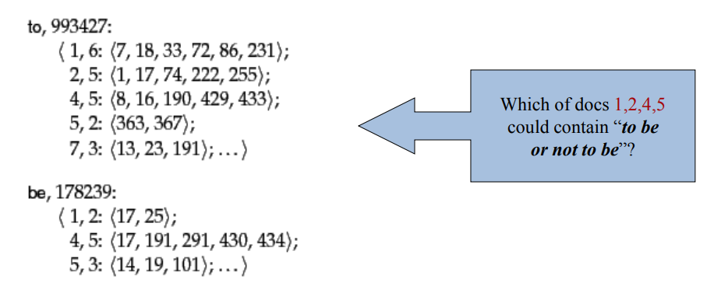
Positional Index

Slide 19
