Slide 1
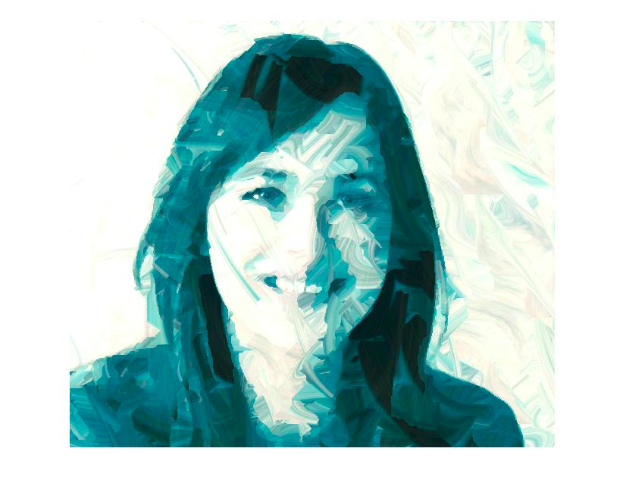
Artistic Rendering of Digital Images
Team Members :
Jyoti Saroha (MT17019)
Vishal Gulia (MT17069)
Ronak Kumar (2015080)

Slide 2
Introduction
Texture Transfer (Subset of Non Photorealistic Rendering)
Generate Sketch like effects in normal images
Appears like drawings or some artistic piece rather than raw camera images.

Slide 3
Literature / Past Works
Efros / Freeman et.al. were the first scholars implementing Texture Transfer to generate drawing kind effects in normal digital images.
Used Image Quilting technique for stitching similar pixel clusters into single image
Ashminkin proposed Fast Texture Transfer algorithm which uses coherent synthesis technique
Shah et.al. used pixel and patch texture synthesis for texture transfer.

Slide 4
Dataset / Training
Our code uses numerical computation using Fast Texture Transfer Algorithm.
Hence, we don’t require any dataset.

Slide 5
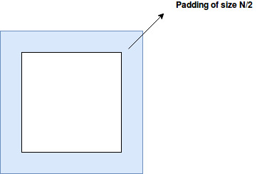
Methodology
Step 1:
Initializing Output Image
With size of target image
Padding of size N/2 for removing harsh edges

Slide 6
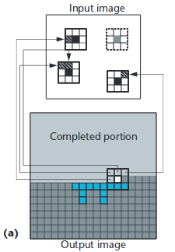
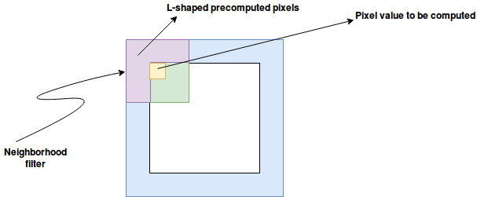
Methodology
Step 2:
Generating Candidate Pixels
Consider an L-shaped neighbourhood
Compute pixel values in the shape with some probability

Slide 7
Methodology
Step 3:
Calculating neighbourhood distance
Neighborhood distance = W*(lsource – Itarget) ^ 2 + (1/#pixels)^2*Dist(NLresultant, NLsource)
Store specified resultant pixels into the resultant image

Slide 8
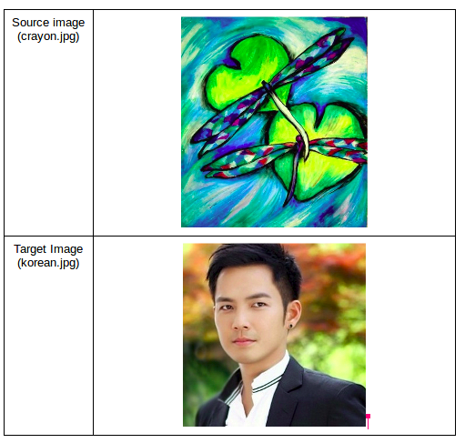
Evaluation

Slide 9
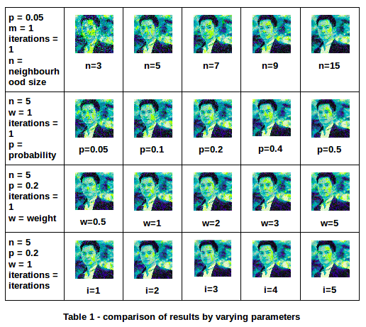

Slide 10
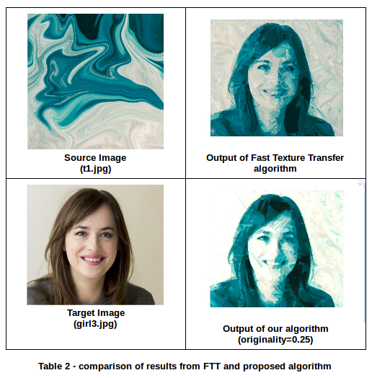

Slide 11
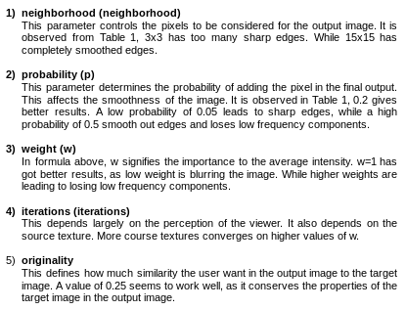
Artistic rendering is a subjective process. For this, this algorithm have five adjustable parameters. These can be adjusted for different results according to the user.

Slide 12
Conclusion
In this project we have successfully implemented the texture transfer algorithm with some modifications. With this we were able to get some better results, which are discussed above. Though this is a simple algorithm, but it is sufficient to give considerably good artistic effects to the target image based on the source texture. More complex and computationally costly high algorithms can also be used.
This project can be extended by applying to other fields of image processing and domains. Obviously, improving the quality of the output result also.

Slide 13
References
[1] Efros, Alexei A., and William T. Freeman. "Image quilting for texture synthesis and transfer." Proceedings of the 28th annual conference on Computer graphics and interactive techniques. ACM, 2001.
[2] Hertzmann, Aaron, et al. "Image analogies." Proceedings of the 28th annual conference on Computer graphics and interactive techniques. ACM, 2001.
[3] Ashikhmin, M., 2003. Fast texture transfer. IEEE Computer Graphics and Applications, (4), pp.38-43.
[4] Shah, Ankit, Parth Bhatt, and Kirit J. Modi. "Image enhancement techniques by texture synthesis." Int. J. Emerg. Technol. Adv. Eng 2 (2012): 97-101.

