Slide 1

Michaels – Customer Purchase Predictions
By Team 27
Archit Sharma, Dharmavaram Arbaaz, Karthik Shivaram, Ronak Kumar, Vijayashree Jayagopal, Marella Partha, Kirubakaran K, Zachary Schauer

Slide 2
Agenda
Summary of project
Model selection
Feature selection
Unique elements of our approach
Questions

Slide 3
Summary of Project
We were given a data set containing data of 10,000 customers along with their buying patterns and other details regarding their interaction with Michaels
Michaels charged us with developing an algorithm to predict which of 44 product departments each of their Loyalty customers would purchase from within the next year

Slide 4
End in Mind
Predict at least one category that each customer will purchase in within the next year
Develop an understanding of how to build applications using Pyspark

Slide 5
Michaels wants to build predictive models to gain better insights from their e-mail campaigns.
Situation
Complication
Key Question
Michaels send out ~11B emails annually, of which majority form mass sends, with minimal to no form of personalization
Michaels believes that an analytical framework around customer’s choices of products might be the key to survive and grow in the current retail landscape
The mails comprise of promotion of all the categories in a random order which might not be according to the priorities of the customer.
Michaels wish to reorder and rank identified departments according to each customer through machine learning models
Going forward, the model must be able to learn and correct itself as new data comes in and thereby work autonomously
Michaels currently does not have an existing analytical framework to understand its customer behavior
Utilization of transaction data at such capacity is a challenge
What techniques can be used to create scalable solutions so that the customer gets promotion e-mail for only those departments in which he is interested in?
End State
Michaels is able to build a model which helps in achieving better engagement, retain & grow its existing customer base, thereby increasing the customer's long term value

Slide 6
Cluster Architecture
2 Masters, 32GB RAM each
10 Slaves, 2 core processor, 8 GB RAM each
144 GB RAM total

Slide 7

Model Selection Criteria :
 | DEEP LEARNING | DECISION TREE | SUPPORT VECTOR MACHINE | RANDOM FOREST
SPEED
SIZE OF DATASET
ACCURACY

Slide 8
Model Parameters
80/20 Train/Test Split
numTrees and maxDepth parameters tuned to optimize training speed and accuracy
Other parameters had no effect on accuracy

Slide 9
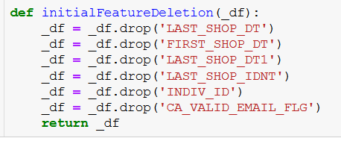
Feature Selection
Date Related Columns
Web-Related Columns
Filled Null Cells with 0
Unique Set of Features for each Model
These columns were dropped as they were not numerical data
Dropped any columns that contained the words ‘APP’, ‘WEB’, or ‘RECENCY’ as these were mostly empty values
We filled Null cells with 0. This is separate from the WEB, APP, and RECENCY drops
Each model was trained on a unique set of features
E.g. Columns containing past data for D18 were the only ones used to predict future D18 purchases

Slide 10
How Do We Determine Our Guesses?
RFC Probability
Lowest Probabilities
Standard Guesses
Results
RFC Models returns a list of the following format:
[P₀, P₁]_{D,C}

Slide 11
How Do We Determine Our Guesses?
RFC Probability
Lowest Probabilities
Standard Guesses
Results
RFC Models returns a list of the following format:
[P₀, P₁]_{D,C}
We choose the departments with the lowest value for P₀ for each customer, provided
P₀ <= 0.5

Slide 12
How Do We Determine Our Guesses?
RFC Probability
Lowest Probabilities
Standard Guesses
Results
RFC Models returns a list of the following format:
[P₀, P₁]_{D,C}
We choose the departments with the lowest value for P₀ for each customer, provided
P₀ <= 0.5
Some Customers have fewer than 5 positive results across departments. In that case, we add guesses from a list of standard guesses until we have 5

Slide 13
How Do We Determine Our Guesses?
RFC Probability
Lowest Probabilities
Standard Guesses
Results
RFC Models returns a list of the following format:
[P₀, P₁]_{D,C}
We choose the departments with the lowest value for P₀ for each customer, provided
P₀ <= 0.5
Some Customers have fewer than 5 positive results across departments. In that case, we add guesses from a list of standard guesses until we have 5
This approach results in a list of 5 unique Department guesses, ordered by probability, per customer

Slide 14
Unique Elements of Our Approach
Model-Specific Features
Standard Guesses
Caching inside Training Loop
Down-sampling
Each model is trained using a unique set of features
Ensures that each the algorithm returns 5 guesses for each customer
Greatly increases speed
Down-sampling negative cases to handle the highly imbalanced classes

Slide 15
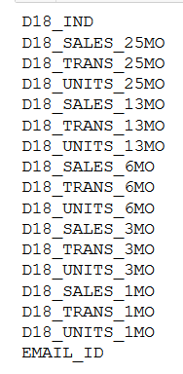
Example of the Model-Specific Feature List
Only features directly related to departmental sales considered when training each model

Slide 16
Standard Guesses

Slide 17
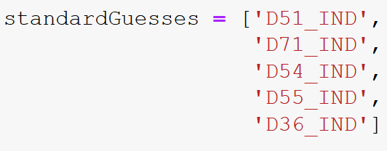
Standard Guesses
Some customers have fewer than 5 positive responses across models
Due to high class imbalance
In that case, the list of guesses is padded to 5 from a list of standard guesses
Standard guesses determined based on departments with the highest positive rate

Slide 18
How Did We Determine the Standard Guesses?
Assumed the 10,000 dataset was representative of the 1 million set
If the 10,000 were not representative, our model would break anyway

Slide 19
How Did We Determine the Standard Guesses?
Assumed the 10,000 dataset was representative of the 1 million set
Calculated the total # of positive responses for each department
If the 10,000 were not representative, our model would break anyway

Slide 20
How Did We Determine the Standard Guesses?
Assumed the 10,000 dataset was representative of the 1 million set
Calculated the total # of positive responses for each department
Chose the 5 departments with the highest positive rate
If the 10,000 were not representative, our model would break anyway

Slide 21
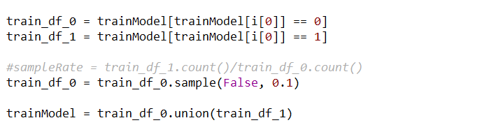
Down-sampling Negative Cases
Classes were highly imbalanced (most balanced department was 15% positive cases). To combat this, we down-sampled negative cases, which greatly increased accuracy

Slide 22

Final Results…

Slide 23
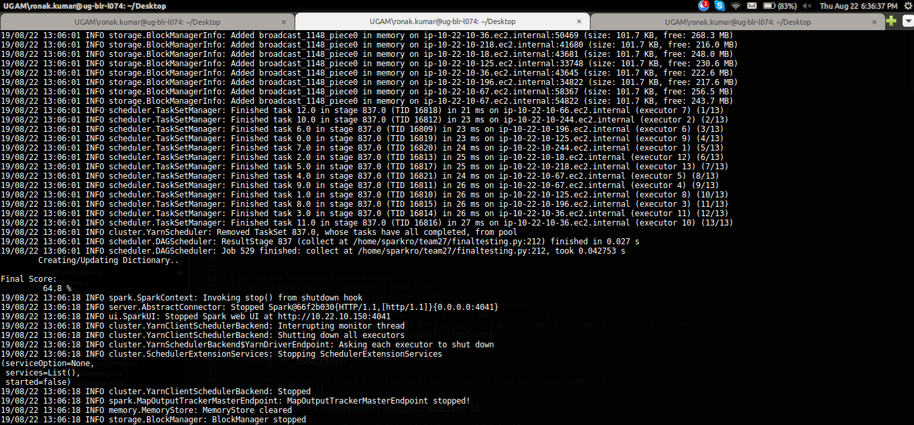

Final Results

Slide 24
Learnings

Slide 25
Learnings
Memory management is extremely important when developing big data ML models
Techniques specific to Pyspark programming (caching and collecting strategically, immutable data frames)
Exploratory Data Analysis is essential

Slide 26
Questions?

