Slide 1


Group #1 AIDI-1100-02
Hung-Yi Chen
Joseph Mendez
Kartik Sharma
Ronak Kumar
Yash Halani

Slide 2
Project Structure
Functions X 6
Loop X 6
Output format X 5
Web scraping
Dictionary
Write csv
From web
Write csv
Read excel
write_csv()
For
Round()
Scan/Parse
Store/Search
remove_duplication()
While
Remove duplication
get_stock()
DataFrame
check_stock()
Naming convention
plt_chart_price()
Timezone
plt_chart_volume()
Visualization
Retrieve Web(API)
New concept X 5
New tool X 1
Error prevention X 6
User-Agent
Power BI
Try/except X 2
Matplotlib
PowerBI
Yfinance
Toronto real-time
Zip()
If/else X 4
%%time
reset_index()
DictWriter()

Slide 3
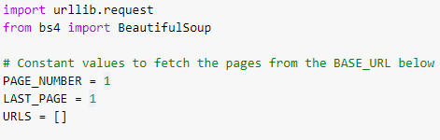
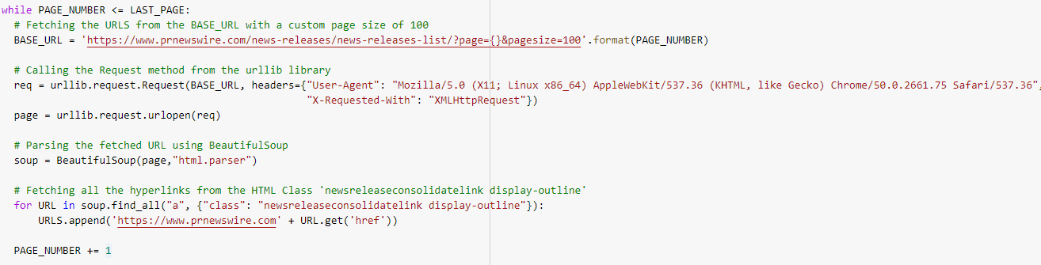
Scan/Parse
Import: urllib, beautiful soup
Importing the Libraries
Initializing the Constant values
WHILE Loop: For extracting pages from the BASE_URL
Fetching the content from the page
FOR Loop: For getting all the URLS from scraped page

Slide 4
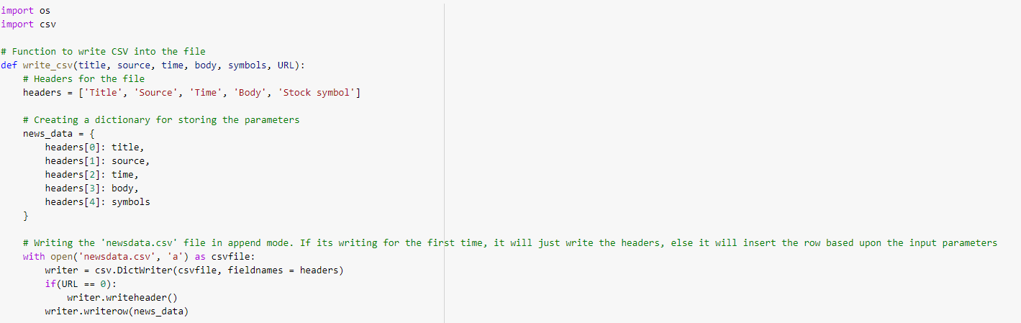
Track/Store
Import: os, csv
Importing the Libraries
Creating Dictionary for storing the parameters with the headers
Writing the CSV file in append mode. If URL == 0 which acts as a flag to check whether the file has already any headers or not

Slide 5
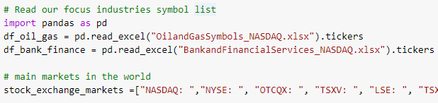
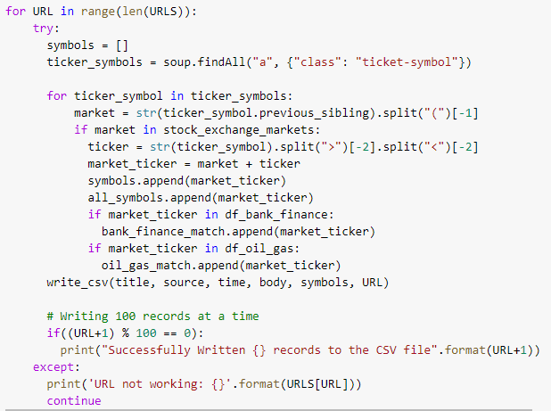
Search Tickers
Import: pandas
Read target industry tickers from excel, lists
Fetch tickers from web
Filter HTML to keep format
Match with target industries
Error prevention
Monitor processing time

Slide 6

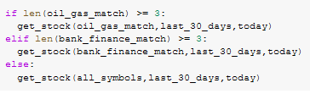
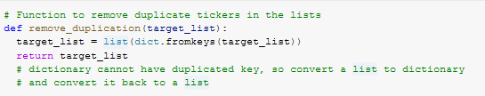
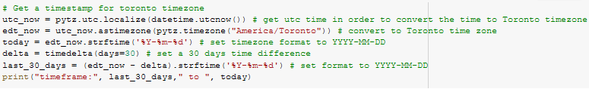
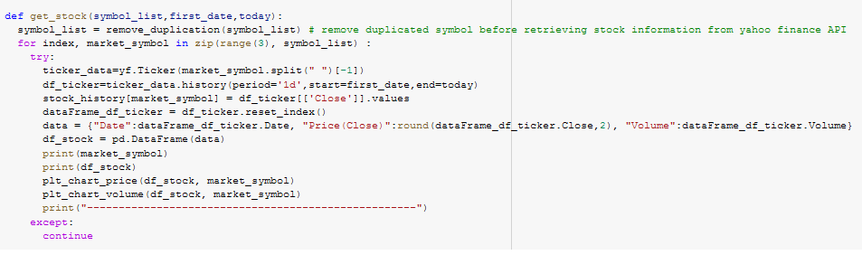

Retrieve Data (Web (API))
Import: yfinance, datetime, timedelta and pytz
If-elif-else: statement
Calls get_stock function depending on oil gas match or bank financial match
Calls check_stock function with no return statement.
Time stamp and conversion to Toronto time zone.
Set the time to today
Apply a 30 day time differential
Retrieve data from the past 30 days
The get_stock function using for loop with try/catch statement

Slide 7
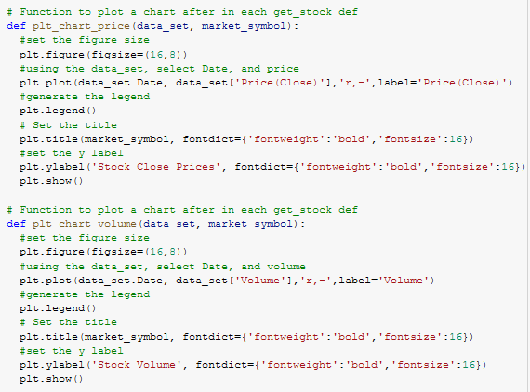

Visualizations
Import: matplotlib
plt_chart_price( data_set, market_symbol )
plt_chart_volume( data_set, market_symbol )
Using data_set and targets the price or volume, compared by the date
Market_symbol parameter is used for title
Set’s the figure size, adds a legend, and title.
Populates graph via imbedded call in get_stock

Slide 8
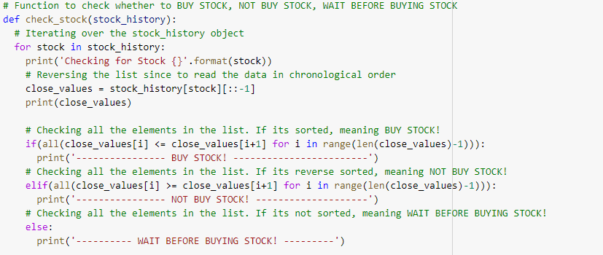
Stock Recommendation
Iterating over the stock_history object
Reversing the list so that it is in chronological order
Checking the values of the list
If sorted -> BUY STOCK
If reverse sorted -> NOT BUY STOCK
Else -> WAIT BEFORE BUYING STOCK

