Slide 1
QUANTUMSIX · SPACE-DRIVEN AI HACKATHON 2.0
RepoPilot AI
From a Prompt to Production
SDLC Engineering Copilot for GitLab Teams
Governed ticket-to-merge-request pipeline with human approval gates
From a Prompt to Production

Slide 2
AGENDA
Presentation Flow (Same as Demo Video)
1. What is RepoPilot AI — problem, solution, 9-step pipeline
2. Live UI walkthrough — Login → Dashboard → Projects → Tasks
3. Task BB-007 end-to-end — Analysis, Code Diff, Validation, GitLab MR
4. Human approval gates — DEMO-004 & DEMO-005
5. Reports, Settings, architecture & competitive positioning
From a Prompt to Production

Slide 3
OVERVIEW
What is RepoPilot AI?
• Welcome to RepoPilot AI — From a Prompt to Production.
• This platform is built for GitLab teams.
• It automates the full software delivery lifecycle starting from a single CSV ticket or a simple prompt.
• Analysis, code generation, testing, validation, and GitLab Merge Request creation — all on one dashboard, w...
• In this video, we will walk through the complete end-to-end flow — how it works, why each step exists, and ...
QuantumSix · Space-Driven AI Hackathon 2.0
From a Prompt to Production

Slide 4
PROBLEM
Software Delivery is Fragmented
Pain Point | Impact
Manual ticket → code → MR cycle | Slow delivery, context switching
Legacy repos hard to navigate | Wrong files changed, regressions
No governance on AI code changes | Trust issues, audit gaps
Scattered tools (Jira, IDE, GitLab, CI) | No single pane of glass
From a Prompt to Production

Slide 5
SOLUTION
One Dashboard — Full SDLC
• Tickets enter as CSV — task_id + requirement columns teams already use
• AI runs analysis, repo search, test generation, code gen, and validation
• Humans approve at TWO gates — before code is written and before MR is created
• Output: real GitLab Merge Request with lint, build, and security checks passed
• Engineering managers get KPIs, pipeline status, and audit trail in one place
From a Prompt to Production

Slide 6
PIPELINE
SDLC Pipeline — 9 Steps
# | Step | What Happens
1 | Requirement Analysis | AI generates acceptance criteria & user stories
2 | Repository Intelligence | Qdrant semantic search finds impacted files
3 | Impact Analysis | Regression areas & API dependencies identified
4 | Test Generation | QA test cases & Playwright specs created
5 | Human Approval | Analysis gate — approve before any code is written
6 | Code Generation | Deterministic replace or LLM file edit
7 | Human Approval | Code diff review gate before MR
8 | Validation + QA | ESLint, build, Playwright, security scan
9 | GitLab MR | Branch, commit, push, merge request created
From a Prompt to Production

Slide 7
PIPELINE
Task Status Flow & Demo Tickets
pending → analyzing → analysis_approval_required → generating_code
→ code_approval_required → validating → security_scan → creating_pr → pr_created
• BB-005 (demo upload): change label "Sides Preview" → "Sides Preview 123"
• BB-007 (live example): completed pipeline with GitLab MR !868
• DEMO-004: waiting at analysis approval gate
• DEMO-005: waiting at code approval gate
From a Prompt to Production

Slide 8
01
Live UI Walkthrough
Same screens & flow as the demo video
RepoPilot AI

Slide 9
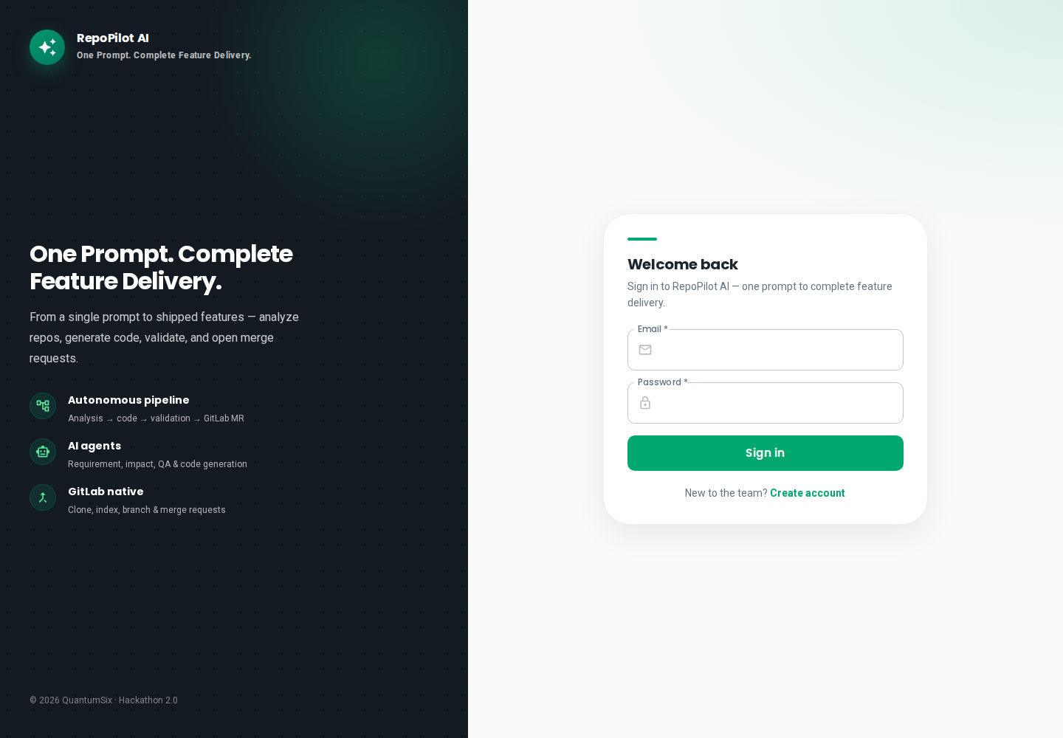
UI DEMO · SCREEN 01
Login
localhost:3100
• We start on the login page.
• Team members sign in with email and password using JWT authentication.
• GitLab OAuth is also available for single sign-on.
• The left panel highlights key product capabilities — autonomous pipeline, AI agents, and native GitLab inte...
• For security, the platform uses bcrypt password hashing and token-based sessions.
From a Prompt to Production
1

Slide 10
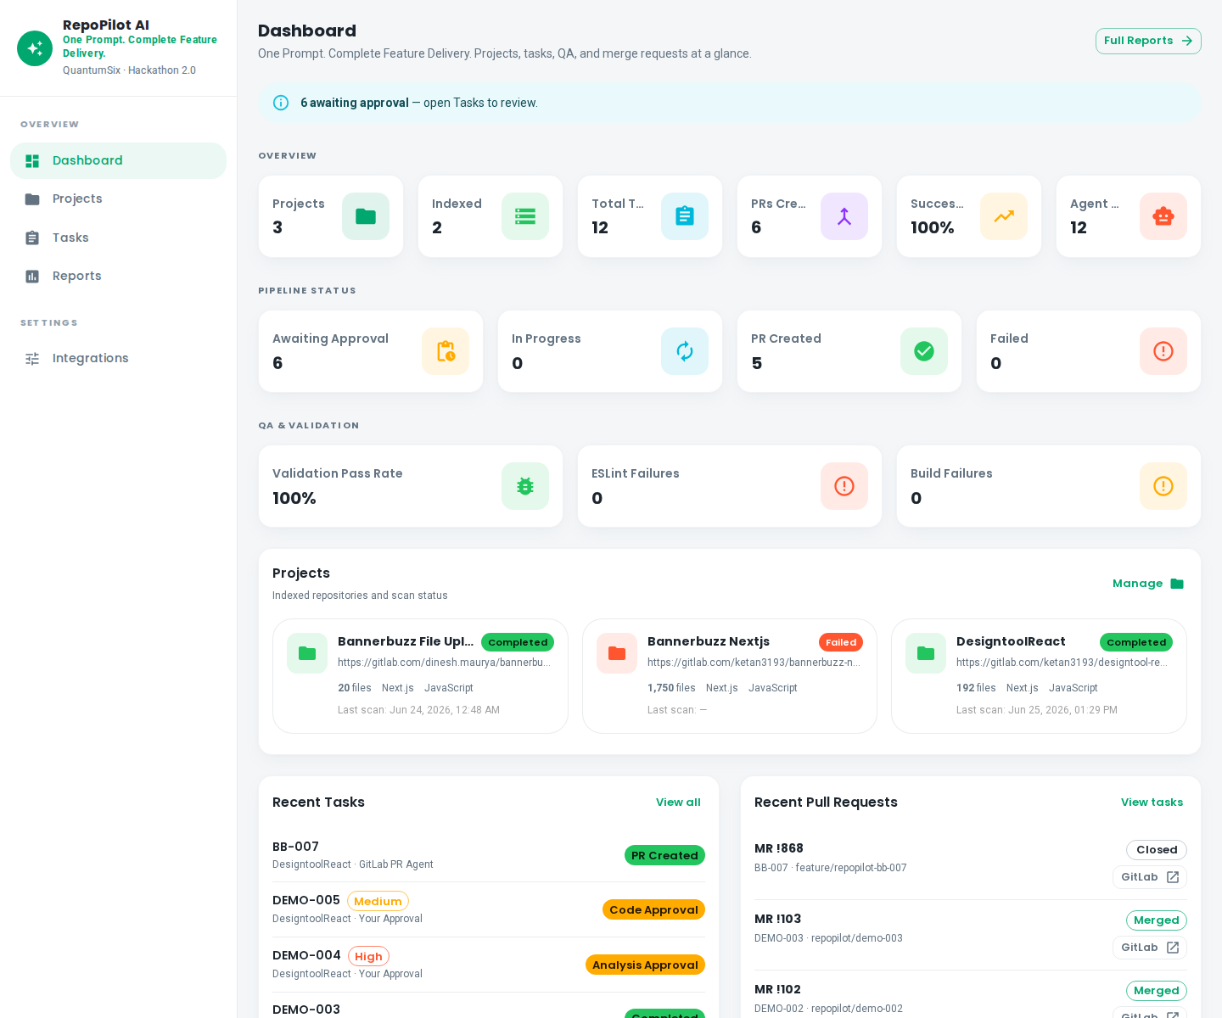
UI DEMO · SCREEN 02
Dashboard
localhost:3100
• After login, the dashboard opens — the engineering manager's command center.
• KPI cards at the top show connected projects, indexed files, total tasks, pull requests, success rate, and ...
• The pipeline status section shows how many tasks are awaiting approval, in progress, or failed.
• Below, recent tasks and GitLab merge requests give the entire team visibility in one place.
From a Prompt to Production
2

Slide 11
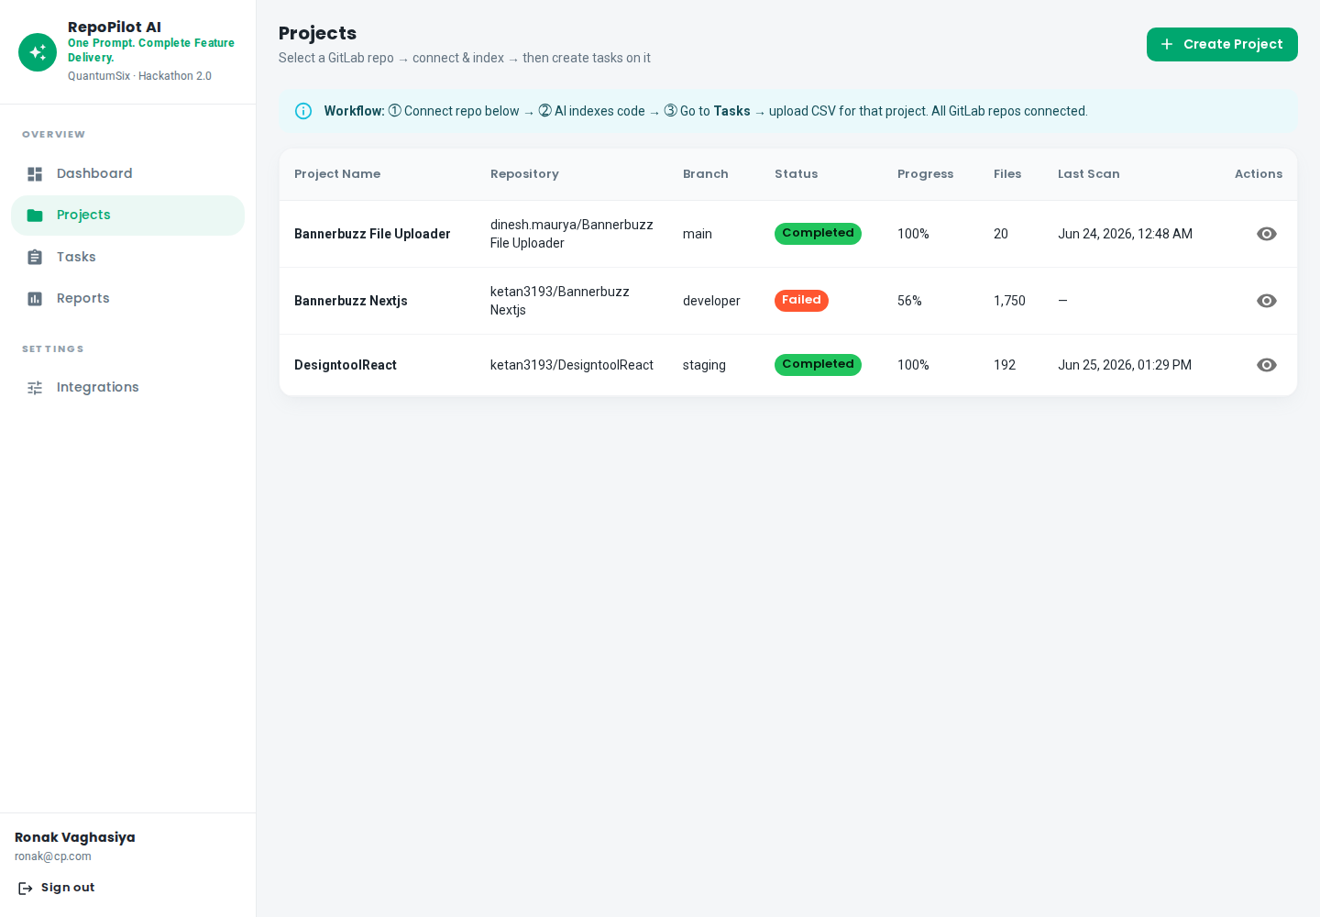
UI DEMO · SCREEN 03
Projects
localhost:3100
• The Projects page lists all connected GitLab repositories.
• Each repo shows its index status — Completed, Indexing, or Failed — along with files indexed, framework, an...
• Use the GitLab picker to connect a new repository.
• Once connected, the platform clones the repo, scans all source files, and stores embeddings in the Qdrant v...
From a Prompt to Production
3

Slide 12
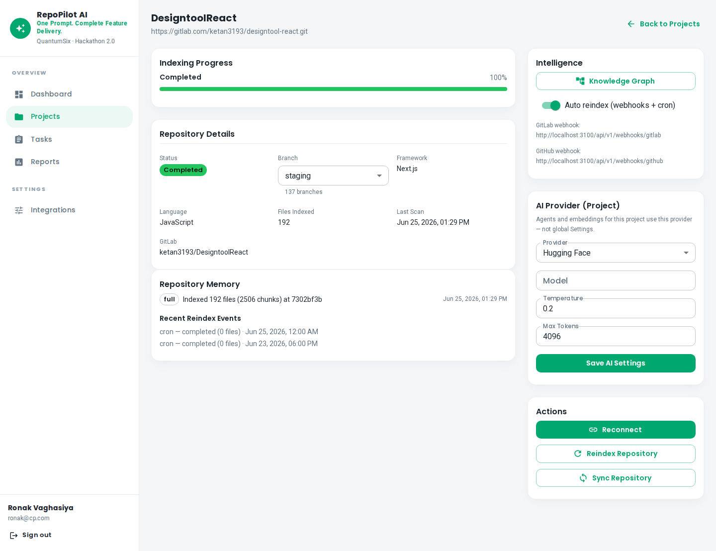
UI DEMO · SCREEN 04
Project Detail
localhost:3100
• The project detail page shows indexing progress and statistics — how many files were scanned and how many e...
• You can select the AI provider — Hugging Face Qwen or OpenAI.
• The re-index button refreshes the repository after webhook events.
• The Knowledge Graph link opens the dependency visualization for that project.
From a Prompt to Production
4

Slide 13
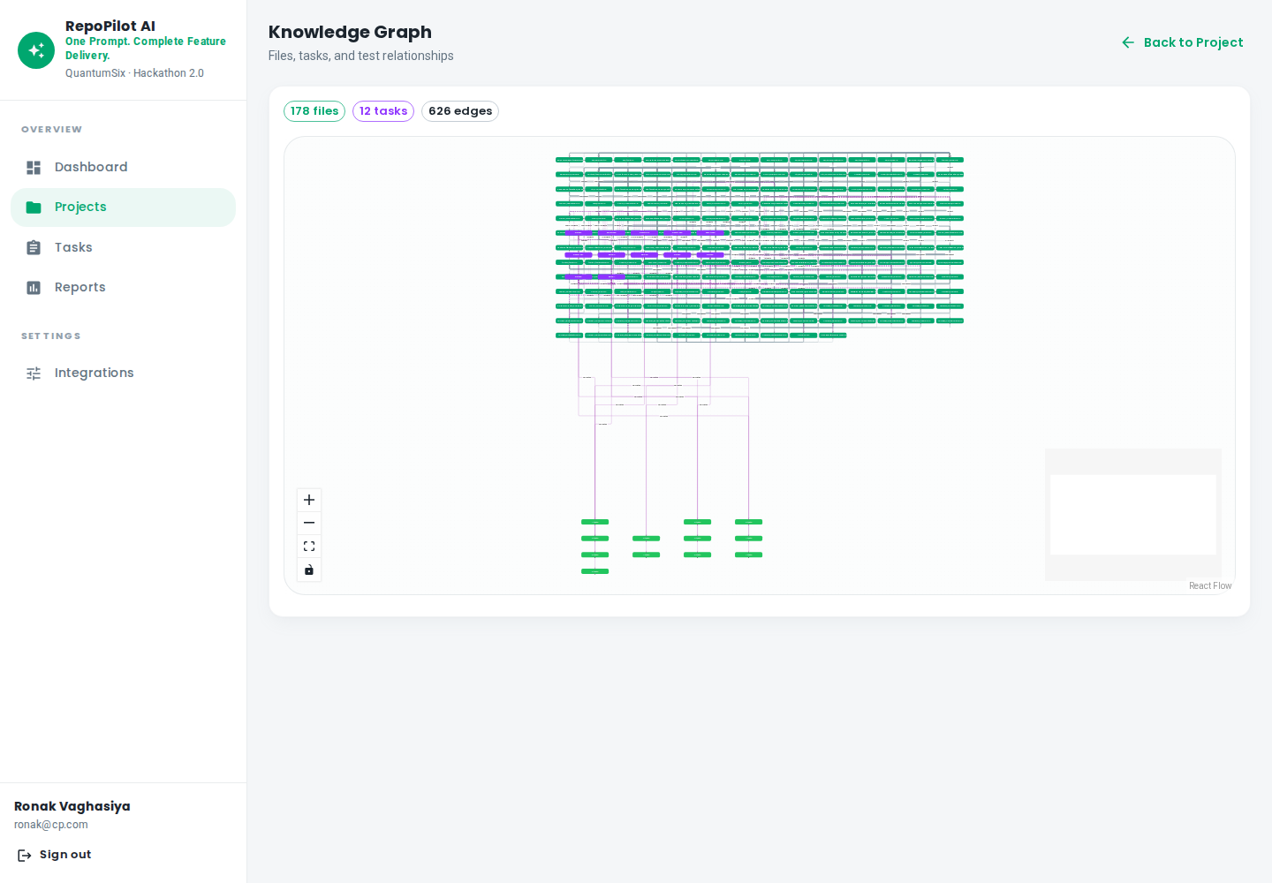
UI DEMO · SCREEN 05
Knowledge Graph
localhost:3100
• The Knowledge Graph is a visual dependency map of the codebase.
• It shows files, components, and imports in a graph layout.
• When a ticket arrives, AI uses this graph plus vector search to identify impacted files — especially critic...
• Repository intelligence prevents wrong file changes and reduces regression risk.
From a Prompt to Production
5

Slide 14
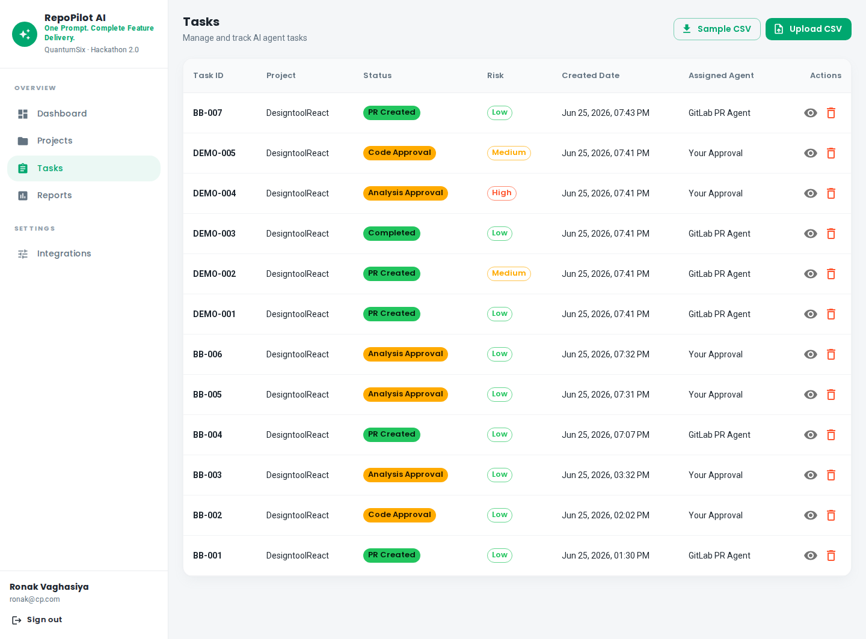
UI DEMO · SCREEN 06
Tasks List
localhost:3100
• The Tasks page lists all tickets with Task ID, Project, Status, Risk level, and Assigned Agent.
• Use the Upload CSV button to import new tasks.
• A Sample CSV download is available for demos.
• Statuses include PR Created, Analysis Approval Required, Code Approval Required, Validating, and more.
• Delete and view detail actions are available on each row.
From a Prompt to Production
6

Slide 15
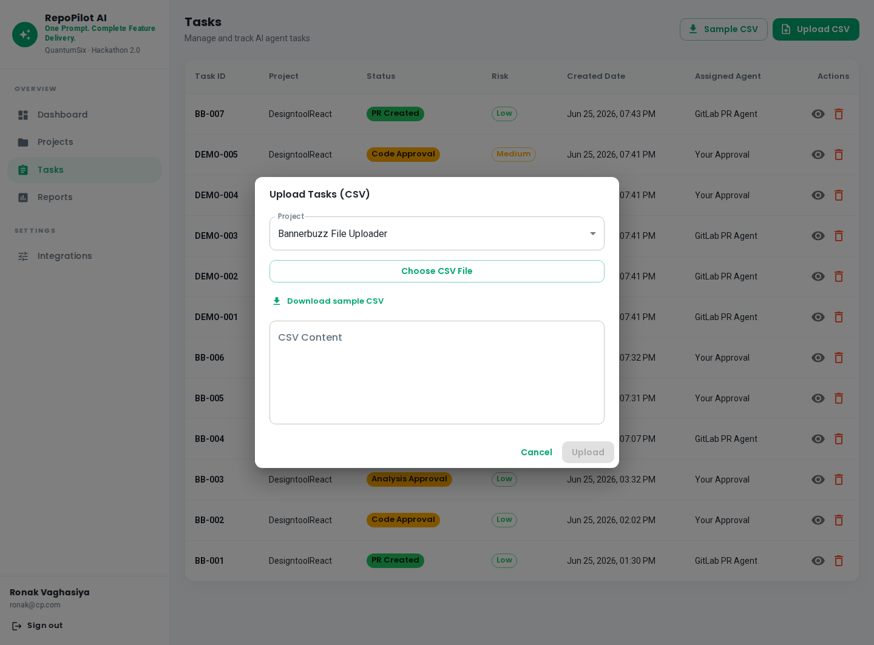
UI DEMO · SCREEN 07
Upload CSV
localhost:3100
• The CSV upload dialog uses a simple format — task_id and requirement columns.
• Select the target project — in this case, DesigntoolReact.
• The example ticket BB-005 asks to change the label from Sides Preview to Sides Preview 123.
• When you upload a single-row CSV, the task detail page opens automatically for a smooth demo experience.
From a Prompt to Production
7

Slide 16
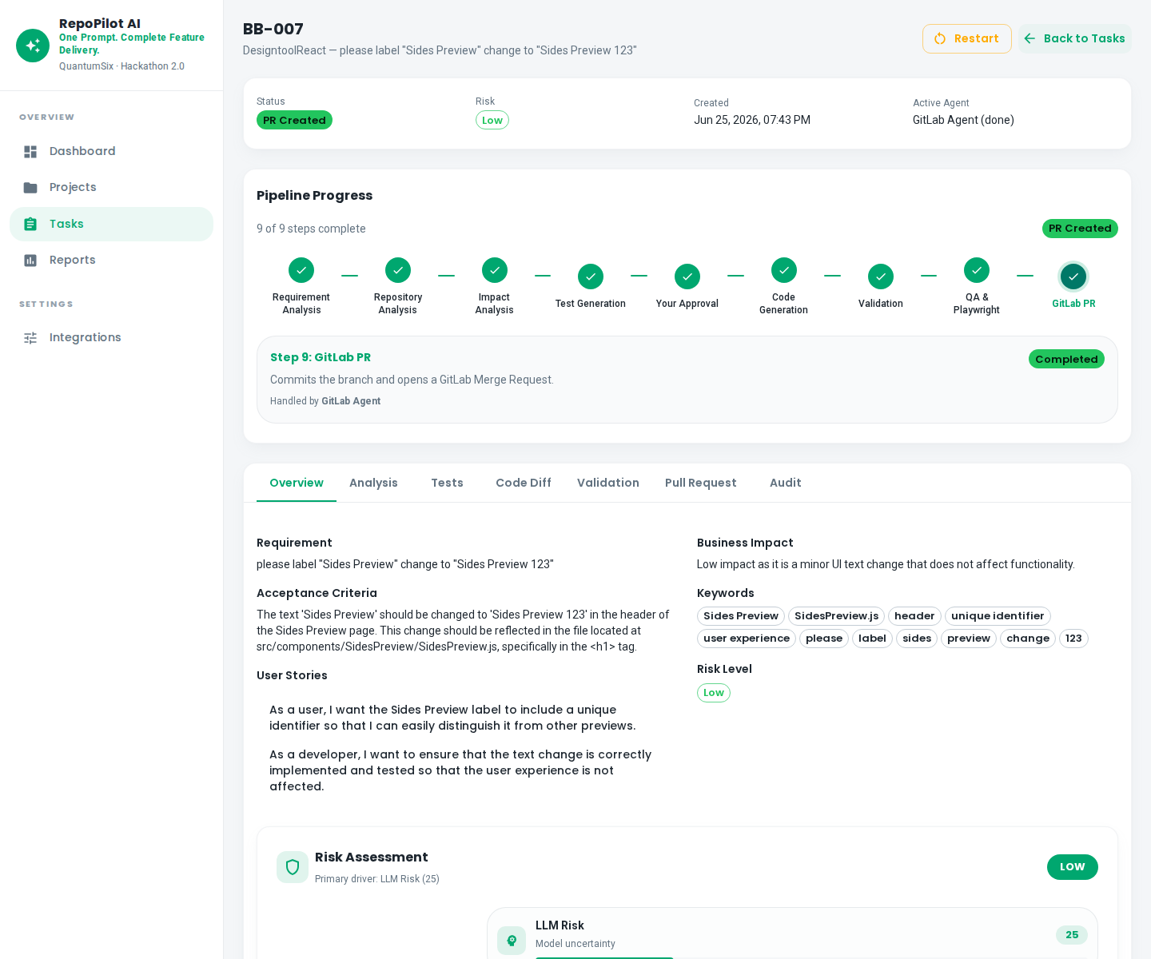
UI DEMO · SCREEN 08
Task Overview — BB-007
localhost:3100
• This is completed task BB-007 — a real live example.
• The requirement is to change the label from Sides Preview to Sides Preview 123.
• The Overview tab shows the nine-step pipeline timeline.
• All steps are complete — status is PR Created, risk is Low, and the GitLab PR Agent handled the final step.
• Live polling provides real-time updates while the pipeline runs.
From a Prompt to Production
8

Slide 17
UI DEMO · SCREEN 09
9-Step Pipeline Explained
localhost:3100
• Here is how the pipeline works.
• Step one — Requirement Analysis: AI generates acceptance criteria and user stories.
• Step two — Repository Intelligence: Qdrant search finds impacted files.
• Step three — Impact Analysis: identifies regression areas.
• Step four — Test Generation: creates QA test cases and Playwright specs.
From a Prompt to Production
9

Slide 18
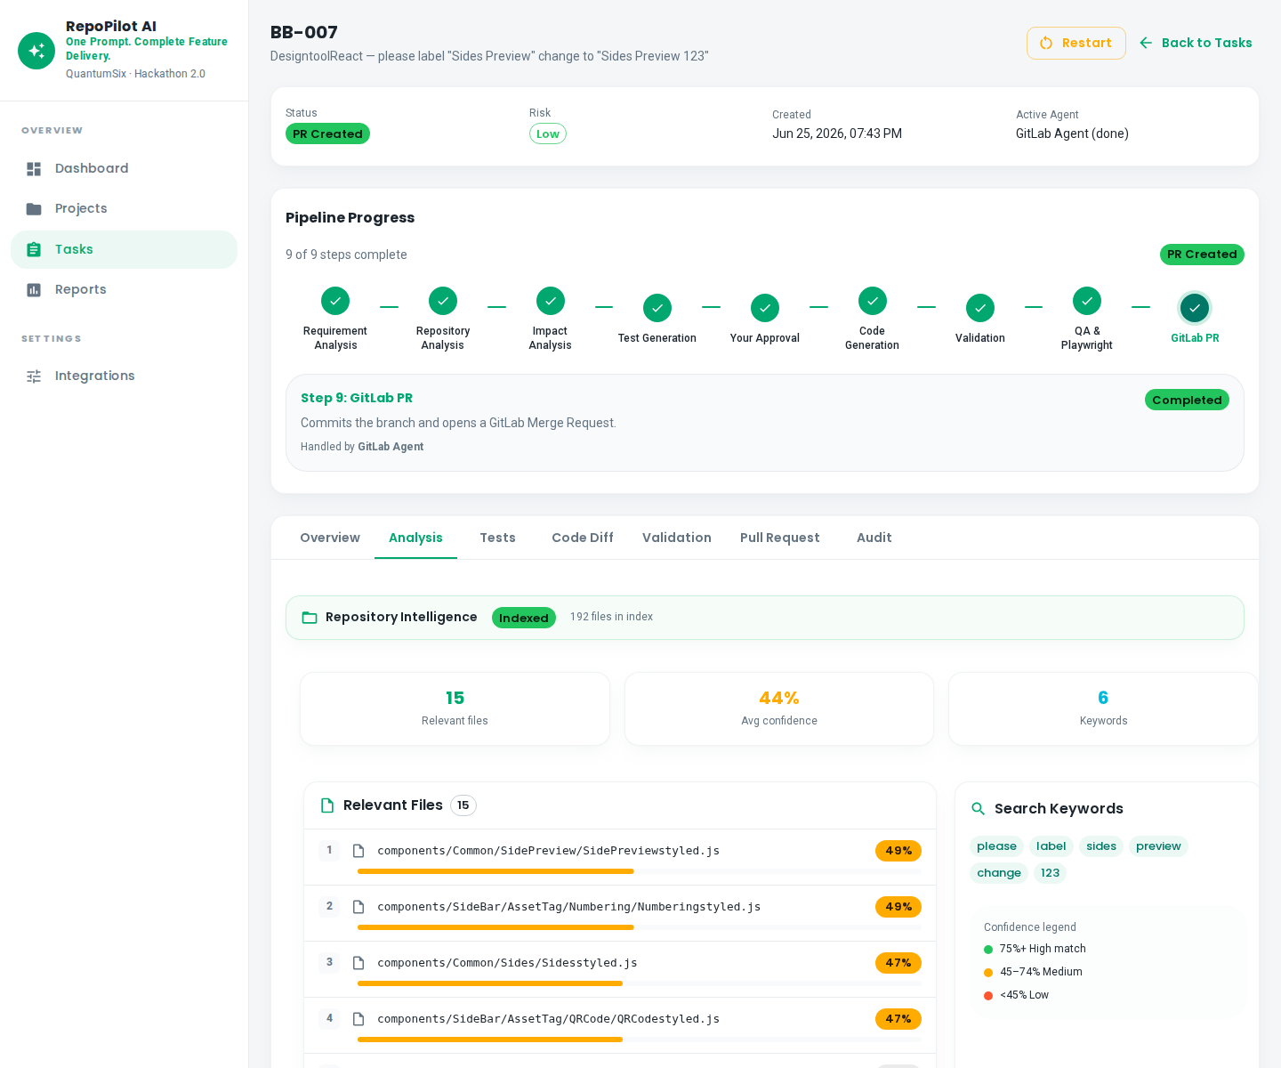
UI DEMO · SCREEN 10
Analysis Tab
localhost:3100
• The Analysis tab shows AI-generated acceptance criteria.
• Impacted files are listed with confidence scores — in this case, SidePreview/index.js was identified at nin...
• Regression areas and API dependencies are also listed.
• Approve or Reject buttons form the first human gate.
• Reject restarts the pipeline; approve moves to code generation.
From a Prompt to Production
10

Slide 19
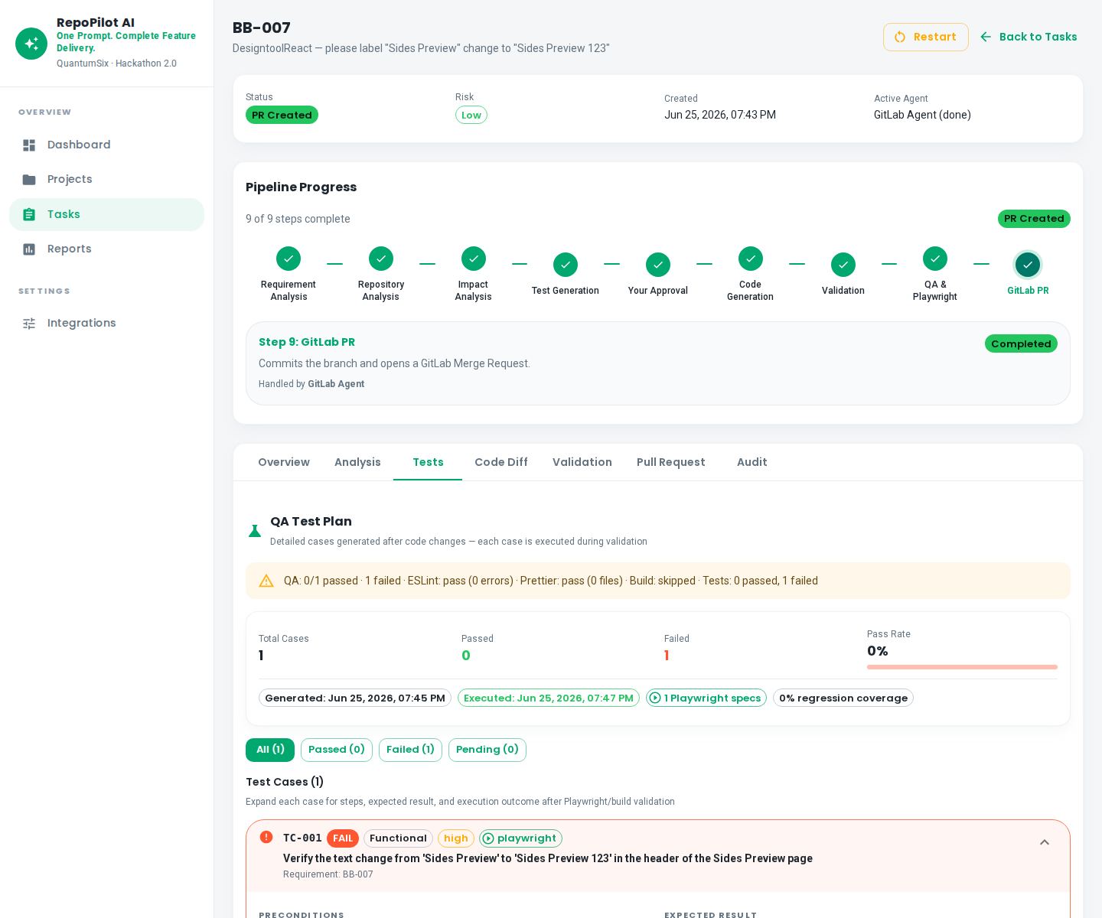
UI DEMO · SCREEN 11
Tests and QA
localhost:3100
• The Tests and QA tab shows auto-generated functional test cases.
• Playwright spec files cover regression scenarios.
• Edge cases and coverage percentage are displayed.
• QA verification completes before code approval — giving developers confidence that the change is safe to ship.
From a Prompt to Production
11

Slide 20
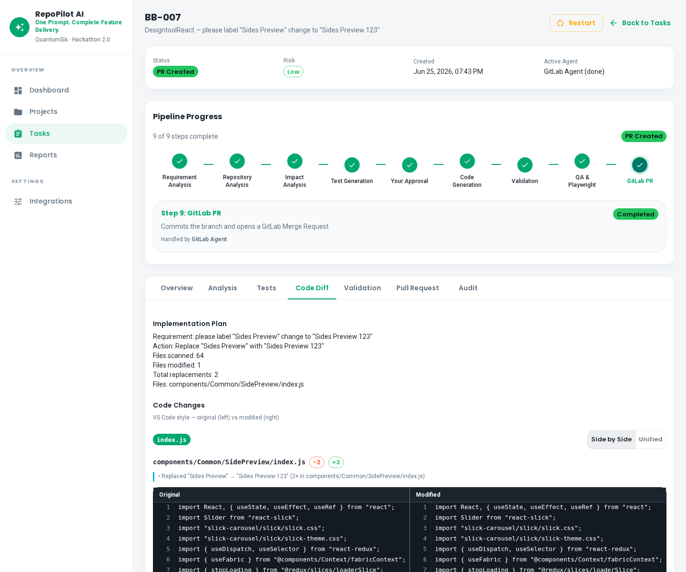
UI DEMO · SCREEN 12
Code Diff
localhost:3100
• The Code Diff tab is the most important screen — a VS Code style side-by-side diff viewer.
• For BB-007, deterministic text replace was used — exactly two occurrences changed in SidePreview/index.js, ...
• The implementation plan shows sixty-four files scanned and one file modified.
• Per-file revert and Revert All buttons are available.
• The full repository is verified — no hallucination, only the exact change is pushed.
From a Prompt to Production
12

Slide 21
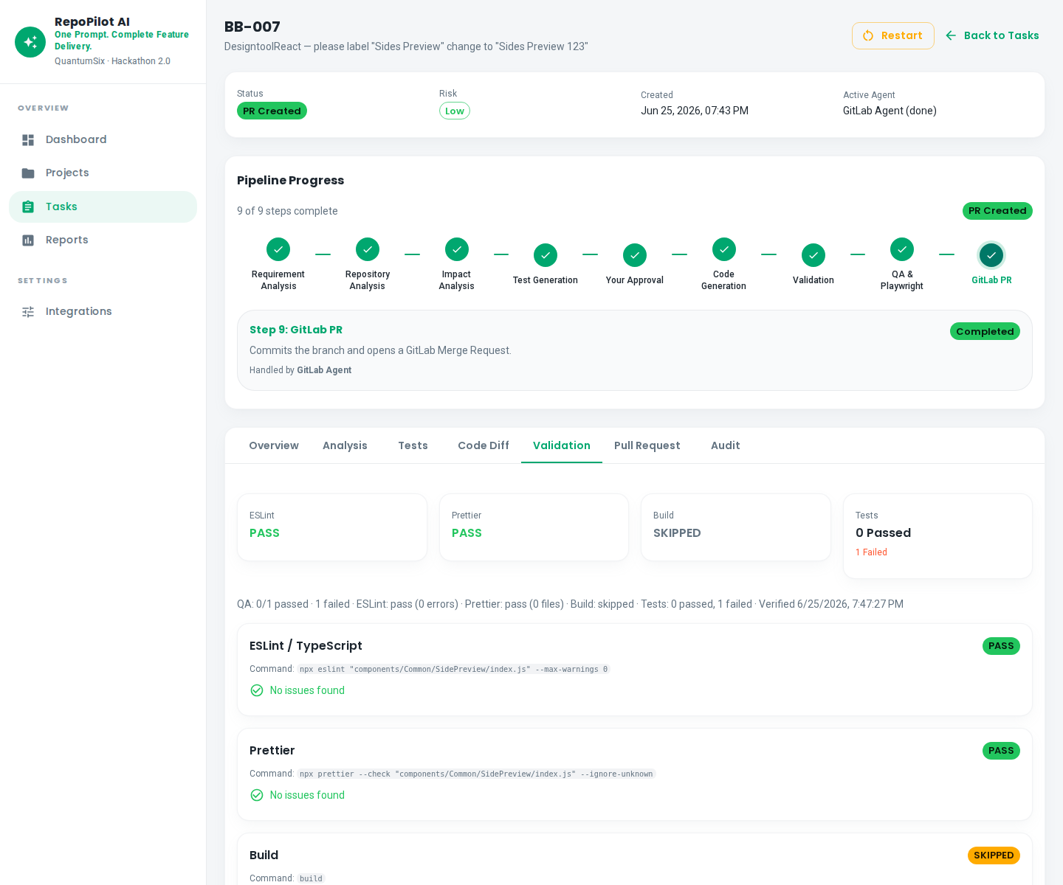
UI DEMO · SCREEN 13
Validation
localhost:3100
• The Validation tab runs automated checks.
• ESLint passes on changed files only.
• Prettier formatting is verified.
• npm run build status is shown.
• Playwright test results are displayed.
From a Prompt to Production
13

Slide 22
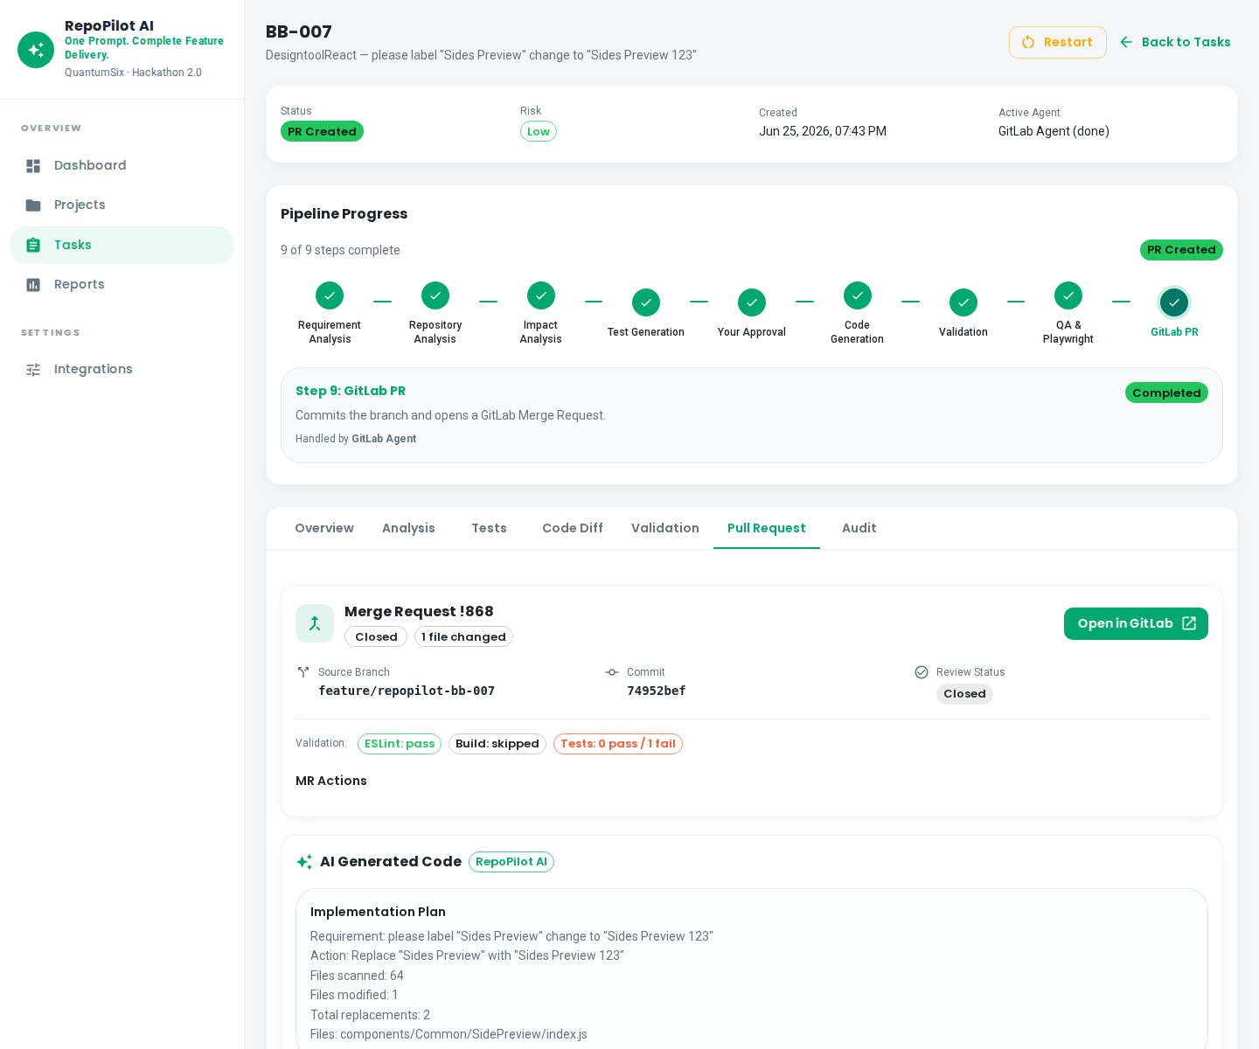
UI DEMO · SCREEN 14
GitLab Pull Request
localhost:3100
• The Pull Request tab shows a real GitLab Merge Request — MR number 868.
• The branch is feature/repopilot-bb-007.
• Open in GitLab launches it in the browser.
• In-app Approve and Merge buttons are available.
• A validation summary is shown.
From a Prompt to Production
14

Slide 23
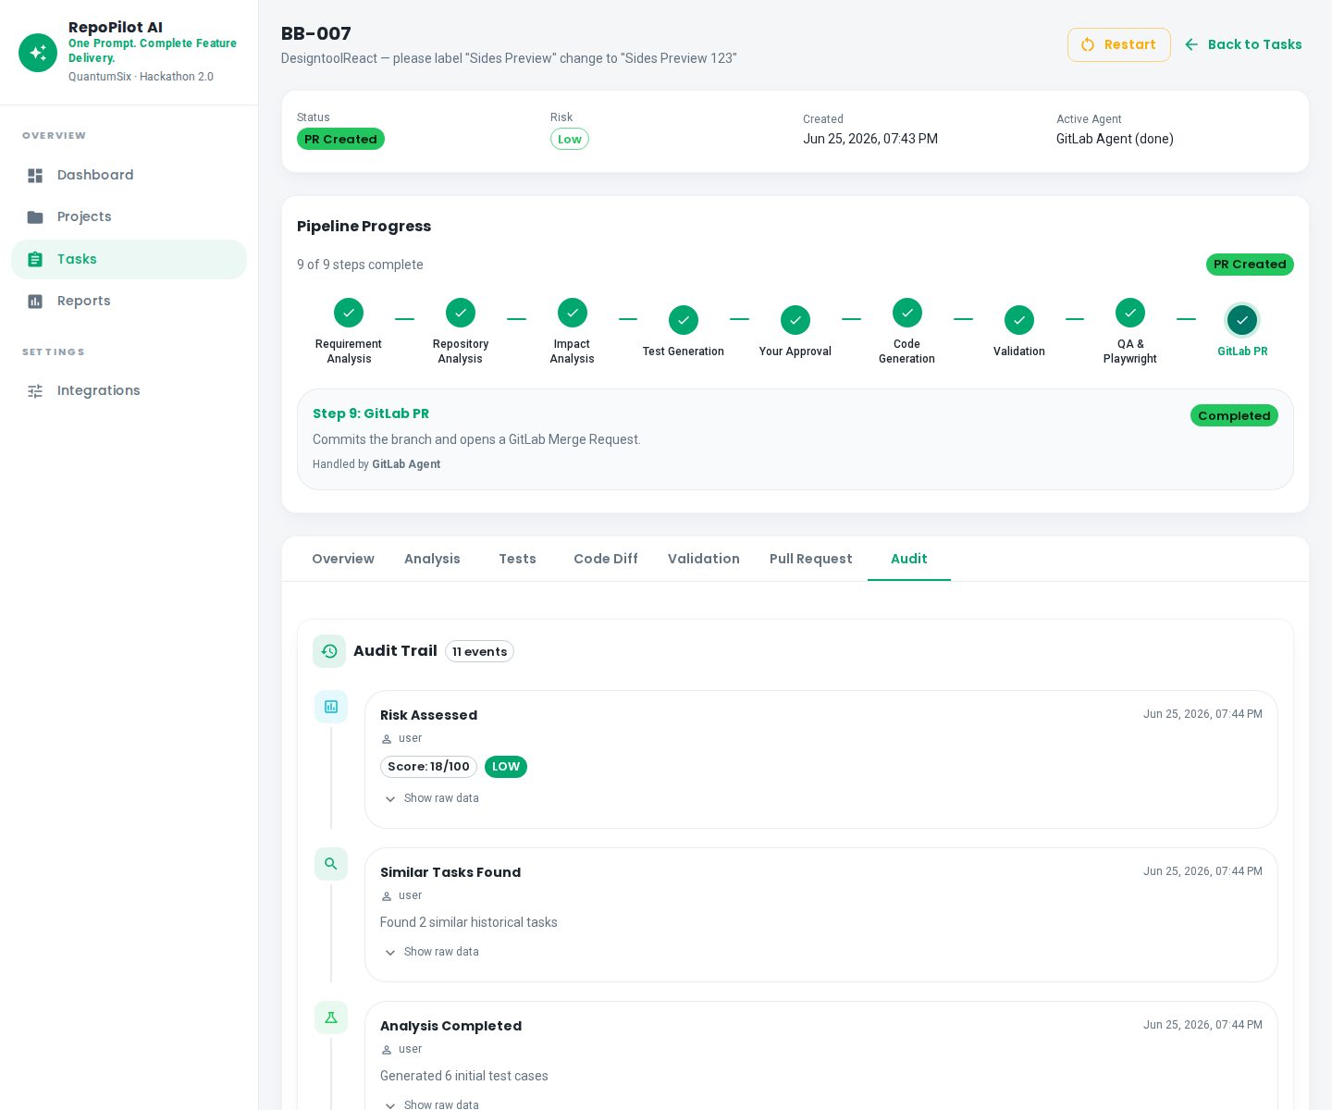
UI DEMO · SCREEN 15
Audit Log
localhost:3100
• The Audit tab supports enterprise governance.
• It records who approved the analysis, who approved the code, and when — with full timestamps.
• Reject history is also stored.
• This audit trail builds trust in AI-assisted changes and supports compliance requirements.
From a Prompt to Production
15

Slide 24
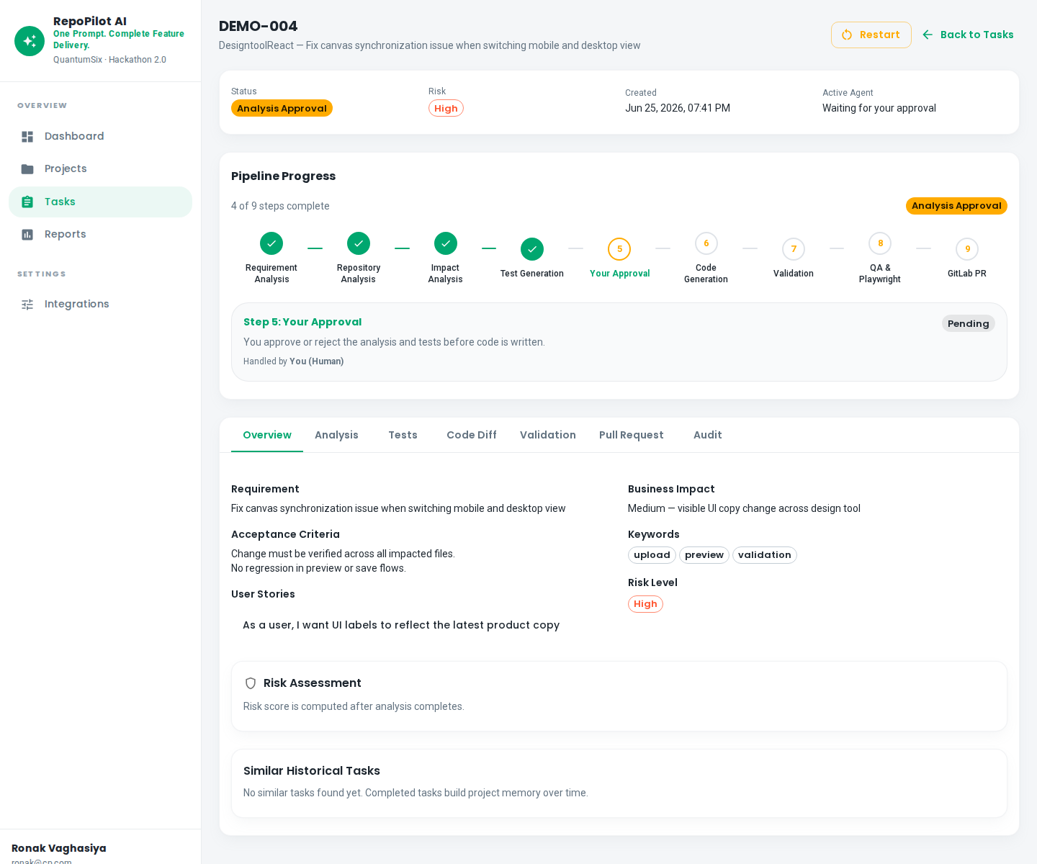
UI DEMO · SCREEN 16
Analysis Approval Gate
localhost:3100
• Task DEMO-004 is waiting for analysis approval.
• The Assigned Agent column shows Your Approval — human in the loop.
• Before any code is written, the tech lead or product manager reviews the AI analysis.
• Approve, Reject, or Request Changes — the pipeline only proceeds after human approval.
From a Prompt to Production
16

Slide 25
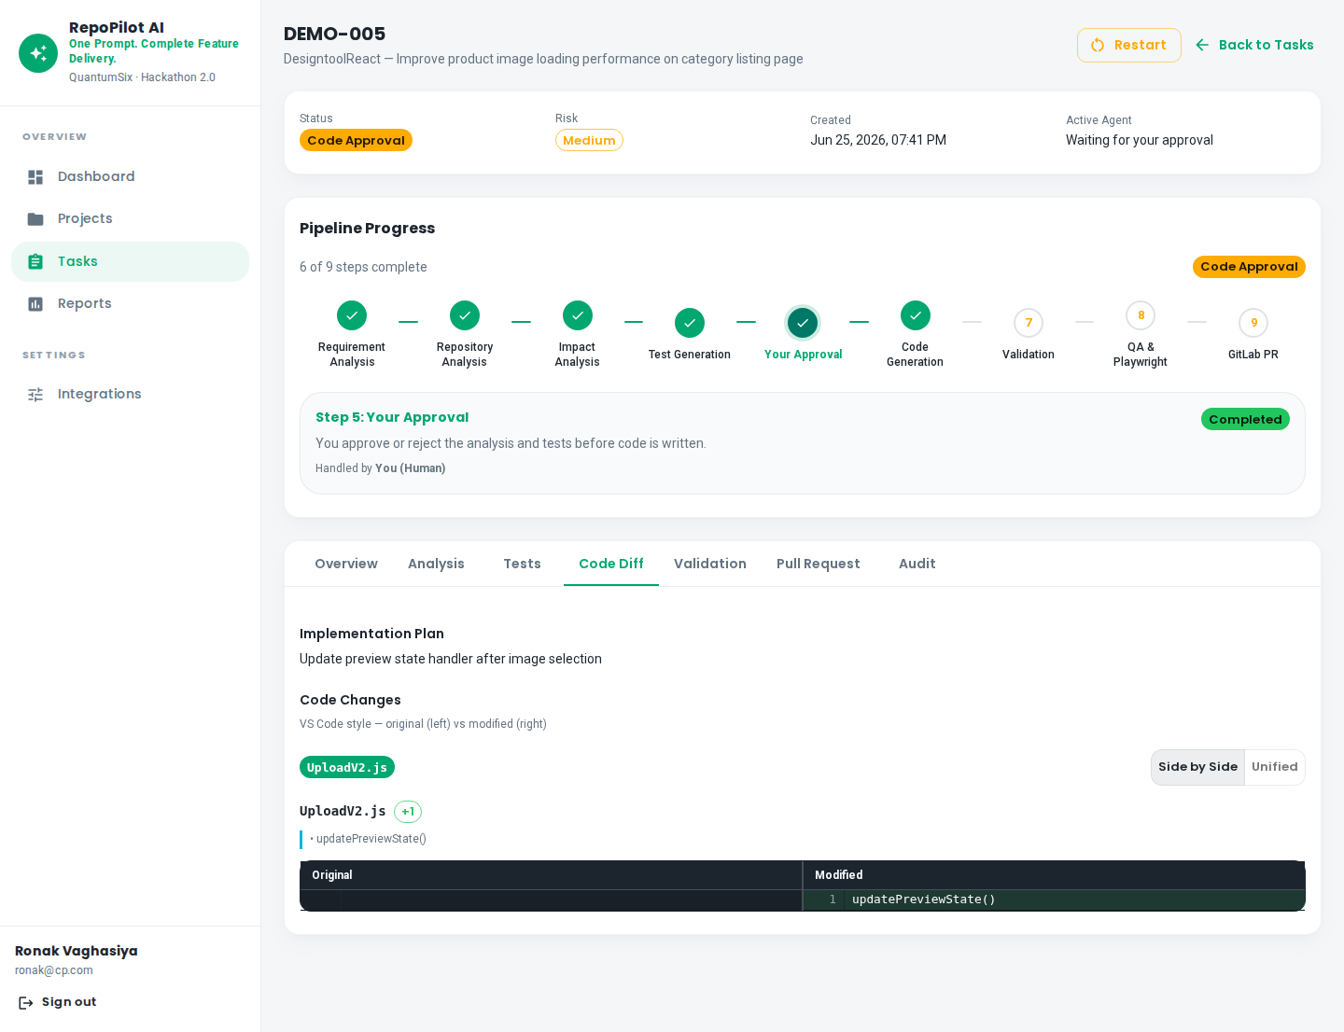
UI DEMO · SCREEN 17
Code Approval Gate
localhost:3100
• Task DEMO-005 is at the code approval gate — the second human gate.
• The developer reviews the exact diff before the merge request is created.
• Reject with feedback restarts the pipeline from the relevant step.
• This dual-gate system differentiates RepoPilot from Cursor or Copilot — governed, auditable delivery for te...
From a Prompt to Production
17

Slide 26
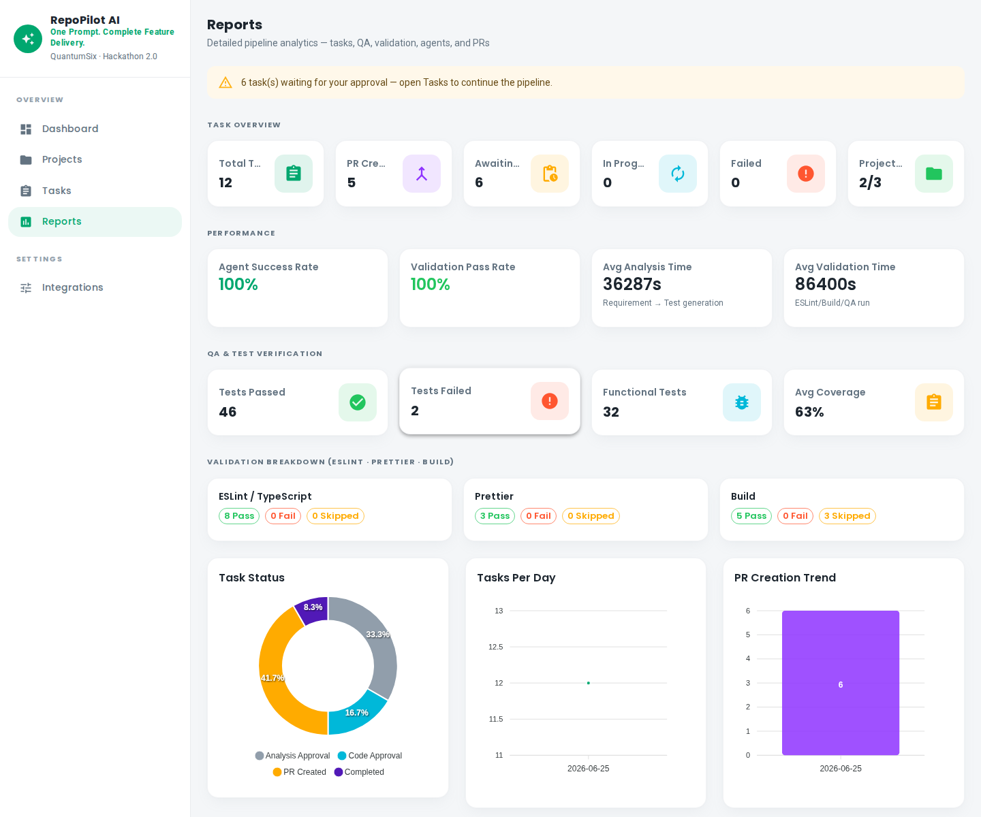
UI DEMO · SCREEN 18
Reports
localhost:3100
• The Reports page provides analytics for engineering managers.
• Task success rate trends over time.
• Agent performance breakdown — runs and success counts.
• Validation pass and fail statistics.
• Project-wise task distribution charts.
From a Prompt to Production
18

Slide 27
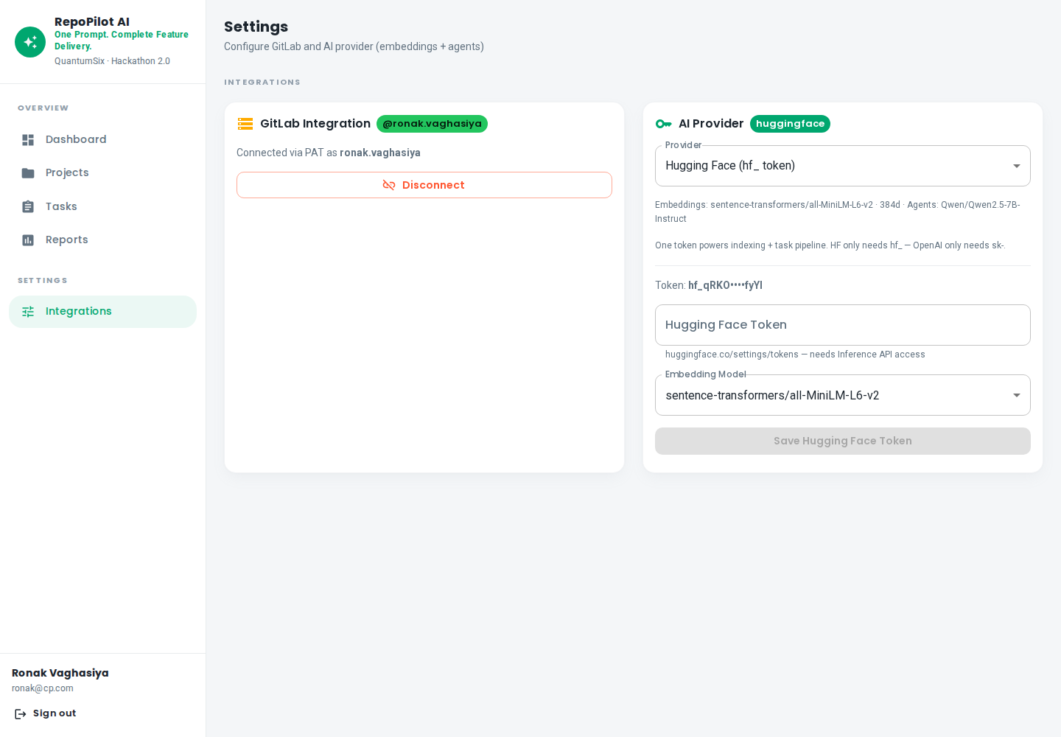
UI DEMO · SCREEN 19
Settings
localhost:3100
• The Settings page configures integrations.
• GitLab Personal Access Token in glpat format.
• Hugging Face or OpenAI API keys.
• Embedding model defaults to MiniLM.
• Chat model is Qwen 2.5 7B Instruct.
From a Prompt to Production
19

Slide 28
02
Platform Deep Dive
Architecture, stack & positioning
RepoPilot AI

Slide 29
ARCHITECTURE
System Architecture
Browser (Next.js :3100) → REST API + JWT → NestJS Backend (:3001)
├── TaskPipelineService — orchestrates all 9 pipeline steps
├── Projects / Indexing / GitLab / Reports modules
└── PostgreSQL — tasks, timeline, diffs, merge requests
├── Qdrant — vector embeddings for semantic file search
├── GitLab API — clone, branch, commit, MR create/merge
└── Local git clone — real commits pushed to GitLab remote
From a Prompt to Production

Slide 30
TECH STACK
Technology Stack
Layer | Technology | Purpose
Frontend | Next.js 14, TypeScript, MUI | Dashboard UI
Backend | NestJS, TypeORM | API + pipeline orchestration
Database | PostgreSQL 16 | Persistent data
Vector DB | Qdrant | Semantic file search
AI (default) | Qwen 2.5 + MiniLM embeddings | Chat + search
VCS | GitLab REST API | Clone, MR, merge
Validation | ESLint, Prettier, Playwright | Quality gate
From a Prompt to Production

Slide 31
COMPETITIVE
RepoPilot vs Market
Tool | RepoPilot Advantage
GitHub Copilot | Full SDLC loop — not just IDE autocomplete
Cursor | Team governance + MR — not single-developer IDE
Devin | Human approval gates + full audit trail
n8n / Zapier | Deep repo intelligence + verified code changes
From a Prompt to Production

Slide 32
DEMO GUIDE
Golden Demo Path (2 Minutes)
Time | Action
0:00 | Dashboard — KPIs & pipeline status
0:20 | Projects — DesigntoolReact indexed repo
0:40 | Tasks — upload BB-005.csv
1:00 | Approve analysis — show impacted files
1:20 | Code Diff — Sides Preview → Sides Preview 123
1:40 | Approve code → show GitLab MR !868
2:00 | Close: From a Prompt to Production
From a Prompt to Production

Slide 33
QUESTIONS?
Thank You
From a Prompt to Production
Cursor helps one developer type faster.
RepoPilot governs the entire change for GitLab teams.
Dashboard: localhost:3100 | API: localhost:3001/docs
QuantumSix · Space-Driven AI Hackathon 2.0
From a Prompt to Production

