Slide 1
Data Mining from experiments
Ronald Ponguillo
University of Ghent

Slide 2
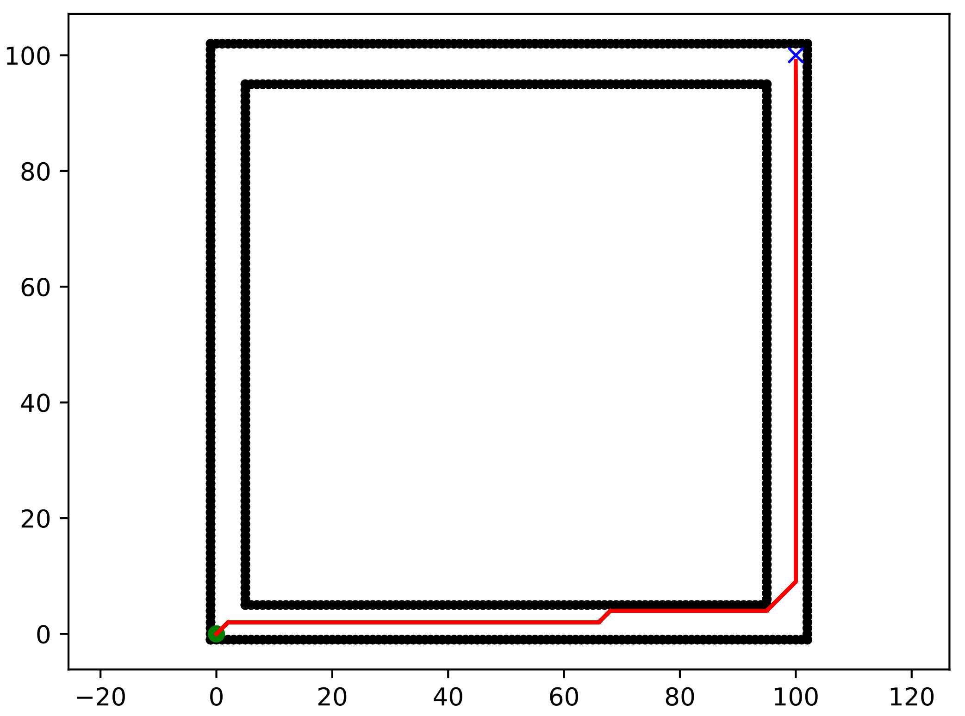
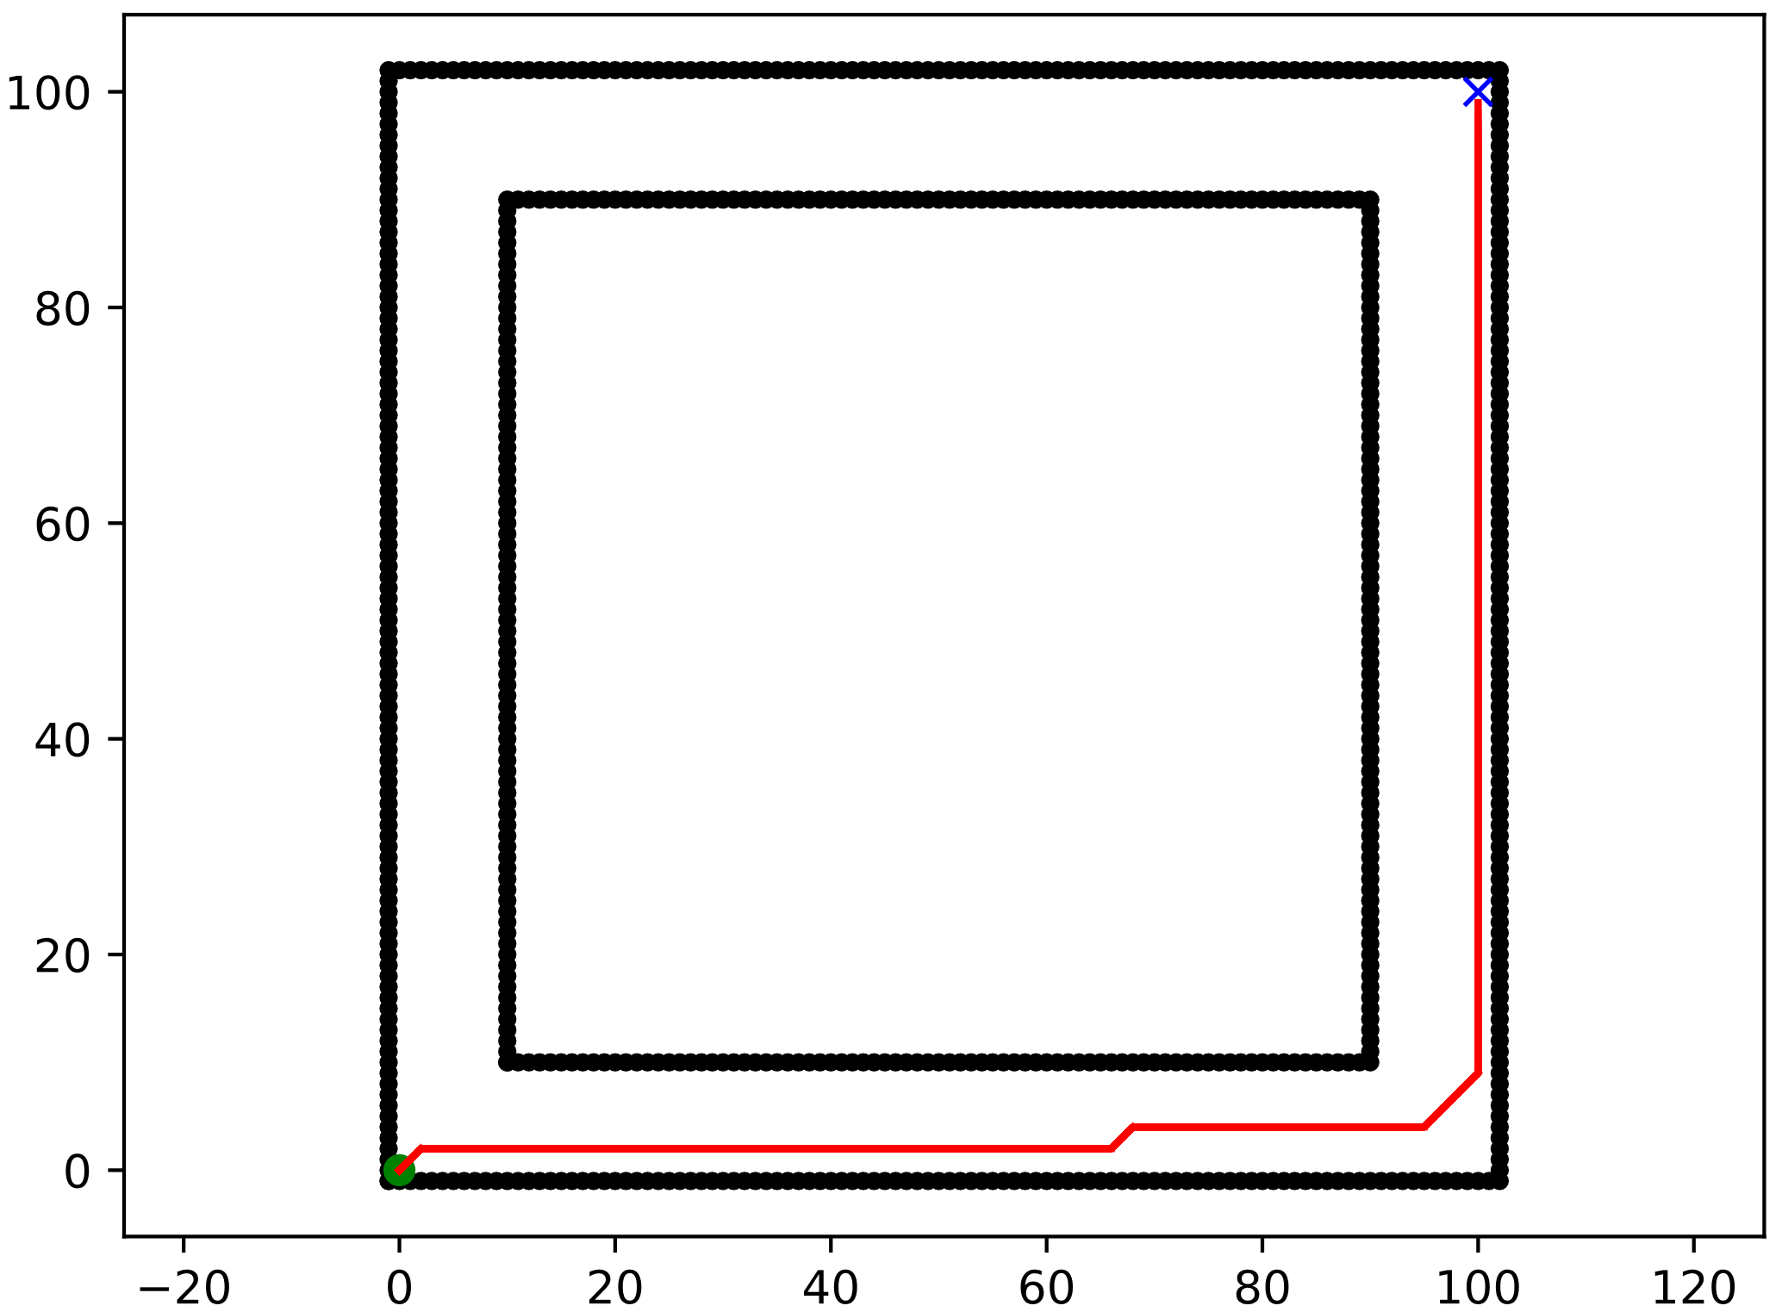
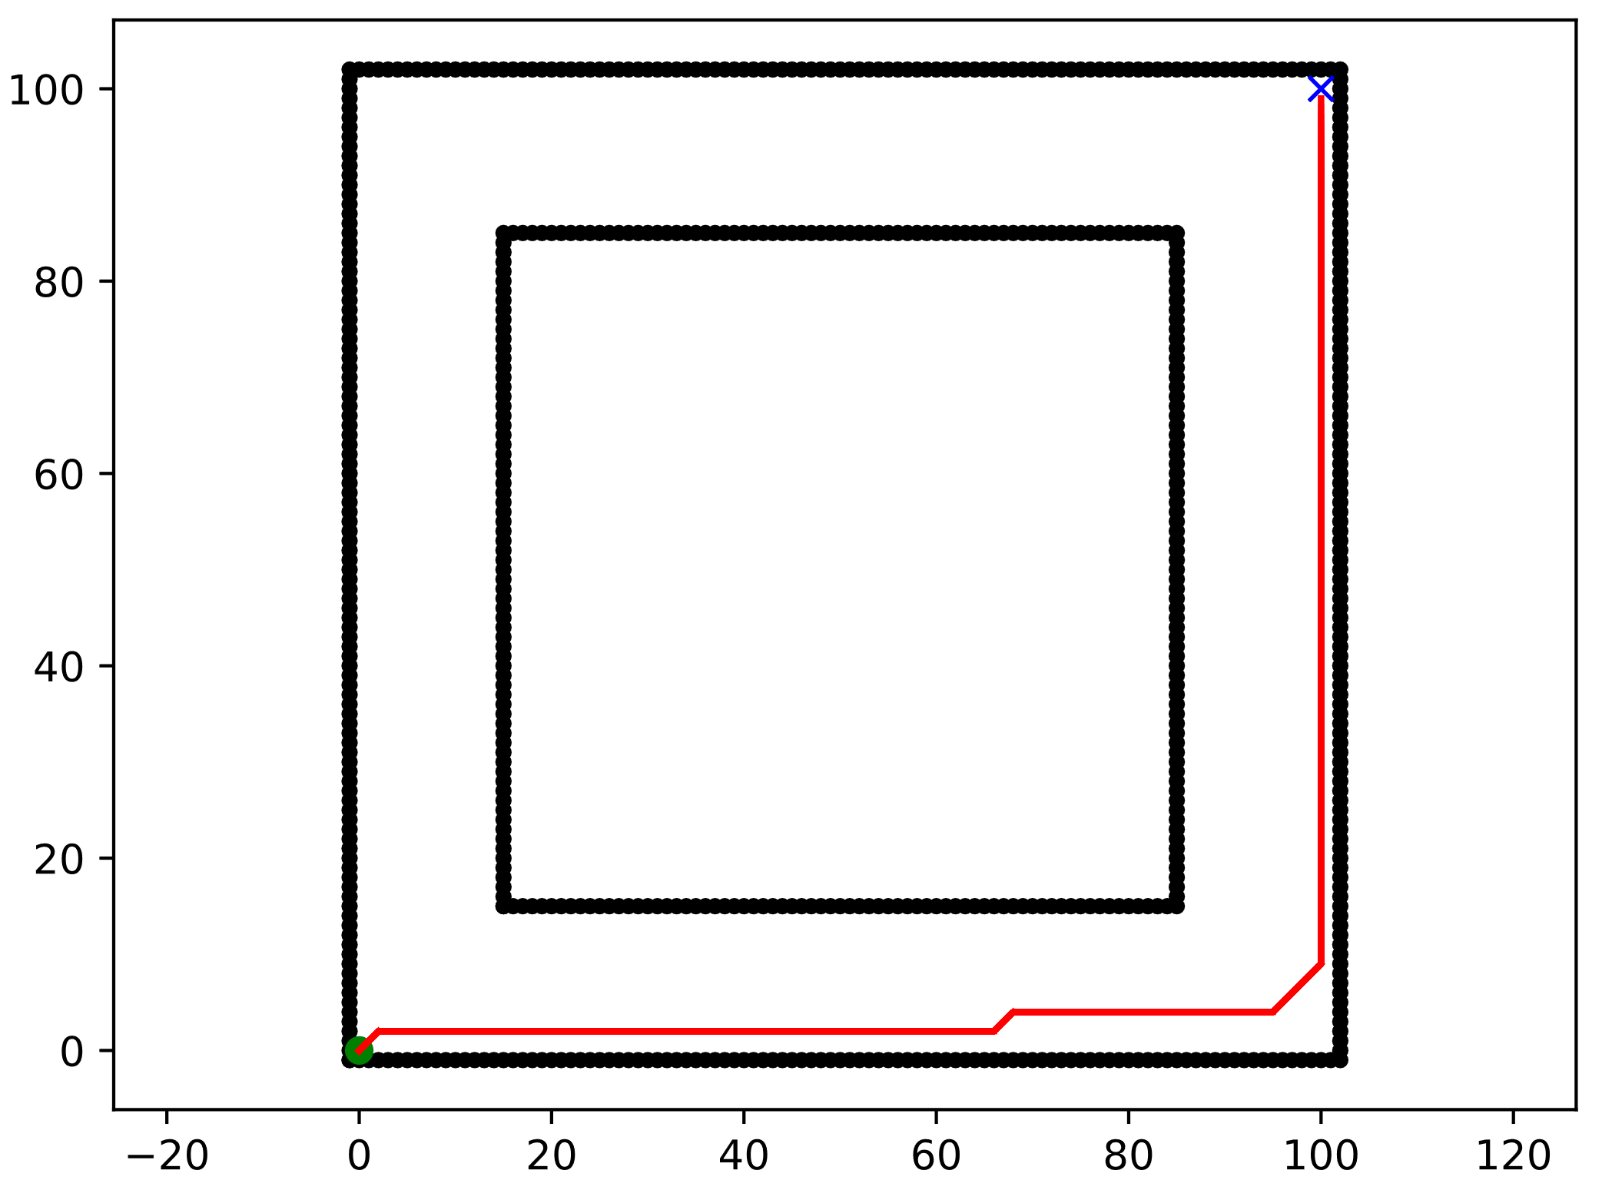
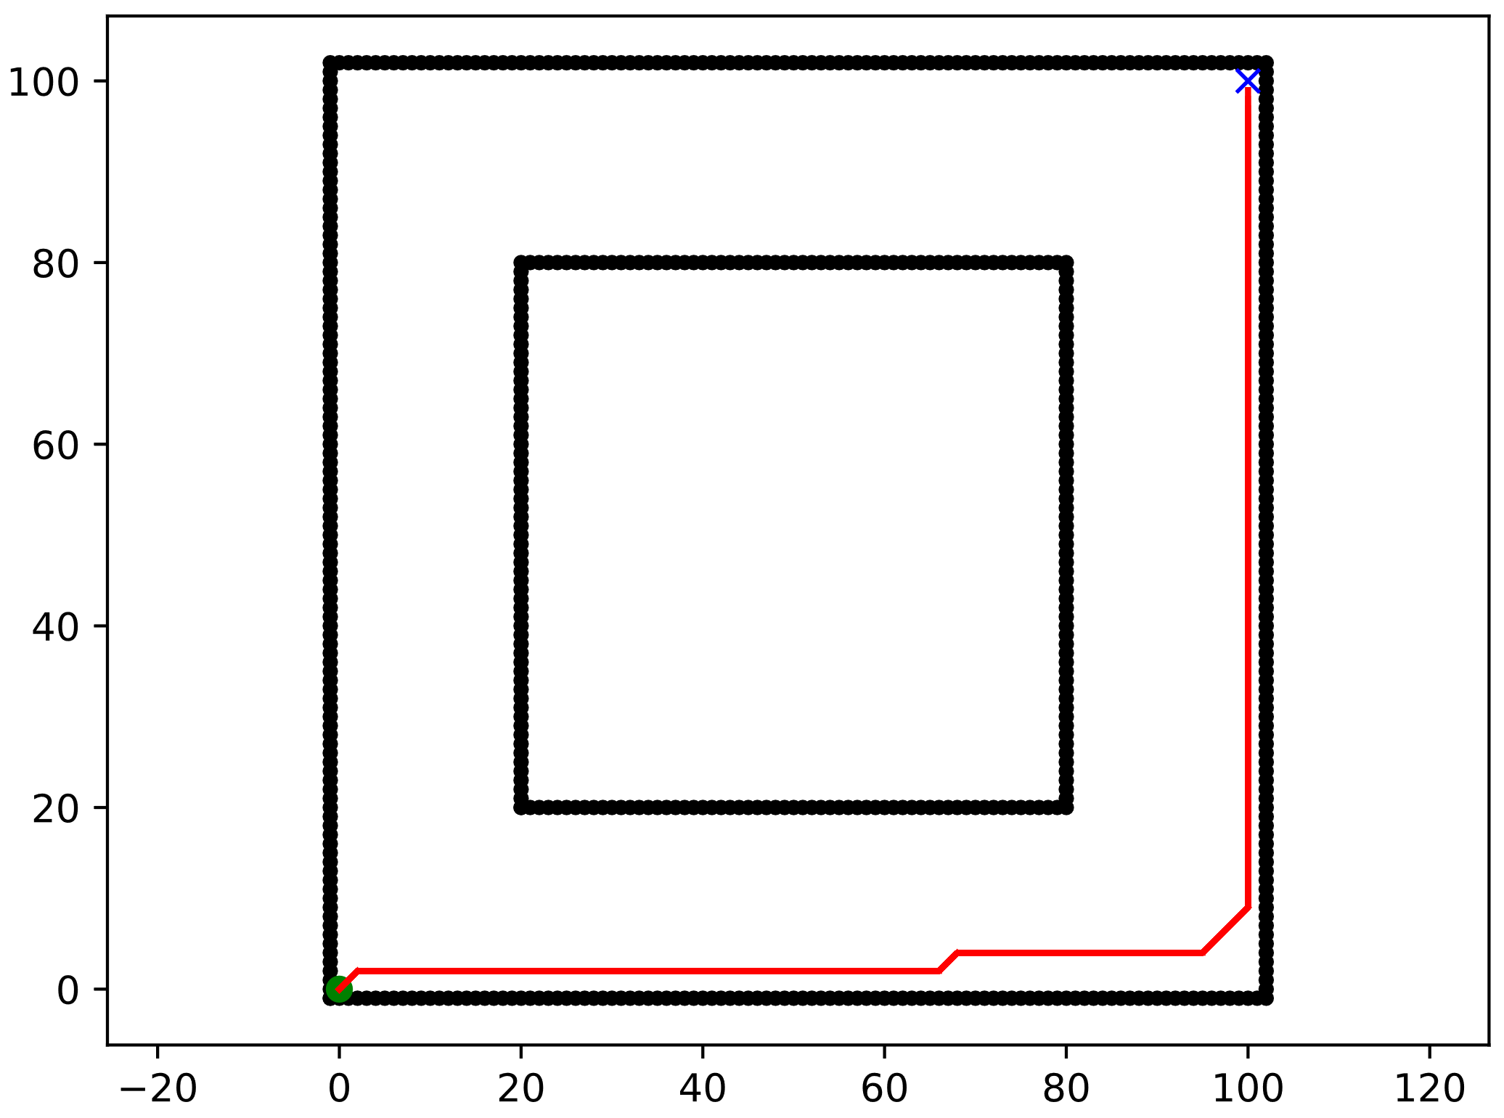
SCENARIOS
Clear_1:
Map
100 x 100 squares
Start → (0, 0)
Goal → (100, 100)
Clearance → 5
Clear_2:
Map
100 x 100 squares
Start → (0, 0)
Goal → (100, 100)
Clearance → 10
Clear_3:
Map
100 x 100 squares
Start → (0, 0)
Goal → (100, 100)
Clearance → 15
Clear_4:
Map
100 x 100 squares
Start → (0, 0)
Goal → (100, 100)
Clearance → 20
Notes:
Scenario 1
5.1 - Positioning of the obstacles in the first scenario:
Bottom left obstacle (X(15:25) and Y(15:25)), and top right obstacle (X(75:85) and Y(85:95)).
5.2 - Positioning of the obstacles in the second scenario:
Bottom obstacle (X(40:50) and Y(40:50)), and the top obstacle (X(40:50) and Y(60:70)).
5.3 - Positioning of the obstacles in the third scenario:
Bottom obstacle (X(40:50) and Y(40:50)), and top obstacle (X(60:70) and Y(60:70)).
Scenario 2

Slide 3
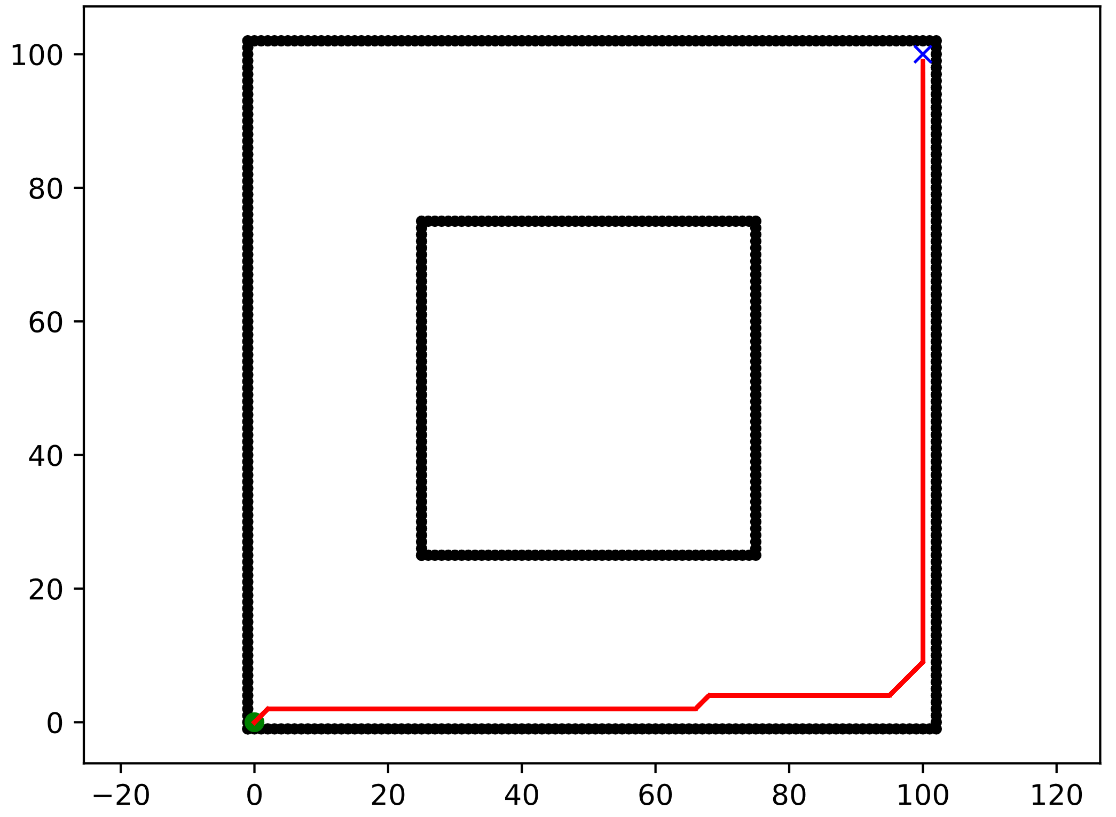
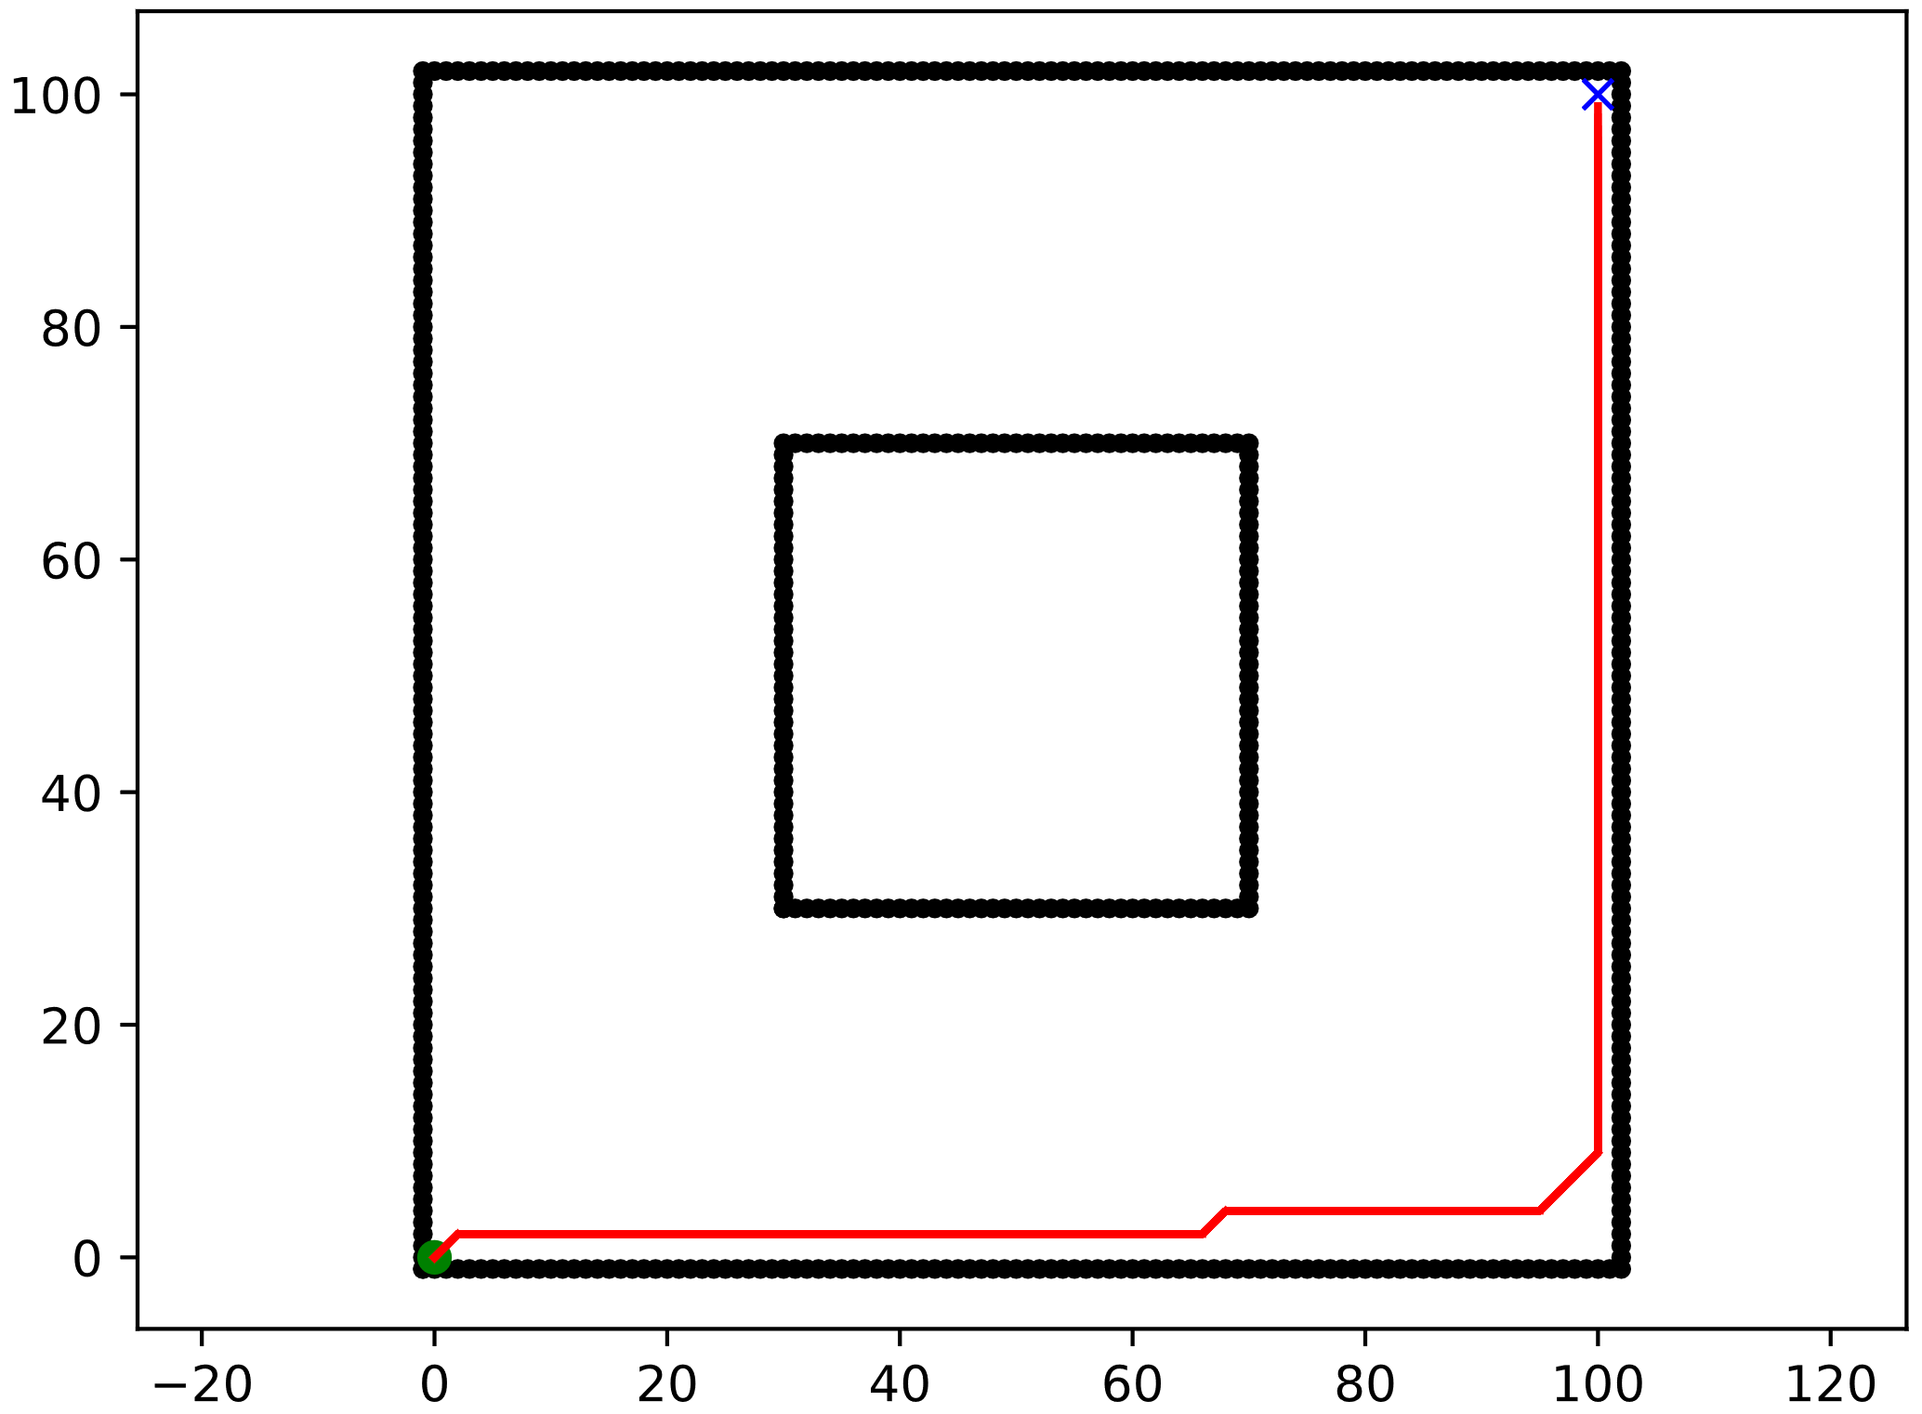
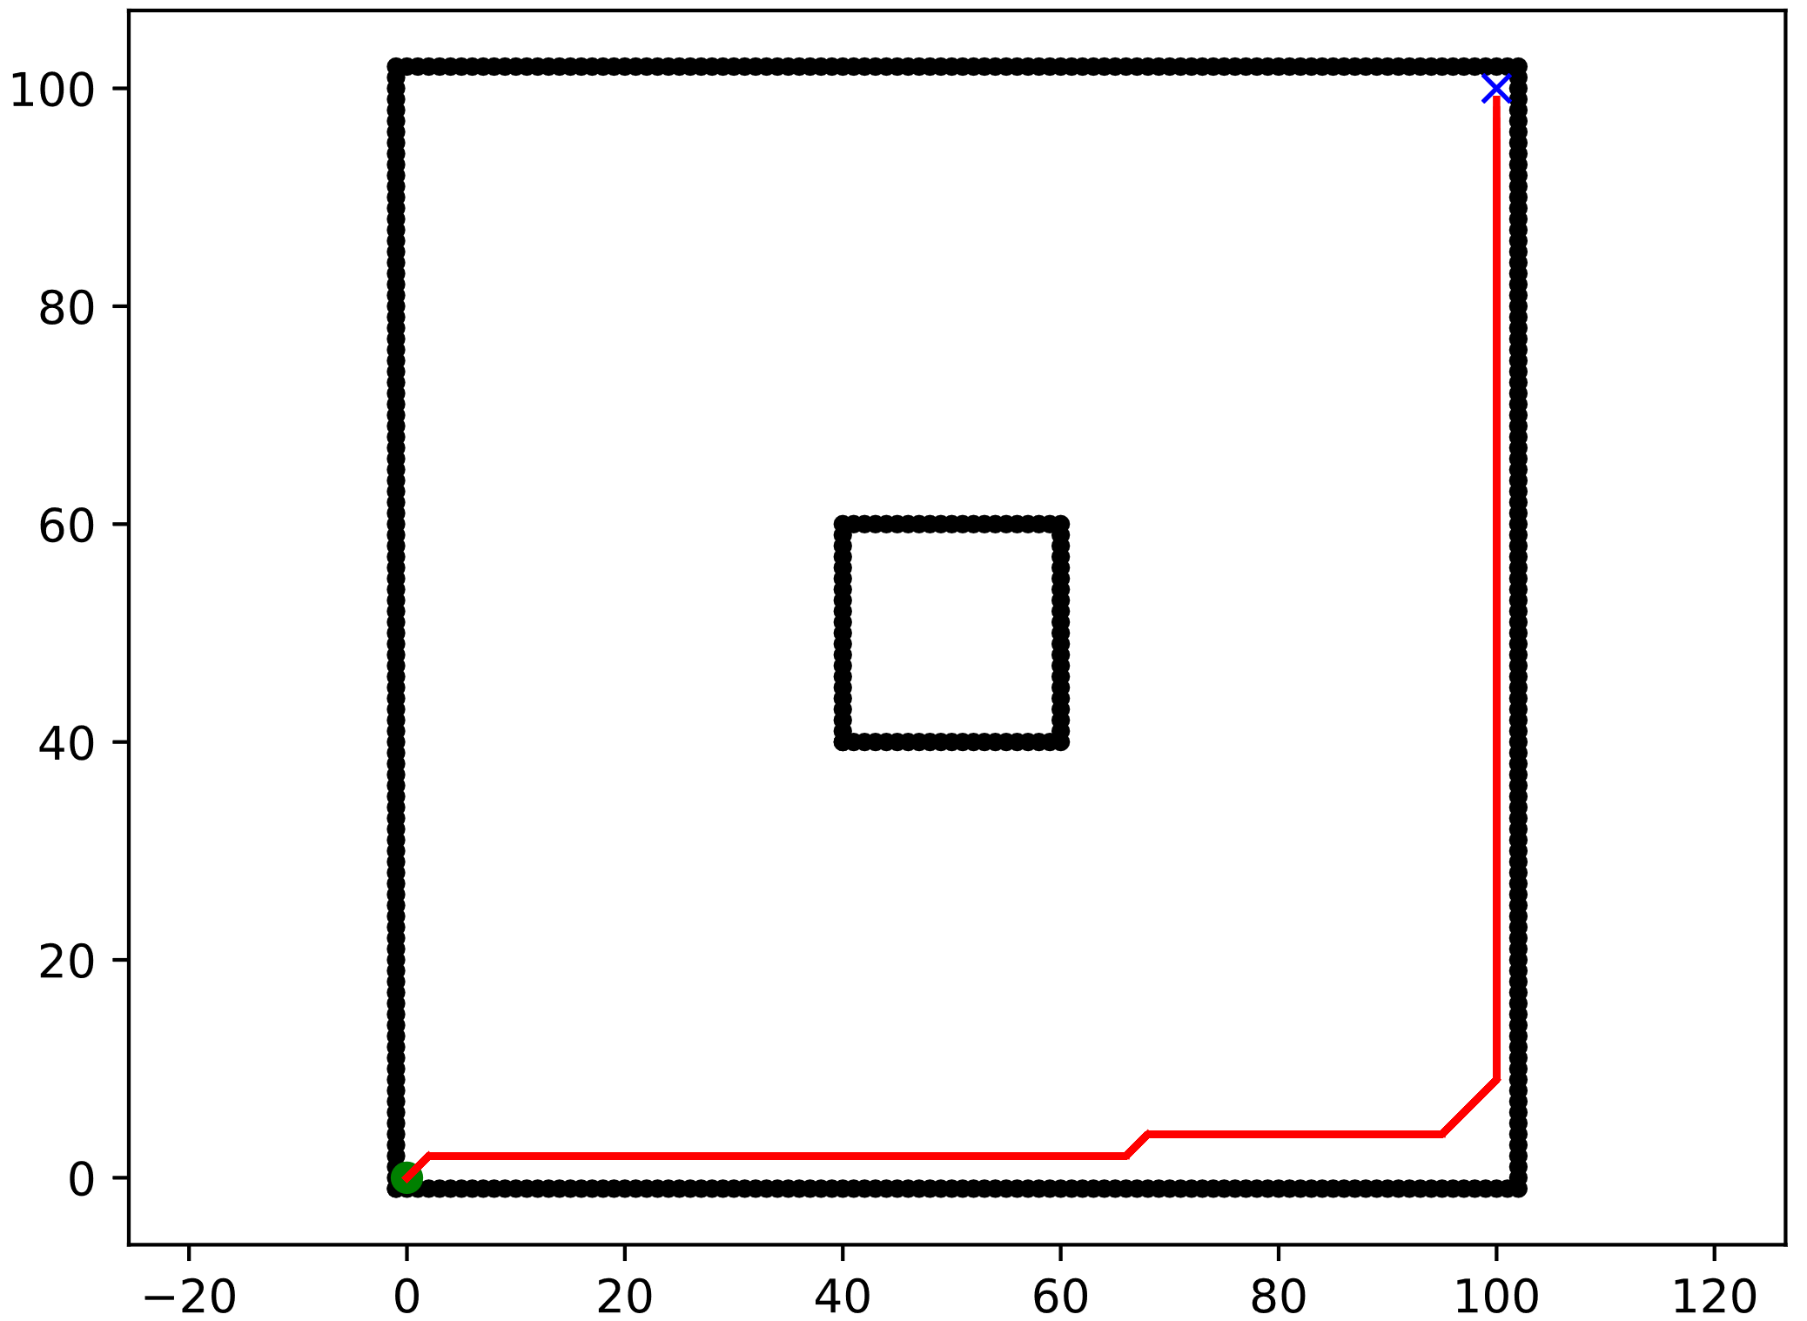
SCENARIOS
Clear_5:
Map
100 x 100 squares
Start → (0, 0)
Goal → (100, 100)
Clearance → 25
Clear_6:
Map
100 x 100 squares
Start → (0, 0)
Goal → (100, 100)
Clearance → 30
Clear_7:
Map
100 x 100 squares
Start → (0, 0)
Goal → (100, 100)
Clearance → 40
Notes:
Scenario 1
5.1 - Positioning of the obstacles in the first scenario:
Bottom left obstacle (X(15:25) and Y(15:25)), and top right obstacle (X(75:85) and Y(85:95)).
5.2 - Positioning of the obstacles in the second scenario:
Bottom obstacle (X(40:50) and Y(40:50)), and the top obstacle (X(40:50) and Y(60:70)).
5.3 - Positioning of the obstacles in the third scenario:
Bottom obstacle (X(40:50) and Y(40:50)), and top obstacle (X(60:70) and Y(60:70)).
Scenario 2

Slide 4
ALGORITHMS EVALUATED
DETERMINISTICS
A_Star
Bidirectional_A_Star
Bidirectional_BFS
BFS
DFS
Dijkstra
D_Star
Greedy_BFS
Visibility_Road_Map
PROBABILISTICS
RRT
RRT_Path_Smoothing
RRT_Sobol_Sampler
RRT_Star

Slide 5


Slide 6
Work in progress
Writing the Problem Statement
Writing the methodology

Slide 7
Relation between Path_length and Iteration
There is some relationship between the path Length obtained and the number of Iterations for each algorithm?
Is different for Deterministic than Probabilistic Algorithm?
Depend on obstacle shape or obstacle position?

