Slide 1
Metrics in Path Planning Algorithm
Ronald Ponguillo
University of Ghent

Slide 2
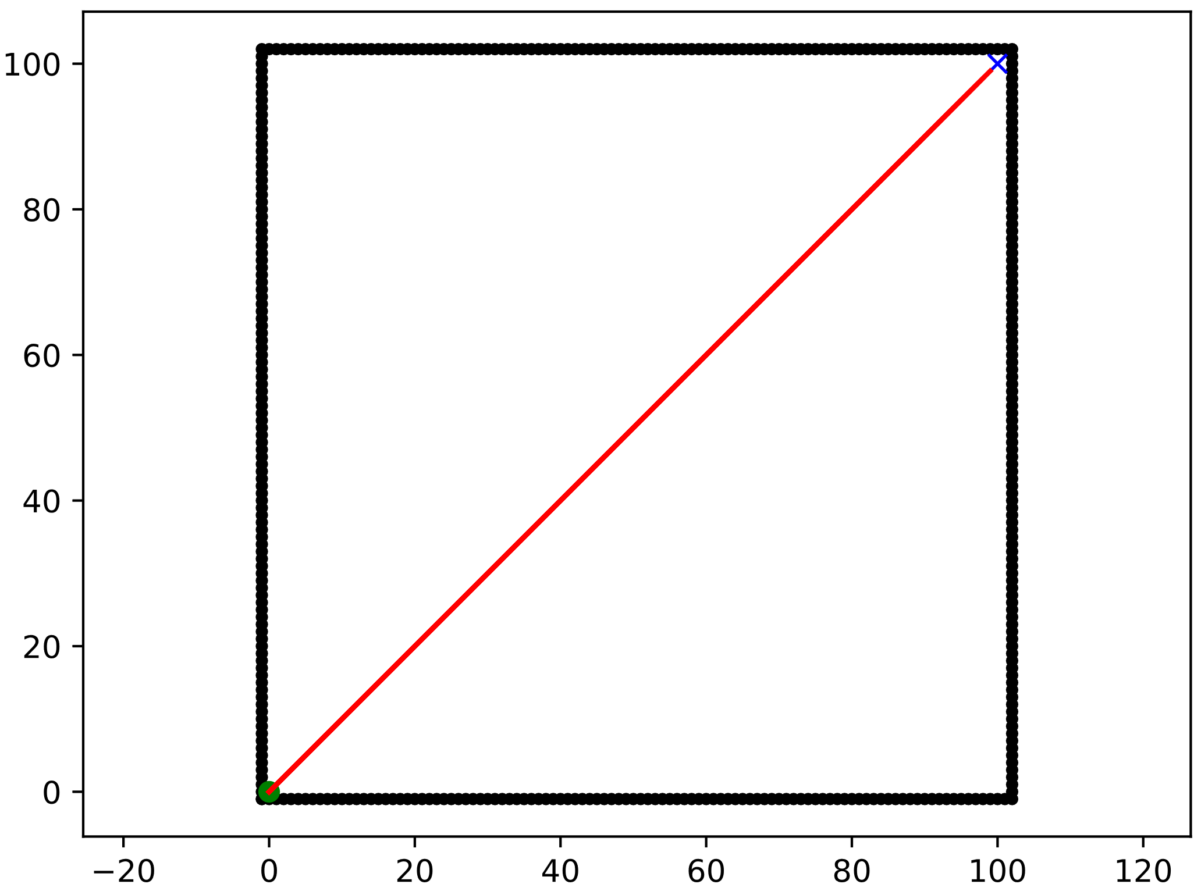
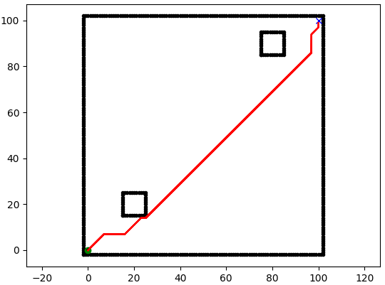
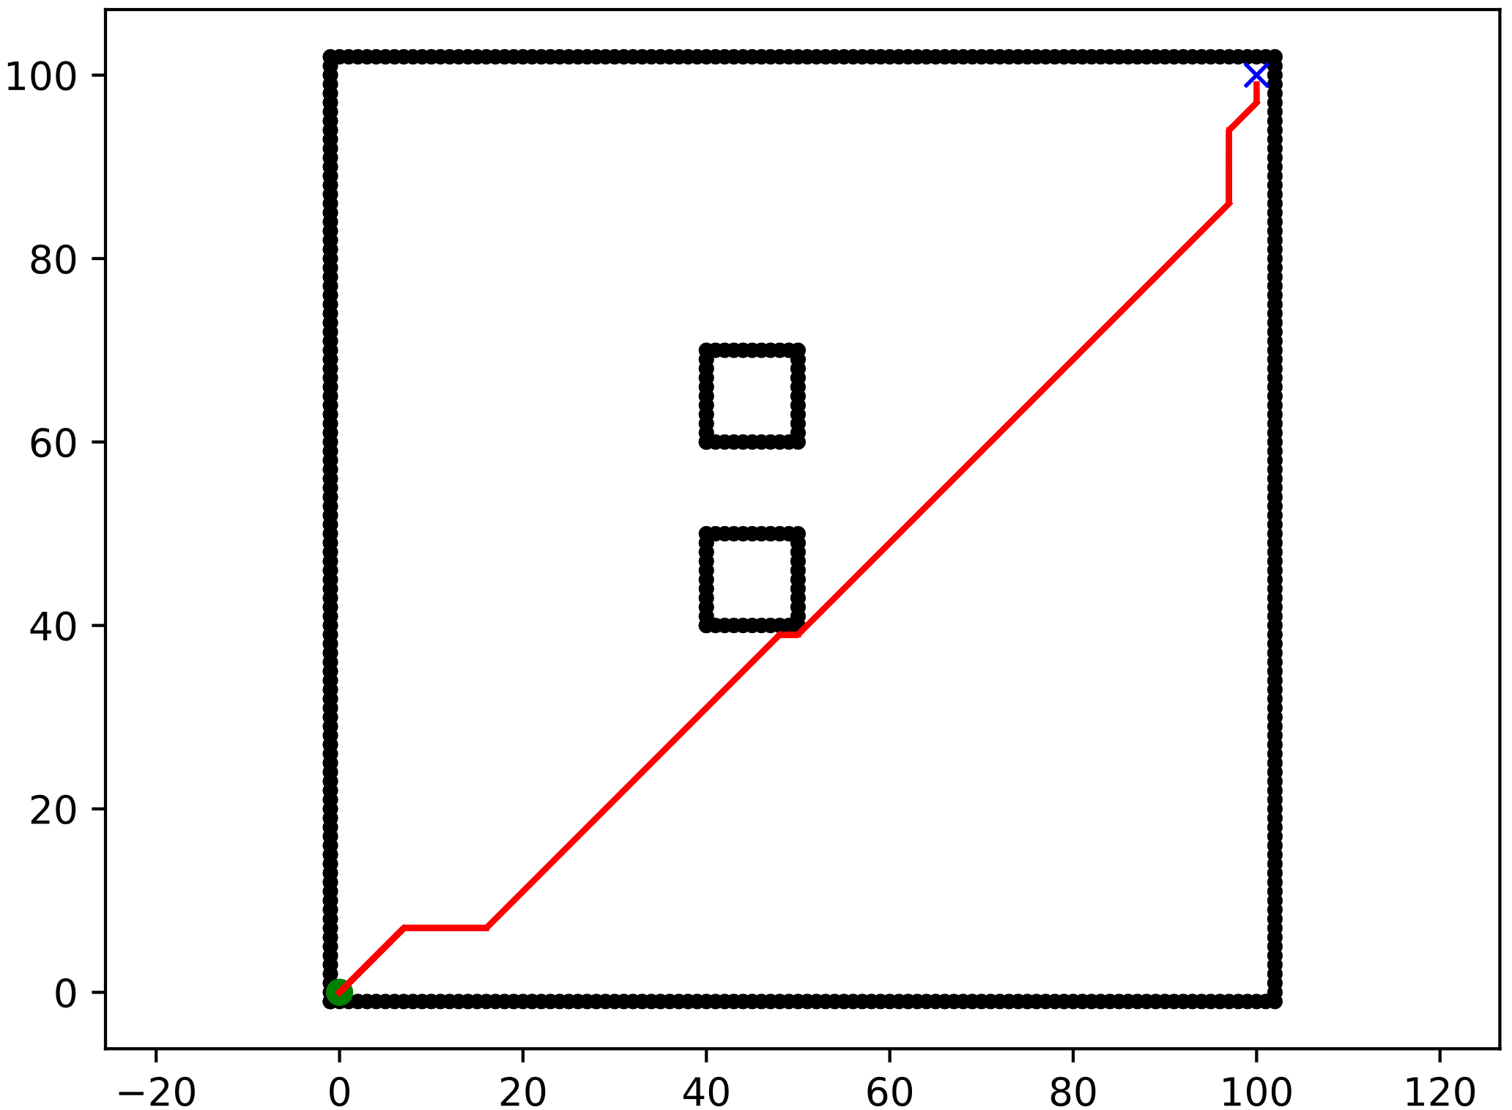
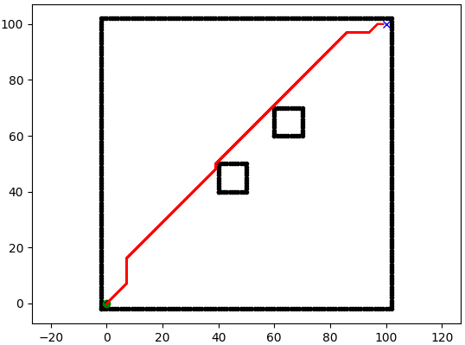
SCENARIOS
Scenario 0:
Empty map
100 x 100 squares
Start → (0, 0)
Goal → (100, 100)
Scenario 1:
Map
100 x 100 squares
Obstacles
10 x 10 squares
Start → (0, 0)
Goal → (100, 100)
Scenario 2:
Map
100 x 100 squares
Obstacles
10 x 10 squares
Start → (0, 0)
Goal → (100, 100)
Scenario 3:
Map
100 x 100 squares
Obstacles
10 x 10 squares
Start → (0, 0)
Goal → (100, 100)
Notes:
Scenario 1
5.1 - Positioning of the obstacles in the first scenario:
Bottom left obstacle (X(15:25) and Y(15:25)), and top right obstacle (X(75:85) and Y(85:95)).
5.2 - Positioning of the obstacles in the second scenario:
Bottom obstacle (X(40:50) and Y(40:50)), and the top obstacle (X(40:50) and Y(60:70)).
5.3 - Positioning of the obstacles in the third scenario:
Bottom obstacle (X(40:50) and Y(40:50)), and top obstacle (X(60:70) and Y(60:70)).
Scenario 2

Slide 3
ALGORITHMS EVALUATED
DETERMINISTICS
A_Star
Bidirectional_A_Star
Bidirectional_BFS
BFS
DFS
Dijkstra
D_Star
Greedy_BFS
Visibility_Road_Map
PROBABILISTICS
RRT
RRT_Path_Smoothing
RRT_Sobol_Sampler
RRT_Star

Slide 4
Scenario 0

Slide 5
Scenario 1

Slide 6
Scenario 2

Slide 7
Scenario 3

Slide 8
NEXT WORKS
Increase the number of samples in Probabilistic Algorithms
Increase the number of obstacles
Change the form and size of the obstacles
Evaluate Replanning Algorithms: D*, Longlife A*, D* Lite

