Slide 1
Metrics in Path Planning Algorithm
Ronald Ponguillo
University of Ghent

Slide 2
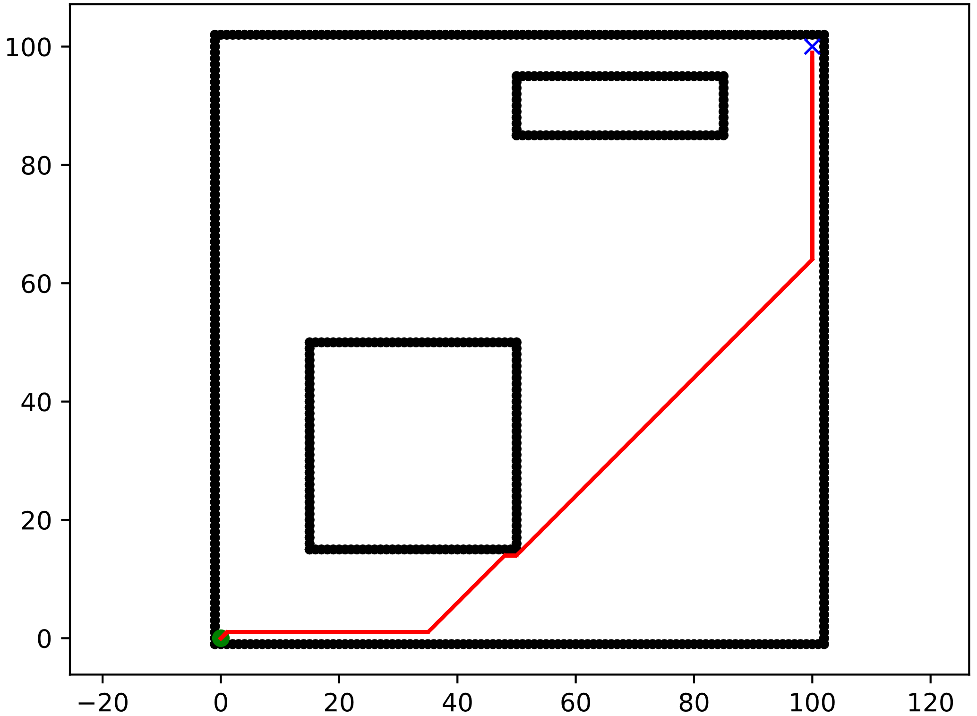
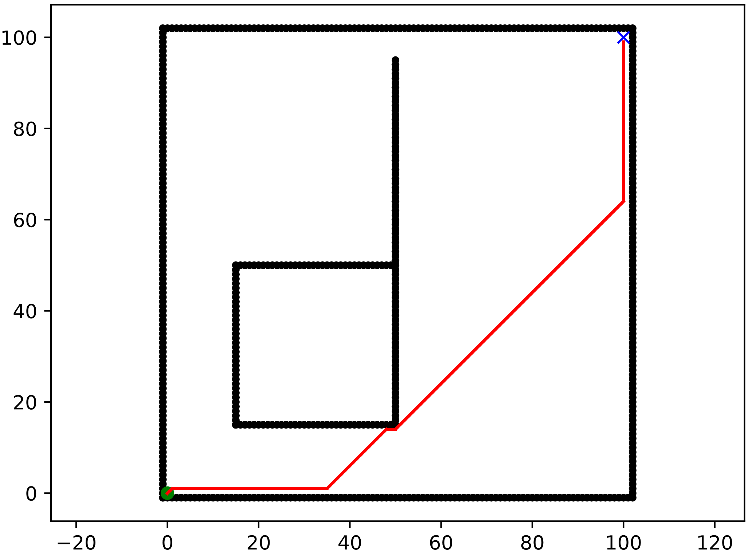
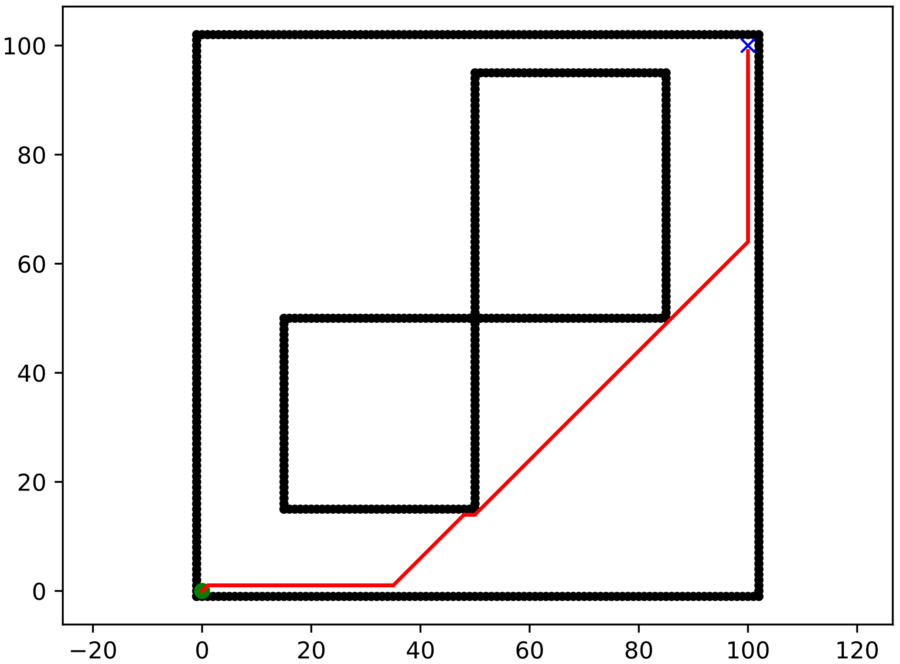
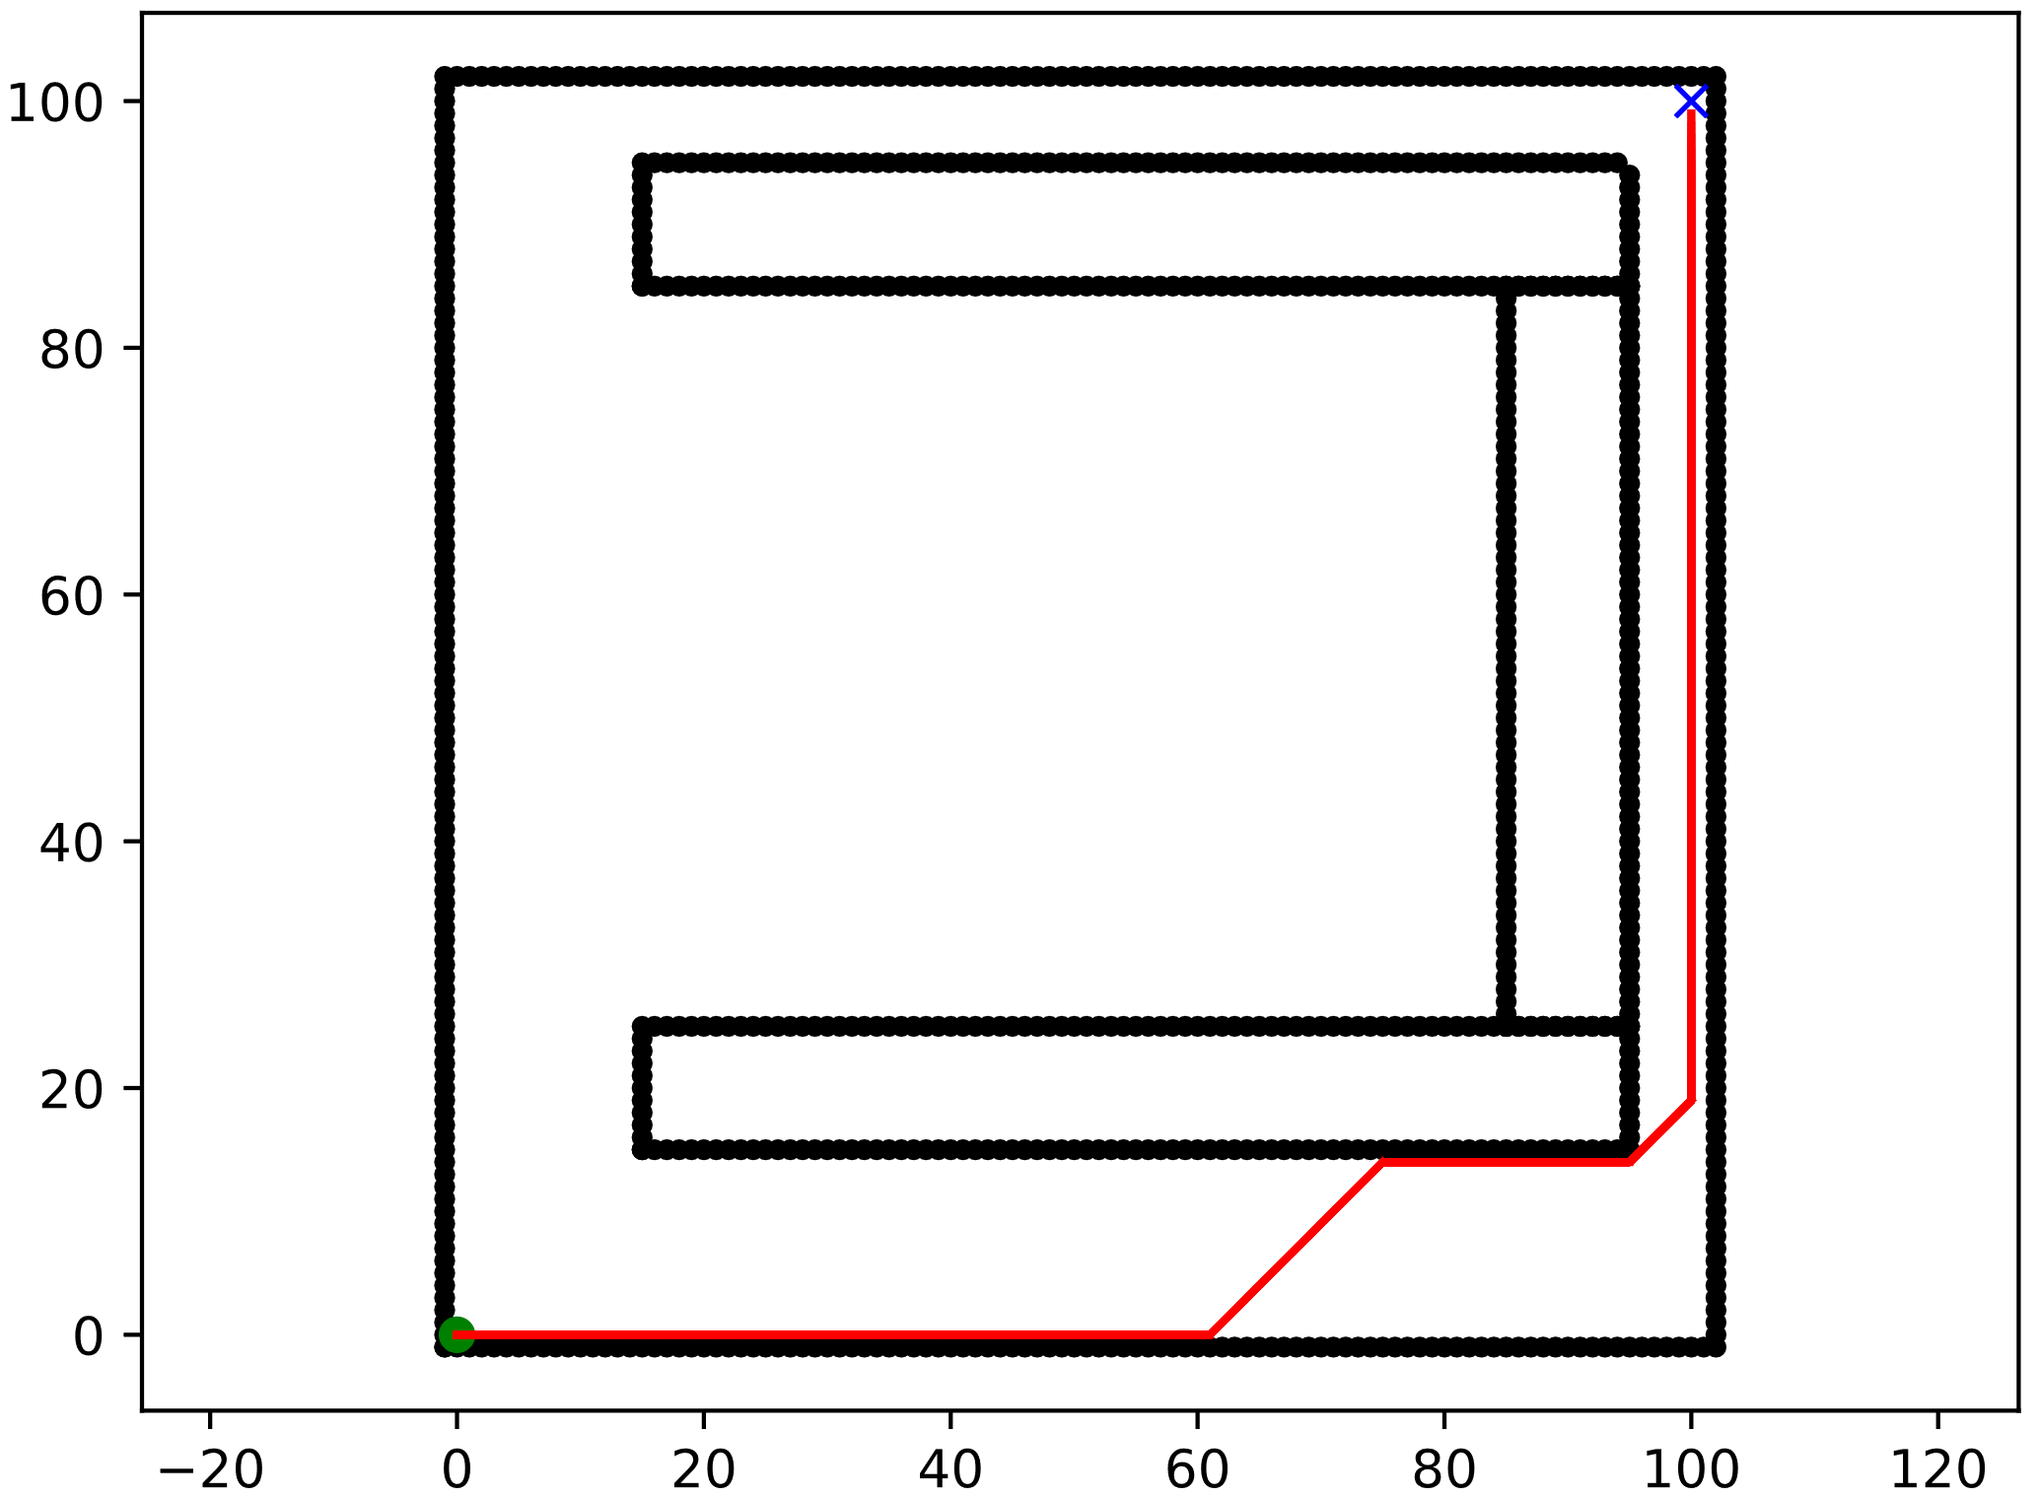
SCENARIOS
Scenario C1:
Empty map
100 x 100 squares
Start → (0, 0)
Goal → (100, 100)
Scenario C2:
Map
100 x 100 squares
Obstacles
10 x 10 squares
Start → (0, 0)
Goal → (100, 100)
Scenario C3:
Map
100 x 100 squares
Obstacles
10 x 10 squares
Start → (0, 0)
Goal → (100, 100)
Scenario C4:
Map
100 x 100 squares
Obstacles
10 x 10 squares
Start → (0, 0)
Goal → (100, 100)
Notes:
Scenario 1
5.1 - Positioning of the obstacles in the first scenario:
Bottom left obstacle (X(15:25) and Y(15:25)), and top right obstacle (X(75:85) and Y(85:95)).
5.2 - Positioning of the obstacles in the second scenario:
Bottom obstacle (X(40:50) and Y(40:50)), and the top obstacle (X(40:50) and Y(60:70)).
5.3 - Positioning of the obstacles in the third scenario:
Bottom obstacle (X(40:50) and Y(40:50)), and top obstacle (X(60:70) and Y(60:70)).
Scenario 2

Slide 3
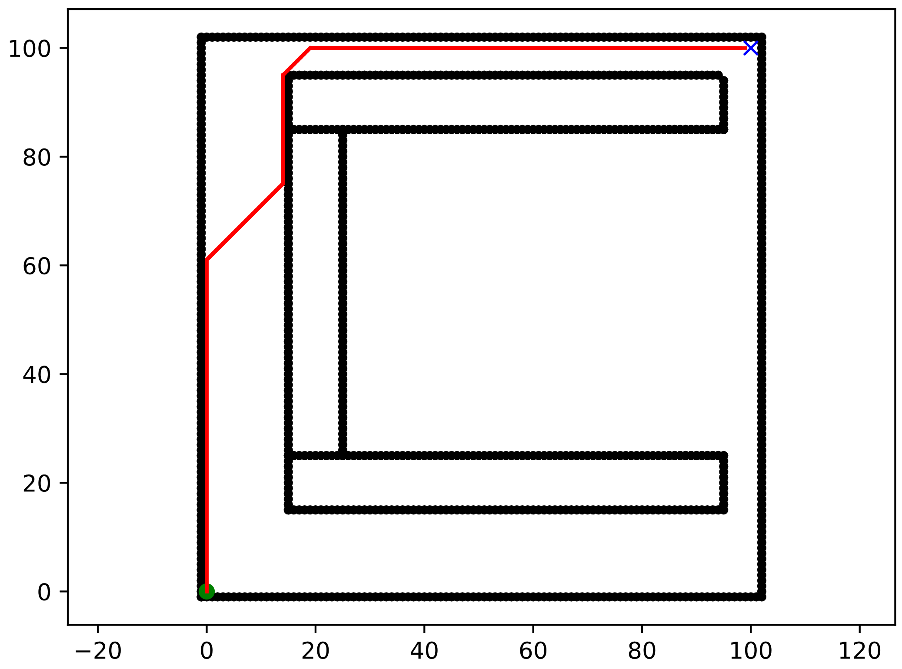
SCENARIOS
Scenario C5:
Empty map
100 x 100 squares
Start → (0, 0)
Goal → (100, 100)
Notes:
Scenario 1
5.1 - Positioning of the obstacles in the first scenario:
Bottom left obstacle (X(15:25) and Y(15:25)), and top right obstacle (X(75:85) and Y(85:95)).
5.2 - Positioning of the obstacles in the second scenario:
Bottom obstacle (X(40:50) and Y(40:50)), and the top obstacle (X(40:50) and Y(60:70)).
5.3 - Positioning of the obstacles in the third scenario:
Bottom obstacle (X(40:50) and Y(40:50)), and top obstacle (X(60:70) and Y(60:70)).
Scenario 2

Slide 4
ALGORITHMS EVALUATED
DETERMINISTICS
A_Star
Bidirectional_A_Star
Bidirectional_BFS
BFS
DFS
Dijkstra
D_Star
Greedy_BFS
Visibility_Road_Map
PROBABILISTICS
RRT
RRT_Path_Smoothing
RRT_Sobol_Sampler
RRT_Star

Slide 5
Scenario C1

Slide 6
Scenario C2

Slide 7
Scenario C3

Slide 8
Scenario C4

Slide 9
Scenario C5

Slide 10
NEXT WORKS
Re write the Robotics Toolbox (Python)
Input and generation of maps
Adding Scenarios for simple evaluation
Analyzing the data provided by Silvio
To easily port to Robotics Toolbox (Python)
To review the Amesim and Prescan Siemens software
Evaluate if it is possile to use for path planning
Evaluate how we can send our work to integrate with these software

