Slide 1
Decoding Geo data with Python
Ronald Ponguillo
University of Ghent

Slide 2
STARTING POINT
Files provided by Silvio

Slide 3
STARTING POINT
Files provided by Silvio
PROJCS["Transverse_Mercator",GEOGCS["GCS_Geographic Coordinate System",DATUM["D_Monte_Mario",SPHEROID["International_1909_Hayford_Intl_1924",6378388,297.0]],PRIMEM["Greenwich",0],UNIT["Degree",0.017453292519943295]],PROJECTION["Transverse_Mercator"],PARAMETER["scale_factor",0.9996],PARAMETER["central_meridian",9],PARAMETER["latitude_of_origin",0],PARAMETER["false_easting",1500000],PARAMETER["false_northing",0],UNIT["Meter",1]]

Slide 4
STARTING POINT
DESCRIPTION=Unknown Area Type
CLOSED=YES
suolo_id=RT0201010300339285
sup3d_id=
un_vol_id=RT0201010300599898
edi_min_id=
edifc_id=RT0201020300145613
un_vol_av=3.690000
un_vol_qe=10.810000
un_vol_por=01
un_vol_dp0=Al Suolo
un_vol_cl=020101
un_vol_dcl=unita' volumetrica
edifc_ty=08
edifc_uso=08
edifc_mon=02
edifc_stat=03
edifc_sot=01
1626262.950,4755628.470,10.81
1626247.370,4755630.650,10.81
1626249.100,4755643.400,10.81
1626264.730,4755641.220,10.81
1626262.950,4755628.470,10.81
Files provided by Silvio
X, Y, Elevation (Z)

Slide 5
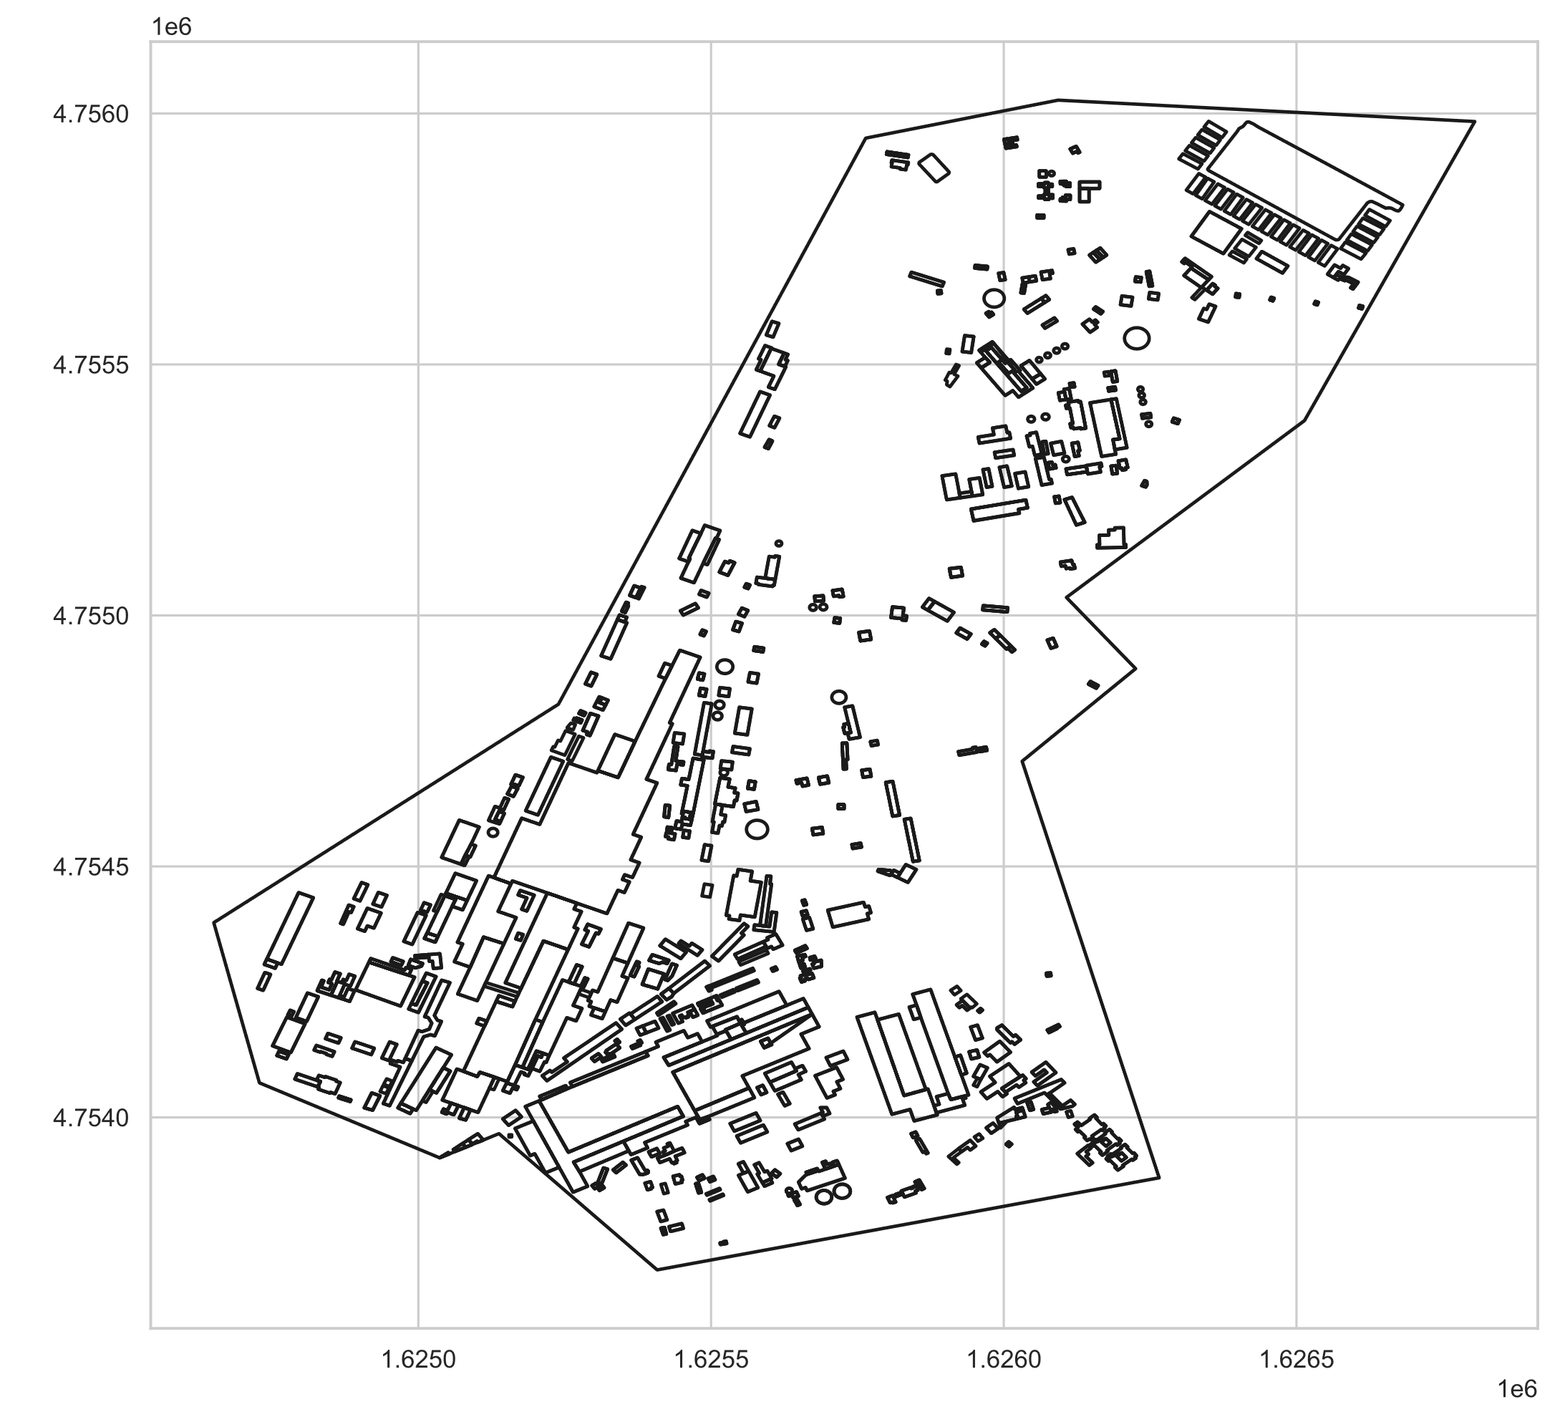
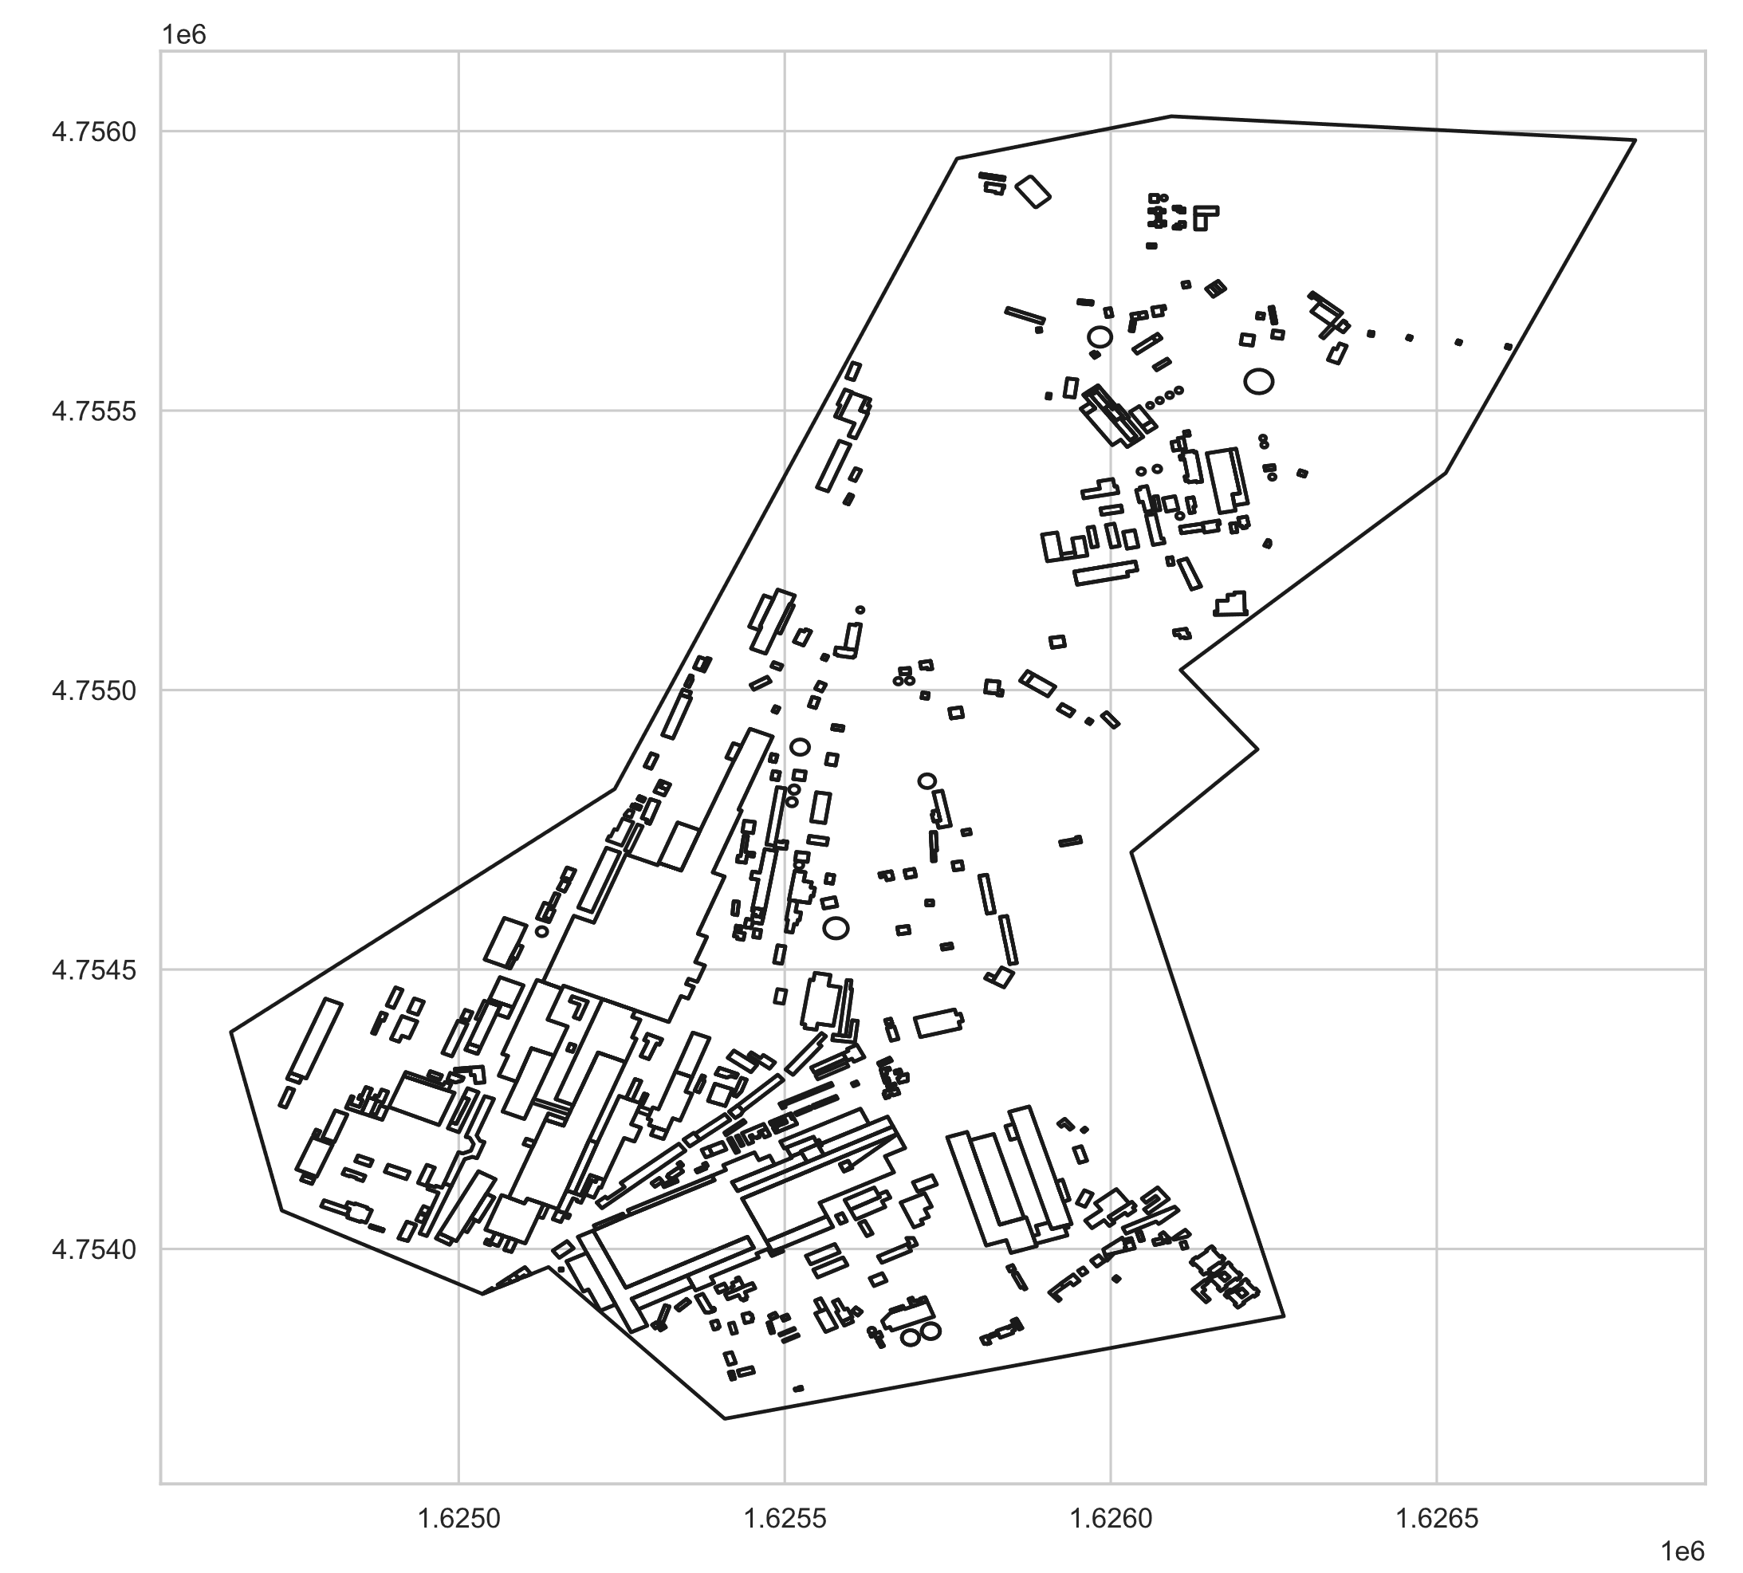
GPP-TEST_AREA
Elevation >= 0 m
Elevation >= 10 m

Slide 6
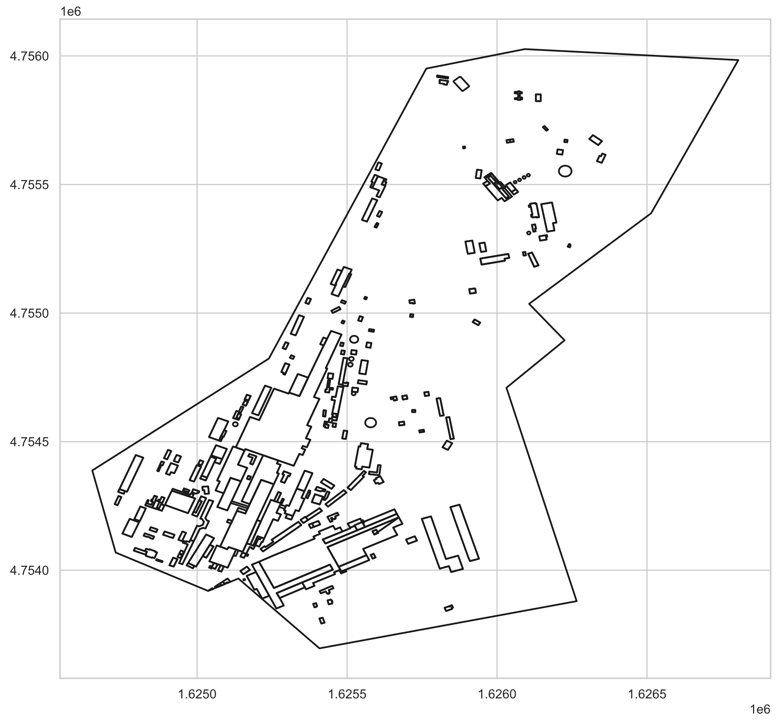
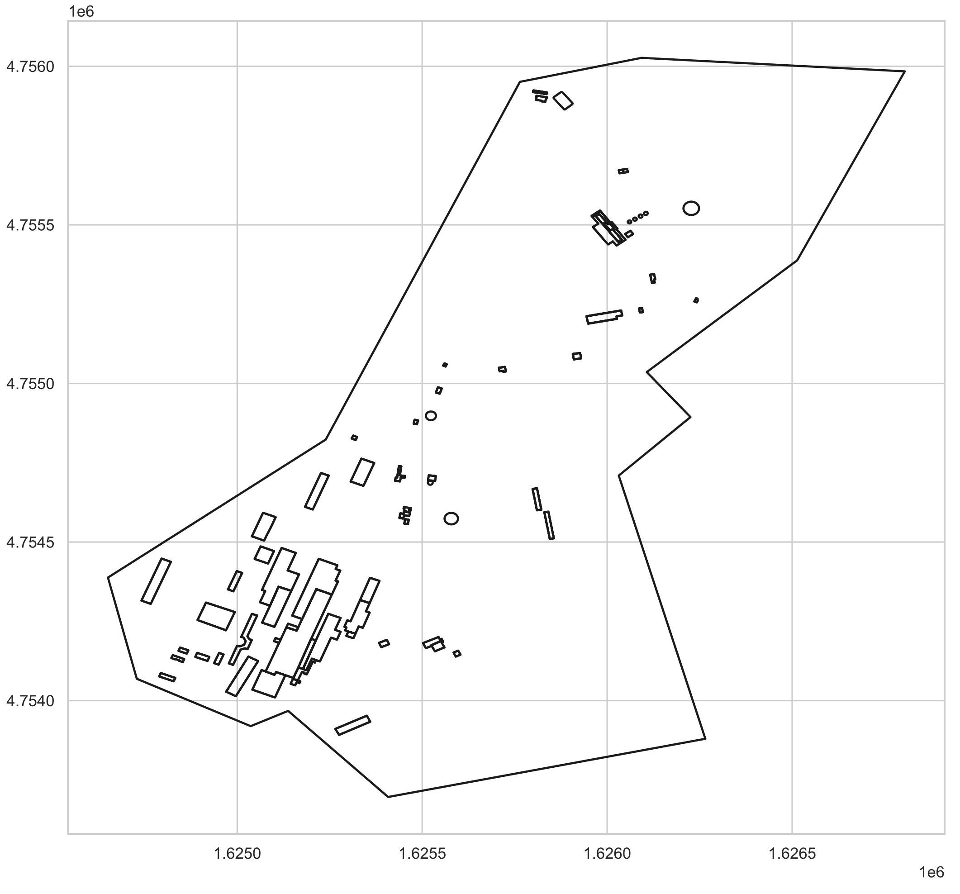
GPP-TEST_AREA
Elevation >= 20 m
Elevation >= 30 m

Slide 7
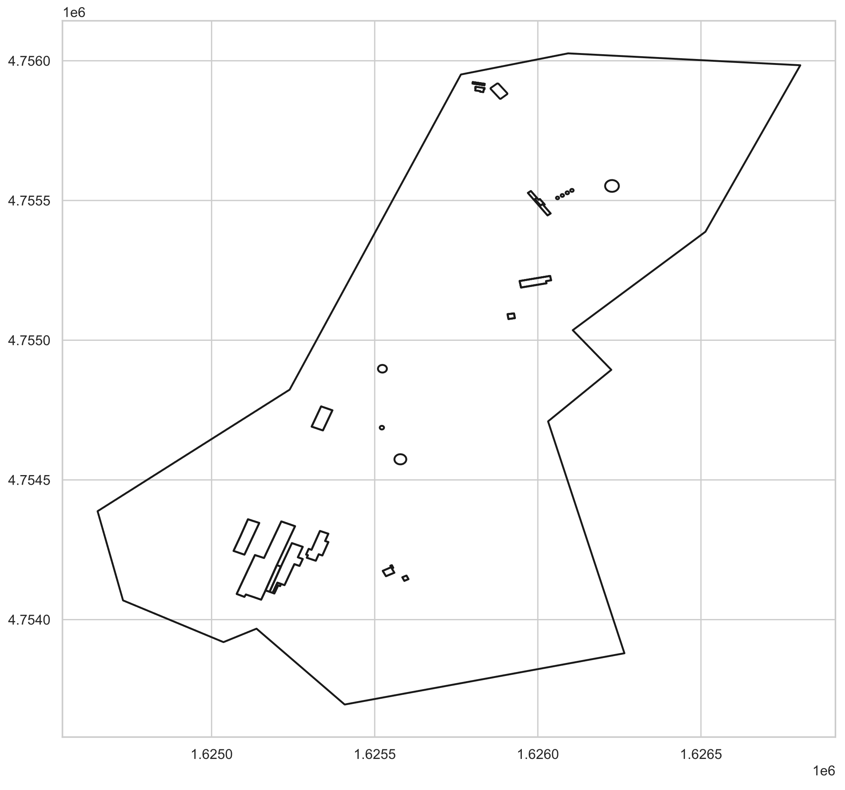
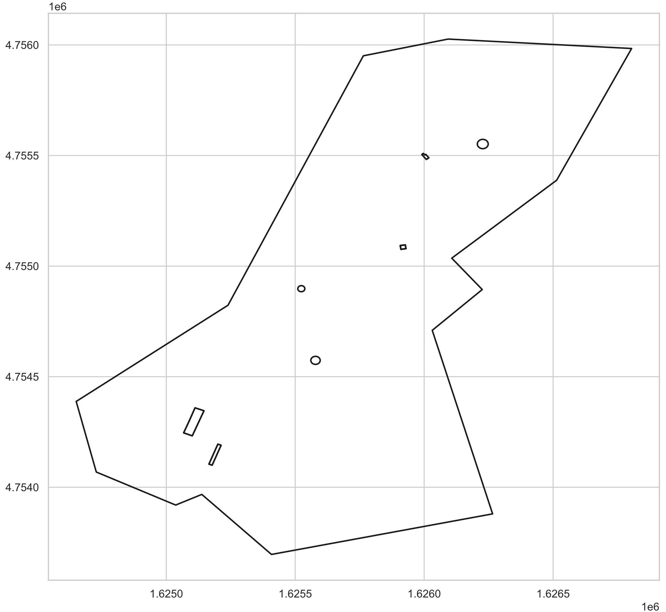
GPP-TEST_AREA
Elevation >= 40 m
Elevation >= 50 m

Slide 8
NEXT WORKS
Re write the Robotics Toolbox (Python)
Input and generation of maps
Adding Scenarios for simple evaluation
Analyzing the data provided by Silvio
To easily port to Robotics Toolbox (Python)
To review the Amesim and Prescan Siemens software
Evaluate if it is possile to use for path planning
Evaluate how we can send our work to integrate with these software

