Slide 1
Data Mining from experiments
Ronald Ponguillo
University of Ghent

Slide 2
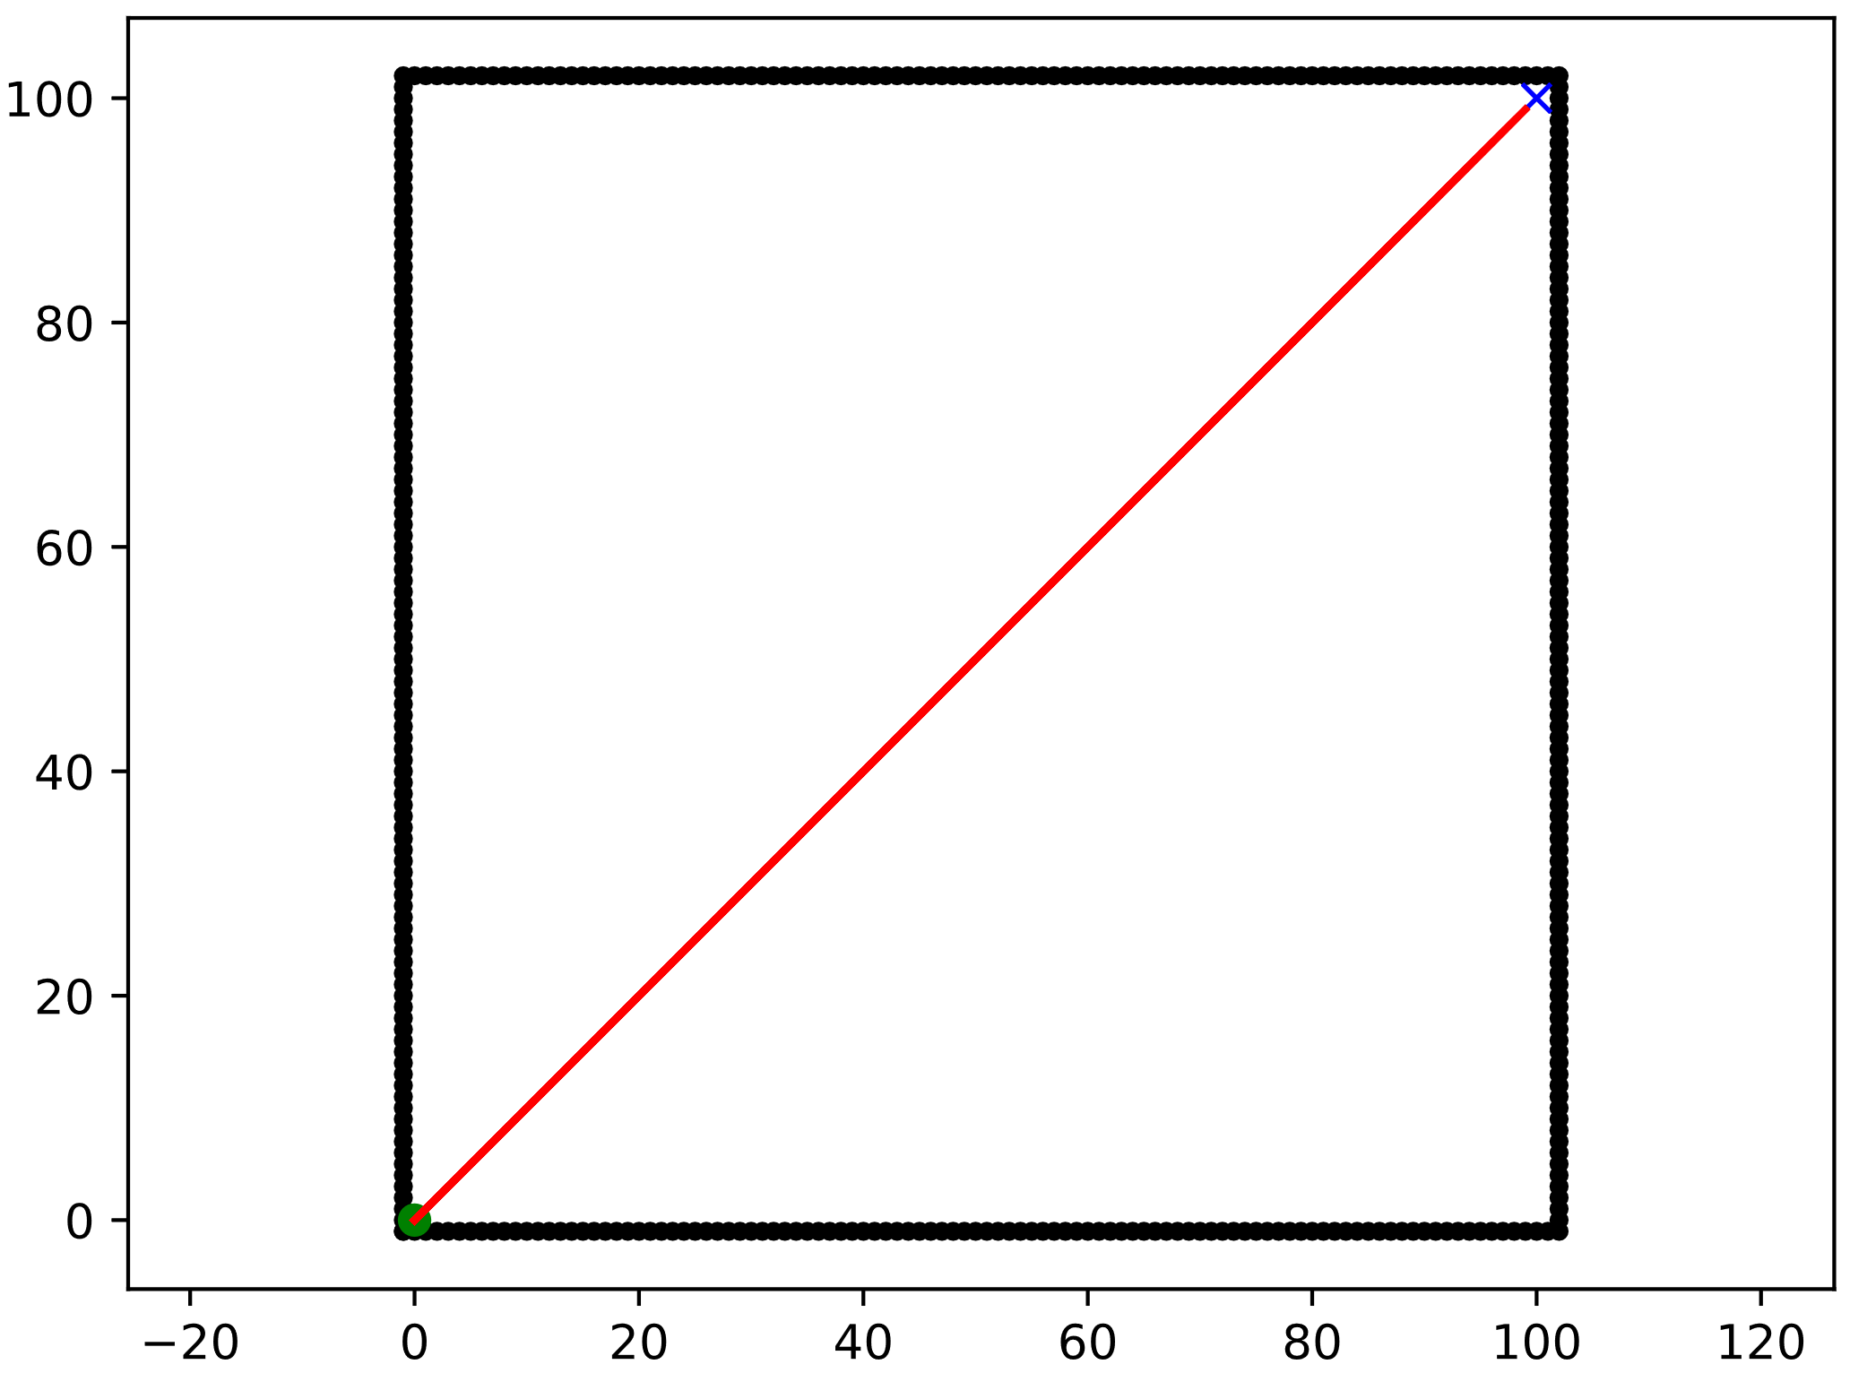
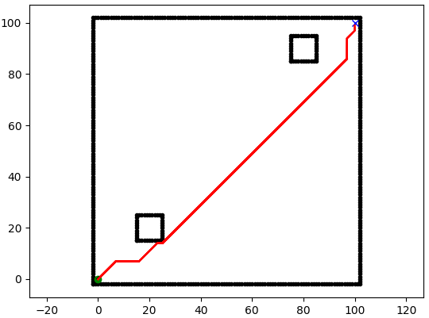
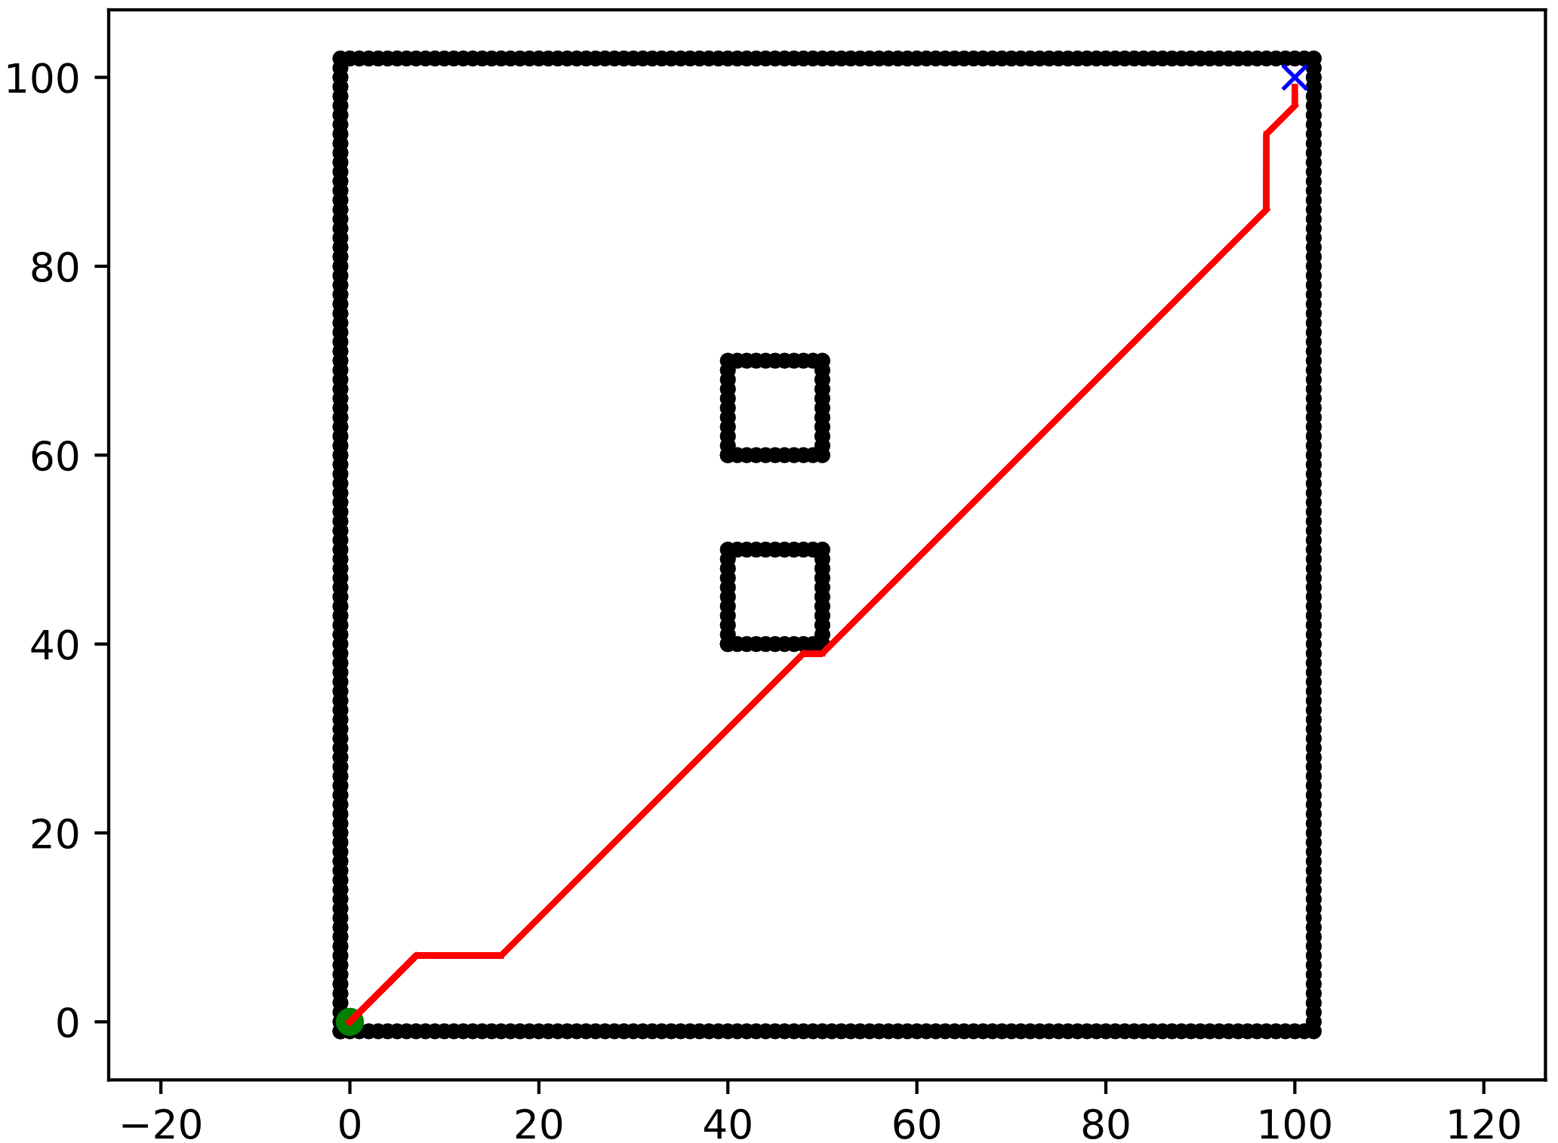
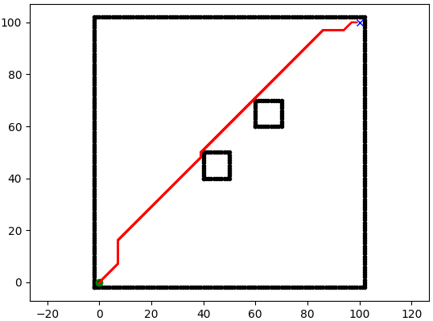
SCENARIOS
Scenario 0:
Empty map
100 x 100 squares
Start → (0, 0)
Goal → (100, 100)
Q_obstacle → 0%
Scenario 1:
Map
100 x 100 squares
Obstacles
10 x 10 squares
Start → (0, 0)
Goal → (100, 100)
Q_obstacle → 2.42%
Scenario 2:
Map
100 x 100 squares
Obstacles
10 x 10 squares
Start → (0, 0)
Goal → (100, 100)
Q_obstacle → 2.42%
Scenario 3:
Map
100 x 100 squares
Obstacles
10 x 10 squares
Start → (0, 0)
Goal → (100, 100)
Q_obstacle → 2.42%
Notes:
Scenario 1
5.1 - Positioning of the obstacles in the first scenario:
Bottom left obstacle (X(15:25) and Y(15:25)), and top right obstacle (X(75:85) and Y(85:95)).
5.2 - Positioning of the obstacles in the second scenario:
Bottom obstacle (X(40:50) and Y(40:50)), and the top obstacle (X(40:50) and Y(60:70)).
5.3 - Positioning of the obstacles in the third scenario:
Bottom obstacle (X(40:50) and Y(40:50)), and top obstacle (X(60:70) and Y(60:70)).
Scenario 2

Slide 3
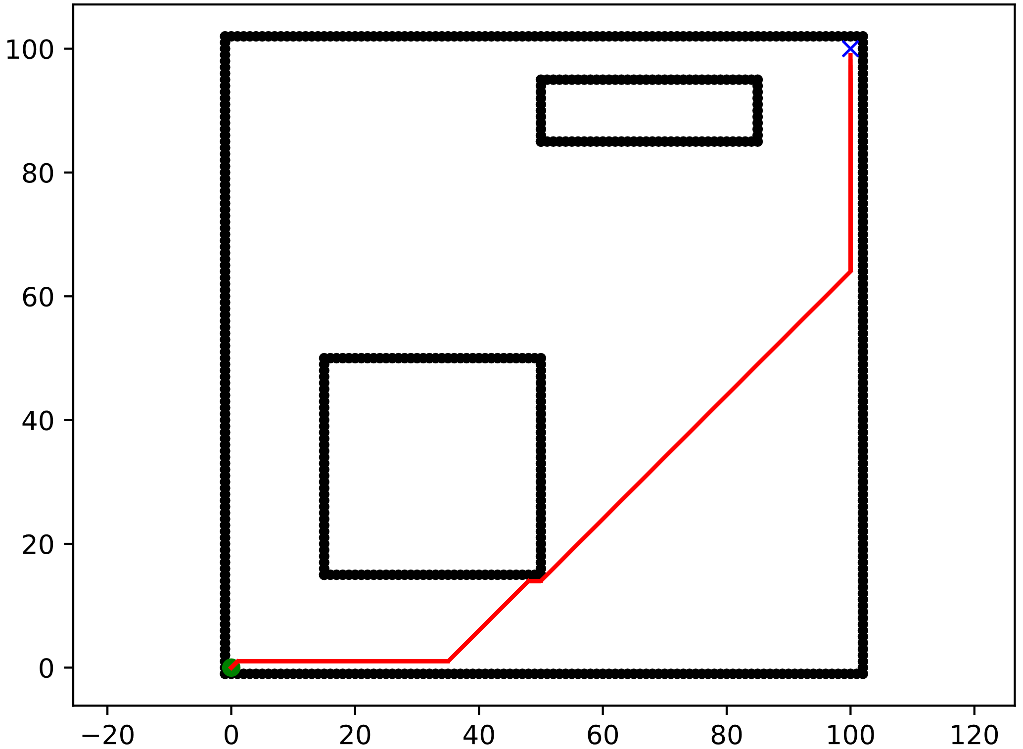
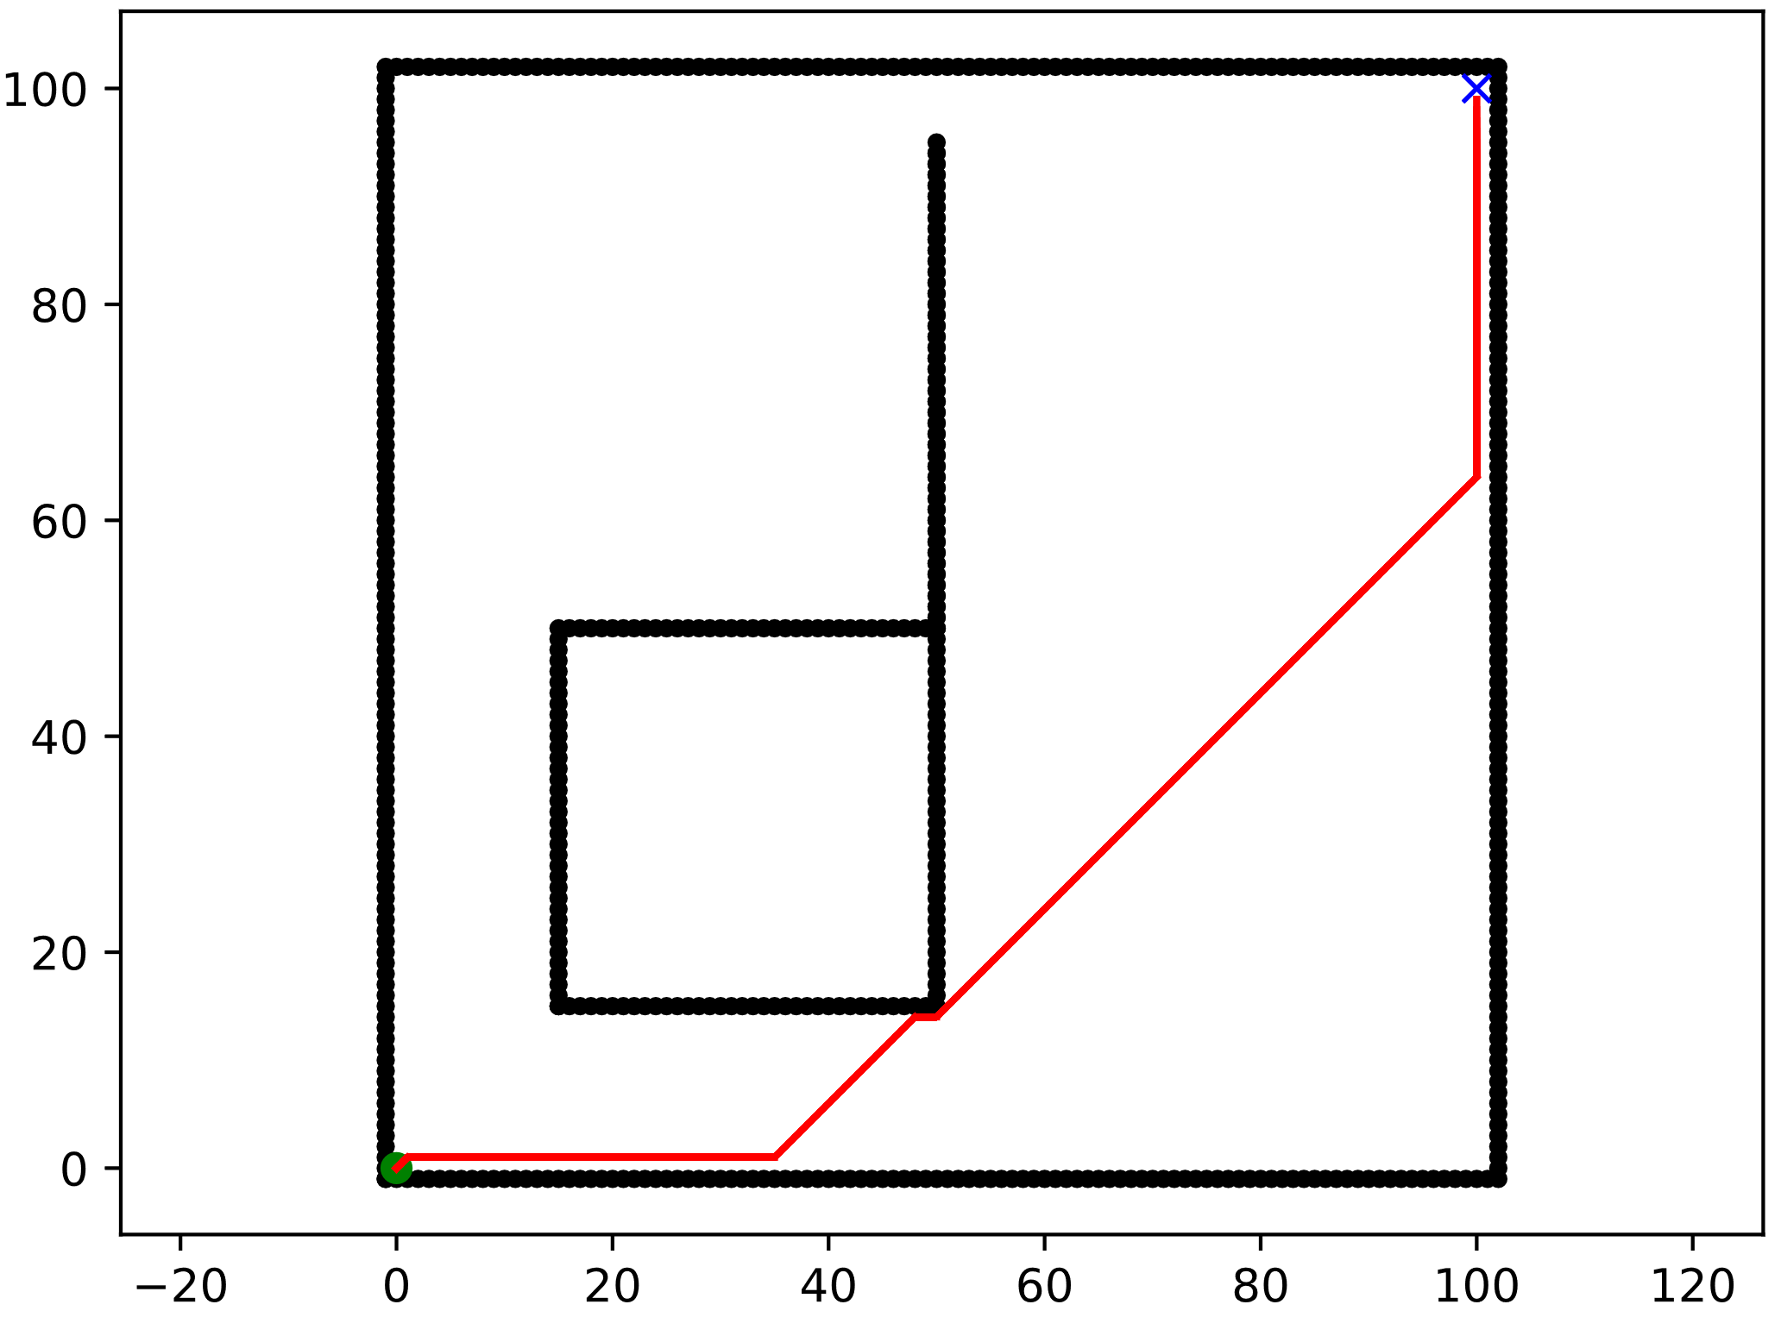
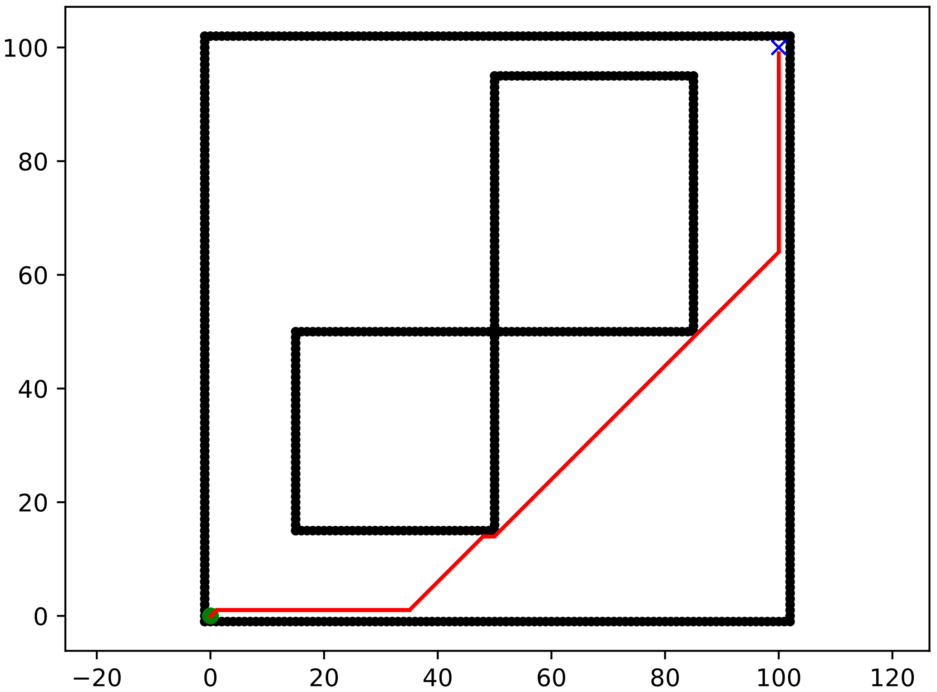
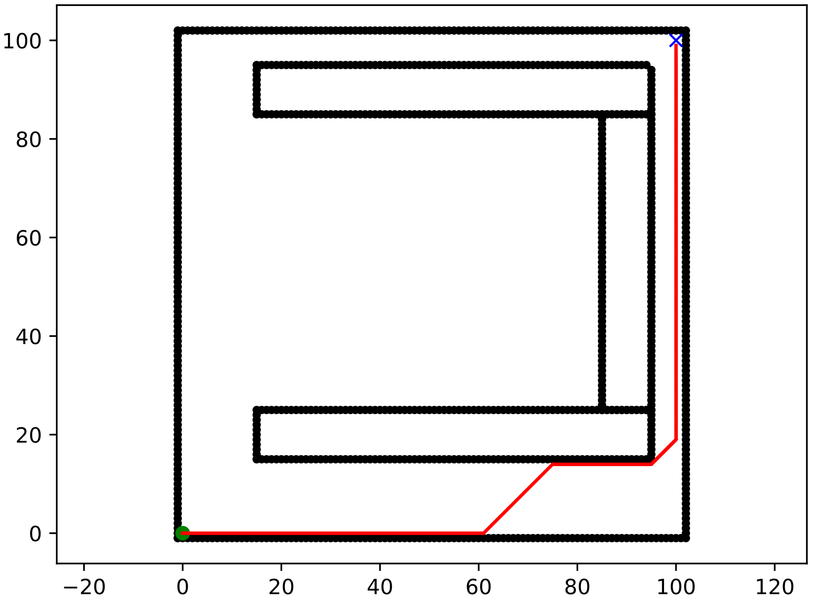
SCENARIOS
Scenario C1:
Empty map
100 x 100 squares
Start → (0, 0)
Goal → (100, 100)
Q_obstacle → 16.92%
Scenario C2:
Map
100 x 100 squares
Obstacles
10 x 10 squares
Start → (0, 0)
Goal → (100, 100)
Q_obstacle → 13.42%
Scenario C3:
Map
100 x 100 squares
Obstacles
10 x 10 squares
Start → (0, 0)
Goal → (100, 100)
Q_obstacle → 25.52%
Scenario C4:
Map
100 x 100 squares
Obstacles
10 x 10 squares
Start → (0, 0)
Goal → (100, 100)
Q_obstacle → 24.31%
Notes:
Scenario 1
5.1 - Positioning of the obstacles in the first scenario:
Bottom left obstacle (X(15:25) and Y(15:25)), and top right obstacle (X(75:85) and Y(85:95)).
5.2 - Positioning of the obstacles in the second scenario:
Bottom obstacle (X(40:50) and Y(40:50)), and the top obstacle (X(40:50) and Y(60:70)).
5.3 - Positioning of the obstacles in the third scenario:
Bottom obstacle (X(40:50) and Y(40:50)), and top obstacle (X(60:70) and Y(60:70)).
Scenario 2

Slide 4
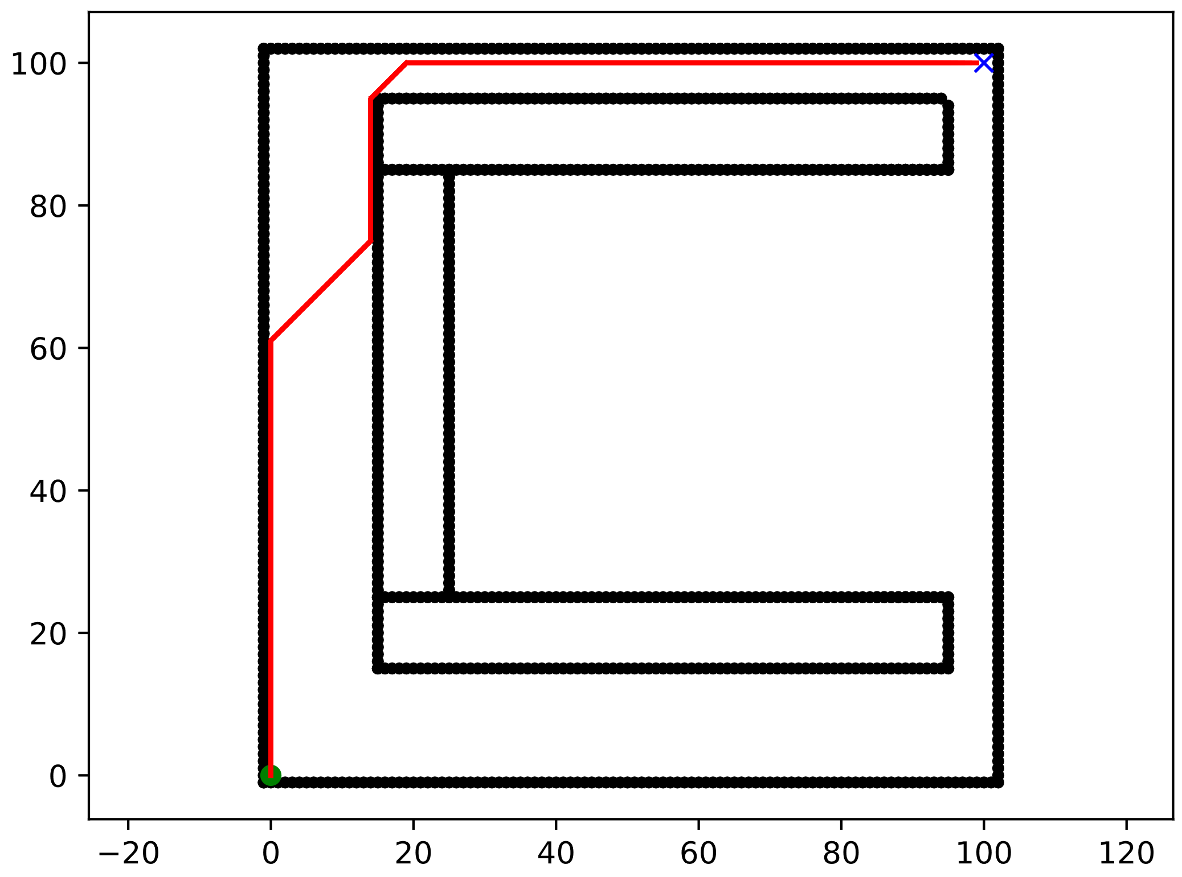
SCENARIOS
Scenario C5:
Empty map
100 x 100 squares
Start → (0, 0)
Goal → (100, 100)
Q_obstacle → 24.31%
Notes:
Scenario 1
5.1 - Positioning of the obstacles in the first scenario:
Bottom left obstacle (X(15:25) and Y(15:25)), and top right obstacle (X(75:85) and Y(85:95)).
5.2 - Positioning of the obstacles in the second scenario:
Bottom obstacle (X(40:50) and Y(40:50)), and the top obstacle (X(40:50) and Y(60:70)).
5.3 - Positioning of the obstacles in the third scenario:
Bottom obstacle (X(40:50) and Y(40:50)), and top obstacle (X(60:70) and Y(60:70)).
Scenario 2

Slide 5
ALGORITHMS EVALUATED
DETERMINISTICS
A_Star
Bidirectional_A_Star
Bidirectional_BFS
BFS
DFS
Dijkstra
D_Star
Greedy_BFS
Visibility_Road_Map
PROBABILISTICS
RRT
RRT_Path_Smoothing
RRT_Sobol_Sampler
RRT_Star

Slide 6


Slide 7
Df_convex vs df_concave
CONVEX OBSTACLES
Scenario 1 → Map P1
Scenario 2 → Map P2
Scenario 3 → Map P3
Scenario C1 → Map C1
Scenario C2 → Map C2
CONCAVE OBSTACLES
Scenario C3 → Map C3
Scenario C4 → Map C4
Scenario C5 → Map C5

Slide 8
Df_setup_0 vs df_setup_not_0
SETUP 0
Expand_dist → 10
Path_resolution → 0.5
Goal_sample_rate → 5
Max_iter → 1000
SETUP 1
Expand_dist → 1
Path_resolution → 0.1
Goal_sample_rate → 1
Max_iter →50000
SETUP 2
Expand_dist → 5
Path_resolution → 0.1
Goal_sample_rate → 1
Max_iter →50000
SETUP 3
Expand_dist → 10
Path_resolution → 0.1
Goal_sample_rate → 1
Max_iter →50000
SETUP 4
Expand_dist → 20
Path_resolution → 0.1
Goal_sample_rate → 1
Max_iter →50000
SETUP 5
Expand_dist → 30
Path_resolution → 0.1
Goal_sample_rate → 1
Max_iter →50000
For experiments with setup 1 to 5, were run 10 times to validate with this setup always the algorithm converge

Slide 9
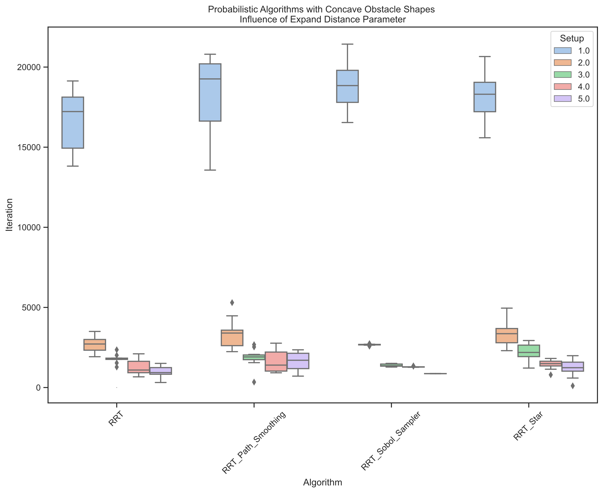
Influence of Expand Distance Parameter on #Iteration
When the Expand Distance Parameter increase → the number of iteration for all algorithms decrease
This decrement trends to be exponential
Notes:
When the Expand Distance Parameter increase → the number of iteration for all algorithms decrease

Slide 10
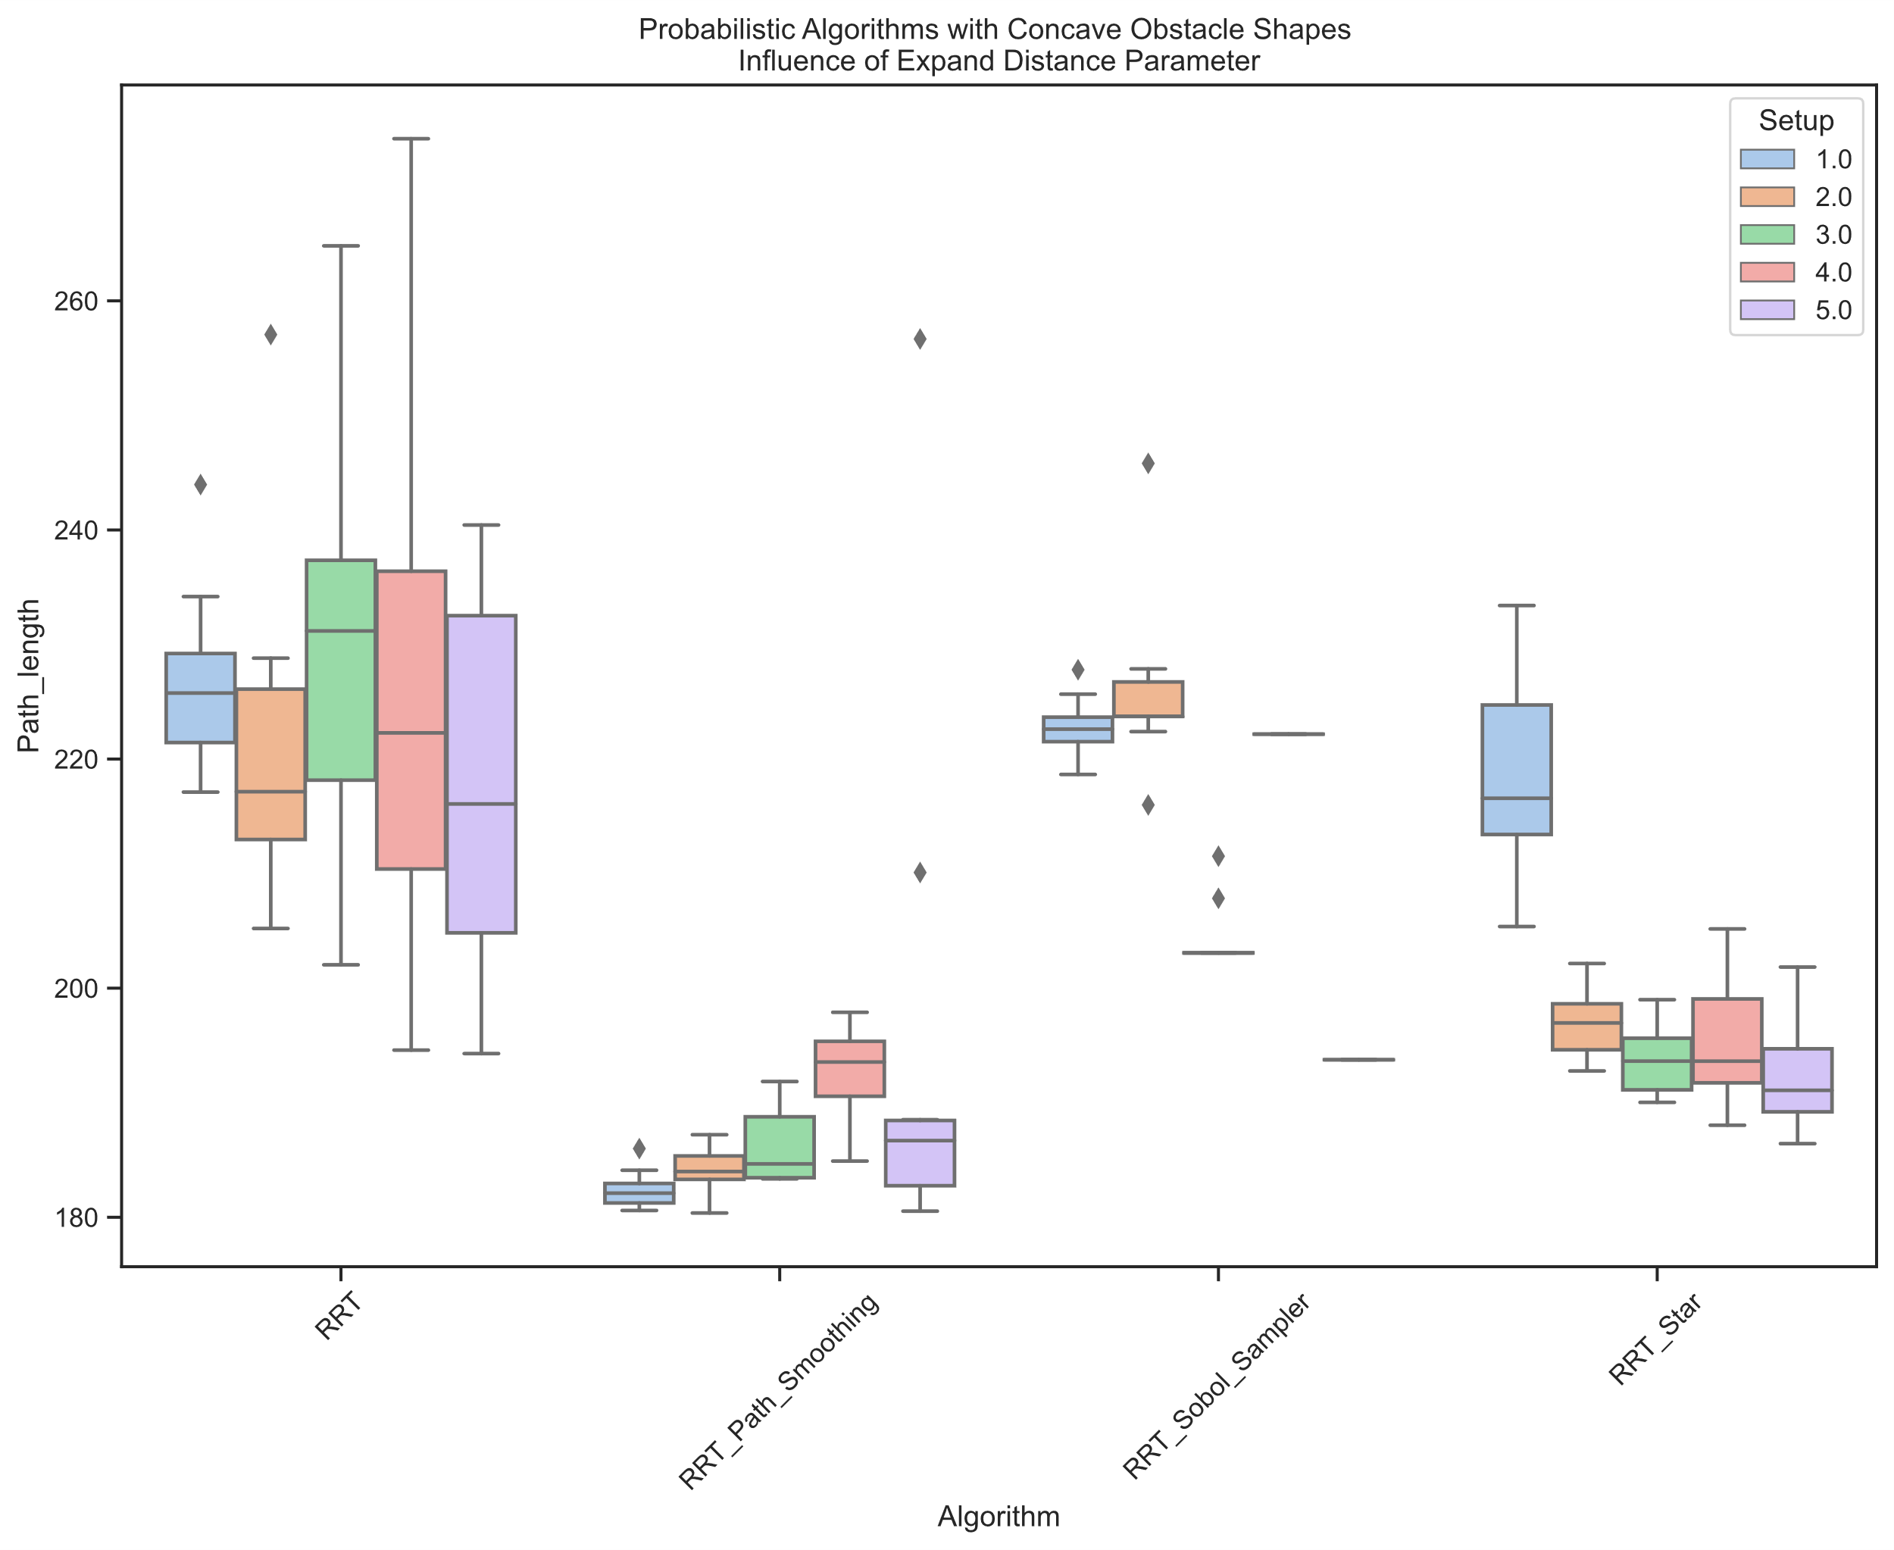
Influence of Expand Distance Parameter on Path Length
Here it is not possible to establish a pattern in path length due to the nature of the algorithms that take random samples in free space, which makes it unlikely that the path built by joining these points will coincide from one run to another.
In the case of RRT*, when using a heuristic, it is possible to see a tendency to decrease as the value of the expand distance parameter increases.

Slide 11
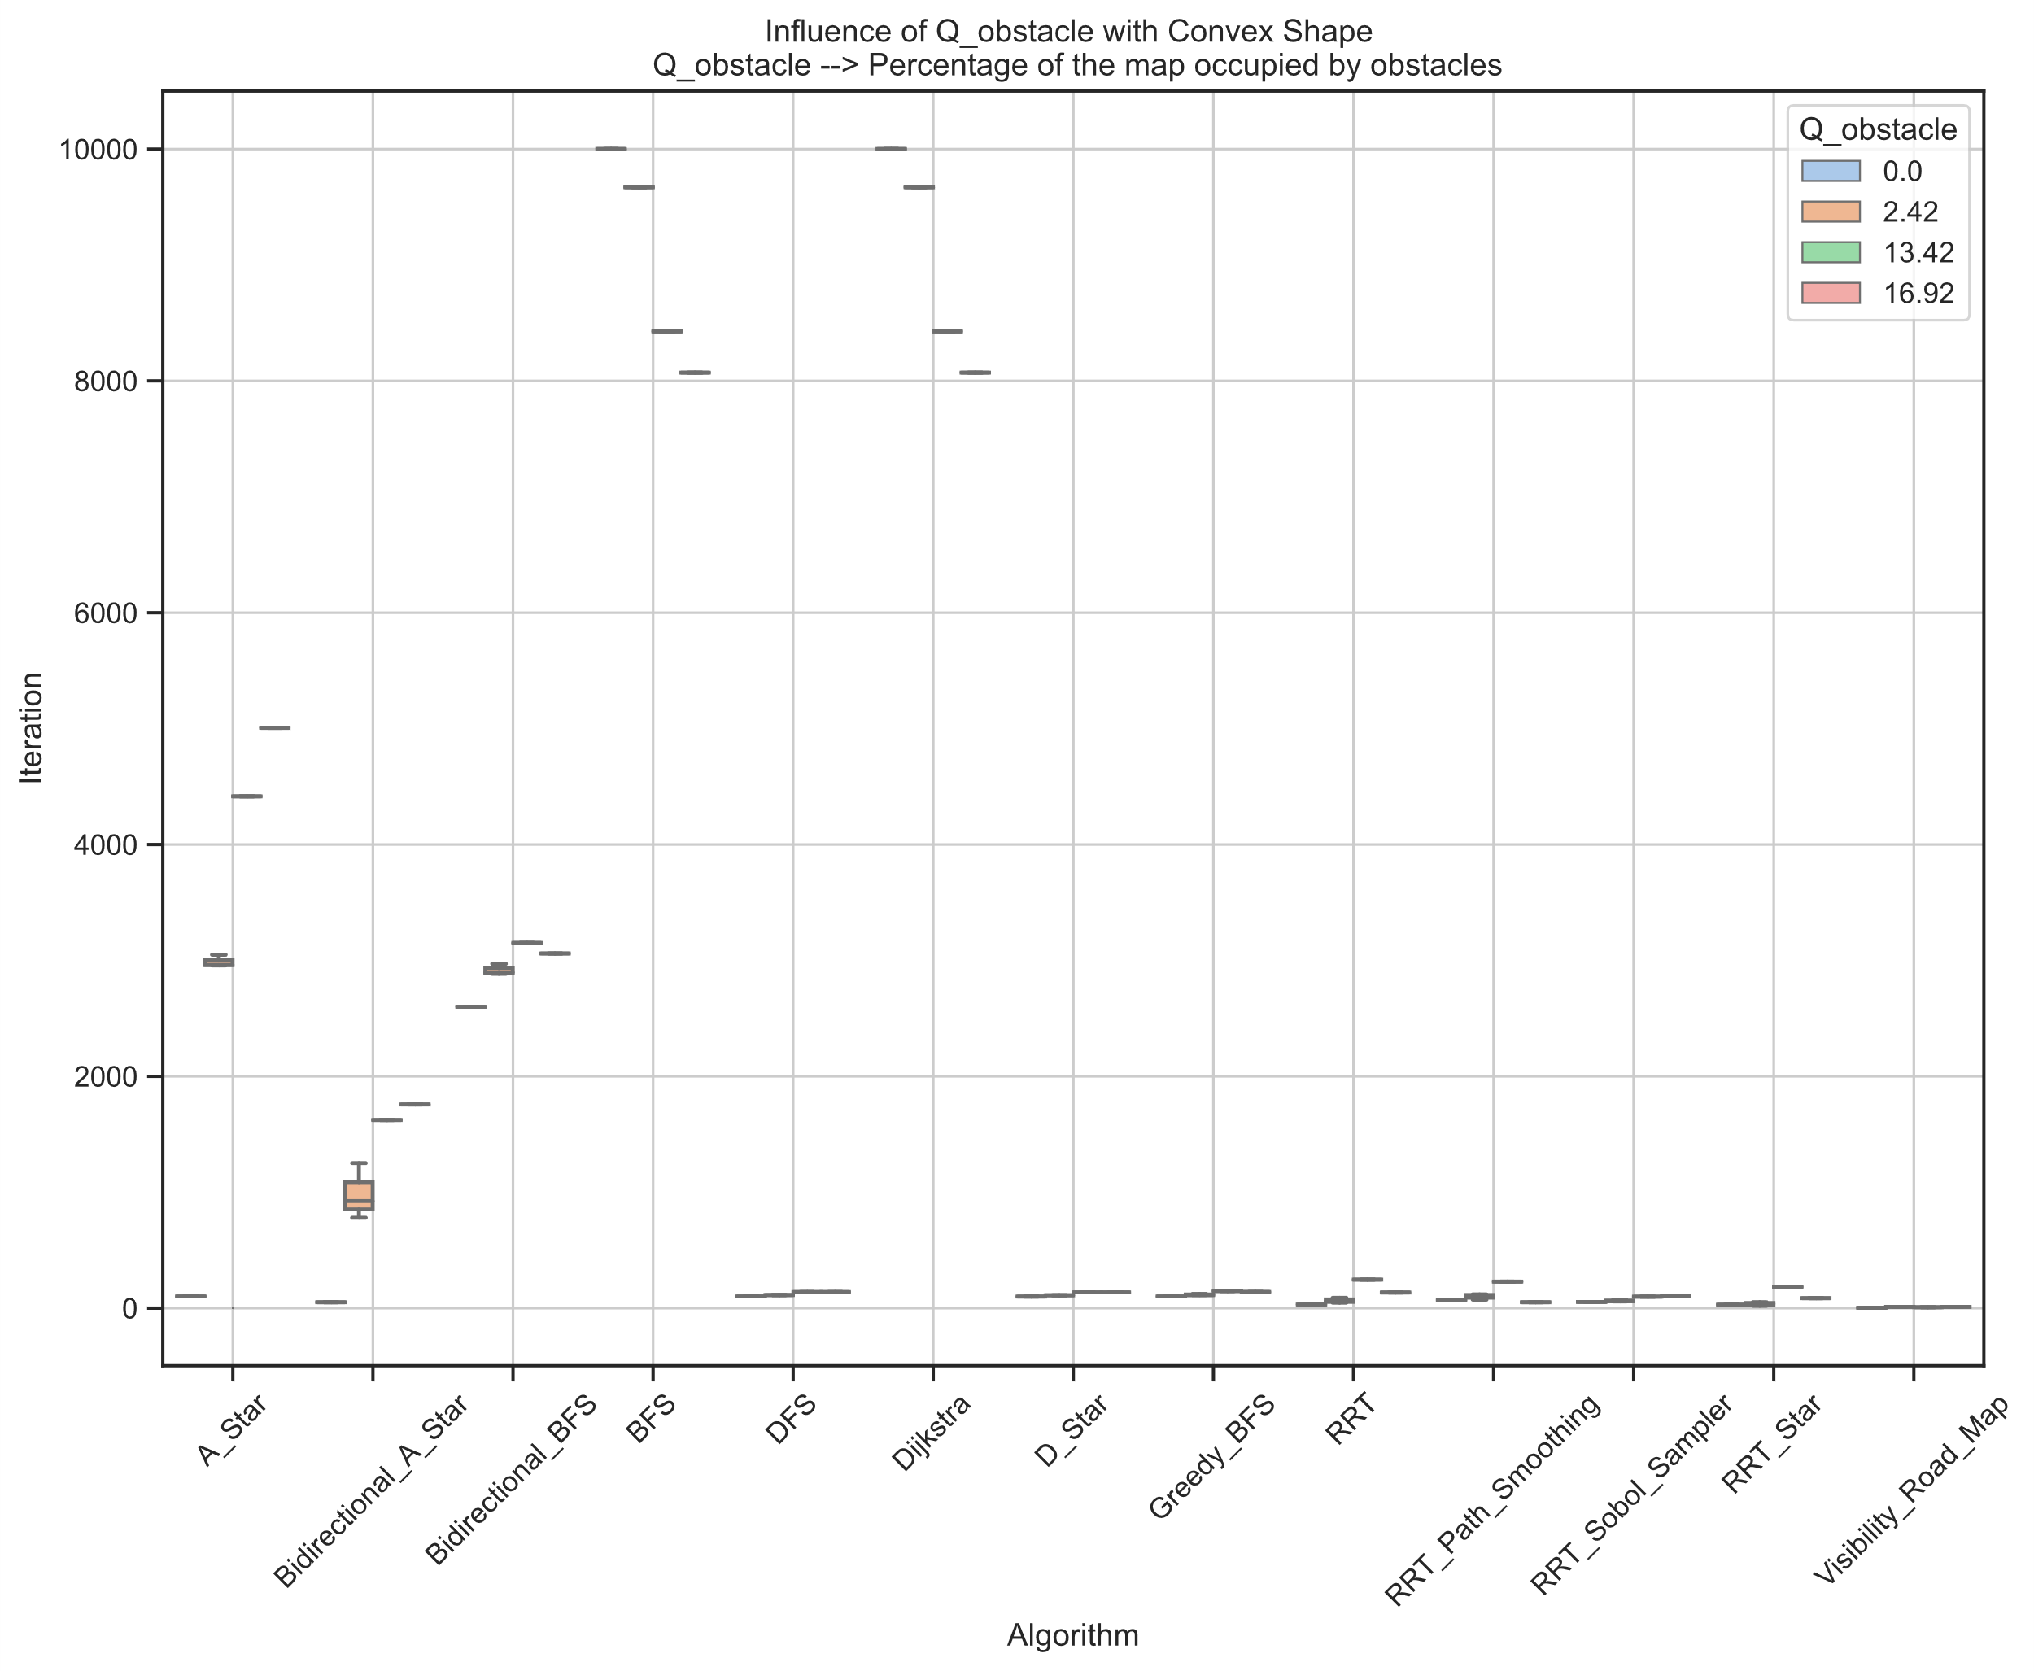
Influence of Q_obstacle on Iteration metric
For most deterministic algorithms, when the percentage of convex obstacles increases, the number of iterations also increases. This does not happen with Visibility Roadmap which remains constant
On the other hand, BFS and Dijkstra that go through all the free space while the more obstacles the number of iterations decreases.
On the other hand, probabilistic algorithms present an ascending and then descending pattern, which leads to think that in them there is not only influence of the number of nodes that the obstacles occupy, but also of their shape and distribution in the configuration space.
Notes:
Hay que ver porque hay dispersion en los datoss (Bidireccional A star

Slide 12
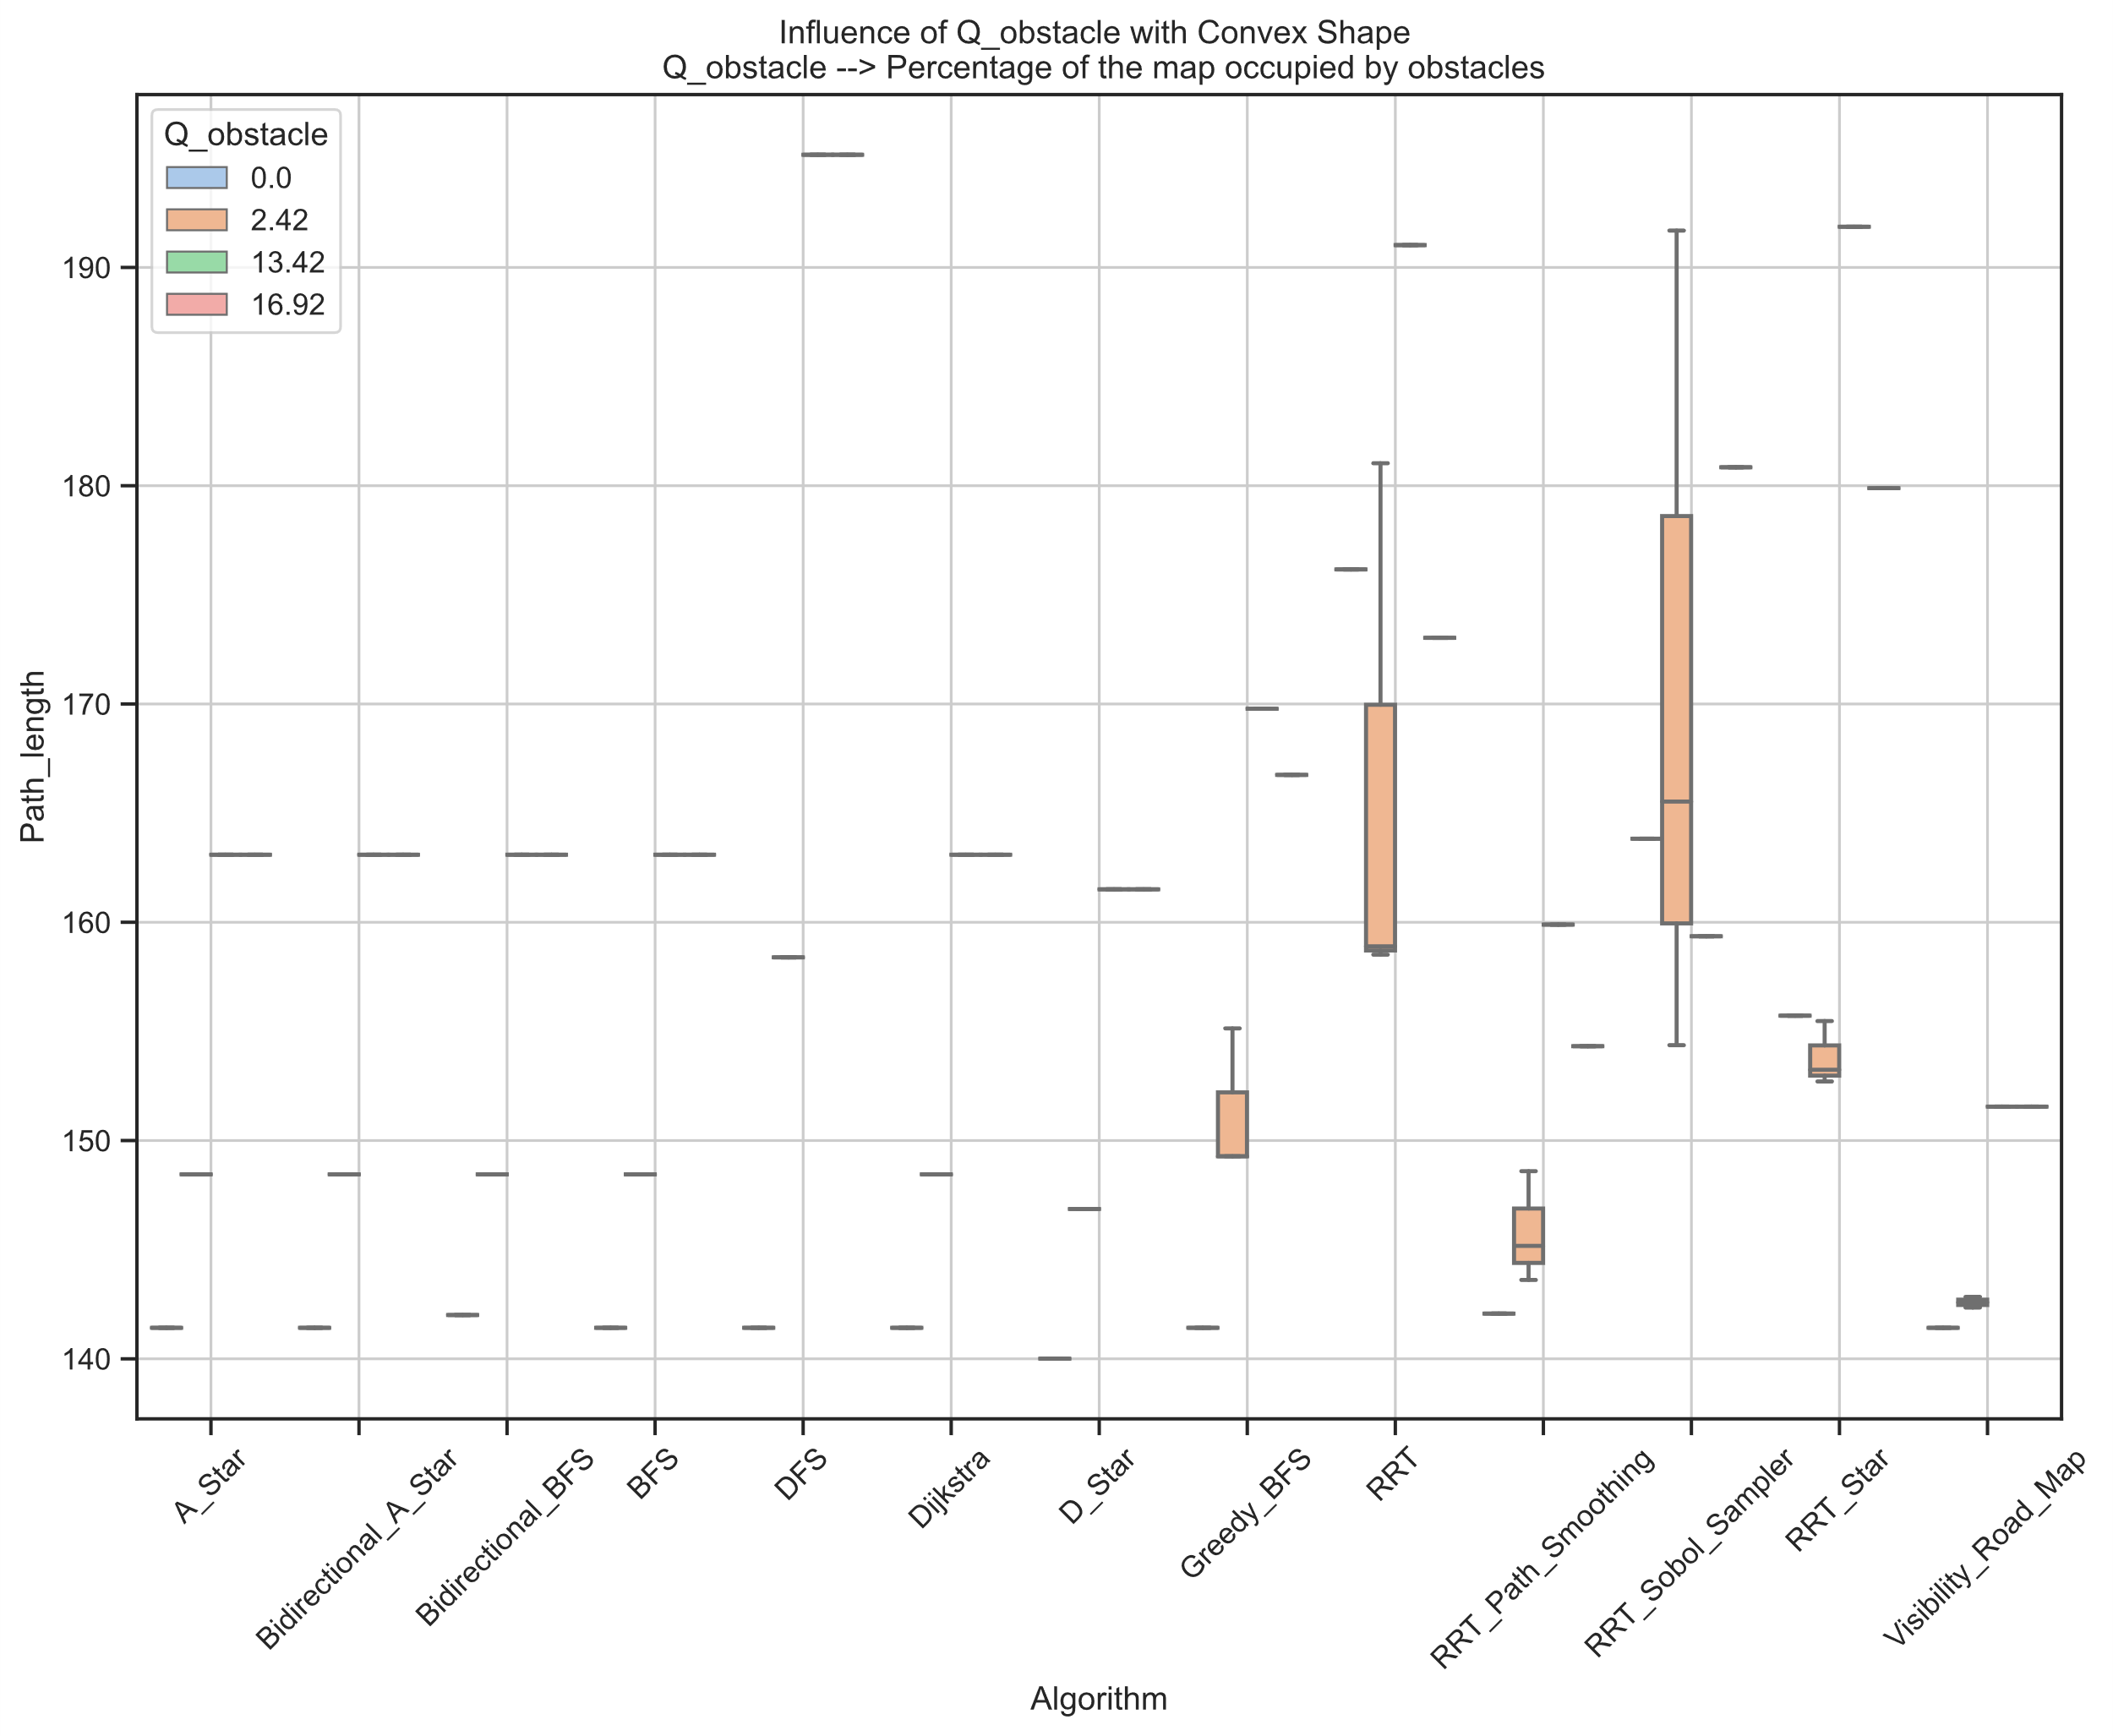
Influence of Q_obstacle on Path_length metric
The deterministic algorithms A*, bidirectional A*, BFS, bidirectional BFS and Dijkstra generate the same path length for each case. They also show a non-dependence on the number of nodes that represent obstacles, but rather on their location on the map.
D* improves the result of the previous ones, maintaining the same behavior in the face of obstacles.
Visibility Road Map exceeds even the results of D*, but it does show a clear dependence on the position of obstacles on the map

Slide 13
CONCLUSION
Deterministic and probabilistic algorithms need to be analyzed separately
For probabilistic algorithms it would be better to run at least 100 times each and analyze the trend of the results.
Perhaps it is good to consider more cases of concave obstacles to have a stronger conclusion about their effects.
It would also be good to consider more cases of obstacles that occupy a different portion of the configuration space to have more solid conclusions about the effect of these in the path_length and Iteration metrics.
Notes:
The deterministic algorithms have obviously shown to have the same behavior in the solution of the scenarios, here it is necessary to evaluate the effects of the shapes and the sizes of the obstacles on the convergence times of the same

Slide 14
Work in progress
Writing the Problem Statement
Writing the methodology

Slide 15
Relation between Path_length and Iteration
There is some relationship between the path Length obtained and the number of Iterations for each algorithm?
Is different for Deterministic than Probabilistic Algorithm?
Depend on obstacle shape or obstacle position?

