Slide 1
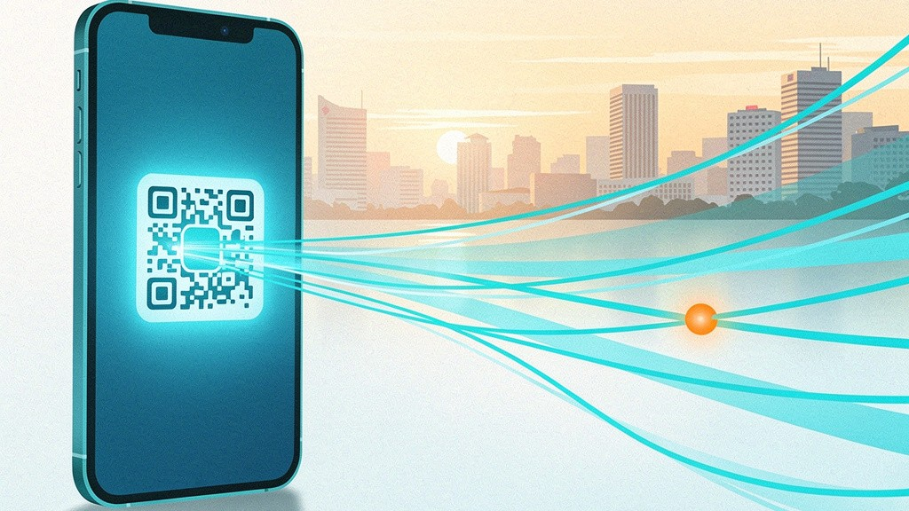

HeyPay
Pay any QRPH merchant with your Stellar balance —
Built for the Philippines, designed to plug into Stellar's global rails.
Built solo by Ronald Ajusan · Artisam Labs
1 / 12
Notes:
Hi everyone, we're [team name], and this is HeyPay. Our one-liner: let anyone holding Stellar-network crypto pay at any QRPH merchant in the Philippines, with the merchant receiving pesos and zero new integration on their side. QRPH is already everywhere in the country; we connect it to a balance people already hold on Stellar. Today I'll cover the problem, a live demo, how it works, our impact on the Stellar ecosystem, how we plan to plug into Stellar's native rails (anchors, SEPs, the DEX), and our go-to-market plan from the Philippines outward to APAC and global.

Slide 2
Two Worlds That Don't Talk
[FULL-SLIDE IMAGE — see image prompt #2: split-world illustration]
Crypto holders can't spend it. Merchants won't integrate anything new.
HeyPay
2 / 12
Notes:
The core problem is a disconnected pair of worlds. Philippine merchants have widely adopted QRPH, the BSP national QR standard, which lands pesos straight in their bank account. Meanwhile people holding Stellar-network crypto like XLM can't spend it at those merchants directly. Today the only path is manual: sell crypto on an exchange, withdraw pesos to a bank, then go pay. That's several apps, several fees, several minutes — and it defeats the point of holding crypto for everyday spend. Merchants, for their part, won't adopt a new system; they already have a working QR. HeyPay exists to bridge exactly this gap.

Slide 3
The Solution
● Pay QRPH straight from your XLM balance — no manual off-ramp step.
● One scan of the merchant's existing QRPH code — camera or photo.
● Live, locked XLM→PHP rate shown before the payer confirms.
● Merchant gets PHP in their existing bank account — zero new integration.
HeyPay
3 / 12
Notes:
HeyPay is a custodial bridge. A payer prefunds their HeyPay wallet with XLM, scans any QRPH code, sees a live conversion rate, and confirms. Behind the scenes we sell that XLM for pesos via our exchange partner and pay the pesos straight into the merchant's registered bank account. The merchant doesn't install anything, change their QR, or learn a new tool — they just register the QR they already display and the bank account they already use once, during onboarding. From the payer's side it feels like one-tap payment; from the merchant's side it's just another QRPH payment landing as PHP.

Slide 4
Live Demo — Payer to Merchant
● Prefund — wallet with XLM; balance updates as the deposit lands.
● Scan — the merchant's QRPH code (camera or photo).
● Confirm — amount and live rate, then tap to pay.
● Watch it settle — live status overlay → merchant paid in PHP.
HeyPay
4 / 12
Notes:
Here's the whole flow in one go. The payer starts on their dashboard, prefunds with XLM — the balance updates as the deposit clears. They hit Scan, point the camera at a merchant's QRPH code, and HeyPay recognizes it as a registered merchant. They enter the amount, see the live rate and exactly how much XLM leaves their wallet, and confirm. The processing overlay then shows every step happening in real time — rate locked, selling the XLM, paying out to the bank — until it confirms pesos were sent to the merchant. Cut to the merchant side: their dashboard shows the settled PHP and the transaction in their history.

Slide 5
How It Works
● Scan & decode to the national EMVCo standard (CRC-checked), matched to a registered merchant.
● Quote & lock a live XLM→PHP rate; exact XLM (plus network fee) is reserved.
● Settle in the background — a worker moves XLM, sells for PHP, pays out. Idempotent, resumable.
● Live status — the payer's screen tracks real progress; auto-refund on failure.
HeyPay
5 / 12
Notes:
Under the hood it's a web app the payer talks to, plus a separate background worker doing the slow money movement. When you scan, we decode the QR to the national standard and match it to a registered merchant. When you confirm, we fetch a live conversion rate, lock it for a short window, and reserve the exact XLM from your wallet so it can't be spent twice. A job worker then moves the XLM, sells it for pesos through our exchange partner, and pays the pesos to the merchant's bank. Every step is saved and resumable — if the server restarts mid-payment it picks up where it left off — and if something fails after funds moved, the payer is refunded automatically.

Slide 6
PRODUCT STATUS
Where We Are Today
● Feature-complete against our full spec: payer, merchant, and admin surfaces all shipped.
● Admin console live — user/merchant management, payment retry & refund, system health.
● Tested — 56 unit/integration tests plus a 4-scenario end-to-end suite, wired into CI.
● Deployable today — containerized, with a one-command Railway deployment config.
This isn't a mockup — it's a working app we can demo end to end, right now.
HeyPay
6 / 12
Notes:
Before we talk about impact and growth, a quick credibility check: this is not a slideware concept. Every flow we just walked through — payer prefund/scan/pay/history, merchant onboarding/dashboard/transactions, and a full admin console with user, merchant, and payment oversight including manual retry and refund — is implemented and tested today. We have 56 automated unit and integration tests plus a 4-scenario end-to-end suite running in CI, and a containerized deployment config ready for Railway. What follows is a real roadmap on top of a real, running product — not a wishlist for something that doesn't exist yet.

Slide 7
Impact & Market — Philippines
● Payers spend crypto without manually off-ramping first.
● Merchants get crypto-funded payments while still receiving plain PHP.
● QRPH is the national rail — already displayed by merchants everywhere.
● A bridge, not yet-another-app — we plug into the rail merchants already use.
$38B+ in annual PH remittances and a fast-growing crypto-holding population make the Philippines the ideal proving ground.
HeyPay
7 / 12
Notes:
Who actually needs this? Two groups: crypto holders who want to spend their balance on real things without the manual off-ramp dance, and merchants who'd love crypto-backed payments but won't integrate anything new or touch crypto themselves. The Philippines is the ideal proving ground — QRPH is already the national standard, on shop windows everywhere, settling straight to bank accounts. Pair that with one of the world's largest remittance corridors, driven by millions of overseas Filipino workers, and a fast-growing crypto-holding population, and the bridge we've built is the missing piece. We're not asking merchants to adopt a new app — we plug into the rail they already use.

Slide 8
WHY THIS MATTERS BEYOND ONE APP
Our Impact on the Stellar Ecosystem
● Everyday-spend utility for XLM — the missing last mile that turns a held Stellar balance into a real-world payment, not just a speculative asset.
● Compounds an active corridor — the Philippines is already a proven Stellar remittance corridor (Coins.ph since 2016, Cebuana Lhuillier, MoneyGram, Tempo × Arf) — HeyPay extends that rail from inbound remittance to everyday outbound spend.
● A template, not a one-off — "custodial wallet + local QR rail + local off-ramp" is a pattern any Stellar team can replicate for any country with its own national QR standard.
● Real transaction volume for Stellar — every HeyPay payment is a genuine Horizon-settled transaction, adding to Stellar's real-world payment volume (not trading/speculative volume).
HeyPay
8 / 12
Notes:
Beyond HeyPay as a single app, here's why this matters for Stellar. XLM's biggest real-world traction today is inbound remittance — Coins.ph has run a live Stellar integration since 2016, and partners like Cebuana Lhuillier, MoneyGram, and the Tempo/Arf corridor all use Stellar to move money INTO the Philippines. HeyPay closes the other half of that loop: once money has landed on Stellar, we let people actually SPEND it locally, at merchants who've changed nothing about how they operate. That's the 'everyday spend utility' Stellar has been missing — turning a held balance into a real transaction, not just a remittance waypoint. And because our architecture — custodial wallet, local QR standard, local off-ramp partner — isn't Philippines-specific in concept, it's a pattern any team could replicate wherever a national QR standard exists. Every payment we settle is also a genuine, real-economy Horizon transaction, which is exactly the kind of volume that strengthens Stellar's case as payments infrastructure rather than a trading venue.

Slide 9
ECOSYSTEM INTEGRATION ROADMAP
Plugging Into Stellar's Native Rails
● Today: one custodial asset (XLM), one off-chain partner (PDAX via plain REST API) — a working but single-rail MVP.
● SEP-1 / SEP-10 / SEP-12 — publish our stellar.toml, add Stellar web-auth, and model KYC to the standard schema so it's portable to any future anchor.
● SEP-6 / SEP-24 / SEP-38 / SEP-31 — treat licensed Philippine anchors as interchangeable on/off-ramp and quote providers, and use SEP-31 for the merchant bank payout leg, reducing single-exchange dependence on PDAX.
● USDC on Stellar — a second custodial asset to remove XLM price-volatility risk between prefund and spend.
● Stellar DEX / path payments — explore on-chain conversion (e.g. XLM→USDC) as a lower-cost, less centralized complement to our exchange partner.
● Soroban escrow contract — hold funds on-chain until merchant payout confirms, cutting reliance on off-chain refund logic.
HeyPay
9 / 12
Notes:
We know exactly how we get from a single-rail MVP to real Stellar infrastructure, and we already have a detailed research report to prove it. Right now, our entire settlement path runs through one exchange partner over a plain REST API — that's a real business risk and it's not how Stellar was designed to be used. Our roadmap: first, the cheap wins — publish a stellar.toml under SEP-1, add SEP-10 web authentication, and model our KYC data to the SEP-12 standard from day one. Next, the real unlock — SEP-6 and SEP-24 let us treat multiple licensed Philippine anchors as interchangeable liquidity providers instead of being locked to one exchange; SEP-38 gives us a standard quote interface to rate-shop across them; and SEP-31 is a natural fit for our merchant payout leg. In parallel, we'll add USDC as a second custodial asset to remove crypto-price volatility between prefund and spend, explore Stellar's built-in DEX and path payments as a lower-cost complement to our exchange partner, and prototype a Soroban escrow contract so funds are provably held on-chain until a merchant payout is confirmed — reducing how much of our refund logic lives off-chain. Notably, our current exchange partner has already run its own Stellar remittance partnership and hosted a Stellar hackathon at its Manila office — so this isn't a cold outreach, it's a natural next conversation.

Slide 10
PHILIPPINES → APAC → GLOBAL
Go-To-Market
PHILIPPINES
APAC
GLOBAL
● Philippines (now): launch on QRPH, HeyPay's proven home rail; grow via the existing OFW remittance corridor — let overseas senders fund a payer's HeyPay wallet directly, not just people who already hold XLM; engage BSP-aligned compliance (VASP/KYC) early; partner-led growth via our exchange partner's own Stellar ecosystem activity (hackathons, prior remittance partnerships).
● APAC (next 12–18mo): replicate the model wherever a national QR standard + a licensed local anchor both exist (e.g. PromptPay/Thailand, VietQR/Vietnam, DuitNow/Malaysia) — same architecture, swap the QR standard and the local off-ramp partner; pursue SDF's APAC-focused grant and hackathon programs for co-marketing and funding.
● Global (18mo+): once the SEP-6/24/31 anchor abstraction is proven in 2+ markets, HeyPay becomes a reusable "Stellar-to-local-QR" bridge pattern rather than a single app — license or white-label the pattern, or plug into any market with EMVCo-style merchant-presented QR and a Stellar anchor.
HeyPay
10 / 12
Notes:
Our go-to-market is deliberately staged. In the Philippines, right now, we launch on QRPH because it's the rail we've already built and proven, and we grow through the country's enormous OFW remittance corridor — the biggest unlock here isn't converting existing XLM holders, it's letting an overseas relative fund a payer's HeyPay wallet directly, so the addressable market is remittance senders and receivers, not just existing crypto holders. We engage BSP-style compliance early rather than late, and we lean on our exchange partner's own visible Stellar ecosystem activity for warm introductions rather than cold outreach. Over the next twelve to eighteen months, we take the same architecture to other APAC markets that share the two ingredients we need — a national merchant-presented QR standard and a licensed local off-ramp partner — think Thailand's PromptPay, Vietnam's VietQR, Malaysia's DuitNow. We'd pursue SDF's APAC-focused grant and hackathon programs along the way, both for funding and credibility. Beyond eighteen months, once we've proven the SEP-6/24/31 anchor abstraction across at least two markets, HeyPay stops being one app and becomes a reusable pattern — a Stellar-to-local-QR bridge that can plug into any market with an EMVCo-style QR standard and a Stellar anchor, globally.

Slide 11
PRODUCT ROADMAP
What's Next
● Real KYC / AML, 2FA & fraud scoring — required before any real money movement at scale.
● Explicit fee model — a transparent markup/merchant discount rate; today's margin is implicit.
● Merchant discovery & recurring payments — beyond point-of-sale into a bigger PH payments TAM.
● Native mobile apps — today it's responsive web.
● Alerting on top of our health dashboard — proactive ops, not just an admin checking a screen.
HeyPay
11 / 12
Notes:
What's built today is a real, working, feature-complete MVP across payer, merchant, and admin. What's left is what turns it into a licensed, scalable business: real KYC, AML, two-factor auth and fraud scoring, which are required before we move real money at scale; an explicit, transparent fee model, since today our margin is implicitly whatever spread our exchange partner allows; merchant discovery and recurring payments to grow beyond point-of-sale into a much larger slice of Philippine payments; native mobile apps on top of the responsive web app we already have; and proactive alerting on top of the health dashboard we've already built, so issues surface to an operator automatically instead of requiring someone to check a screen.

Slide 12
Team & Thanks
● Ronald Ajusan — solo developer: full-stack, design, infrastructure
● Artisam Labs — artisam.xyz
● One person, end to end: payer, merchant, admin, settlement worker
● Contact: ronaldajusan0@gmail.com · github.com/ronaldajusan0/HeyPay
● Thanks: organizers, the Stellar developer docs, and our exchange partner's public API docs.
HeyPay
12 / 12
Notes:
We're [team name] — [brief intro per member]. Thanks to the organizers for the event, to the open Stellar developer documentation that made prototyping the payment-rail integration realistic, and to our exchange partner's public API docs. We'd love to talk to anyone interested in payments, Stellar ecosystem growth, or the Philippine market. You can reach us at [contact], and the project is at [URL]. Happy to take questions.

