Slide 1
Information Retrieval and Web Search
Vasile Rus, PhD
vrus@memphis.edu
www.cs.memphis.edu/~vrus/teaching/ir-websearch/

Slide 2
Outline
Introduction to Web Search

Slide 3
The World Wide Web
Developed by Tim Berners-Lee in 1990 at CERN to organize research documents available on the Internet
Combined idea of documents available by FTP with the idea of hypertext to link documents
Developed initial HTTP network protocol, URLs, HTML, and first “web server”

Slide 4
Web Pre-History
Ted Nelson developed idea of hypertext in 1965
Doug Engelbart invented the mouse and built the first implementation of hypertext in the late 1960’s at SRI
ARPANET was developed in the early 1970’s
The basic technology was in place in the 1970’s; but it took the PC revolution and widespread networking to inspire the web and make it practical

Slide 5
Web Browser History
Early browsers were developed in 1992 (Erwise, ViolaWWW)
In 1993, Marc Andreessen and Eric Bina at UIUC NCSA developed the Mosaic browser and distributed it widely
Andreessen joined with James Clark (Stanford Prof. and Silicon Graphics founder) to form Mosaic Communications Inc. in 1994 (which became Netscape to avoid conflict with UIUC)
Microsoft licensed the original Mosaic from UIUC and used it to build Internet Explorer in 1995

Slide 6
Search Engine - Early History
By late 1980’s many files were available by anonymous FTP
In 1990, Alan Emtage of McGill Univ. developed Archie (short for “archives”)
  Assembled lists of files available on many FTP servers
  Allowed regex search of these file names
In 1993, Veronica and Jughead were developed to search names of text files available through Gopher servers

Slide 7
Web Search History
In 1993, early web robots (spiders) were built to collect URL’s:
  Wanderer
  ALIWEB (Archie-Like Index of the WEB)
  WWW Worm (indexed URL’s and titles for regex search)
In 1994, Stanford grad students David Filo and Jerry Yang started manually collecting popular web sites into a topical hierarchy called Yahoo

Slide 8
Web Search History (cont)
In early 1994, Brian Pinkerton developed WebCrawler as a class project at U Wash (eventually became part of Excite and AOL)
A few months later, Fuzzy Maudlin, a grad student at CMU developed Lycos; first to use a standard IR system as developed for the DARPA Tipster project; first to index a large set of pages
In late 1995, DEC developed Altavista; used a large farm of Alpha machines to quickly process large numbers of queries; supported boolean operators and phrases

Slide 9
Web Search Recent History
In 1998, Larry Page and Sergey Brin, Ph.D. students at Stanford, started Google; Main advance is use of link analysis to rank results partially based on authority

Slide 10
Web Search
Search engines that index a portion of the web
Web directories
Search based on hyperlink structure

Slide 11
Web Challenges for IR
Distributed Data: Documents spread over millions of different web servers
Volatile Data: Many documents change or disappear rapidly (e.g. dead links)
Large Volume: Billions of separate documents.
Unstructured and Redundant Data: No uniform structure, HTML errors, up to 30% (near) duplicate documents
Quality of Data: No editorial control, false information, poor quality writing, typos, etc.
Heterogeneous Data: Multiple media types (images, video, VRML), languages, character sets, etc.

Slide 12
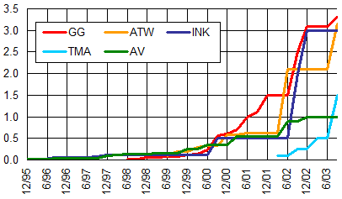
Growth of Web Pages Indexed
Google
Inktomi
AllTheWeb
Teoma
Altavista
Billions of Pages
SearchEngineWatch
Assuming 20KB per page
1 billion pages is about 20 terabytes of data.

Slide 13
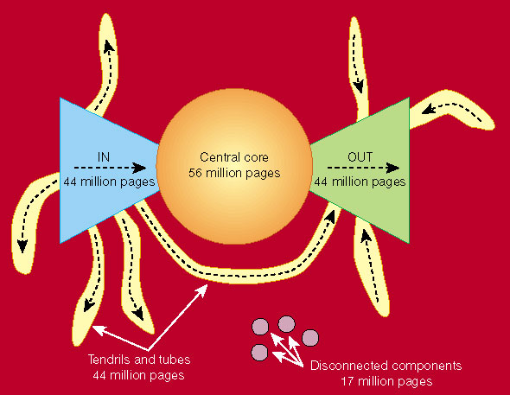
Graph Structure in the Web
http://www9.org/w9cdrom/160/160.html

Slide 14
Zipf’s Law on the Web
Number of in-links/out-links to/from a page has a Zipfian distribution
Length of web pages has a Zipfian distribution
Number of hits to a web page has a Zipfian distribution

Slide 15
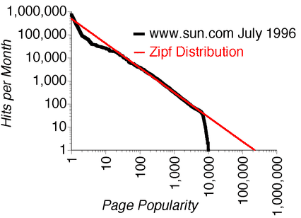
Zipfs Law and Web Page Popularity
incoming page-requests to a single site
Popularity 1 – home page

Slide 16
“Small World” (Scale-Free) Graphs
Small World Phenomenon
  Taking a connected graph or network with a high graph diameter and adding a very small number of edges randomly, the diameter tends to drop drastically. This is known as the small world phenomenon
  It is sometimes also known as "six degrees of separation" since, in the social network of the world, any person turns out to be linked to any other person by roughly six connections

Slide 17
Topology of WWW Graph
Barabási and his colleagues at the University of Notre Dame mapped the connectedness of the Web in 1999 (Barabási and Albert, 1999)
  the Web did not have an even distribution of connectivity (so-called "random connectivity")
  some network nodes, so-called “hubs” had many more connections than the average

Slide 18
Scale-Free Graphs
some nodes act as "highly connected hubs" (high degree)
most nodes are of low degree
Scale-free networks' structure and dynamics are independent of the number of nodes in the network
  a network that is scale-free will have the same properties no matter what the number of its nodes is
  Power law distribution of in and out degrees
Distinct from purely random graphs
  Start with n vertices and no edges and at each step add one new edge chosen uniformly from the set of missing edges

Slide 19
Many Real-World Networks
“Rich get richer” generation of graphs
  Barabási and Albert's (1999) rich get richer generative model
  A new Web page links to existing Web pages with a probability distribution which is not uniform, but proportional to the current in-degree of Web pages
  A page with many in-links will attract more in-links than a regular page
Kevin Bacon game
Erdos number
networks of proteins reacting with each other in the cell
Networks in biochemistry, roads, telecommunications, Internet, etc are “small word”

Slide 20
Manual Hierarchical Web Taxonomies
Yahoo approach of using human editors to assemble a large hierarchically structured directory of web pages
  http://www.yahoo.com/
Open Directory Project is a similar approach based on the distributed labor of volunteer editors (“net-citizens provide the collective brain”); used by most other search engines; Started by Netscape
  http://www.dmoz.org/

Slide 21
Automatic Document Classification
Manual classification into a given hierarchy is labor intensive, subjective, and error-prone
Text categorization methods provide a way to automatically classify documents
Best methods based on training a machine learning (pattern recognition) system on a labeled set of examples (supervised learning)

Slide 22
Automatic Document Hierarchies
Manual hierarchy development is labor intensive, subjective, and error-prone.
It would nice to automatically construct a meaningful hierarchical taxonomy from a corpus of documents
This is possible with hierarchical text clustering (unsupervised learning)
  Hierarchical Agglomerative Clustering (HAC)
Text clustering is a another topic we will discuss later in the course

Slide 23
Search Engine Architectures
Centralized crawler-indexed architecture
  Problems with gathering the data
    No coordinated crawlers
  Saturated communication links
  High load of Web servers
Distributed Harvest architecture
  Gatherers: indexing and query interface
  Brokers: retrieve information from one or more gatherers or brokers
  Central broker: contains info about other brokers and gatherers
  Replicators and object caches

Slide 24


Web Search Using IR
Web
Spider
Document
corpus
IR
System
Query String
1. Page1
2. Page2
3. Page3
.
.
Ranked
Documents

Slide 25
Summary
Intro to Web Search

Slide 26
Next
More on Web Search
Link Analysis

