Slide 1
Information Retrieval and Web Search
Vasile Rus, PhD
vrus@memphis.edu
www.cs.memphis.edu/~vrus/teaching/ir-websearch/

Slide 2
Outline
More Web Search Issues
Web search engines
Technological background
  Hardware
  Distributed and positional inverted index
Advanced search capabilities

Slide 3
Interfaces
Query interface
  Simple box where you type a bag of words
  Advanced search: boolean operators, phrase search, wild cards, etc.
Answer interface
  A (ranked) list of documents
    URL
    Size
    The date the page was indexed
    A small fragment of the document

Slide 4
Ranking
Based on index not on the real documents
Hard to compare different search engines
  Always improving
  Recall is hard to measure

Slide 5
Ranking
Yuwono and Lee proposed three ranking algorithms
  Standard Boolean and Vectorial extended to pages that link to or are linked from pages in the answer set
  Most-cited: ranking based on terms in pages that link to pages in the answer set

Slide 6
Algorithms based on Hyperlink Structure
Based on Prestige Principle: a page is popular if many other pages link to it
Query-based
  WebQuery: the answer set is ranked based on how connected that page is
  HITS
Query-ignorant
  PageRank

Slide 7
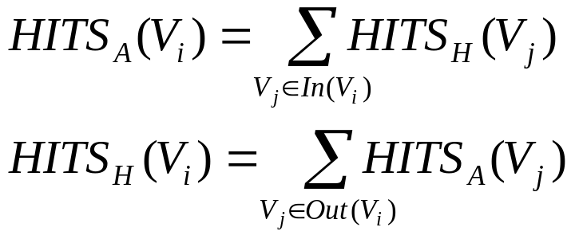
HITS
Hyperlinked Induced Topic Search (Kleinberg 1999)
  authorities (many incoming links)
  hubs (many outgoing links)
  S: set of pages that link to or are linked from pages in the answer set; V are pages, i.e. vertices, in this set (graph)

Slide 8
Page Rank
Larry Page and then Sergey Brin
  “PageRank relies on the uniquely democratic nature of the web by using its vast link structure as an indicator of an individual page's value. In essence, Google interprets a link from page A to page B as a vote, by page A, for page B. But, Google looks at more than the sheer volume of votes, or links a page receives; it also analyzes the page that casts the vote. Votes cast by pages that are themselves "important" weigh more heavily and help to make other pages "important"

Slide 9
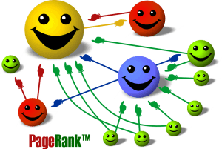
PageRank (cont’d)

Slide 10
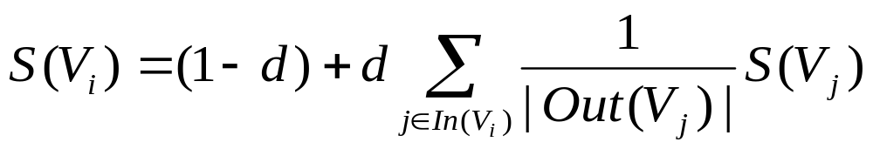
Random Walk Algorithms
Usually applied on directed graphs
  From a given vertex, the walker selects at random one of the out-edges
Given G = (V,E) a directed graph with vertices V and edges E
  In(Vi) = predecessors of Vi
  Out(Vi) = successors of Vi
d – damping factor ∈[0,1] (usually 0.85)

Slide 11
Crawling
Strategies:
  Seed URLs
    Depth-first
    Breadth-first
  Divide by country (.de; .it)

Slide 12
Indices
Variants of inverted file
50Gb needed to store descriptions of 100 mil pages
  500 bytes per URL + description (title + few headings)

Slide 13
Browsing
Use web directories
  Yahoo Directory
  Google Directory
    Based on Open Directory Project

Slide 14
Meta-Search Engines
Search engine that passes query to several other search engines and integrate results
  Submit queries to host sites
  Parse resulting HTML pages to extract search results
  Integrate multiple rankings into a “consensus” ranking
  Present integrated results to user
Examples:
  Metacrawler
  SavvySearch
  Dogpile

Slide 15
WWW Search Engines
Challenges
  Huge document set
  Dynamic collection
  Very large number of users
  Different media types and formats
  Etc.
Importance
  Gateway to the WWW
  Jobs for us ☺

Slide 16
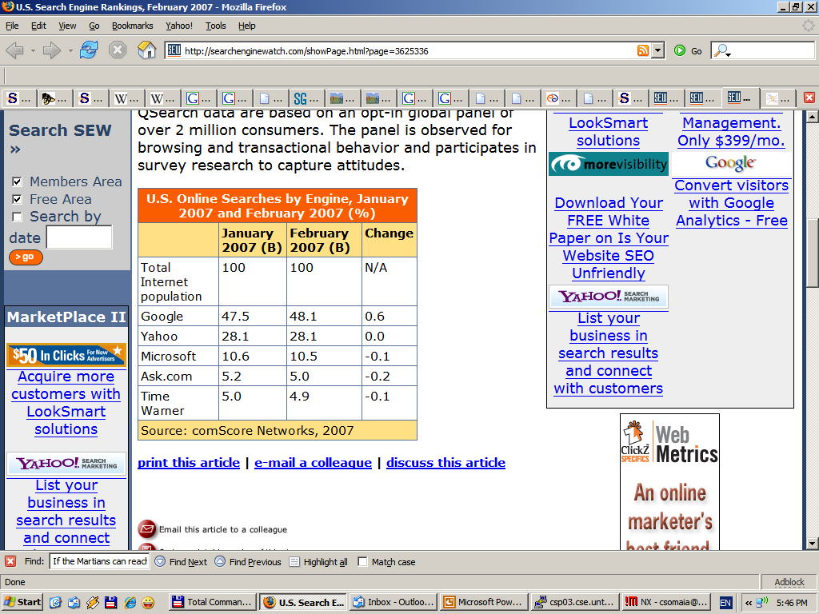
Search engine usage
7 billion searches in February 2007
Some search engines get around 3 billion searches per month

Slide 17
Computational and storage considerations
The web is growing at an increased rate
  Indexing time for reported pages growing
Considerable computational cost
  Google uses approx 450.000 servers – to handle approx. 3 billion queries per month, and build/store the index
Storage
  Relatively easier: 2003 estimate 170 Tbytes in surface web
  Search engines usually index most of surface web and some deep web (e.g. phone books, etc.)
  Google is estimated to index about 8 billion pages
  Most search engines cache all/some pages
Response has to be virtually immediate

Slide 18
Distributed indexing technology
Individual machines are fault-prone
  Can unpredictably slow down or fail
Maintain a master machine directing the indexing job – considered “safe”
Break up indexing into sets of (parallel) tasks
Master machine assigns each task to an idle machine from a pool

Slide 19
Parallel tasks
Uses two sets of parallel tasks
  Parsers
  Inverters
Break the input document corpus into splits
  Each split is a subset of documents
Master assigns a split to an idle parser machine
Parser reads a document at a time and emits
(term, doc) pairs

Slide 20
Parallel tasks
Parser writes pairs into j partitions
Each for a range of terms’ first letters
  (e.g., a-f, g-p, q-z) – here j=3.
Now to complete the index inversion

Slide 21
Data flow
assign
Master
assign
Postings
Parser
a-f
g-p
q-z
Inverter
a-f
Parser
a-f
g-p
q-z
Inverter
g-p
splits
Inverter
q-z
Parser
a-f
g-p
q-z

Slide 22
Inverters
Collect all (term, doc) pairs for a partition
Sorts and writes to postings list
Each partition contains a set of postings

Slide 23
User interfaces
Principle of least astonishment – users expect to see their search terms on the page
  How does this relate to the vector space model?
  What is the other option?
  Boolean (mixture)
Simplicity
  A single text box creates less confusion
Presenting the results
  Rank by relevance…
  Provide snippets

Slide 24
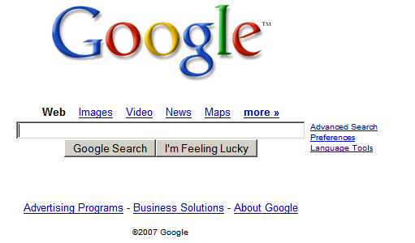
Advanced search features
In case you never noticed

Slide 25
Advanced features
Semantically related words
  E.g. in Google the “~” operator, as in “California ~hiking”
  “Hiking” matches “outdoors”, “trail”, etc.
Boolean operators (AND, OR, NOT)
Search specific document parts: e.g. title, keywords, URL, etc.
Site restrictions (search only specific sites)
Phrase search
Proximity search

Slide 26
Proximity and phrase search
Phrase search is one of the few advanced features frequently used by average users (some studies say 10%)
Most search engines: double quote strings e.g. “Natural Language Processing”
Proximity search:
  NEAR keyword (AltaVista): Natural NEAR Processing
  wildcard search (Google): “Natural * Processing”, “Pirates * Caribbean” – wildcard * matches multiple words

Slide 27
Positional Inverted index
Required for phrase search (e.g. “Information Retrieval”)
Store the position of the word in document
Increases index size up to 2-4 times the size of a non-positional index, or 30-50% of the original text
Needs to index all stopwords
Standard in most search engines

Slide 28
Positional inverted index
Store, for each term, entries of the form:
  <number of docs containing term;
  doc1: position1, position2 … ;
  doc2: position1, position2 … ;
  etc.>

Slide 29
Positional index example
<be: 993427;
1: 7, 18, 33, 72, 86, 231;
2: 3, 149;
4: 17, 191, 291, 430, 434;
5: 363, 367, …>
Which of docs 1,2,4,5
could contain “to be
or not to be”?
Can compress position values/offsets
Nevertheless, this expands postings storage substantially

Slide 30
Processing a phrase query
Extract inverted index entries for each distinct term: to, be, or, not.
Merge their doc:position lists to enumerate all positions with “to be or not to be”.
  to:
    2:1,17,74,222,551; 4:8,16,190,429,433; 7:13,23,191; ...
  be:
    1:17,19; 4:17,191,291,430,434; 5:14,19,101; ...
Same general method for proximity searches

Slide 31
Efficient merging with skip pointers
16
128
2
4
8
16
32
64
128
8
31
1
2
3
5
8
17
21
31
Suppose we’ve stepped through the lists until we process 8 on each list.
When we get to 16 on the top list, we see that its
successor is 32.
But the skip successor of 8 on the lower list is 31, so
we can skip ahead past the intervening postings.

Slide 32
Query processing
Some search engines use some form of lemmatization or stemming
  Plural of nouns
  Morphological variations
  In Google it doesn’t work only for English
Case sensitivity
  Most engines are case insensitive
Stopword removal

Slide 33
Web search engine rankings
An unknown weighted combination of features
Link analysis
  Page Rank
  Yahoo also uses weight information from their directory structure
Content analysis
  Think Vector Space Model with Boolean constraints
  Special weights for different document parts
    Page title
    Keywords

Slide 34
More Special Features
Hyperlink anchor text
  Higher rank if search terms appeared in anchor texts linking to the page
  Google bombing: a large number of Web pages with links that point to a specific Web site so that the site will appear at the top
Term proximity
  Higher rank if search terms appear in close proximity of each other in the text
Domain name and URL
And some features hidden by the secrecy of search engines…

Slide 35
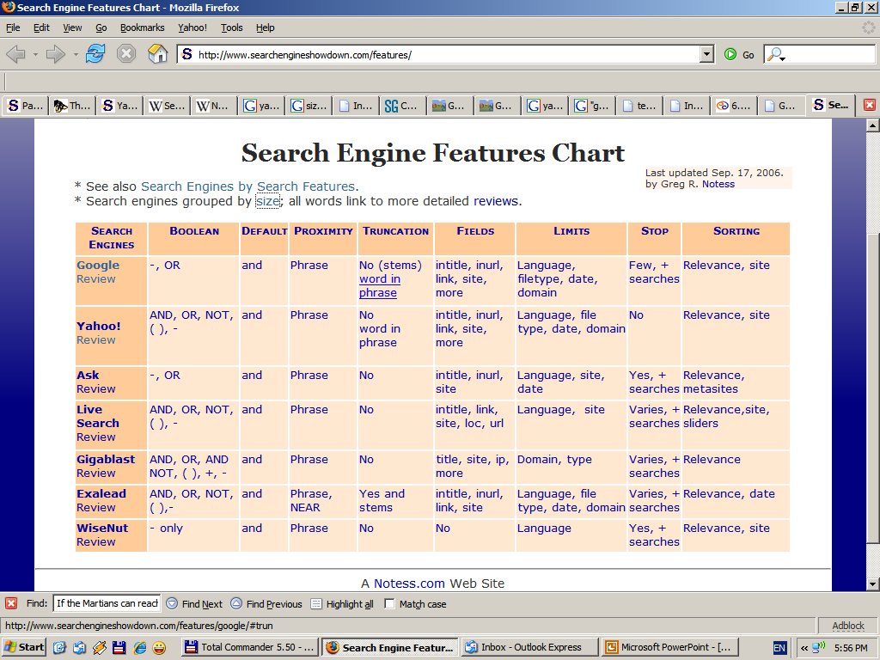
Search engine features comparison
Source: www.searchengineshowdown.com

Slide 36
Summary
Web Search Tech

Slide 37
Next
More on Web Search
Text Categorization

