Slide 1
Information Retrieval and Web Search
Vasile Rus, PhD
vrus@memphis.edu
www.cs.memphis.edu/~vrus/teaching/ir-websearch/

Slide 2
Outline
Information Retrieval Models

Slide 3
Retrieval Models
A retrieval model specifies the details of:
  Document representation
  Query representation
  Retrieval function
Determines a notion of relevance
Notion of relevance can be binary or continuous (i.e. ranked retrieval)

Slide 4
Introduction
IR systems usually adopt index terms to process queries
Index term:
  a keyword or group of selected words
  any word (more general)
Stemming might be used:
  connect: connecting, connection, connections
An inverted file is built for the chosen index terms

Slide 5

Introduction
Docs
Index Terms
doc
match
Ranking
Information Need
query

Slide 6
Introduction
Matching at index term level is quite imprecise
No surprise that users get frequently unsatisfied
Since most users have no training in query formation, problem is even worse
Frequent dissatisfaction of Web users
Issue of deciding relevance is critical for IR systems: ranking

Slide 7
Introduction
A ranking is an ordering of the documents retrieved that (hopefully) reflects the relevance of the documents to the user query
A ranking is based on fundamental premisses regarding the notion of relevance, such as:
  common sets of index terms
  sharing of weighted terms
  likelihood of relevance
Each set of premises leads to a distinct IR model

Slide 8
Classes of Retrieval Models
Boolean models (set theoretic)
  Extended Boolean
Vector space (VS) models (statistical/algebraic)
  Generalized VS
  Latent Semantic Indexing
  Latent Dirichlet Allocation
Probabilistic models

Slide 9
Other Model Dimensions
Logical View of Documents
  Index terms
  Full text
  Full text + Structure (e.g. hypertext)
User Task
  Retrieval
  Browsing

Slide 10
Retrieval Tasks
Ad hoc retrieval: Fixed document corpus, varied queries.
Filtering: Fixed query, continuous document stream.
  User Profile: A model of relative static preferences.
  Binary decision of relevant/not-relevant.
Routing: Same as filtering but continuously supply ranked lists rather than binary filtering.

Slide 11
IR Models
Set Theoretic
Fuzzy
Extended Boolean
Classic Models
boolean
vector
probabilistic
Algebraic
U
s
e
r
T
a
s
k
Generalized Vector
Lat. Semantic Index
Neural Networks
Retrieval:
Adhoc
Filtering
Structured Models
Probabilistic
Non-Overlapping Lists
Proximal Nodes
Inference Network
Belief Network
Browsing
Browsing
Flat
Structure Guided
Hypertext

Slide 12
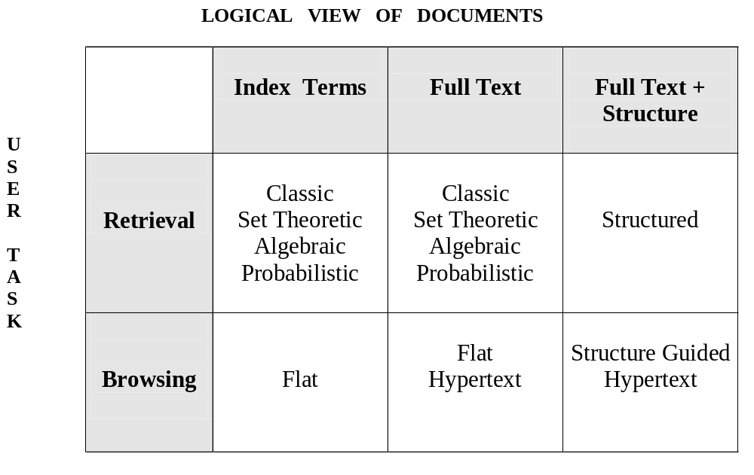
IR Models
The IR model, the logical view of the docs, and the retrieval task are distinct aspects of the system

Slide 13
Retrieval: Ad Hoc vs Filtering
Ad hoc retrieval:
Q1
Q2
Q3
Collection
“Fixed Size”
Q4
Q5

Slide 14
Retrieval: Ad Hoc vs Filtering
Filtering:
User 2
Profile
Docs Filtered
for User 2
User 1
Profile
Docs for
User 1
Documents Stream

Slide 15
Classes of Retrieval Models
Boolean models (set theoretic)
  Extended Boolean
Vector space models (statistical/algebraic)
  Generalized VS
  Latent Semantic Indexing
Probabilistic models

Slide 16
Classic IR Models - Basic Concepts
Each document represented by a set of representative keywords or index terms
An index term is a document word useful for remembering the document main themes
Usually, index terms are nouns because nouns have meaning by themselves
However, search engines assume that all words are index terms (full text representation)

Slide 17
Classic IR Models - Basic Concepts
Not all terms are equally useful for representing the document contents: less frequent terms allow identifying a narrower set of documents
The importance of the index terms is represented by weights associated to them
The weight w_{ij} quantifies the importance of the index term for describing the document contents

Slide 18
Common Preprocessing Steps
Strip unwanted characters/markup (e.g. HTML tags, punctuation, numbers, etc.)
Break into tokens (keywords) on whitespace
Stem tokens to “root” words
  computational → comput
Remove common stopwords (e.g. a, the, it, etc.).
Detect common phrases (possibly using a domain specific dictionary)
Build inverted index (keyword → list of docs containing it)

Slide 19
Boolean Model
A document is represented as a set of keywords
Queries are Boolean expressions of keywords, connected by AND, OR, and NOT, including the use of brackets to indicate scope
  [[Rio & Brazil] | [Hilo & Hawaii]] & hotel & !Hilton
Output: Document is relevant or not; No partial matches or ranking

Slide 20
Boolean Retrieval Model
Popular retrieval model because:
  Easy to understand for simple queries
  Clean formalism
Boolean models can be extended to include ranking
Reasonably efficient implementations possible for normal queries

Slide 21
Boolean Models − Problems
Very rigid: AND means all; OR means any
Difficult to express complex user requests
Difficult to control the number of documents retrieved
  All matched documents will be returned
Difficult to rank output
  All matched documents logically satisfy the query
Difficult to perform relevance feedback
  If a document is identified by the user as relevant or irrelevant, how should the query be modified?

Slide 22
Statistical Models
A document is typically represented by a bag of words (unordered words with frequencies)
Bag = set that allows multiple occurrences of the same element
User specifies a set of desired terms with optional weights:
  Weighted query terms:
  Q = < database 0.5; text 0.8; information 0.2 >
  Unweighted query terms:
  Q = < database; text; information >
  No Boolean conditions specified in the query

Slide 23
Statistical Retrieval
Retrieval based on similarity between query and documents
Output documents are ranked according to similarity to query
Similarity based on occurrence frequencies of keywords in query and document
Automatic relevance feedback can be supported:
  Relevant documents “added” to query
  Irrelevant documents “subtracted” from query

Slide 24
Issues for Statistical Model
How to determine important words in a document?
  Word sense?
  Word n-grams (and phrases, idioms,…) → terms
How to determine the degree of importance of a term within a document and within the entire collection?
How to determine the degree of similarity between a document and the query?
In the case of the web, what is a collection and what are the effects of links, formatting information, etc.?

Slide 25
The Vector-Space Model
Assume t distinct terms remain after preprocessing; call them index terms or the vocabulary.
These “orthogonal” terms form a vector space
  Dimension = t = |vocabulary|
Each term, i, in a document or query, j, is given a real-valued weight, w_{ij.}
Both documents and queries are expressed as t-dimensional vectors:
  d_{j} = (w_{1j}, w_{2j}, …, w_{tj})

Slide 26
Graphic Representation
Example:
D₁ = 2T₁ + 3T₂ + 5T₃
D₂ = 3T₁ + 7T₂ + T₃
Q = 0T₁ + 0T₂ + 2T₃
T₃
5
D₁ = 2T₁+ 3T₂ + 5T₃
Q = 0T₁ + 0T₂ + 2T₃
2
3
T₁
D₂ = 3T₁ + 7T₂ + T₃
Is D₁ or D₂ more similar to Q?
How to measure the degree of similarity? Distance? Angle? Projection?
7
T₂

Slide 27
Document Collection
A collection of n documents can be represented in the vector space model by a term-document matrix.
An entry in the matrix corresponds to the “weight” of a term in the document; zero means the term has no significance in the document or it simply doesn’t exist in the document.
T₁ T₂ …. T_{t}
D₁ w₁₁ w₂₁ … w_{t1}
D₂ w₁₂ w₂₂ … w_{t2}
: : : :
: : : :
D_{n} w_{1n} w_{2n} … w_{tn}

Slide 28
Term Weights: Term Frequency
More frequent terms in a document are more important, i.e. more indicative of the topic
  f_{ij} = frequency of term i in document j
normalize term frequency (tf) within document
  tf_{ij} = f_{ij} / max_{l}{f_{lj}}
May want to normalize term frequency (tf) across the entire corpus:
  tf_{ij} = f_{ij} / max{f_{ij}}

Slide 29
Term Weights: Inverse Document Frequency
Terms that appear in many different documents are less indicative of overall topic
df _{i} = document frequency of term i
= number of documents containing term i
idf_{i} = inverse document frequency of term i,
= log₂ (N/ df _{i})
(N: total number of documents)
An indication of a term’s discrimination power.
Log used to dampen the effect relative to tf

Slide 30
TF-IDF Weighting
A typical combined term importance indicator is tf-idf weighting:
w_{ij} = tf_{ij} idf_{i} = tf_{ij} log₂ (N/ df_{i})
A term occurring frequently in the document but rarely in the rest of the collection is given high weight
Many other ways of determining term weights have been proposed
Experimentally, tf-idf has been found to work well
It was also theoretically proved to work well (Papineni, NAACL 2001)

Slide 31
Computing TF-IDF - An Example
Given a document containing terms with given frequencies:
A(3), B(2), C(1)
Assume collection contains 10,000 documents and
document frequencies of these terms are:
A(50), B(1300), C(250)
Then:
A: tf = 3/3; idf = log(10000/50) = 5.3; tf-idf = 5.3
B: tf = 2/3; idf = log(10000/1300) = 2.0; tf-idf = 1.3
C: tf = 1/3; idf = log(10000/250) = 3.7; tf-idf = 1.2

Slide 32
Query Vector
Query vector is typically treated as a document and also tf-idf weighted
Alternative is for the user to supply weights for the given query terms
For the query term weights, a suggestion is
  w_{iq} = ( 0.5 + [0.5 * freq(i,q) / max_{l}(freq(l,q)] ) * log(N/n_{i})

Slide 33
Similarity Measure
A similarity measure is a function that computes the degree of similarity between two vectors
Using a similarity measure between the query and each document:
  It is possible to rank the retrieved documents in the order of presumed relevance
  It is possible to enforce a certain threshold so that the size of the retrieved set can be controlled

Slide 34
Desiderata for proximity
If d₁ is near d₂, then d₂ is near d₁
If d₁ near d₂, and d₂ near d₃, then d₁ is not far from d₃
No document is closer to d than d itself.
  Sometimes it is a good idea to determine the maximum possible similarity as the “distance” between a document d and itself

Slide 35
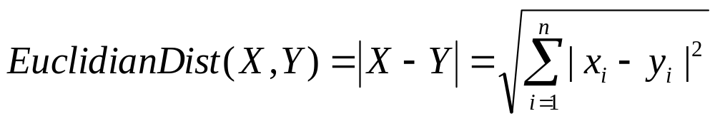
Euclidean distance
Distance between vectors d₁ and d₂ is the length of the vector |d₁ – d₂|
  Euclidean distance
Exercise: Determine the Euclidean distance between the vectors (0, 3, 2, 1, 10) and (2, 7, 1, 0, 0)

Slide 36
Euclidian Distance
Why is this not a great idea?
We still haven’t dealt with the issue of length normalization
  Long documents would be more similar to each other by virtue of length, not topic
However, we can implicitly normalize by looking at angles instead

Slide 37
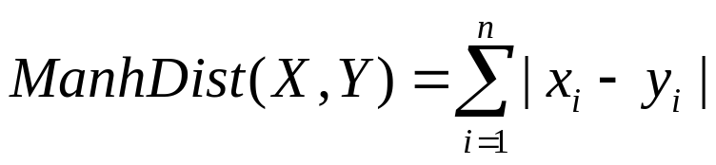
Manhattan Distance
Or “city block” measure
  Based on the idea that generally in American cities you cannot follow a direct line between two points
Uses the formula:
Exercise: Determine the Manhattan distance between the vectors (0, 3, 2, 1, 10) and (2, 7, 1, 0, 0)
y
x

Slide 38
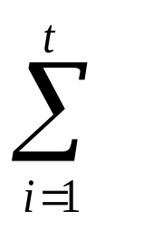
Inner Product
Similarity between vectors for the document d_{i} and query q can be computed as the vector inner product:
sim(d_{j},q) = d_{j}•q = w_{ij} · w_{iq}
  where w_{ij} is the weight of term i in document j and w_{iq} is the weight of term i in the query
For binary vectors, the inner product is the number of matched query terms in the document (size of intersection).
For weighted term vectors, it is the sum of the products of the weights of the matched terms

Slide 39
Properties of Inner Product
The inner product is unbounded
Favors long documents with a large number of unique terms
Measures how many terms matched but not how many terms are not matched

Slide 40
Inner Product - Examples
architecture
management
computer
information
retrieval
text
database
Binary:
  D = 1, 1, 1, 0, 1, 1, 0
  Q = 1, 0 , 1, 0, 0, 1, 1
  sim(D, Q) = 3
Size of vector = size of vocabulary = 7
0 means corresponding term not found in document or query
Weighted:
D₁ = 2T₁ + 3T₂ + 5T₃ D₂ = 3T₁ + 7T₂ + 1T₃
Q = 0T₁ + 0T₂ + 2T₃
sim(D₁ , Q) = 2*0 + 3*0 + 5*2 = 10
sim(D₂ , Q) = 3*0 + 7*0 + 1*2 = 2

Slide 41
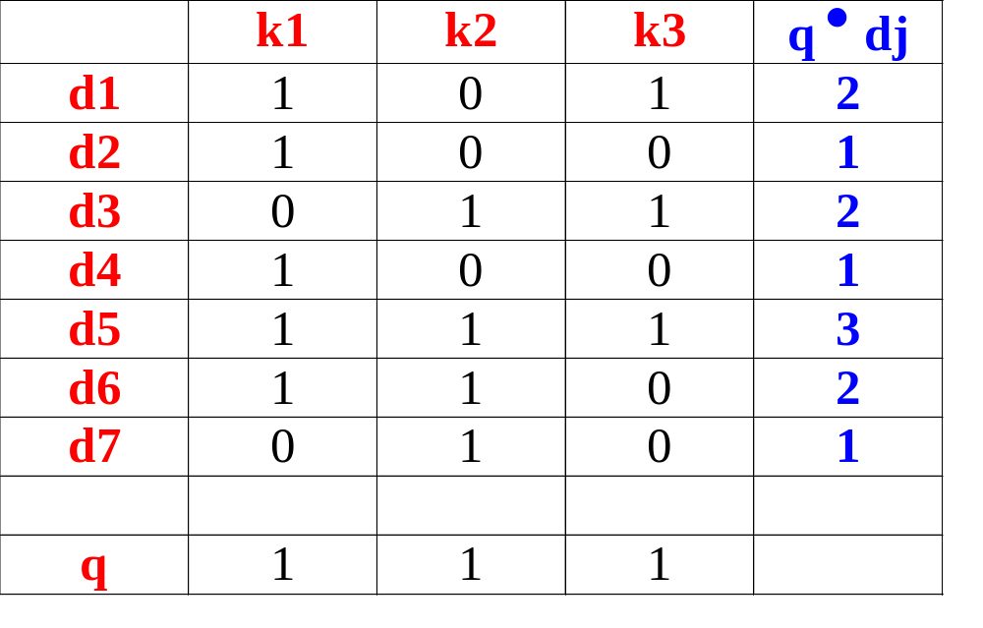
Inner Product Example
k2
k1
d7
d2
d6
d4
d5
d3
d1
k3

Slide 42
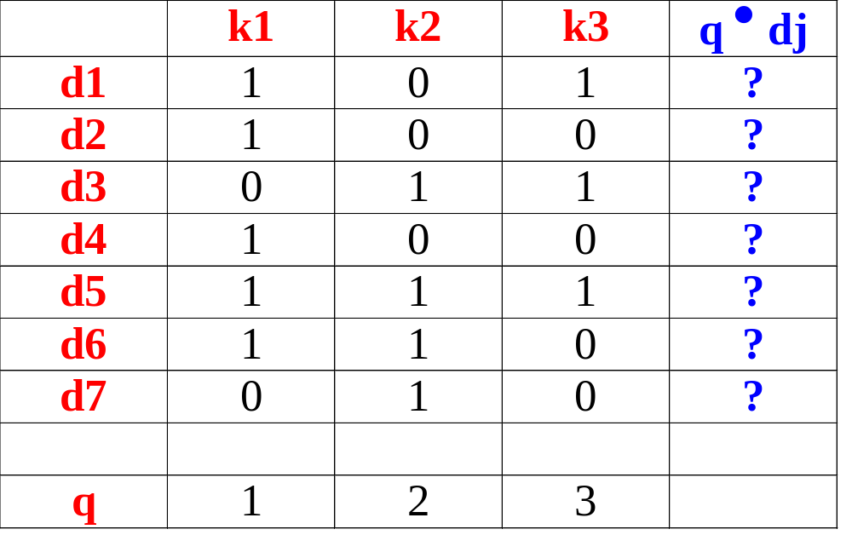
k2
k1
Inner Product Exercise
d7
d2
d6
d4
d5
d3
d1
k3

Slide 43
Cosine similarity
Distance between vectors d₁ and d₂ captured by the cosine of the angle x between them
Note – this is similarity, not distance
  No triangle inequality for similarity
t ₃
d₂
d₁
θ
t ₁
t ₂

Slide 44
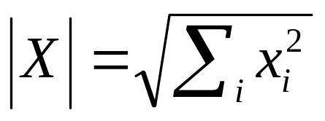
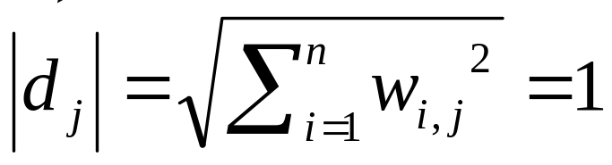
Cosine similarity
A vector can be normalized (given a length of 1) by dividing each of its components by its length
This maps vectors onto the unit sphere:
Longer documents don’t get more weight

Slide 45
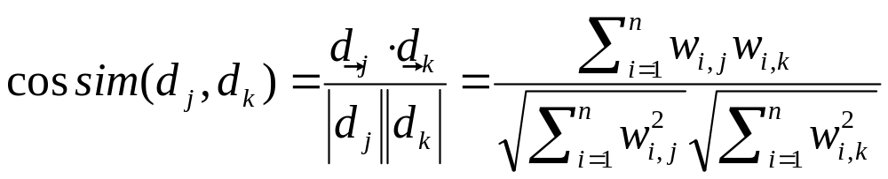
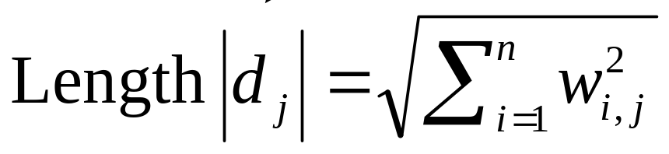
Cosine similarity
Cosine of angle between two vectors
The denominator involves the lengths of the vectors
So the cosine measure is also known as the normalized inner product

Slide 46
Cosine similarity exercise
Exercise: Rank the following by decreasing cosine similarity:
  Two documents that have only frequent words (the, a, an, of) in common
  Two documents that have no words in common
  Two documents that have many rare words in common (wingspan, tailfin)

Slide 47
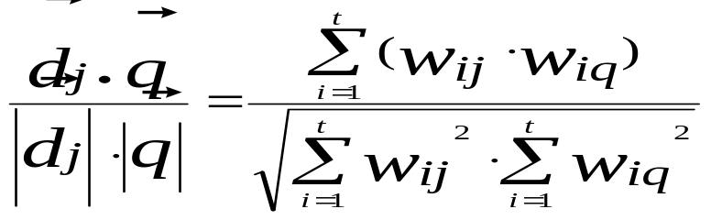
Cosine Similarity vs. Inner Product
t₃
Cosine similarity measures the cosine of the angle between two vectors
Inner product normalized by the vector lengths
θ₁
D₁
Q
θ₂
t₁
CosSim(d_{j}, q) =
t₂
D₂
D₁ = 2T₁ + 3T₂ + 5T₃ CosSim(D₁ , Q) = 10 / √(4+9+25)(0+0+4) = 0.81
D₂ = 3T₁ + 7T₂ + 1T₃ CosSim(D₂ , Q) = 2 / √(9+49+1)(0+0+4) = 0.13
Q = 0T₁ + 0T₂ + 2T₃
D₁ is 6 times better than D₂ using cosine similarity but only 5 times better using inner product.

Slide 48
Naïve Implementation
Convert all documents in collection D to tf-idf weighted vectors, d_{j}, for keyword vocabulary V
Convert query to a tf-idf-weighted vector q
For each d_{j} in D do
Compute score s_{j} = cosSim(d_{j,} q)
Sort documents by decreasing score
Present top ranked documents to the user
Time complexity: O(|V|·|D|) Bad for large V & D !
|V| = 10,000; |D| = 100,000; |V|·|D| = 1,000,000,000

Slide 49
Comments on Vector Space Models
Simple, mathematically based approach
Considers both local (tf) and global (idf) word occurrence frequencies
Provides partial matching and ranked results
Tends to work quite well in practice despite obvious weaknesses
Allows efficient implementation for large document collections

Slide 50
Problems with Vector Space Model
Missing semantic information (e.g. word sense)
Missing syntactic information (e.g. phrase structure, word order, proximity information)
Assumption of term independence
Lacks the control of a Boolean model (e.g., requiring a term to appear in a document)
  Given a two-term query “A B”, may prefer a document containing A frequently but not B, over a document that contains both A and B, but both less frequently

Slide 51
Summary
Information Retrieval Models

Slide 52
Next Time
Evaluation in IR

