Slide 1
Information Retrieval and Web Search
Vasile Rus, PhD
vrus@memphis.edu
www.cs.memphis.edu/~vrus/teaching/ir-websearch/

Slide 2
Outline
Announcements
Query Expansion
  Based on feedback from user
  Based on feedback from initially retrieved documents (called local set)
  Based on global information about the collection of documents

Slide 3
Announcements
Web Crawling presentation

Slide 4
Relevance Feedback
After initial retrieval results are presented, user provides feedback on the relevance of the retrieved documents
  Top 10 or 20
IDEA: select important terms associated with the relevant documents and increase their importance in a new query formulation
  Query expansion
  Term reweighting

Slide 5
Advantages of Relevance Feedback
The user does not have to reformulate the query
It breaks down the search process in small steps
Controlled process to refine the query terms

Slide 6


Relevance Feedback Architecture
Document
corpus
Query String
Revised
Query
IR
System
Rankings
ReRanked
Documents
1. Doc2
2. Doc4
3. Doc5
.
.
Query
Reformulation
Ranked
Documents
1. Doc1
2. Doc2
3. Doc3
.
.
1. Doc1 ⇓
2. Doc2 ⇑
3. Doc3 ⇓
.
.
Feedback

Slide 7
Query Reformulation
Revise query to account for feedback:
  Query Expansion: Add new terms to query from relevant documents.
  Term Reweighting: Increase weight of terms in relevant documents and decrease weight of terms in irrelevant documents.
Several algorithms for query reformulation

Slide 8
Query Reformulation for Vector Space Model
Change query vector using vector algebra
Add the vectors for the relevant documents to the query vector
Subtract the vectors for the irrelevant docs from the query vector
This adds both positive and negatively weighted terms to the query as well as reweighting the initial terms

Slide 9
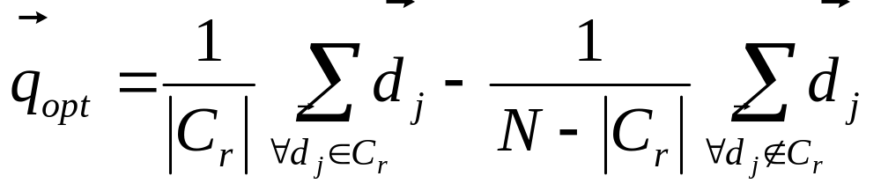
Optimal Query
Assume that the relevant set of documents C_{r} is known
Then the best query that ranks all and only the relevant docs at the top is:
Where N is the total number of documents

Slide 10
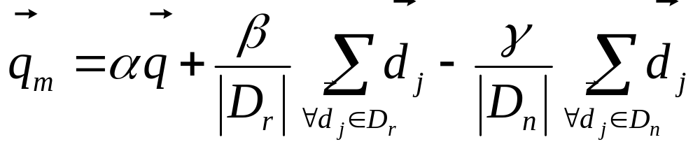
Standard Rochio Method
Since all relevant documents are unknown, just use the known relevant (D_{r}) and irrelevant (D_{n}) sets of documents and include the initial query q
α: Tunable weight for initial query
β: Tunable weight for relevant documents
γ: Tunable weight for irrelevant documents

Slide 11
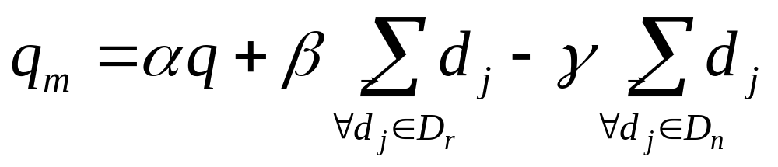
Ide Regular Method
Since more feedback should perhaps increase the degree of reformulation, do not normalize for amount of feedback:
α: Tunable weight for initial query
β: Tunable weight for relevant documents
γ: Tunable weight for irrelevant documents

Slide 12
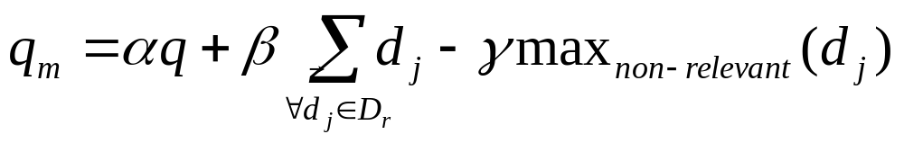
Ide “Dec Hi” Method
Bias towards rejecting just the highest ranked of the irrelevant documents:
α: Tunable weight for initial query
β: Tunable weight for relevant documents
γ: Tunable weight for irrelevant document

Slide 13
Comparison of Methods
Overall, experimental results indicate no clear preference for any one of the specific methods
All methods generally improve retrieval performance (recall & precision) with feedback
Generally just let tunable constants equal 1

Slide 14
Evaluating Relevance Feedback
By construction, reformulated query will rank explicitly-marked relevant documents higher and explicitly-marked irrelevant documents lower
Method should not get credit for improvement on these documents, since it was told their relevance
In machine learning, this error is called “testing on the training data”
Evaluation should focus on generalizing to other un-rated documents
  The goal is to compare methods and not to compare overall performance

Slide 15
Fair Evaluation of Relevance Feedback
Remove from the corpus any documents for which feedback was provided
Measure recall/precision performance on the remaining residual collection
Compared to complete corpus, specific recall/precision numbers may decrease since relevant documents were removed
However, relative performance on the residual collection provides fair data on the effectiveness of relevance feedback

Slide 16
Why is Feedback Not Widely Used
Users sometimes reluctant to provide explicit feedback
Results in long queries that require more computation to retrieve, and search engines process lots of queries and allow little time for each one
Makes it harder to understand why a particular document was retrieved

Slide 17
Pseudo Feedback
Use relevance feedback methods without explicit user input
Just assume the top m retrieved documents are relevant, and use them to reformulate the query
Allows for query expansion that includes terms that are correlated with the query terms

Slide 18
Pseudo Feedback Architecture
Document
corpus
Query String
Revised
Query
IR
System
Rankings
ReRanked
Documents
1. Doc2
2. Doc4
3. Doc5
.
.
Query
Reformulation
Ranked
Documents
1. Doc1
2. Doc2
3. Doc3
.
.
Pseudo
Feedback
1. Doc1 ⇑
2. Doc2 ⇑
3. Doc3 ⇑
.
.

Slide 19
Pseudo Feedback Results
Found to improve performance on TREC competition ad-hoc retrieval task

Slide 20
Automatic Local Analysis
Automatically cluster documents as relevant or irrelevant
IDEA: find terms that are related to query terms
Related Terms:
  Co-occurrence
  Within a certain distance in document

Slide 21
Local Clustering
Association Clusters
  Based on term co-occurrences in documents
Metric Clusters
  Based on distance/proximity among terms
Scalar
  Two terms are similar if their company is similar

Slide 22
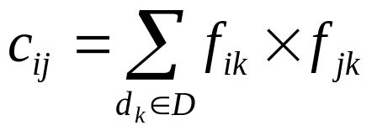
Association Matrix
w₁ w₂ w₃ …………………..w_{n}
w₁
w₂
w₃
.
.
w_{n}
c₁₁ c₁₂ c₁₃…………………c_{1n}
c₂₁
c₃₁
.
.
c_{n1}
c_{ij}: Correlation factor between term i and term j
f_{ik} : Frequency of term i in document k

Slide 23
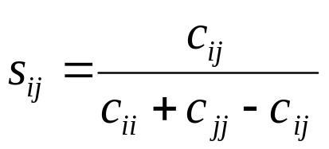
Normalized Association Matrix
Frequency based correlation factor favors more frequent terms
Normalize association scores:
Normalized score is 1 if two terms have the same frequency in all documents

Slide 24
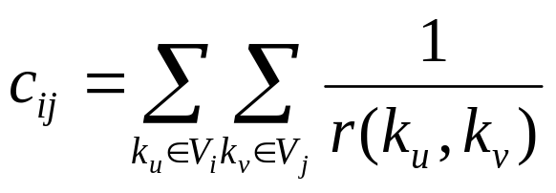
Metric Correlation Matrix
Association correlation does not account for the proximity of terms in documents, just co-occurrence frequencies within documents
Metric correlations account for term proximity.
V_{i}: Set of all occurrences of term i in any document.
r(k_{u},k_{v}): Distance in words between word occurrences k_{u} and k_{v}
(∞ if k_{u} and k_{v} are occurrences in different documents).

Slide 25
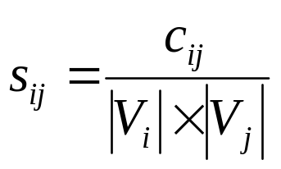
Normalized Metric Correlation Matrix
Normalize scores to account for term frequencies:

Slide 26
Query Expansion with Correlation Matrix
For each term i in query, expand query with the n terms with the highest value of c_{ij} (s_{ij})
This adds semantically related terms in the “neighborhood” of the query terms

Slide 27
Automatic Global Analysis
IDEA: expand queries using information from the whole set of documents in the collection
Query Expansion using a Similarity Thesaurus
  Built considering term to term relationships
  Terms are indexed by the documents in which they appear
Query Expansion based on a Statistical Thesaurus
  Thesaurus composed of classes of correlated terms in the whole collection
    highly discriminative terms are selected
  In practice:
    Group documents in cluster
    Pick the highly discriminative terms from these documents

Slide 28
Thesaurus
A thesaurus provides information on synonyms and semantically related words and phrases
Example:
physician
syn: doctor, doc, physician, MD, Dr., medico
sawbones
rel: general practitioner, surgeon

Slide 29
Thesaurus-based Query Expansion
For each term, t, in a query, expand the query with synonyms and related words of t from the thesaurus
May weight added terms less than original query terms
Generally increases recall
May significantly decrease precision, particularly with ambiguous terms
  “interest rate” → “interest rate fascinate evaluate”

Slide 30
WordNet
A more detailed database of semantic relationships between English words
Developed by famous cognitive psychologist George Miller and a team at Princeton University
  wordnet.princeton.edu
About 155,287 English words
Nouns, adjectives, verbs, and adverbs grouped into about 117,659 synonym sets called synsets

Slide 31
WordNet Synset Relationships
Antonym: front → back
Attribute: benevolence → good (noun to adjective)
Pertainym: alphabetical → alphabet (adjective to noun)
Similar: unquestioning → absolute
Cause: kill → die
Entailment: breathe → inhale
Holonym: chapter → text (part-of)
Meronym: computer → cpu (whole-of)
Hyponym: tree → plant (specialization)
Hypernym: fruit → apple (generalization)

Slide 32
WordNet Query Expansion
Add synonyms in the same synset
Add hyponyms to add specialized terms
Add hypernyms to generalize a query
Add other related terms to expand query

Slide 33
Statistical Thesaurus
Existing human-developed thesauri are not easily available in all languages
Human thesauri are limited in the type and range of synonymy and semantic relations they represent
Semantically related terms can be discovered from statistical analysis of corpora

Slide 34
Global vs. Local Analysis
Global analysis requires intensive term correlation computation only once at system development time
Local analysis requires intensive term correlation computation for every query at run time (although number of terms and documents is less than in global analysis)
But local analysis gives better results

Slide 35
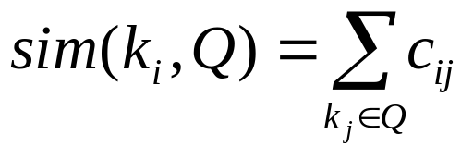
Global Analysis Refinements
Only expand query with terms that are similar to all terms in the query.
  “fruit” not added to “Apple computer” since it is far from “computer”
  “fruit” added to “apple pie” since “fruit” close to both “apple” and “pie”
Use more sophisticated term weights (instead of just frequency) when computing term correlations

Slide 36
Query Expansion Conclusions
Expansion of queries with related terms can improve performance, particularly recall
However, must select similar terms very carefully to avoid problems, such as loss of precision

Slide 37
Summary
Query Operations

Slide 38
Next
Text Properties and Text Processing

