Slide 1
Information Retrieval and Web Search
Vasile Rus, PhD
vrus@memphis.edu
www.cs.memphis.edu/~vrus/teaching/ir-websearch/

Slide 2
Outline
Text Categorization

Slide 3
Is this spam?
From: "" <takworlld@hotmail.com>
Subject: real estate is the only way... gem oalvgkay
Anyone can buy real estate with no money down
Stop paying rent TODAY !
There is no need to spend hundreds or even thousands for similar courses
I am 22 years old and I have already purchased 6 properties using the
methods outlined in this truly INCREDIBLE ebook.
Change your life NOW !
=================================================
Click Below to order:
http://www.wholesaledaily.com/sales/nmd.htm
=================================================

Slide 4
Categorization/Classification
Given:
  A description of an instance, x∈X, where X is the instance language or instance space
    Issue: how to represent text documents
  A fixed set of categories:
  C = {c₁, c₂,…, c_{n}}
Determine:
  The category of x: c(x)∈C, where c(x) is a categorization function whose domain is X and whose range is C
    We want to know how to build categorization functions (“classifiers”)

Slide 5
Document Classification
“planning
language
proof
intelligence”
Testing
Data:
(AI)
(Programming)
(HCI)
Classes:
ML
Planning
Semantics
Garb.Coll.
Multimedia
GUI
Training
Data:
learning
intelligence
algorithm
reinforcement
network...
planning
temporal
reasoning
plan
language...
programming
semantics
language
proof...
garbage
collection
memory
optimization
region...
...
...
(Note: in real life there is often a hierarchy, not present in the above problem statement; and you get papers on ML approaches to Garb. Coll.)

Slide 6
Text Categorization Examples
Assign labels to each document or web-page:
Labels are most often topics such as Yahoo-categories
e.g., "finance," "sports," "news>world>asia>business"
Labels may be genres
e.g., "editorials" "movie-reviews" "news“
Labels may be opinion
e.g., “like”, “hate”, “neutral”
Labels may be domain-specific binary
e.g., "interesting-to-me" : "not-interesting-to-me”
e.g., “spam” : “not-spam”
e.g., “is a toner cartridge ad” :“isn’t”

Slide 7
Methods (1)
Manual classification
  Used by Yahoo!, Looksmart, about.com, Medline
  very accurate when job is done by experts
  consistent when the problem size and team is small
  difficult and expensive to scale
Automatic document classification
  Hand-coded rule-based systems
    Used by CS dept’s spam filter, Reuters, CIA, …
    E.g., assign category if document contains a given boolean combination of words
    Commercial systems have complex query languages
  Accuracy is often very high if a query has been carefully refined over time by a subject expert
  Building and maintaining these queries is expensive

Slide 8
Methods (2)
Supervised learning of document-label assignment function
  Many new systems rely on machine learning (MSN, Verity, …)
    k-Nearest Neighbors (simple, powerful)
    Naive Bayes (simple, common method)
    Support-vector machines (new, more powerful)
    … plus many other methods
    No free lunch: requires hand-classified training data
    But can be built (and refined) by non-experts

Slide 9
Text Categorization: attributes
Representations of text are very high dimensional (one feature for each word)
Algorithms that prevent overfitting in high-dimensional space are best
For most text categorization tasks, there are many irrelevant and many relevant features
Methods that combine evidence from many or all features (e.g. naive Bayes, kNN, neural-nets) tend to work better than ones that try to isolate just a few relevant features (standard decision-tree or rule induction)*
*Although one can compensate by using many rules
Notes:
Explain supervised learning

Slide 10
Categorization/Classification
Given:
  A description of an instance, x∈X, where X is the instance language or instance space
    Issue: how to represent text documents
  A fixed set of categories:
  C = {c₁, c₂,…, c_{n}}
Determine:
  The category of x: c(x)∈C, where c(x) is a categorization function whose domain is X and whose range is C
    We want to know how to build categorization functions (“classifiers”)

Slide 11
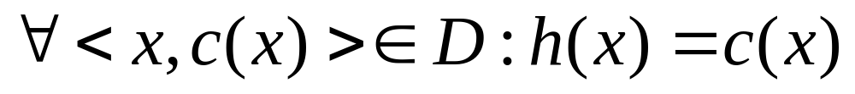
Learning for Categorization
A training example is an instance x∈X, paired with its correct category c(x): <x, c(x)> for an unknown categorization function, c
Given a set of training examples, D
Find a hypothesized categorization function, h(x), such that:
Consistency

Slide 12
Sample Category Learning Problem
Instance language: <size, color, shape>
  size ∈ {small, medium, large}
  color ∈ {red, blue, green}
  shape ∈ {square, circle, triangle}
C = {positive, negative}
D:
Example | Size | Color | Shape | Category
1 | small | red | circle | positive
2 | large | red | circle | positive
3 | small | red | triangle | negative
4 | large | blue | circle | negative

Slide 13
General Learning Issues
Many hypotheses are usually consistent with the training data
Bias
  Any criteria other than consistency with the training data that is used to select a hypothesis
Classification accuracy (% of instances classified correctly)
  Measured on independent test data
Training time (efficiency of training algorithm)
Testing time (efficiency of subsequent classification)

Slide 14
Generalization
Hypotheses must generalize to correctly classify instances not in the training data
Simply memorizing training examples is a consistent hypothesis that does not generalize
Occam’s razor:
  Finding a simple hypothesis helps ensure generalization

Slide 15
Text Categorization
Assigning documents to a fixed set of categories
Applications:
  Web pages
    Recommending
    Yahoo-like classification
  Newsgroup Messages
    Recommending
    spam filtering
  News articles
    Personalized newspaper
  Email messages
    Routing
    Prioritizing
    Folderizing
    spam filtering

Slide 16
Learning for Text Categorization
Manual development of text categorization functions is difficult
Learning Algorithms:
  Bayesian (naïve)
  Neural network
  Relevance Feedback (Rocchio)
  Rule based (Ripper)
  Nearest Neighbor (case based)
  Support Vector Machines (SVM)

Slide 17
Using Relevance Feedback (Rocchio)
Relevance feedback methods can be adapted for text categorization
Use standard TF/IDF weighted vectors to represent text documents (normalized by maximum term frequency)
For each category, compute a prototype vector by summing the vectors of the training documents in the category
Assign test documents to the category with the closest prototype vector based on cosine similarity

Slide 18
Rocchio Text Categorization Algorithm
(Training)
Assume the set of categories is {c₁, c₂,…c_{n}}
For i from 1 to n
let p_{i} = <0, 0,…,0> (init. prototype vectors)
For each training example <x, c(x)> ∈ D
Let d be the frequency normalized TF/IDF term vector for doc x
Let i = j: (c_{j} = c(x))
(sum all the document vectors in c_{i} to get p_{i})
Let p_{i} = p_{i} + d

Slide 19
Rocchio Text Categorization Algorithm
(Test)
Given test document x
Let d be the TF/IDF weighted term vector for x
Let m = –2 (init. maximum cosSim)
For i from 1 to n:
(compute similarity to prototype vector)
Let s = cosSim(d, p_{i})
if s > m
let m = s
let r = c_{i} (update most similar class prototype)
Return class r

Slide 20
Illustration of Rocchio Text Categorization

Slide 21
Rocchio Properties
Does not guarantee a consistent hypothesis
Forms a simple generalization of the examples in each class (a prototype)
Prototype vector does not need to be averaged or otherwise normalized for length since cosine similarity is insensitive to vector length
Classification is based on similarity to class prototypes

Slide 22
Nearest-Neighbor Learning Algorithm
Learning is just storing the representations of the training examples in D
Testing instance x:
  Compute similarity between x and all examples in D
  Assign x the category of the most similar example in D
Does not explicitly compute a generalization or category prototypes
Also called:
  Case-based
  Memory-based
  Lazy learning

Slide 23
K Nearest-Neighbor
Using only the closest example to determine categorization is subject to errors due to:
  A single atypical example
  Noise (i.e. error) in the category label of a single training example
More robust alternative is to find the k most-similar examples and return the majority category of these k examples
Value of k is typically odd to avoid ties, 3 and 5 are most common

Slide 24
Similarity Metrics
Nearest neighbor method depends on a similarity (or distance) metric
Simplest for continuous m-dimensional instance space is Euclidian distance
Simplest for m-dimensional binary instance space is Hamming distance (number of feature values that differ)
For text, cosine similarity of TF-IDF weighted vectors is typically most effective

Slide 25
3 Nearest Neighbor Illustration
(Euclidian Distance)
.
.
.
.
.
.
.
.
.
.
.

Slide 26
K Nearest Neighbor for Text
Training:
For each each training example <x, c(x)> ∈ D
Compute the corresponding TF-IDF vector, d_{x}, for document x
Test instance y:
Compute TF-IDF vector d for document y
For each <x, c(x)> ∈ D
Let s_{x} = cosSim(d, d_{x})
Sort examples, x, in D by decreasing value of s_{x}
Let N be the first k examples in D (get most similar neighbors)
Return the majority class of examples in N

Slide 27
Illustration of 3 Nearest Neighbor for Text

Slide 28
Rocchio Anomaly
Prototype models have problems with polymorphic (disjunctive) categories

Slide 29
3 Nearest Neighbor Comparison
Nearest Neighbor tends to handle polymorphic categories better

Slide 30
Nearest Neighbor Time Complexity
Training Time: O(|D| L_{d}) to compose TF-IDF vectors
Testing Time: O(L_{t} + |D||V_{t}|) to compare to all training vectors
  Assumes lengths of d_{x} vectors are computed and stored during training, allowing cosSim(d, d_{x}) to be computed in time proportional to the number of non-zero entries in d (i.e. |V_{t}|)
Testing time can be high for large training sets

Slide 31
Nearest Neighbor with Inverted Index
Determining k nearest neighbors is the same as determining the k best retrievals using the test document as a query to a database of training documents
Use standard vector space inverted index methods to find the k nearest neighbors
Testing Time: O(B|V_{t}|) where B is the average number of training documents in which a test-document word appears
Therefore, overall classification is O(L_{t} + B|V_{t}|)
  Typically B << |D|

Slide 32
Evaluating Categorization
Evaluation must be done on test data that are independent of the training data (usually a disjoint set of instances)
Classification accuracy: c/n where n is the total number of test instances and c is the number of test instances correctly classified by the system
Results can vary based on sampling error due to different training and test sets
Average results over multiple training and test sets (splits of the overall data) for the best results

Slide 33
N-Fold Cross-Validation
Ideally, test and training sets are independent on each trial
  But this would require too much labeled data
Partition data into N equal-sized disjoint segments
Run N trials, each time using a different segment of the data for testing, and training on the remaining N−1 segments
This way, at least test-sets are independent
Report average classification accuracy over the N trials
Typically, N = 10

Slide 34
Learning Curves
In practice, labeled data is usually rare and expensive
Would like to know how performance varies with the number of training instances
Learning curves plot classification accuracy on independent test data (Y axis) versus number of training examples (X axis)

Slide 35
N-Fold Learning Curves
Want learning curves averaged over multiple trials
Use N-fold cross validation to generate N full training and test sets
For each trial, train on increasing fractions of the training set, measuring accuracy on the test data for each point on the desired learning curve

Slide 36
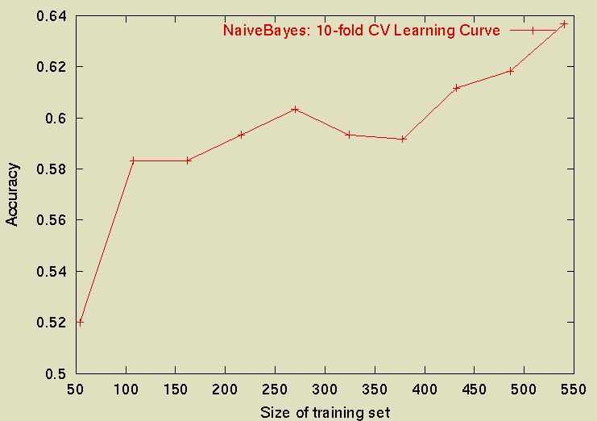
Sample Learning Curve
(Yahoo Science Data)

Slide 37
Summary
Text Categorization

Slide 38
Next
More on Text Categorization

