Slide 1
Information Retrieval and Web Search
Vasile Rus, PhD
vrus@memphis.edu
www.cs.memphis.edu/~vrus/teaching/ir-websearch/

Slide 2
Outline
Project Test Questions
Text Clustering

Slide 3
Clustering
Partition unlabeled examples into disjoint subsets of clusters, such that:
  Examples within a cluster are very similar
  Examples in different clusters are very different
Discover new categories in an unsupervised manner (no sample category labels provided)

Slide 4
Clustering Example
.
.
.
.
.
.
.
.
.
.
.
.
.
.
.
.
.
.
.
.
.
.
.
.
.
.
.
.
.
.
.
.

Slide 5
Hierarchical Clustering
Build a tree-based hierarchical taxonomy (dendrogram) from a set of unlabeled examples
Recursive application of a standard clustering algorithm can produce a hierarchical clustering
animal
vertebrate
invertebrate
fish reptile amphib. mammal worm insect crustacean

Slide 6
Aglommerative vs. Divisive Clustering
Aglommerative (bottom-up) methods start with each example in its own cluster and iteratively combine them to form larger and larger clusters
Divisive (partitional, top-down) separate all examples immediately into clusters

Slide 7
Direct Clustering Method
Direct clustering methods require a specification of the number of clusters, k, desired
A clustering evaluation function assigns a real-value quality measure to a clustering
The number of clusters can be determined automatically by explicitly generating clusterings for multiple values of k and choosing the best result according to a clustering evaluation function

Slide 8
Hierarchical Agglomerative Clustering (HAC)
Assumes a similarity function for determining the similarity of two instances
Starts with all instances in a separate cluster and then repeatedly joins the two clusters that are most similar until there is only one cluster
The history of merging forms a binary tree or hierarchy

Slide 9
HAC Algorithm
Start with all instances in their own cluster
Until there is only one cluster:
Among the current clusters, determine the two
clusters, c_{i} and c_{j}, that are most similar
Replace c_{i} and c_{j} with a single cluster c_{i} ∪ c_{j}

Slide 10
Cluster Similarity
Assume a similarity function that determines the similarity of two instances: sim(x,y)
  Cosine similarity of document vectors
How to compute similarity of two clusters each possibly containing multiple instances?
  Single Link: Similarity of two most similar members
  Complete Link: Similarity of two least similar members
  Group Average: Average similarity between members

Slide 11
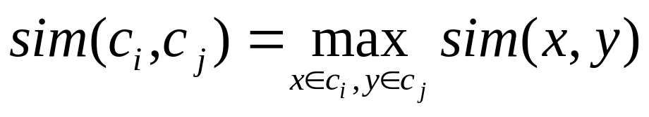
Single Link Agglomerative Clustering
Use maximum similarity of pairs:
Can result in “straggly” (long and thin) clusters due to chaining effect
  Appropriate in some domains, such as clustering islands

Slide 12
Single Link Example

Slide 13
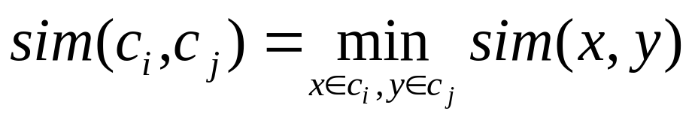
Complete Link Agglomerative Clustering
Use minimum similarity of pairs:
Makes more “tight,” spherical clusters that are typically preferable

Slide 14
Complete Link Example

Slide 15
Computing Cluster Similarity
After merging c_{i} and c_{j}, the similarity of the resulting cluster to any other cluster, c_{k}, can be computed by:
  Single Link:
  Complete Link:

Slide 16
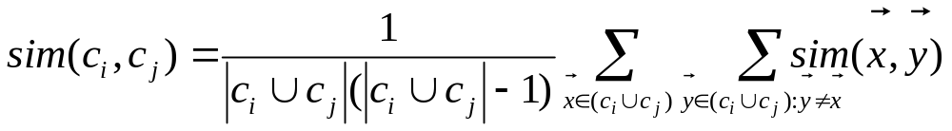
Group Average Agglomerative Clustering
Use average similarity across all pairs within the merged cluster to measure the similarity of two clusters
Compromise between single and complete link

Slide 17
Non-Hierarchical Clustering
Typically must provide the number of desired clusters, k
Randomly choose k instances as seeds, one per cluster
Form initial clusters based on these seeds
Iterate, repeatedly reallocating instances to different clusters to improve the overall clustering
Stop when clustering converges or after a fixed number of iterations

Slide 18
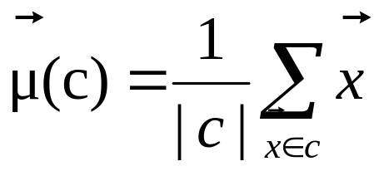
K-Means
Assumes instances are real-valued vectors
Clusters based on centroids, center of gravity, or mean of points in a cluster, c:
Reassignment of instances to clusters is based on distance to the current cluster centroids

Slide 19
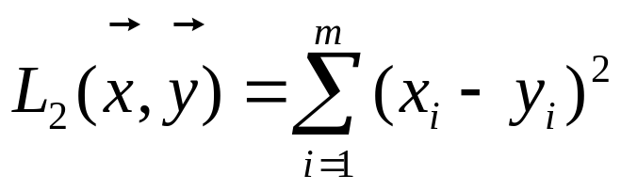
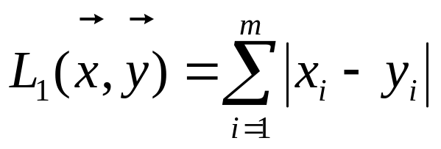
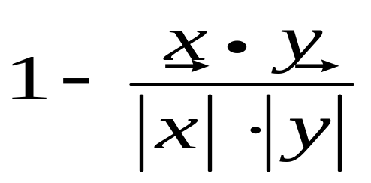
Distance Metrics
Euclidian distance (L₂ norm):
L₁ norm:
Cosine Similarity (transform to a distance by subtracting from 1):

Slide 20
K-Means Algorithm
Let d be the distance measure between instances
Select k random instances {s₁, s₂,… s_{k}} as seeds
Until clustering converges or other stopping criterion:
For each instance x_{i}:
Assign x_{i} to the cluster c_{j} such that d(x_{i}, s_{j}) is minimal
(Update the seeds to the centroid of each cluster)
For each cluster c_{j}
s_{j} = μ(c_{j})

Slide 21
K Means Example
(K=2)
Pick seeds
Reassign clusters
Compute centroids
Reassign clusters
x
x
x
Compute centroids
x
x
x
Reassign clusters
Converged!

Slide 22
Seed Choice
Results can vary based on random seed selection
Some seeds can result in poor convergence rate, or convergence to sub-optimal clusterings
Select good seeds using a heuristic or the results of another method

Slide 23
Buckshot Algorithm
Combines HAC and K-Means clustering
First randomly take a sample of instances of size √n
Run group-average HAC on this sample
Use the results of HAC as initial seeds for K-means
Avoids problems of bad seed selection

Slide 24
Text Clustering
HAC and K-Means have been applied to text in a straightforward way
Typically use normalized, TF/IDF-weighted vectors and cosine similarity
Optimize computations for sparse vectors
Applications:
  During retrieval, add other documents in the same cluster as the initial retrieved documents to improve recall
  Clustering of results of retrieval to present more organized results to the user (à la Northernlight folders)
  Automated production of hierarchical taxonomies of documents for browsing purposes (à la Yahoo & DMOZ)

Slide 25
Soft Clustering
Clustering typically assumes that each instance is given a “hard” assignment to exactly one cluster
Does not allow uncertainty in class membership or for an instance to belong to more than one cluster
Soft clustering gives probabilities that an instance belongs to each of a set of clusters
Each instance is assigned a probability distribution across a set of discovered categories (probabilities of all categories must sum to 1)

Slide 26
Expectation Maximization (EM)
Probabilistic method for soft clustering
Direct method that assumes k clusters:{c₁, c₂,… c_{k}}
Soft version of k-means
Assumes a probabilistic model of categories that allows computing P(c_{i} | E) for each category, c_{i}, for a given example, E
For text, typically assume a naïve-Bayes category model
  Parameters θ = {P(c_{i}), P(w_{j} | c_{i}): i∈{1,…k}, j ∈{1,…,|V|}}

Slide 27
EM Algorithm
Iterative method for learning probabilistic categorization model from unsupervised data
Initially assume random assignment of examples to categories
Learn an initial probabilistic model by estimating model parameters θ from this randomly labeled data
Iterate following two steps until convergence:
  Expectation (E-step): Compute P(c_{i} | E) for each example given the current model, and probabilistically re-label the examples based on these posterior probability estimates
  Maximization (M-step): Re-estimate the model parameters, θ, from the probabilistically re-labeled data

Slide 28
Learning from Probabilistically Labeled Data
Instead of training data labeled with “hard” category labels, training data is labeled with “soft” probabilistic category labels
When estimating model parameters θ from training data, weight counts by the corresponding probability of the given category label
For example, if P(c₁ | E) = 0.8 and P(c₂ | E) = 0.2, each word w_{j} in E contributes only 0.8 towards the counts n₁ and n_{1j}, and 0.2 towards the counts n₂ and n_{2j}

Slide 29
Naïve Bayes EM
Randomly assign examples probabilistic category labels
Use standard naïve-Bayes training to learn a probabilistic model
with parameters θ from the labeled data
Until convergence or until maximum number of iterations reached:
E-Step: Use the naïve Bayes model θ to compute P(c_{i} | E) for
each category and example, and re-label each example
using these probability values as soft category labels
M-Step: Use standard naïve-Bayes training to re-estimate the
parameters θ using these new probabilistic category labels

Slide 30
Semi-Supervised Learning
For supervised categorization, generating labeled training data is expensive
Idea: Use unlabeled data to aid supervised categorization
Use EM in a semi-supervised mode by training EM on both labeled and unlabeled data
  Train initial probabilistic model on user-labeled subset of data instead of randomly labeled unsupervised data
  Labels of user-labeled examples are “frozen” and never relabeled during EM iterations
  Labels of unsupervised data are constantly probabilistically relabeled by EM

Slide 31
Semi-Supervised Example
Assume “quantum” is present in several labeled physics documents, but “Heisenberg” occurs in none of the labeled data
From labeled data, learn that “quantum” is indicative of a physics document
When labeling unsupervised data, label several documents with “quantum” and “Heisenberg” correctly with the “physics” category
When retraining, learn that “Heisenberg” is also indicative of a physics document
Final learned model is able to correctly assign documents containing only “Heisenberg” to physics

Slide 32
Semi-Supervision Results
Experiments on assigning messages from 20 Usenet newsgroups their proper newsgroup label
With very few labeled examples (2 examples per class), semi-supervised EM improved accuracy from 27% (supervised data only) to 43% (supervised + unsupervised data)
With more labeled examples, semi-supervision can actually decrease accuracy, but refinements to standard EM can prevent this
For semi-supervised EM to work, the “natural clustering of data” must be consistent with the desired categories

Slide 33
Exercise
Cluster the following documents using K-means with K=2 and cosine similarity
  Doc1: “go monster go”
  Doc2: “go karting”
  Doc3: “karting monster”
  Doc4: “monster monster”
Assume Doc1 and Doc3 are chosen as initial seeds. Use tf (no idf). Show the clusters and their centroids for each iteration. The algorithm should converge after 2 iterations.

Slide 34
Summary
Text Clustering

Slide 35
Next
Advanced IR Models

