Slide 1
Hide and Seek
Games Programming Taster
An Introduction to Unity Development
Dr. Ronald Mo
ronald.mo@sunderland.ac.uk

Slide 2
Create a Unity Account
Open Unity Hub
Create an account…
…and Sign in ☺

Slide 3
Create a New Project
Create a new project by clicking this button

Slide 4
Create a New Project
Select Universal 3D
Give your project a name
Click Create project

Slide 5
Unity 6

Slide 6
Change the Layout
Let’s change the layout to 2 by 3

Slide 7
Scene
Game
Hierarchy
Project
Inspector

Slide 8
Where is Everything?
Project pane contains all the elements we can use to develop our game
Hierarchy pane contains all the elements in the game

Slide 9
Set Up the Game Environment
Rename the current scene to something more meaningful (e.g., MainScene)
Assets/Scenes
Right-click on SampleScene and choose Rename

Slide 10
Set Up the Game Environment
In the Hierarchy pane, add a new plane, and name it Ground
Right-click -> 3D Object -> Plane
Go to the Inspector pane and follow the below setting

Slide 11
Set Up the Game Environment
In the Project pane, create a folder called Environment under the Assets folder
Inside Environment, create a material and call it Green
Inside the Inspector pane, change its Base Map to Green
Drag the Green material to the ground in the Scene pane

Slide 12
Create the Player
Inside the Hierarchy pane, create an empty object called PlayerObject
Position: x=0, y=0, z=0
Create a 3D Capsule object under PlayerObject and call it PlayerModel
Position: x=0, y=1, z=0
Create a Camera object under PlayerObject and call it Camera
Tag: MainCamera
Position: x=0, y=1.5, z=0
Disable the Main Camera in the Hierarchy pane

Slide 13
Create the Player
Let’s assign a color to the player
In the Project pane, create a folder called Player under the Assets folder
Create a material and call it Blue under Player
Inside the Inspector pane, change its Base Map to blue
Drag the Blue material to the player in the Scene pane

Slide 14
Moving Game Objects
Learn how to orientate yourself, the camera and your Game Objects

Slide 15
Move the Player
Let’s add some code to the player so that we can move it
In the Project pane, create a MonoBehaviour called PlayerMovement under the Assets/Player folder
Double-click PlayerMovement to open it in Visual Studio

Slide 16
Visual Studio 2022

Slide 17
Move the Player
Copy the code from XXXX and paste it into Visual Studio
Make sure you commit your changes and go back to Unity
Ctrl + S to save your script, for example

Slide 18
Inside the Script
void Start()
Executes when the game starts
Hides the cursor and deals with player control
void Update()
Executes every frame
Call the Movement() and RotateAndLook() methods

Slide 19
Inside the Script
void Movement()
Move the player by the keypresses
Make a jump
Something more ☺
void RotateAndLook()
Rotate the camera

Slide 20
Move the Player
Select PlayerObject in the Hierarchy pane
Drag the PlayerMovement script into the Inspector plan
Change the center of y in CharacterController to 1.1

Slide 22
Run the Game
Click the run button to run the game
You should be able to move the player by the arrow keys on your keyboard
You can also jump using the space bar and change the camera angle with your mouse

Slide 23
What’s Wrong?
Even though you can move the player, it moves very slowly
It can barely jump, too ☹
There are two workarounds
Change the code which could be tedious
Change the settings in the Inspector which is a lot more intuitive
See which settings you should modify

Slide 24
Next Up…
Moving around on empty ground can be boring
Why don’t we put together some obstacles?
You may right-click on the Hierarchy pane and add some 3D Game Objects (e.g., cube, sphere, capsule)
Use your imagination to create your game environment ☺

Slide 25
Enemies
It’s time to create some enemies
Inside the Hierarchy pane, create an empty object called EnemyObject, and keep it far from the player
e.g., Position: x=-5, y=0, z=-5
Create a 3D Capsule object under EnemyObject and call it EnemyModel
Position: x=0, y=1, z=0

Slide 26
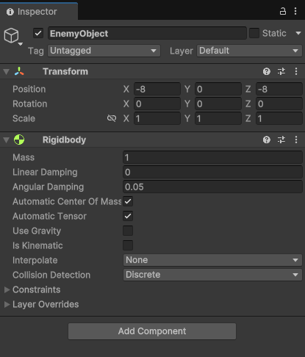
Enemies
While keeping EnemyObject selected, add a Rigidbody component in the Inspector pane
Deselect Use Gravity

Slide 27
Enemies
In the Project pane, create a folder called Enemy under the Assets folder
Create a material and call it Red under Enemy
Inside the Inspector pane, change its Base Map to red
Drag the Red material to the enemy in the Scene pane

Slide 28
Move the Enemy
The enemy will chase the player upon spotting them
In the Project pane, create a MonoBehaviour called EnemyAttack under the Assets/Enemy folder
Double-click PlayerMovement to open it in Visual Studio
Copy the code from XXXX and paste it into Visual Studio
Make sure you commit your changes and go back to Unity
Ctrl + S to save your script, for example

Slide 29
Inside the Script
void Start()
Executes when the game starts
Set the time and obtain the enemy game object
void Update()
Executes every frame
Call the Attack() method

Slide 30
Inside the Script
void IsReadyToAttack()
Check if the enemy is ready to attack
void Attack()
Attack the player if the enemy sees them
The enemy will approach the player
void OnCollisionEnter()
Check if the enemy has caught the player and terminate the game appropriately

Slide 31
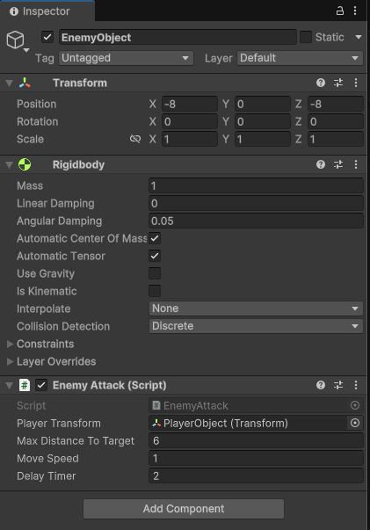
Move the Enemy
Select EnemyObject in the Hierarchy pane
Drag the EnemyAttack script into the Inspector plan
Drag PlayerObject in Hierarchy into the Player Transform field in Inspector

Slide 32
Run the Game (Again)
Click the run button to run the game
The enemy will chase you if you get too close
However, they will stop if you move out of their sight
The game ends if they catch you ☹

Slide 33
What’s More?
To enhance the gameplay, you may
Add more enemies by copying and pasting EnemyObject
Change the setting in the script EnemyAttack
Enable Use Gravity in the Rigidbody of EnemyObject
Some potential improvements
Add a timer
Make the enemy jump perhaps

Slide 34
Dr. Ronald Mo
ronald.mo@sunderland.ac.uk

