Slide 1
NASA Space Apps 2023
Presented by: Cameroonionauts, Washington DC
DEBORAH DJON, COREY HOWELL, YINQUAN LI, RONALD LANDRY NGOUNOU
Challenge:
Your challenge is to design a platform to explore open data that is available from NASA and other federal data repositories or to improve the functionality of an existing such platform, and then demonstrate how your solution can be applied to an area of study that has significant societal benefits (e.g., environmental justice, ecological conservation, or human health).
Notes:
The world is facing many big challenges like climate change, water insecurity, and diseases; addressing these challenges in innovative ways requires interdisciplinary research using data from multiple sources. Many U.S. government agencies have substantial archives of high-quality, freely available data, but these archives can be difficult to navigate.

Slide 2
Climate change has had a great impact on agricultural yield around the world! How can we better understand and engage with agricultural data better?
By building a platform that enables people to better understand and access data, this will democratize access to various U.S. government datasets!

Slide 3





Data Architecture
Data Pipeline:
We have a script in Python that take data from the internet and downloads that data and put it to AWS.
Once the dataset is stored on S3, we can use Tableau and a web application to pull the data for visualizations.

Slide 4
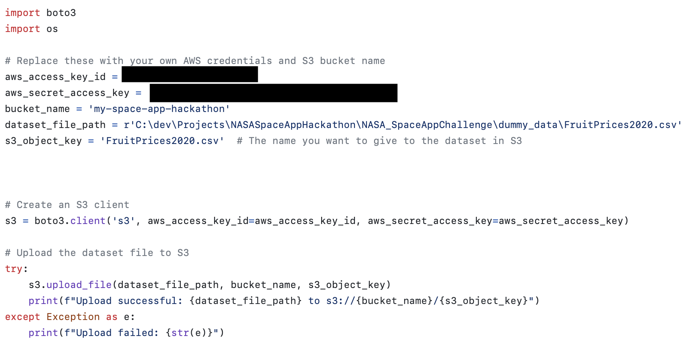
Data Pipeline Code

Slide 5
Data Sources
Four data sources, from US Department of Agriculture (USDA) and NASA, were chosen to tell our story.
NASA EarthData Search
USDA AG Data Commons
USDA Economic Research Service
A Global Dataset of Soil Respiration, v5.0
CPI Forecast
Feed Grains
Food Prices (2020)

Slide 6
Tableau Data Dashboard

Slide 7
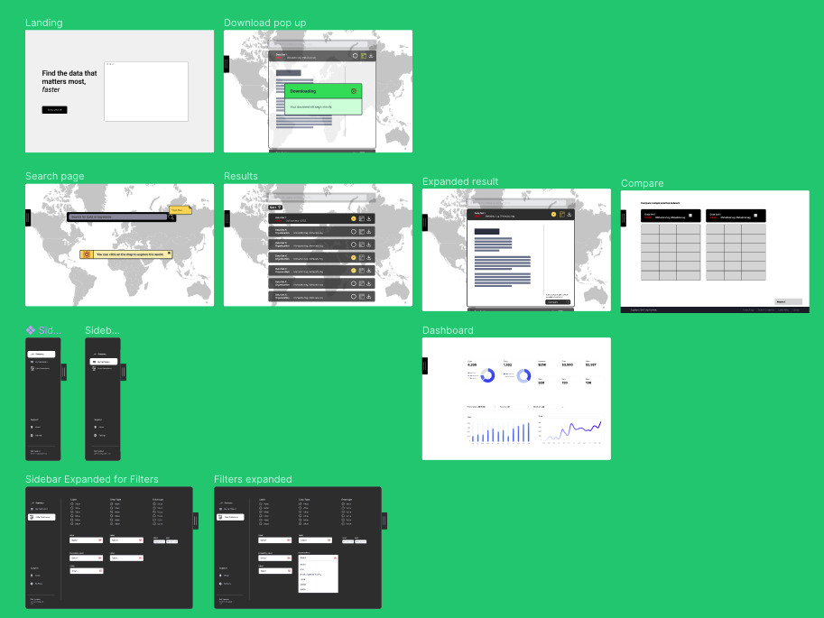
Wireframe + Web Application
Our prototype was first drafted from typical data interfaces. We used a proto-customer journey to apply design thinking processes and find where we could improve. Feedback was drawn from all team members, not just designers, for fresh eyes and input.
Click here to view our live prototype

