Slide 1


ROLES IN A KNOWLEDGE SHARING NETWORK
Ronaldo Ribeiro de Campos
21 to 27 October - London, England

Slide 2
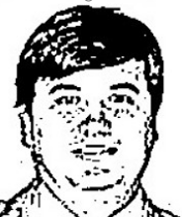
About me...
Ronaldo Ribeiro de Campos
ronaldodecampos.rc@gmail.com
https://github.com/ronaldodecampos/Roles-Sharing-Network

Slide 3
Work Time
1 - Find your group color
2 - Introduce yourself (briefly)
3 - Answer the questions (1, 2) and hand the form to the speaker
4 - Discuss with your group about the questions: Which is the institution does your group trust the most in order to get information about technology? Why?
5 - Talk (present) to the other groups the answer of question discussed at the step 4
6 - Our own network and analysis

Slide 4

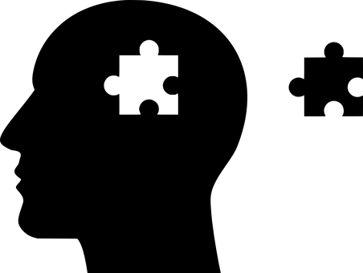

Knowledge?

Slide 5
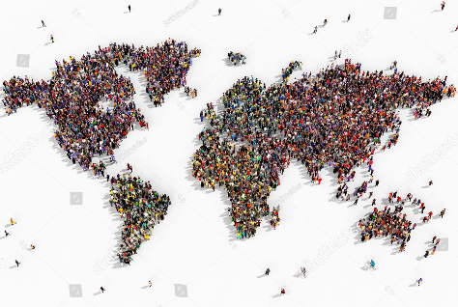


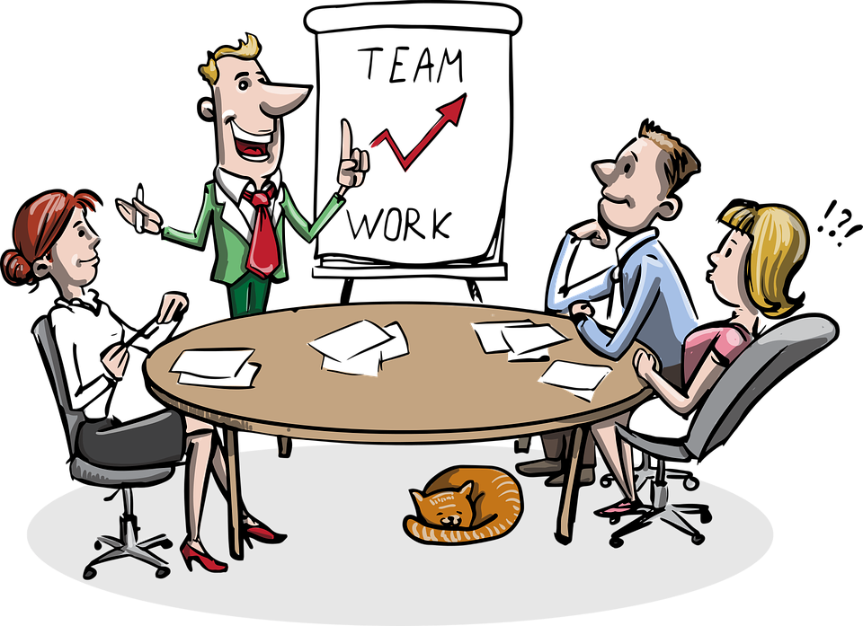
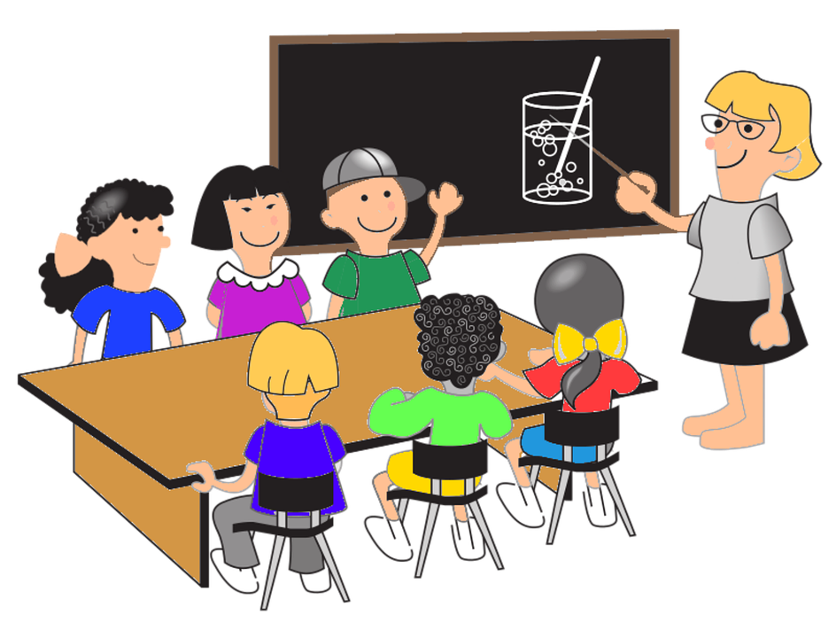
Social Network: What is that?
Family
Friends
School

Slide 6



How to understand it?
Social Network Analisys
Complex Networks
Knowledge Sharing

Slide 7
How to understand it? Complexity
Adaptation
& Evolution
Network Theory
Complexity Theory
Self-organization
Complex Systems
Systems Theory
Nonlinear
&
Emergence

Slide 8

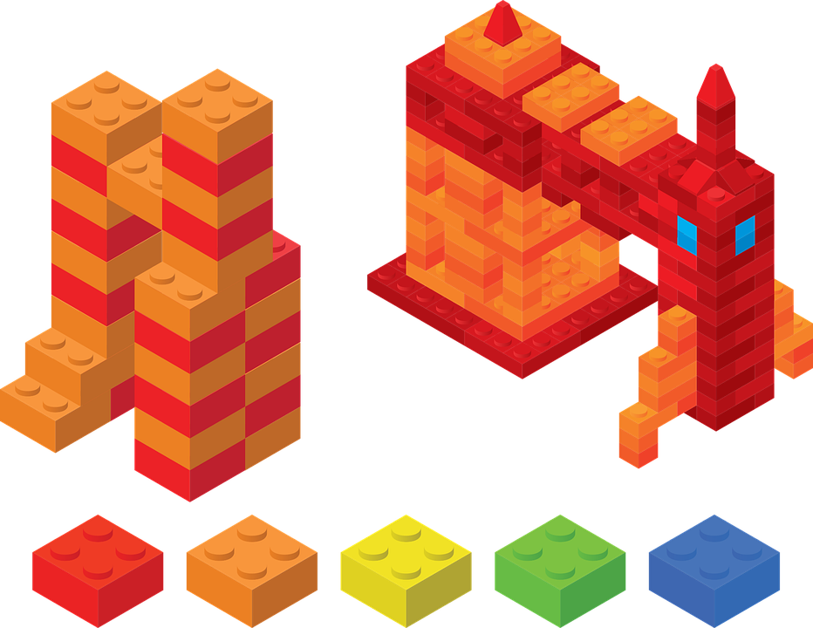
Complicated vs Complex

Slide 9
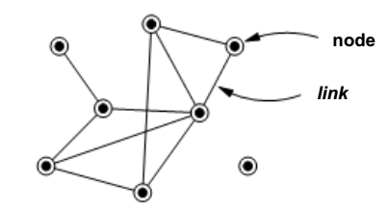
How to represent network connections?
node

Slide 10
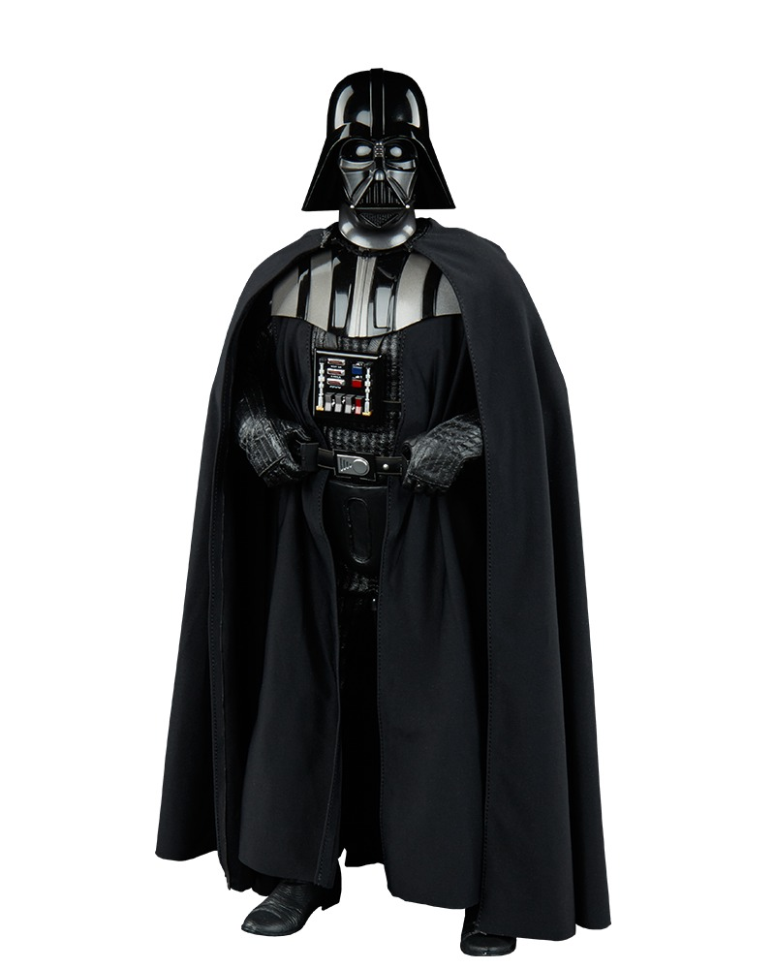
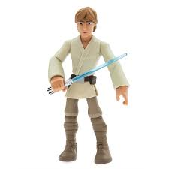
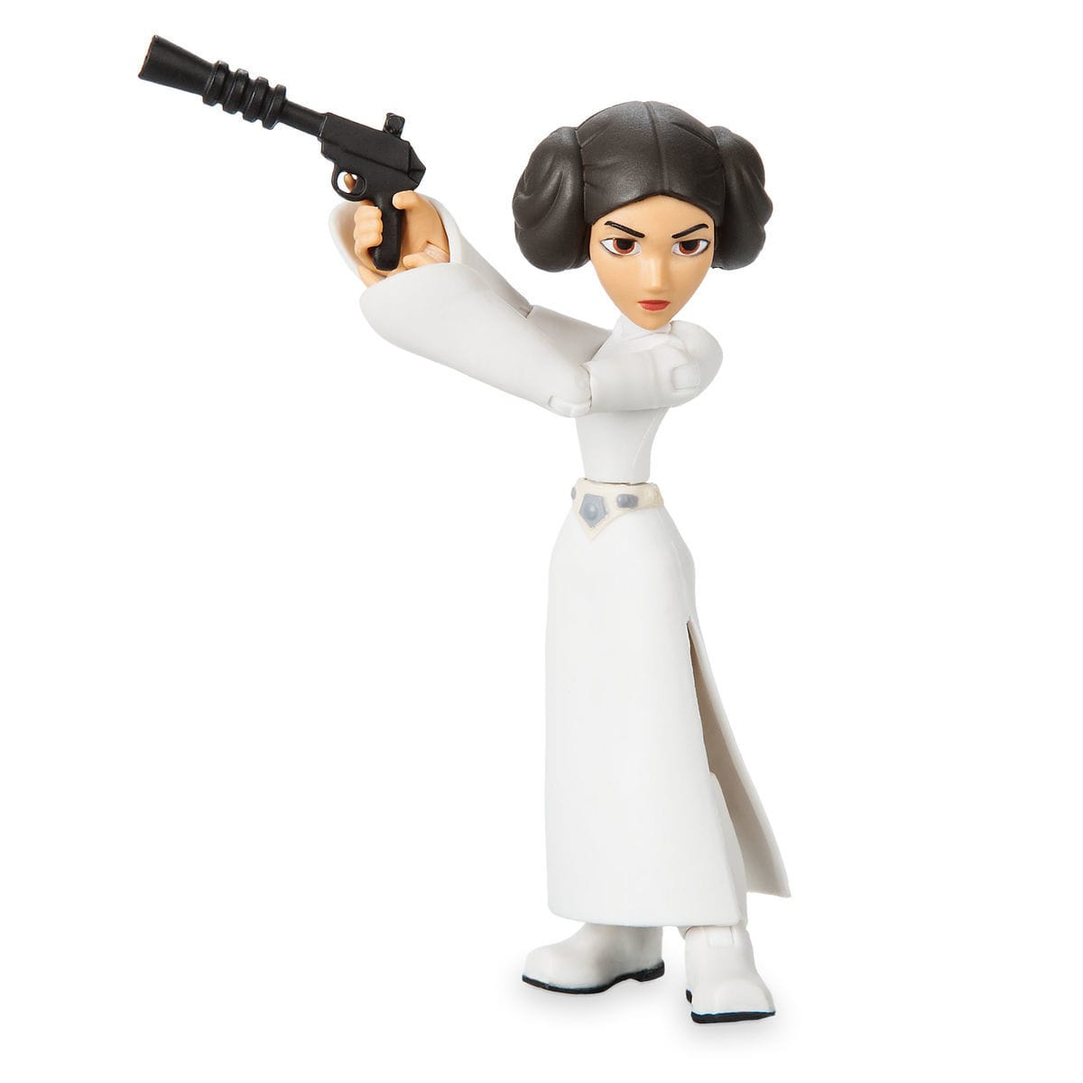
This is a graph
W_{0.5}
W_{0.5}
Direct
Direct
father
father
W_{2.0}
siblings
Birect or Undirect

Slide 11
What can you assume?
Susie
Lisa
Hellen
Mike
Bill
Nancy
David
Mary
John
Maketing
Sal
Kevin
Sales
Lee
Paul
Finance

Slide 12
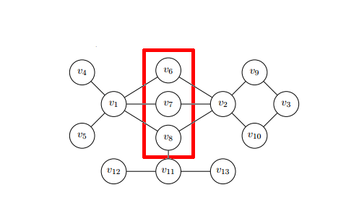

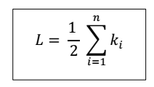
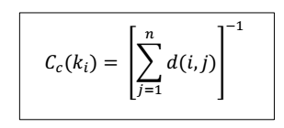


SNA - SOCIAL NETWORK ANALYSIS

Slide 13
Measures and Roles
1
Outdegree
X
Y
Supplier of informantion
It represents a source to other members
Power and influence to distribute information the network

Slide 14
Network Behavior - Outdegree
Behavior
Just feel nodes with a high outdegree value it's a indicator that the network has a small numbers of point of information source.
Actions
Using techology to Increase the points of difusion of information (eg: website, wiki) Teaching individuals who have a low number of outdegree inspiring them to contribute.
Challenges
How to make sure about the quality of information that the nodes are spreding?

Slide 15
Measures and Roles
2
Indegree
X
Y
Receiver of informantion
It absorves information from other members
It also could be a listener or
Someone who knows the needs of network

Slide 16
Network Behavior - Indegree
Behavior
Feel nodes with a high indegree value it's a indicator that the network has a small numbers of point to absortion of information.
Actions
Using techology to detect if information has value to members (eg: favorite ou votes) Incentiving individuals who have a low number of indegree to use the sources of information
Challenges
How to find out which is the information that would be useful to the network?

Slide 17
Measures and Roles
3
Closeness
How integrated or isolated is a node?
Indegree and outdgree centrality is possible
Relationship of a node with its neighborhood
Hight levels of closeness indicate few points of distribuition of information
Y₄
Y₃
X
Y₁
Y₂
Y₄
Y₃
X
Y₁
Y₂

Slide 18
Network Behavior - Closeness
Behavior
Members with low closeness are isolated and are not able to share (either to offer or to get information)
Actions
Actions to help members to build neighbourly connections
Challenges
How to inspire members to take part of groups? How techology could support it?

Slide 19
Measures and Roles
How many connection compared to the possible connections
Y₅
Y₃
Y₄
4
Density
X
Y₂
Y₁

Slide 20
Network Behavior - Density
Behavior
Low density = low possibliies of flow High density = Is it to much? Overflow??
Actions
Trying to find out the network model and understand the connections behavior
Challenges
How to reach the optimized connections number?

Slide 21
Measures and Roles
5
Betweeness
Y₅
Y₈
Y₄
Y₃
Gatekeeper
Information flux from a group to another
Y₆
Y₉
Y₂
X
Y₁
Y₇

Slide 22
Network Behavior - Betweeness
Behavior
The groups are depending on few members to comunicate
Actions
Trying to understand how the high betweenss members are acting Using techonology to work as a bridge between the groups
Challenges
How to balance the flux betwwen the groups?

Slide 23
Frequency
Challenges
How to decide what a good frequency is? How to feed the information to keep the network alive?

Slide 24
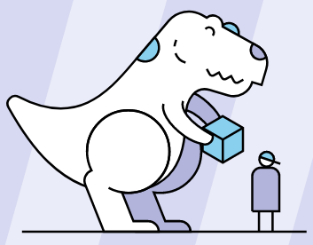
WE ARE ALL CONNECTED!
I'm glad you came!
THANK YOU!
THANKS
MOZILLA !
Images from Pixabay https://pixabaycom

