Slide 1

Data Science Salary Prediction
By Ronald pacheco

Slide 2
What is the problem?
Predict the salary for positions in the Data Science field accordingly to the current market.

Slide 3
The Data
https://www.kaggle.com/andrewmvd/data-analyst-jobs
https://www.kaggle.com/andrewmvd/business-analyst-jobs
https://www.kaggle.com/atharvap329/glassdoor-data-science-job-data?select=Data_Job_SF.csv
https://www.kaggle.com/andrewmvd/data-scientist-jobs
13,585 observations distributed amongst 7 datasets

Slide 4

Key findings
Biotech & Pharmaceuticals, Agriculture & Forestry, and Media
CA, KY, VA, NY and MD
Julia and Python
CA and Python

Slide 5
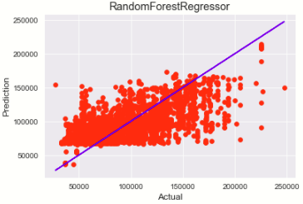
MODELING AND RESULTS ANALYSIS
RandomForestRegressor(n_jobs=-1, random_state=42, bootstrap= True, max_depth= 10, max_features= 'auto', min_samples_leaf= 5, n_estimators= 1000)
Lasso
XGBoost
LinearRegression
MAE = $20,941

Slide 6
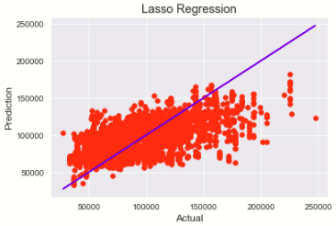
MODELING AND RESULTS ANALYSIS
RandomForestRegressor
Lasso (alpha=1)
XGBoost
LinearRegression
MAE = $21,739

Slide 7
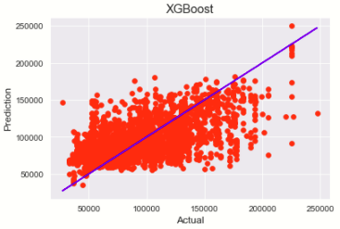
MODELING AND RESULTS ANALYSIS
RandomForestRegressor
Lasso
XGBoost(learning_rate=0.01, max_depth=10, n_estimators=1000, objective='reg:squarederror', seed=123)
LinearRegression
MAE = $21,048

Slide 8

MODELING AND RESULTS ANALYSIS
RandomForestRegressor
Lasso
XGBoost
LinearRegression: Pipeline(steps=[('selectkbest', SelectKBest(k=79)), ('linearregression', LinearRegression())])
MAE = $21,696

Slide 9
Conclusions
RandomForest was the best model.
Mean Absolute Error = $20,941
Original dataset had a salary range bigger than 2xMAE

Slide 10

Future Research
NLP can be applied to Job_Desc to try and find correlations with the actual text and the salary, since some companies might be more specific about the role they aree trying to fill and have a better understanding of the market.

Slide 11

Thank you

Slide 12

Questions?

